Slide 1
Shikayat
Campus complaints that count.
A student writes in English, Hinglish or Hindi. Gemma 4 buckets it, spots the duplicates, and asks back when it is unsure.
Sarthak Shrivastava · Vedant · Sumagna Das · Devanshu Sabharwal · Neil
OpenLake × MLH Hack Day · IIT Bhilai · 10 October 2026

Slide 2
THE PROBLEM
Complaint portals already exist.
They make you fill forms.
Dropdowns, required fields, a login. So students give up and complain in the hostel WhatsApp group instead.
They bury wardens in duplicates.
Forty students report the same dead Wi-Fi forty times. Nobody can tell which problem is actually the biggest.
Nobody counts. So the loudest complaint wins, not the most common one.
Shikayat
2

Slide 3
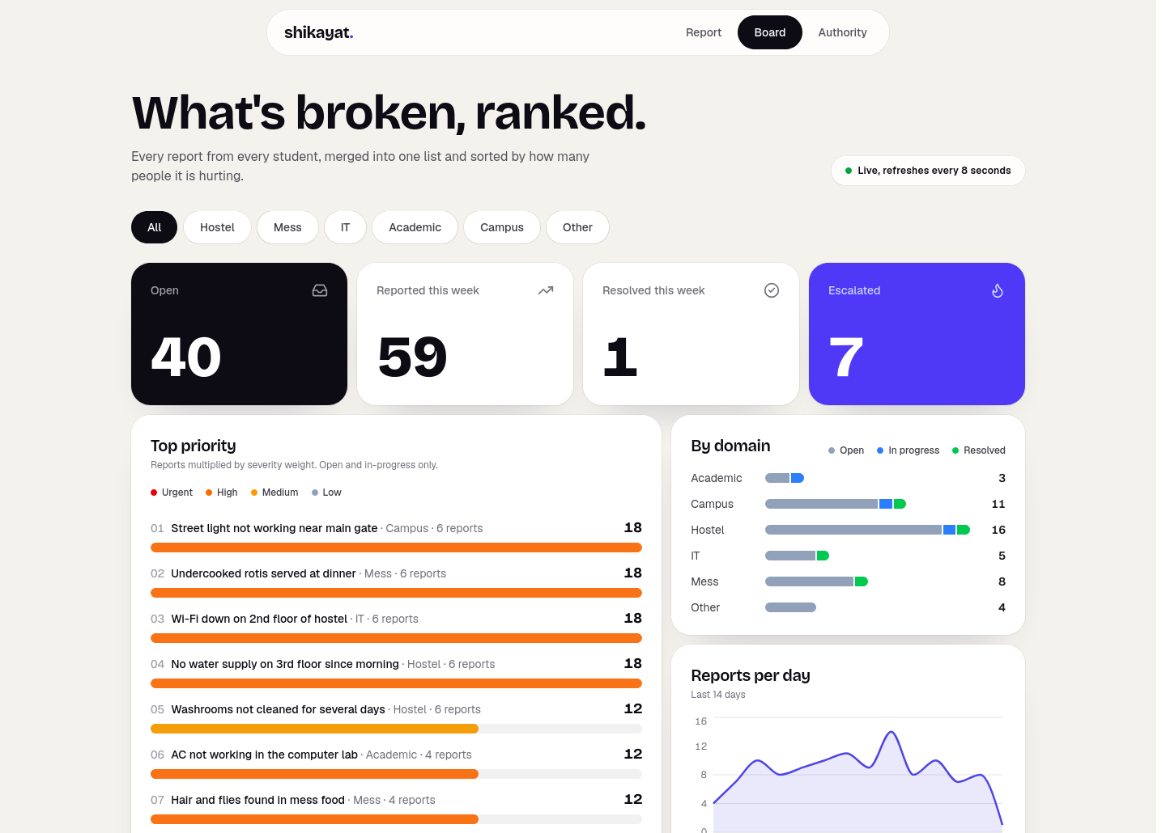
WHAT WE BUILT
One board, ranked by how much it hurts.
46
7
complaints
escalated
priority = reports × severity
Computed in code, never by the model. An issue escalates at five reports, or at once if it is a safety risk.
15 buckets, 7 authorities
Hostel Office, Mess Committee, IT Cell and the rest each see only their own queue.
Shikayat
3

Slide 4
THE PART NOBODY ELSE DOES
Gemma asks back when it is unsure.
In the student's own language.
Hinglish in, Hinglish out. One short question, at most two per report — a limit our code enforces, not a rule we hope the model follows.
It knows what it already has.
Same issue, same place → merged, and the count goes up. A different room → a new complaint. A hostel that does not exist → it asks.
Student
AC se paani tapak raha hai
Gemma
Kaunse hostel aur kis room mein?
Student
BH2 E207
Filed #47 · Hostel Office · BH2 (Gopad) E207
Shikayat
4

Slide 5
THE MODEL
How we use Gemma 4.
gemma-4-26b-a4b-it
through the Gemini API, with google-genai. Every call in the project goes through one helper.
Two calls per complaint.
One to pick a bucket and look for duplicates. One to decide: file, merge, ask or reject. The starter's loop needed four.
# gemma_client.py
client.models.generate_content(
model="gemma-4-26b-a4b-it",
contents=contents, config=config)
The model never decides:
priority · escalation · complaint ids · how many questions it may ask
All four are enforced in our code. merge_into rejects any id that was not in the search results it was just shown.
Shikayat
5

Slide 6
OUR OPEN-SOURCE CONTRIBUTION
What we changed in the harness.
Per-agent tool sets
Each agent sends only the tools it needs.
Image input
A photo is evidence. Sent as inline bytes.
Terminal tools
@tool(stop=True) ends the run with its own result.
Pause for a human
@tool(pause=True) asks, then resumes the same conversation.
Step labels + RunResult
The UI shows "Looking for similar reports in Mess".
4 Gemma calls → 2. 36 tests, all on a fake model, so they run with no API key.
Shikayat
6

Slide 7
NEXT
What we would do next.
Institute SSO
The role picker is a demo stand-in.
Object storage for photos
Local disk today; S3 or Cloud Storage in production.
WhatsApp intake
Students already complain in hostel groups. Meet them there.
Promote the Other bucket
Four laundry reports. Admin turns a suggestion into a category.
github.com/sarthak0707git/shikayat · MIT · built today
Shikayat
7

