Slide 1
Universal Healthcare system
Sumil Suthar
Sarthak Tanpure
Om Pathak
Mentor: Prof. Nagaveni Hebbar

Slide 2
Why choose this topic?
Universally there is a need for central healthcare reference Data. Many Humans face life threating situations like Accidents , Urgent Vital Organ demand supply like blood , bone marrow , liver , kidney . In absence of Single source of truth (SSOT) , catastrophic or life threating situation are raised .

Slide 3
THE IDEA
We do not carry our Health reports everywhere so we need to find a solution for this issue.
It will have a patient interface and a Doctor interface which can be accessed through the login types.
Patient will be able to update their personal information and view reports and ongoing medications.
Doctors will be able to update/view/modify these records.
Everything will be in one program which will support images of previous reports and also their digital reports like X-ray.
During emergency Doctors can access patient information through UHS using the patients Phone number.
It will be universal system and can be accessed in every Hospital/clinic which currently is a issue.

Slide 4
The Front end of topic will be implemented in Java.
Back end will be using MySQL and connecting using JDBC.

Slide 5
Advantages
All patient details in one Application.
Doctors can get all the previous reports of patients regardless where they had done the treatment previously.
The problem of carrying reports will be solved.
X-Rays, CT scan, blood reports, etc can be accessed.
Patient will get a brief overview of ongoing medications
Displaying ongoing health issues.
Scalable project in future can be improvised my using APIS such as Aadhaar for better verification, Smart watch data Analysis.

Slide 6
Disadvantages
Dependency on Technology.
Need for Internet Connectivity.

Slide 7
REQUIREMENTS
All the software used are Free and Open Source.
Java
MySQL
IntelliJ Idea

Slide 8
References
Java Documentation - Get Started (oracle.com)
MySQL :: MySQL Documentation

Slide 9
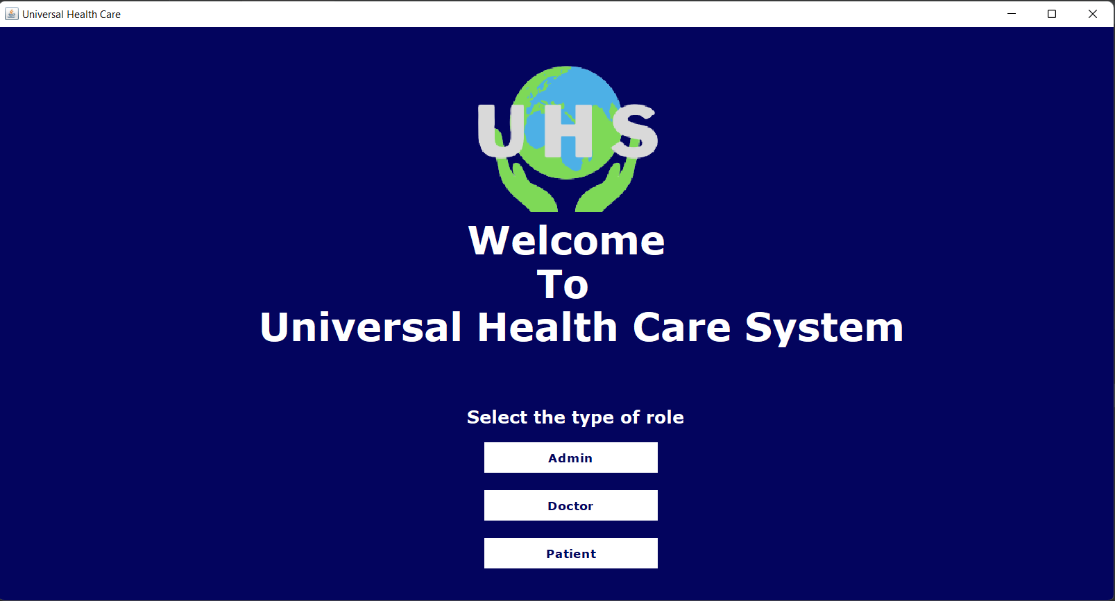
THANK YOU

Slide 10
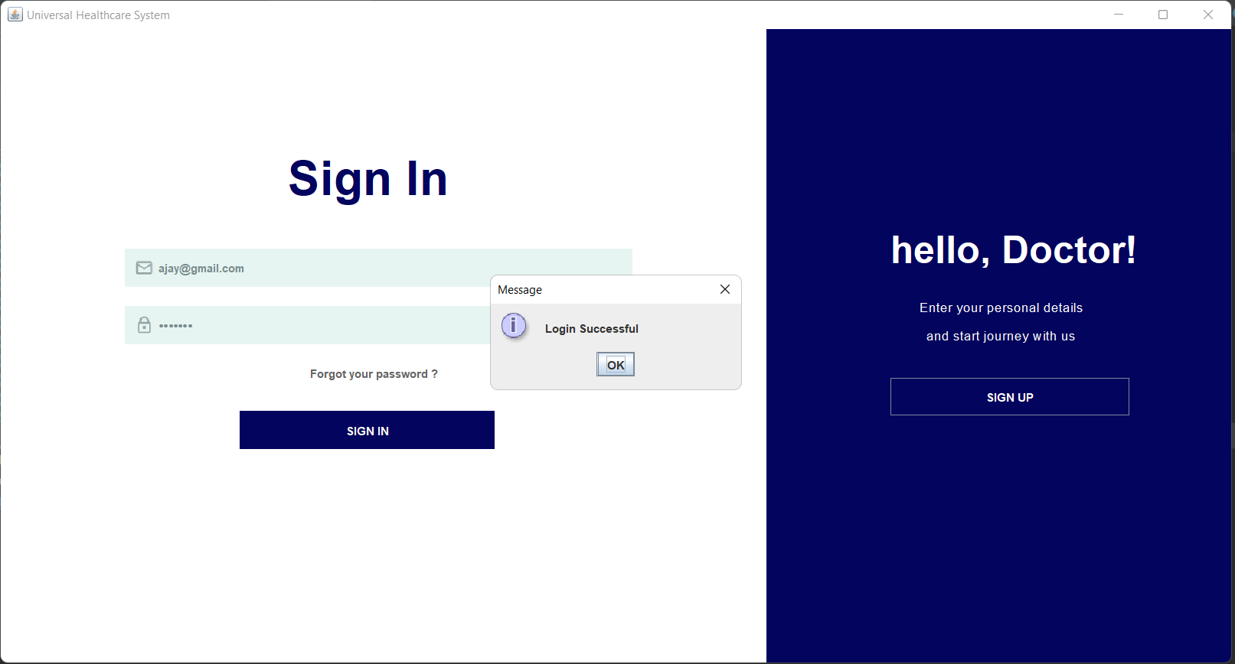
THANK YOU

Slide 11
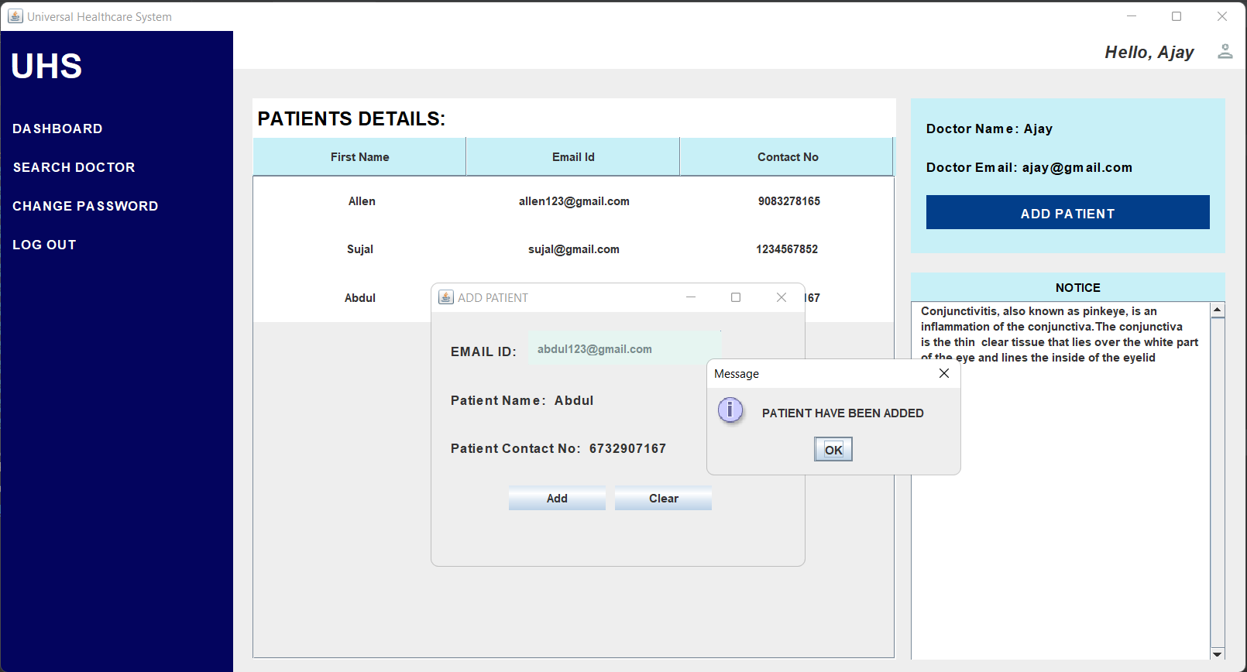
THANK YOU

Slide 12
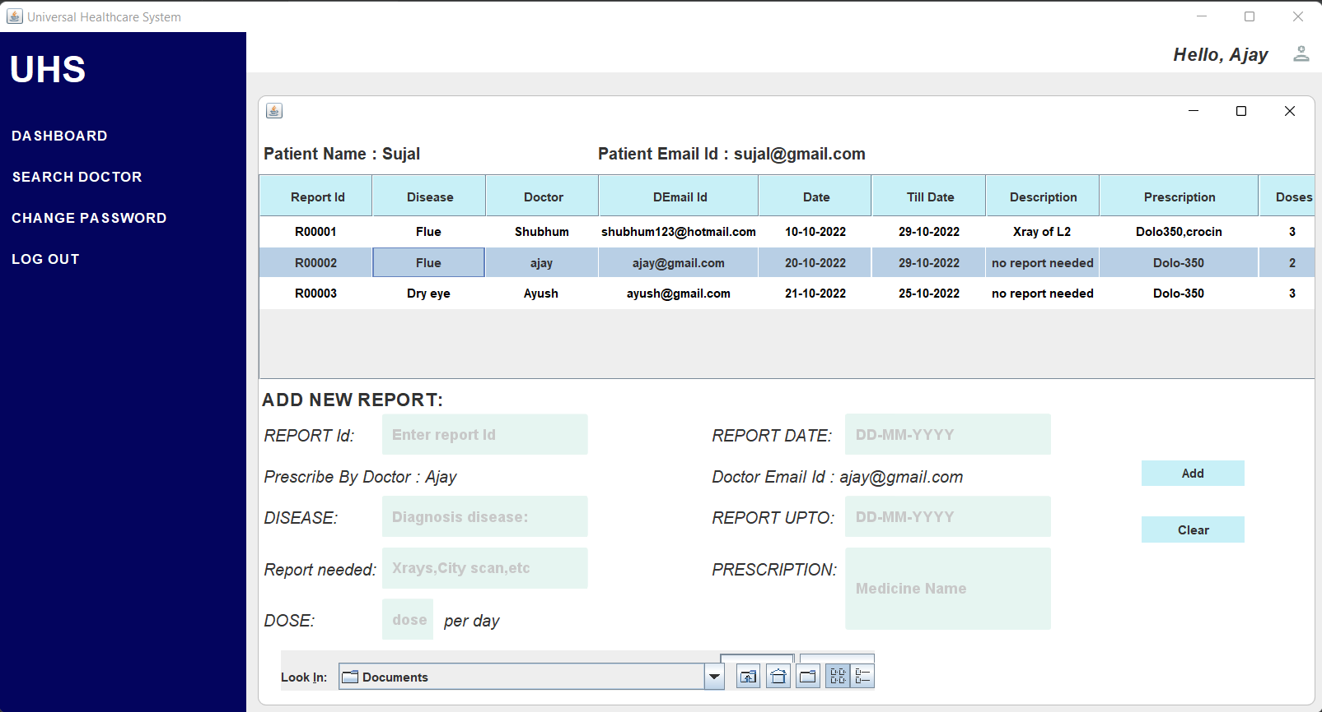
THANK YOU

Slide 13
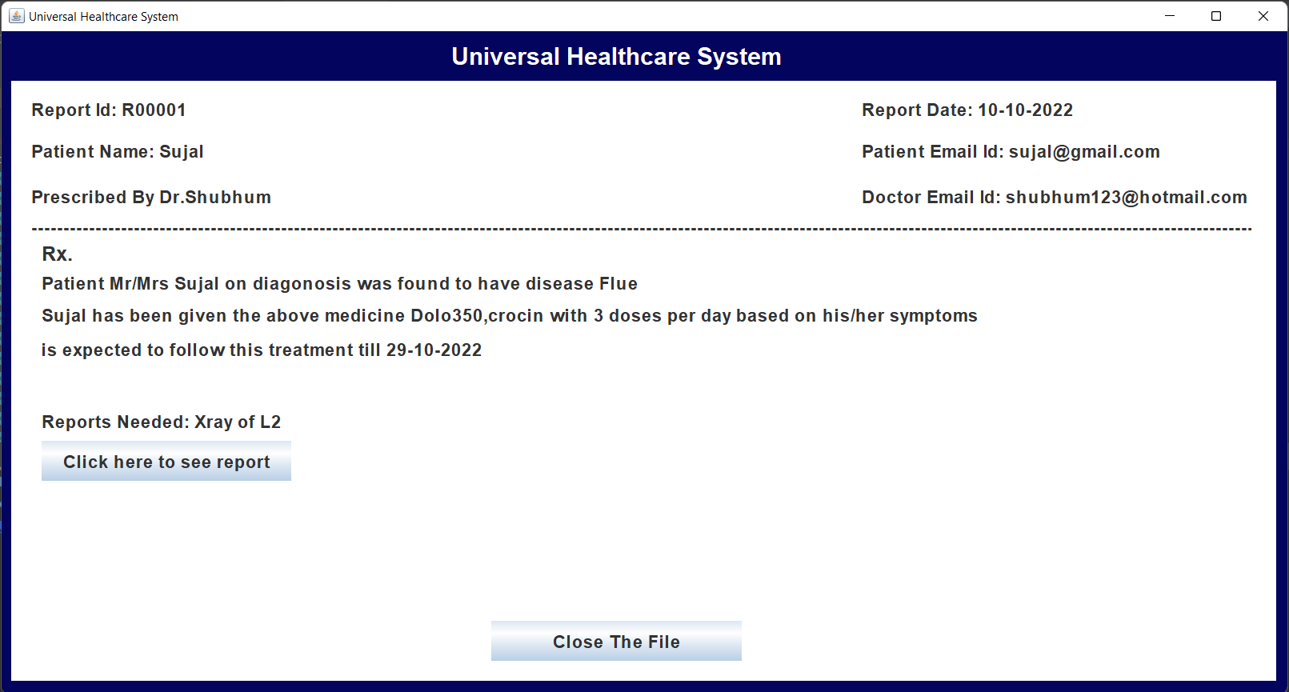
THANK YOU

Slide 14
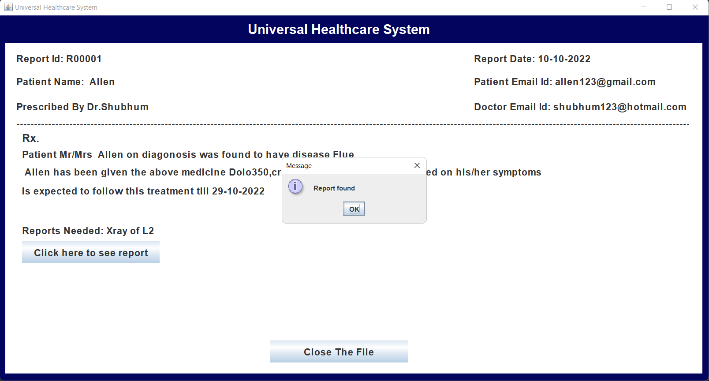
THANK YOU

Slide 15
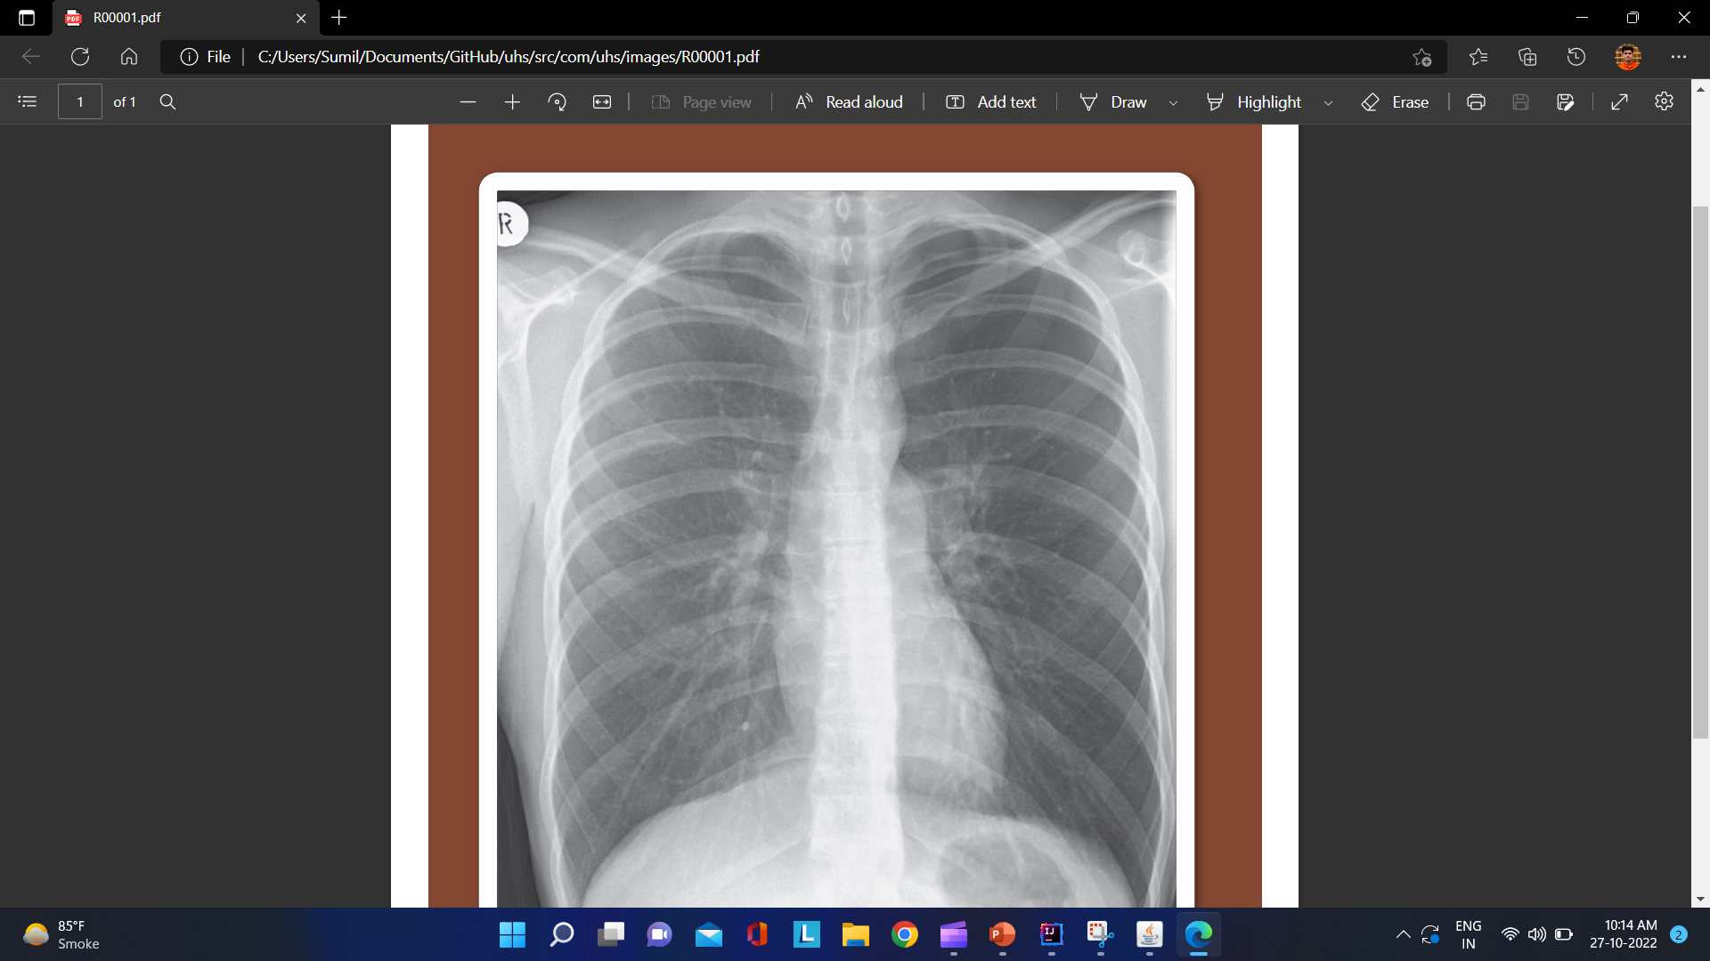
THANK YOU

Slide 16
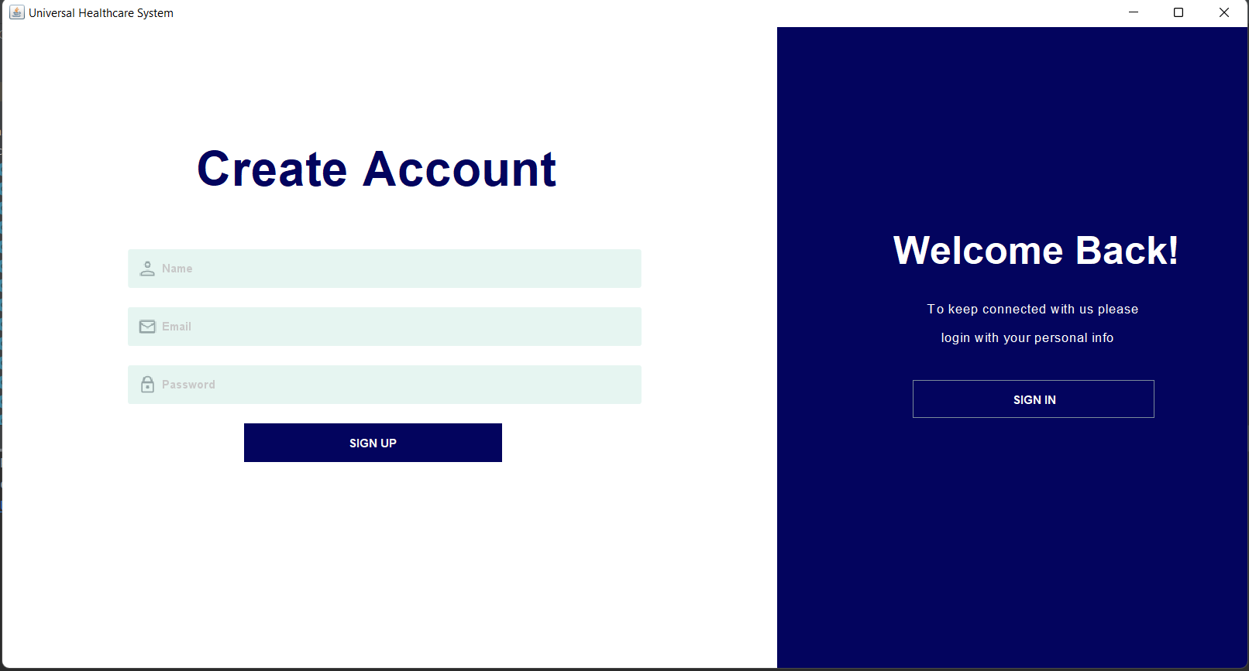
THANK YOU

Slide 17
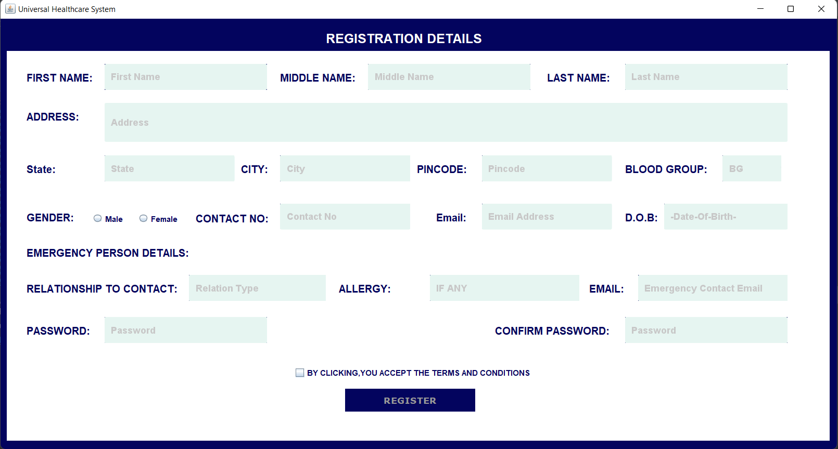
THANK YOU

Slide 18
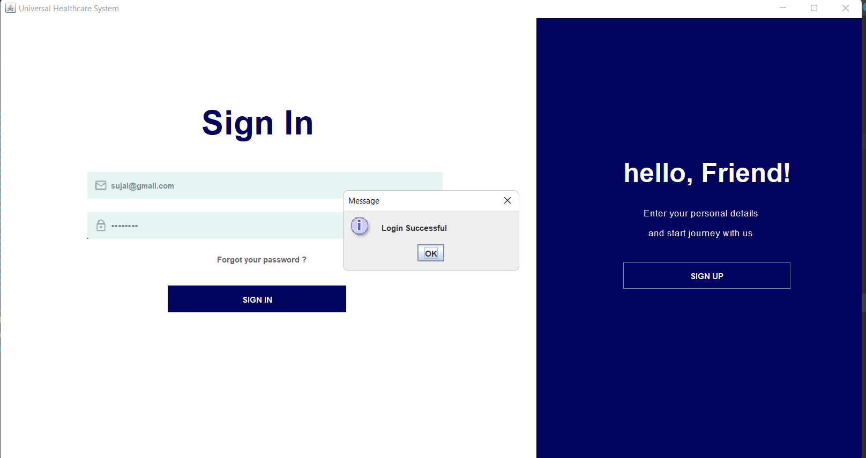
THANK YOU

Slide 19
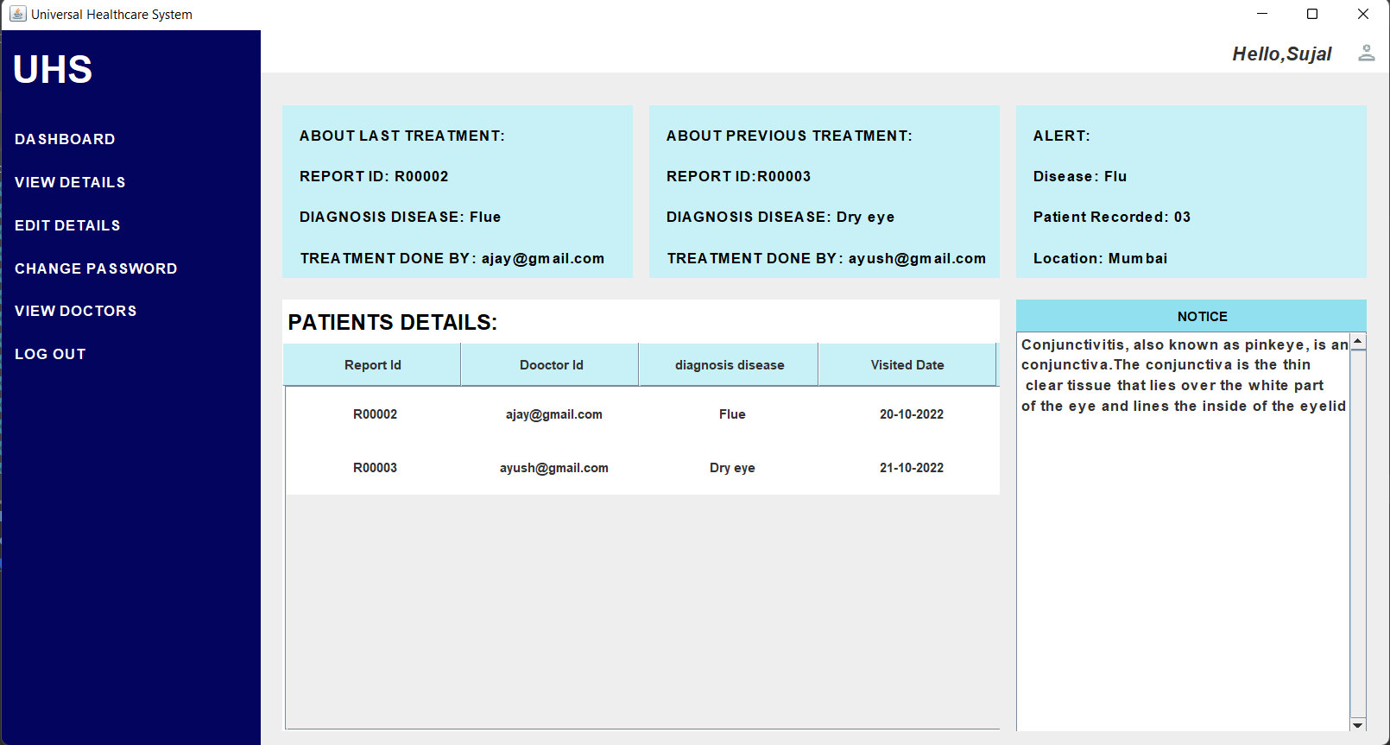
THANK YOU

Slide 20
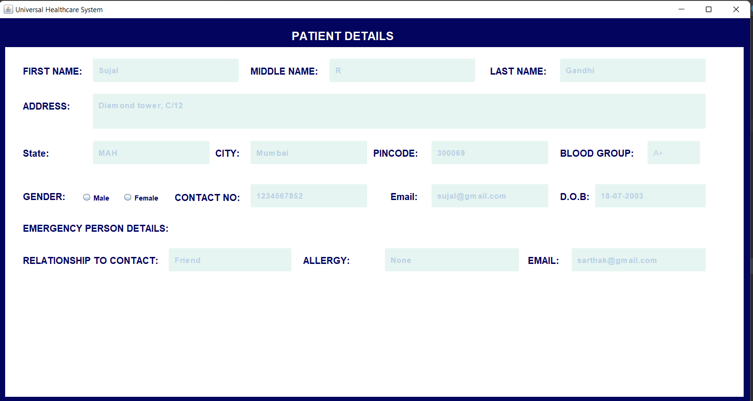
THANK YOU

Slide 21
THANK YOU

