Slide 1

Group-25 CloudUp CSCI-5409 Adv Topics in Cloud Computing
Sarthak Patel – B00912612
Kavan Patel – B00869224
Hardee Rameshchandra Garala – B00869195 Faculty - Prof. Robert Hawkey TA – Devarshi Vyas

Slide 2
Words On Cloud - Objectives
Knowledge
Entertainment

Slide 3
Features
Play game
Create game
Leaderboard

Slide 4


How to play game?
Guess a 5 letters random word.
All the tiles are ‘grey’? Don’t use any letters from this word.
Found one ‘yellow’? One letter is correct, but not at the right place.

Slide 5



How to play game?
4) Found a ‘green’ tile. Let’s not change that letter’s position.
3 matches we are getting closer!
Hurray we guessed the word correctly!!!

Slide 6
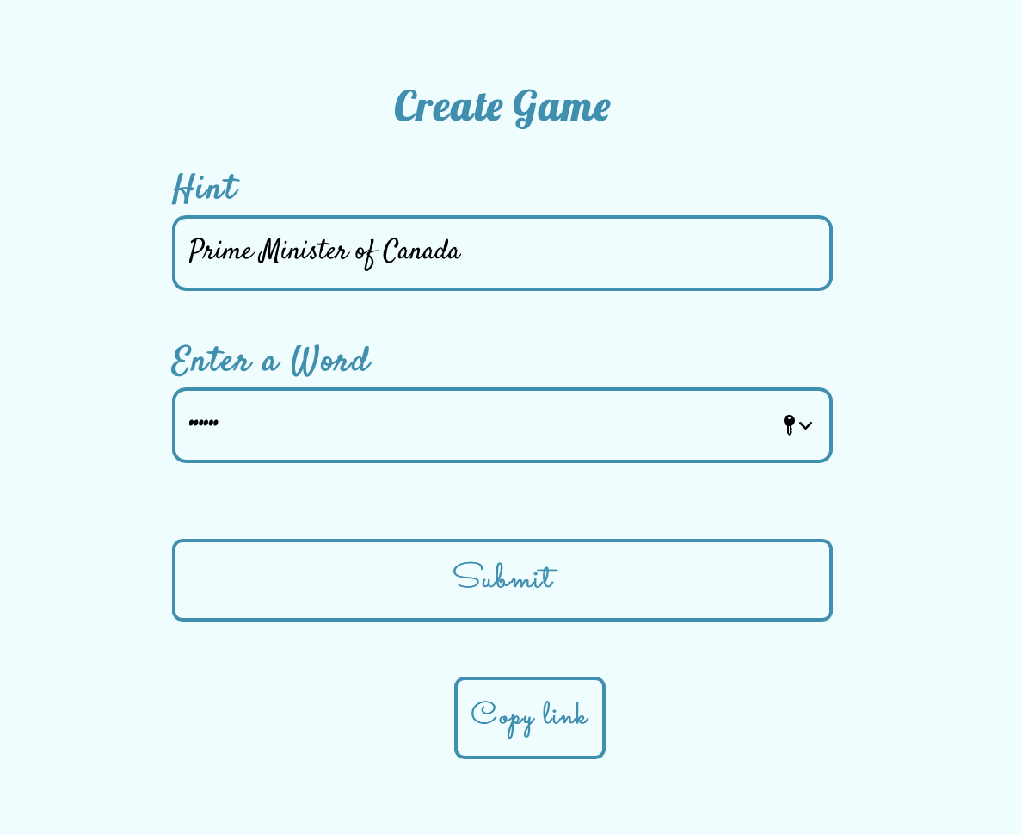
How to create game?

Slide 7
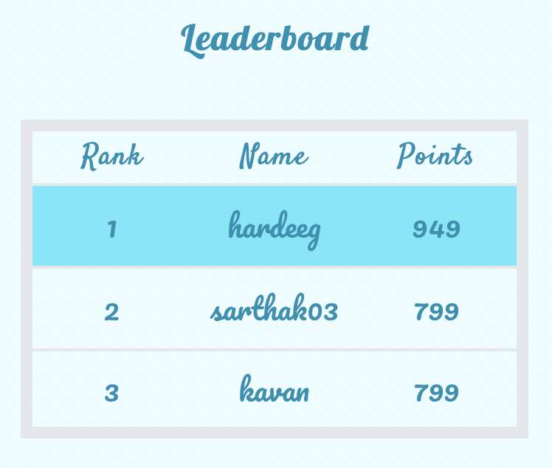
Leaderboard

Slide 8

SARTHAK

Slide 9
Tech Stack
Node js
React js

Slide 10
Services
Service | Use case
AWS Elastic Beanstalk | Host the game
AWS Lambda | Backend APIs
AWS S3 | Store the word dictionary
AWS DynamoDB | Store word and game statistics
AWS VPC | Security
Amazon Cognito | User Management
AWS Eventbridge | Trigger lambda at intervals

Slide 11
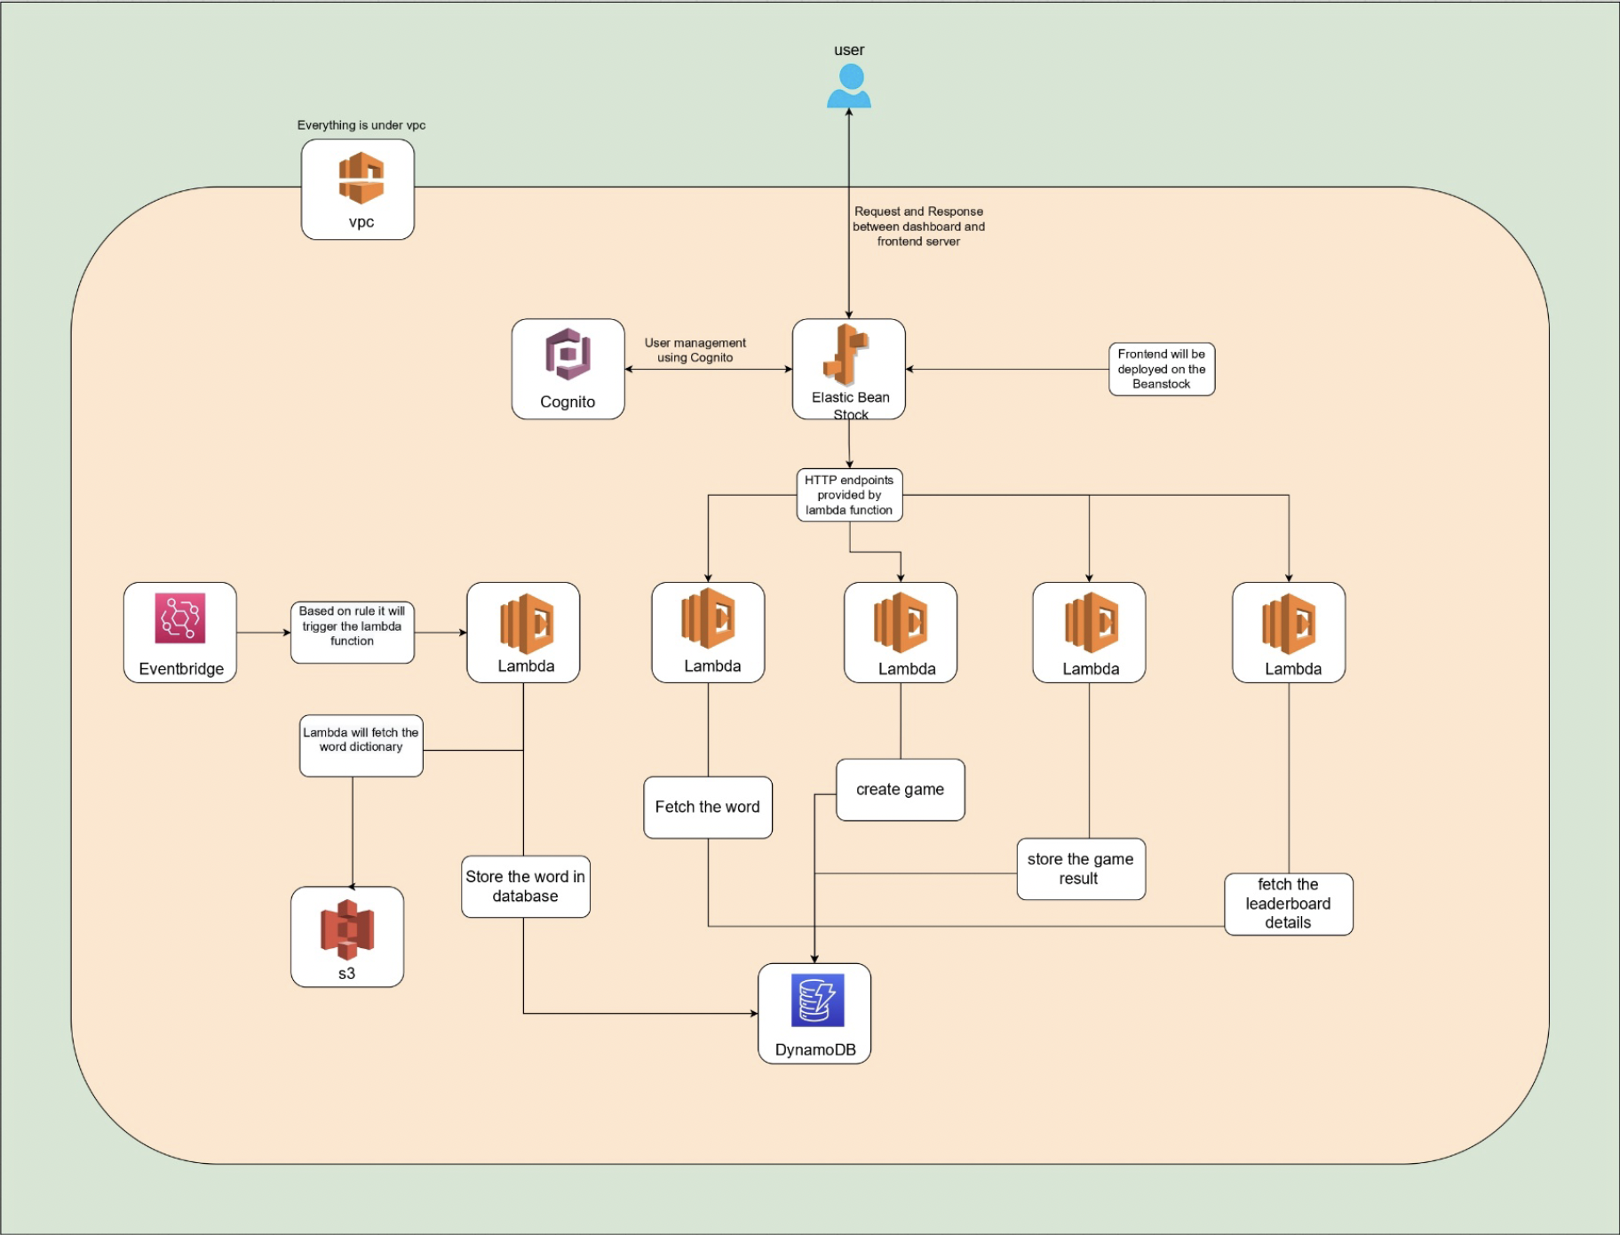
Dataflow

Slide 12
Demo!

Slide 13
Future plans
Play game – different categories
Create game – leaderboard
Other leaderboard features - number of time the user has played - average score till now
Mobile application

Slide 14
Thank you!

