Slide 1


ENCRYPTION

Slide 2
Agenda
What is Encryption?
Why Encryption?
Major Role Players
How it works?
Types of Encryption
Comparison of types
Applications of Encryption
Email Encryption
References
Questions

Slide 3
What is Encryption?
Encryption is the process of encoding a message or information in such a way that only authorized parties can access it and those who are not authorized cannot. It does not itself prevent interference, but denies the intelligible content to a would-be interceptor.

Slide 4
Why Encryption?
Data privacy concerns
Hacking is big business
Regulations demand it
Authenticity verification

Slide 5
Major Role Players
Plaintext – The intended meaningful information or message.
Ciphertext – Scrambled or meaningless text that can be read only if decrypted.
Encryption Algorithm – An algorithm that takes plaintext and encryption key as input and produces ciphertext.
Encryption Key – A value known to the sender.
Decryption Key – A value known to the receiver. In some cases, it can be same as encryption key based on the type of encryption used.
Decryption Algorithm – An algorithm that takes ciphertext and decryption key as input and produces plaintext.

Slide 6
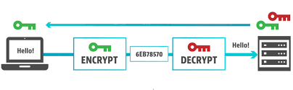
How it works?

Slide 7
Types of Encryption
Symmetric Key Encryption
Asymmetric Key Encryption

Slide 8
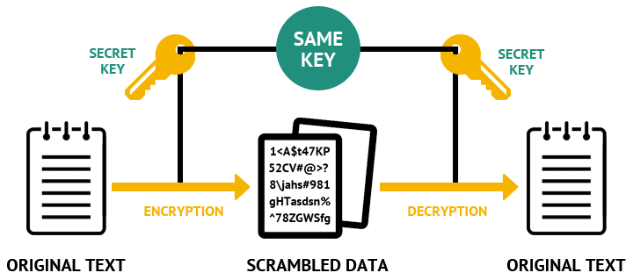
Symmetric Key Encryption
The encryption process where same keys are used for encrypting and decrypting the information.
Few well-known examples of symmetric key encryption methods − Digital Encryption Standard (DES), Triple-DES (3DES), AES, and BLOWFISH.

Slide 9
Symmetric Key Encryption (contd.)
Features of this encryption scheme are −
Must share common key prior to exchange.
Keys are recommended to be changed regularly.
A robust mechanism needs to exist to exchange the key as keys are required to be changed regularly, this mechanism becomes expensive and cumbersome.
Length of key in this encryption is smaller and hence, process of encryption-decryption is faster than asymmetric key encryption.
Processing power of computer system required to run symmetric algorithm is less.

Slide 10
Symmetric Key Encryption (contd.)
There are two restrictive challenges of employing symmetric key cryptography.
Key establishment − Before any communication, both the sender and the receiver need to agree on a secret symmetric key. It requires a secure key establishment mechanism in place.
Trust Issue − Since the sender and the receiver use the same symmetric key, there is an implicit requirement that the sender and the receiver ‘trust’ each other. For example, it may happen that the receiver has lost the key to an attacker and the sender is not informed.

Slide 11
Asymmetric Key Encryption
The encryption process where different keys are used for encrypting and decrypting the information.
Though the keys are different, they are mathematically related and hence, retrieving the plaintext by decrypting ciphertext is feasible.
Well-regarded asymmetric key techniques are Diffie-Hellman Key exchange protocol, Digital Signature Standard (DSS), elliptic curve techniques etc.

Slide 12
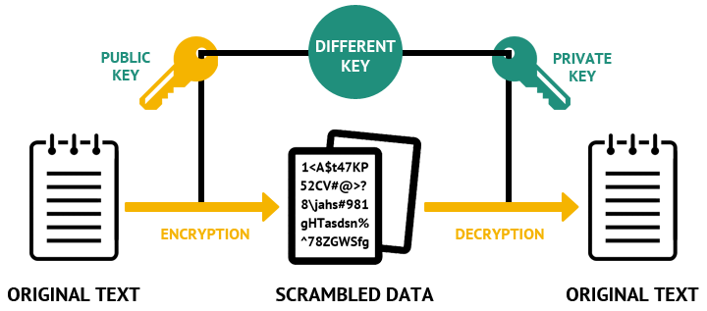
Asymmetric Key Encryption (contd.)

Slide 13
Asymmetric Key Encryption (contd.)
One significant challenge faced is that the user needs to trust the public key that he is using in communications with a person really is the public key of that person and has not been spoofed by a malicious third party, which is usually accomplished through a Public Key Infrastructure (PKI).

Slide 14
Symmetric v/s Asymmetric Key Encryption
Attributes | Symmetric | Asymmetric
Keys | One key is shared between two or more entities. | One entity has a public key and other has a private key.
Speed | Algorithms are less complex and faster. | Algorithms are more complex and slower.
Number of Keys | Grows exponentially as users grow. | Grows linearly with users.
Use | Confidentiality. | Confidentiality and Digital Signatures.
Size of ciphertext | Same or less that the plaintext size. | More than the plaintext size.
Key Exchange | Out-of-band through secure mechanisms. | Public key is made available to everyone and private key is kept secret by the owner.

Slide 15
Applications
Email Encryption
Disk Encryption
Files/Folder Encryption
Message Verification
Data erasure
Encryption over Internet through SSL
And many more

Slide 16

Email Encryption
Is email communication secure?
Encryption of email messages to protect the content from being read by other entities than the intended recipients. Email encryption may also include authentication.
Encryption protocols –
Transport level encryption.
End-To-End encryption.
It can be achieved through –
Through TLS(SSL).
Through PGP (Pretty Good Privacy).
By Third Party Email Encryption Techniques.

Slide 17

Email Encryption – Transport level
Most commonly used encryption extension is STARTTLS.
STARTTLS is a TLS(SSL) layer over the plaintext communication, allowing email servers to upgrade plaintext to cipher one.
Google mail servers all speak STARTTLS .However, the sending and receiving server stores an unencrypted copy of the mail. This leaves them open to various threats.

Slide 18
Email Encryption – Transport level (TLS)
Encrypting email with TLS –
TLS is a kind of point-to-point encryption, it protects data along each hop.
When you send an encrypted email, your computer executes a handshake with webmail client.
The two confirm that each other’s identity, agree on an encryption method and create a session key. The client uses that session key to send the message to the server, which decrypts the message. The whole process repeats, sending the message from your server to the recipient’s server, and finally to the recipient’s email address.
Unfortunately, it’s not secure enough. If the recipient’s server doesn’t use TLS, your email will be sent in plain text (i.e. unencrypted) and you won’t even know it has been exposed. TLS encrypted email is also vulnerable at each server.

Slide 19
Email Encryption – End-To-End (PGP)
Encrypting email with PGP –
The program creates a one-time session key, which is then used to encrypt the email.
The session key is then encrypted with recipient’s public key, and both are sent.
The recipient uses their private key to retrieve the original session key, which then decrypts the email.
PGP is very secure when used correctly, it’s unlikely a third party will be able to read your messages.

Slide 20
References
https://en.wikipedia.org/wiki/Encryption
https://en.wikipedia.org/wiki/Transport_Layer_Security
https://www.virtru.com/resources/education/email-encryption-work/
https://en.wikipedia.org/wiki/Opportunistic_TLS
https://www.sparkpost.com/resources/email-explained/ssl-tls-starttls-encyption/
https://security.stackexchange.com/questions/97064/is-gmail-to-gmail-still-insecure-why

Slide 21
QUESTIONS?

Slide 22
THANK YOU

