Slide 1

Project 5 Presentation Group 37
CSE 535 MOBILE COMPUTING
FALL 2023
Deepak Reddy Nayani, Sarthak Shah, Samarth Singh, Shashank Shivarasi, Prajjwal Pandey

Slide 2
Problem Addressed
Challenges of Teen Safety in a Digital World
Vehicle Accidents: "Reducing teen risk in traffic through enhanced safety monitoring."
Fall Detection: "Protecting over 2.2M children under 14 from fall-related injuries annually."
Geofencing: "Creating safe zones through geofencing to ensure teen security."
SOS Feature: "Facilitating immediate emergency communication between parents and teens."
Health Monitoring: Empowering teens to measure and monitor heart rate and respiratory rate for timely health insights.
Need for real-time monitoring of teen's location for safety without invading privacy
Difficulty in emergency communication between parents and teens
Notes:
References:
https://www.cdc.gov/transportationsafety/teen_drivers/teendrivers_factsheet.html
https://www.stanfordchildrens.org/en/topic/default?id=falls--injury-statistics-and-incidence-rates-90-P02974

Slide 3
Challenges Encountered
Precision in Fall Detection: Innovatively minimizing false alarms in fall detection through advanced algorithms and sensor calibration, ensuring accuracy and reliability.
Technical Integration: Seamlessly combining GPS tracking, health monitoring, and emergency response features into a reliable and efficient system.
Database Design & Customization: Designing a robust database that caters to diverse needs, ensuring efficient data management and quick access to critical information."
User Interface Design:Creating an intuitive and user-friendly interface for both parents and teenagers, considering their different technological abilities and needs.
Enhancing User Experience: Going beyond basic alerts to provide comprehensive support – like immediate information on nearby police and hospitals during emergencies, and starting video recording when SOS is activated for added safety.

Slide 4
How these Challenges were Overcome
Precision in Fall Detection:
Solution: Implemented a response-based alert system for falls - if no response within 15 seconds or a negative response is received, parents are alerted.
Technical Integration:
Solution: Achieved seamless system integration with modular, reusable functions for GPS, health monitoring, and emergency responses.
Database Design & Customization:
Solution: Developed a scalable, secure database through advanced planning, ensuring efficient data management and quick access.
User Interface Design:
Solution: Designed an intuitive interface through extensive user testing, tailored for both parents and teens.
Enhancing User Experience:
Solution for Fall Detection: Implemented a response-based alert system for falls - if no response within 15 seconds or a negative response is received, parents are alerted.
Additional Feature for SOS: Provided an option to start video recording automatically when the SOS button is pressed, enhancing incident documentation and response.

Slide 5
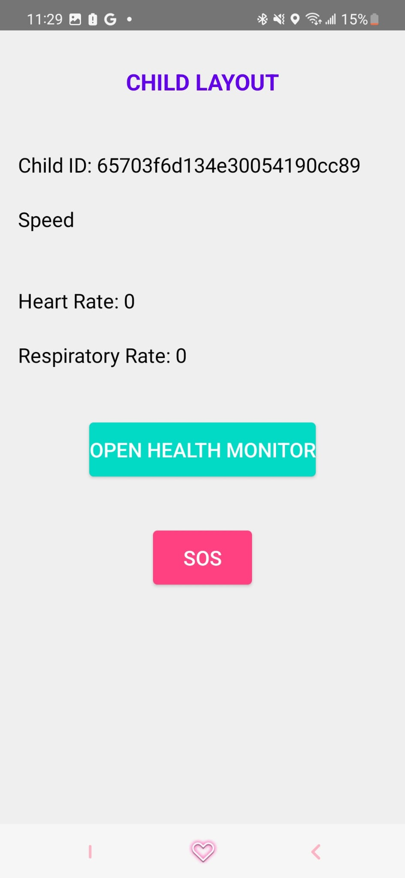
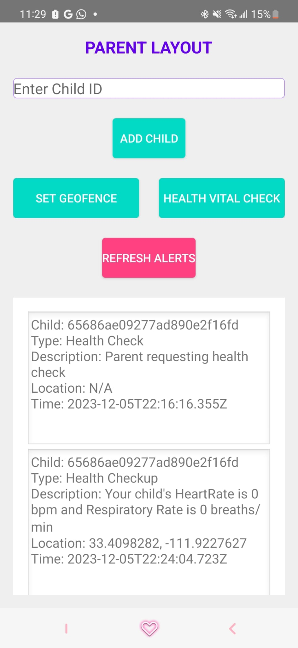
DEMONSTRATION

Slide 6
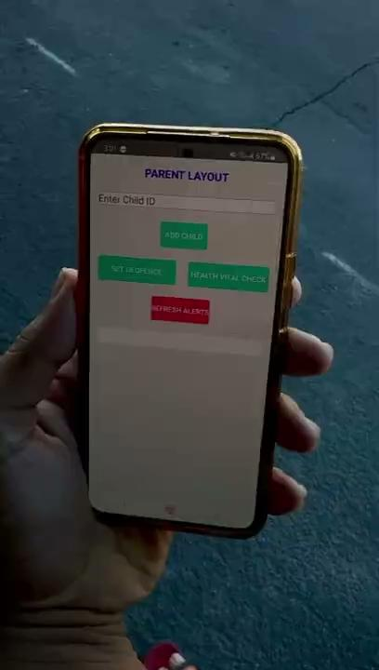
Speed Monitoring

Slide 7
QA Session
If you need more details or wish to discuss specific aspects of our project, we are here to answer.

