Slide 1
Adv. Software Development Concepts Assignment – 2 (Part - II)
Name: Sarthak Patel
Reg. No: B00919946
Prof.: Dr. Tushar Sharma

Slide 2
Commits
The Code has been taken from the Apache atlas GitHub repository.
The Commits has been taken within the period of 6 months so that there is a significant changes in the Line of Code.
Commit Number | Commit Date
1 | 5th June 2018
2 | 4th January 2019
3 | 3rd June 2019
4 | 9th January 2020
5 | 3rd June 2020
6 | 4th January 2021
7 | 4th June 2021
8 | 20th January 2022
9 | 15th June 2022
10 | 27th January 2023
https://github.com/apache/atlas

Slide 3
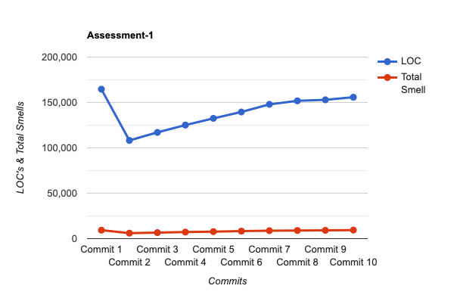
Assessment-1
Observations
In the first commit, there was a significant Line Of Code (LOC) and Total Smells, but it seems that they decreased the LOC’s and Total Smells during Commit 2.
It can be observed from the line graph that LOCs and Total smells are proportional to each other (For this code).

Slide 4
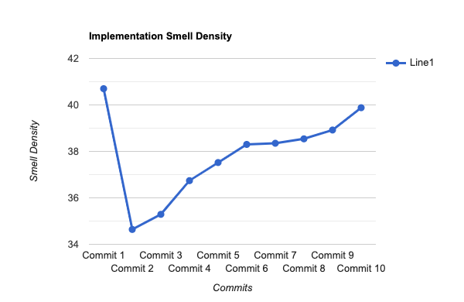
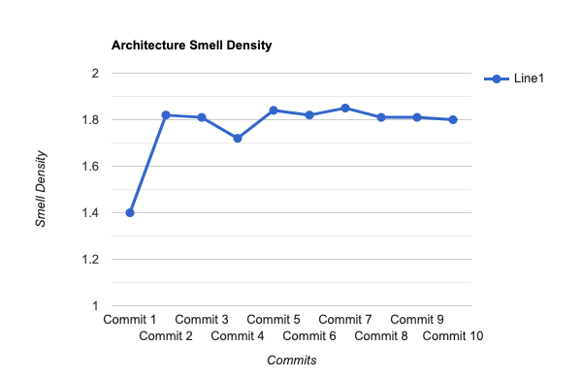
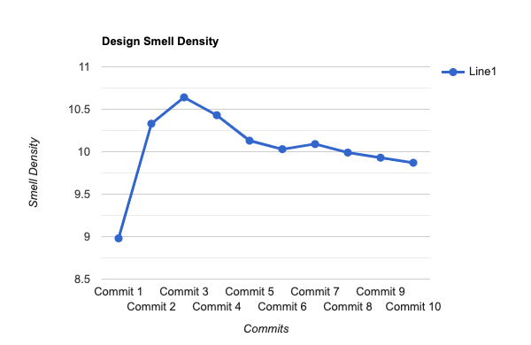
Assessment-2
It seems that they refactored their code on large scale and divided their code into classes and components, as a result their implementation smell density decreased but architecture and design smell densities increased significantly.

Slide 5
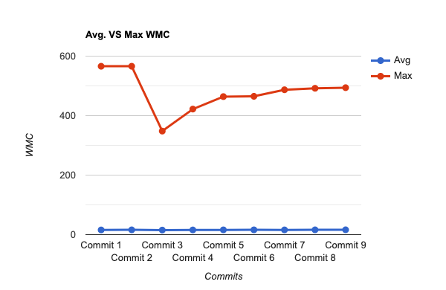
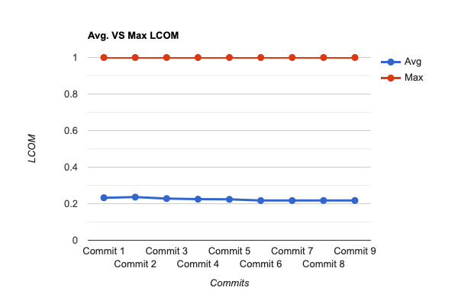
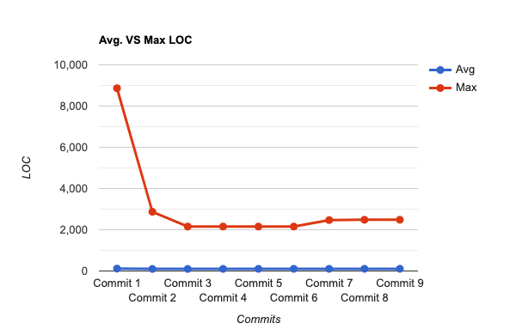
Assessment-3

