Slide 1

IILM UNIVERSITY, GREATER NOIDA
School of Computer Science and Engineering
WEB DEVELOPMENT INTERNSHIP
Internship Report & Presentation
Sarthak Singh
Web Development Intern
Organization
Duration
Location
SnowXAI Technologies Private Limited
01 Jun 2026 – 31 Aug 2026
New Delhi, India
B.Tech (Computer Science & Engineering) • Batch 2024–2028
IILM University • School of Computer Science and Engineering | 1

Slide 2
Internship Overview
Key details recorded on the official completion certificate
Internship Role
Duration
Certificate
Web Development Intern
01 June 2026 – 31 August 2026
SXAI/INT-CERT/2026/002
Organization
Director
Location
SnowXAI Technologies Private Limited
Mohd Zaid
New Delhi, India
Nature of Experience
The certificate records assigned activities and contributions related to Web Development, with practical exposure to professional workflows, project collaboration and relevant technical practices.
IILM University • School of Computer Science and Engineering | 2

Slide 3
Organization Profile
SnowXAI Technologies Private Limited
About the Internship Organization
Organization
The internship completion certificate identifies SnowXAI Technologies Private Limited as the organization associated with the internship. It states that the internship was undertaken during the pre-incorporation period of the business that subsequently became SnowXAI Technologies Private Limited, and was formally acknowledged and recorded by the company following incorporation.
SnowXAI Technologies Private Limited
Leadership
Mohd Zaid — Director
Location
The report therefore focuses on the Web Development internship experience and avoids unsupported claims about specific company products or technologies.
New Delhi, India
IILM University • School of Computer Science and Engineering | 3

Slide 4
Role: Web Development Intern
Desired role and responsibilities represented in the internship
Role Focus
Assigned Activities
Project Contribution
Web Development
Participated in assigned activities related to Web Development.
Contributed to projects related to Web Development.
The internship role was officially recorded as Web Development Intern.
Professional Workflow
Collaboration
Gained exposure to professional workflows and technical practices.
Gained exposure to project collaboration.
Key takeaway: the internship connected academic knowledge with practical web-development work and professional project practices.
IILM University • School of Computer Science and Engineering | 4

Slide 5
Objectives of the Internship
What the internship aimed to develop
Gain practical exposure to Web Development.
Apply programming and development knowledge to assigned activities.
Understand professional development workflows.
Improve problem-solving and debugging ability.
Understand project collaboration and communication.
Develop familiarity with relevant technical practices.
Improve confidence in working on web-development tasks.
Connect academic concepts with practical software development.
Build professional discipline and task ownership.
Prepare a foundation for further growth in Web Development.
IILM University • School of Computer Science and Engineering | 5

Slide 6
Scope of the Internship
Practical areas covered by the reported experience
Task Execution
Development
Testing
Assigned Web Development activities and project-related contributions.
Implementation or modification of web-related functionality.
Checking developed work and identifying issues.
Debugging
Collaboration
Professional Practice
Correcting errors and refining the implementation.
Coordinating with project-related work and communication.
Understanding workflow, responsibility and quality expectations.
Note: The certificate does not specify a detailed day-wise syllabus, named project, or exact technology stack.
IILM University • School of Computer Science and Engineering | 6

Slide 7
Conceptual System / Work Architecture
General workflow used to approach a web-development task
1
2
3
4
5
Task / Requirement
Planning
Development
Testing
Debugging
Understand the assigned requirement.
Break the task into manageable steps.
Implement or modify the required functionality.
Check functionality and identify issues.
Resolve errors and refine the work.
6
7
Review / Collaboration
Completion
Incorporate feedback and coordinate progress.
Prepare the work for submission or integration.
IILM University • School of Computer Science and Engineering | 7

Slide 8
Methodology
Activity-oriented approach followed during the internship
Phase
Activity
Purpose
1
Task Understanding
Understand requirements and expected results.
2
Planning
Identify the steps needed to complete the activity.
3
Implementation
Work on the assigned Web Development task.
4
Testing
Verify the implemented functionality.
5
Debugging
Identify and resolve issues.
6
Collaboration
Communicate progress and coordinate work.
7
Review
Evaluate and improve completed work.
IILM University • School of Computer Science and Engineering | 8

Slide 9
Skills Developed & Learning Outcomes
Technical and professional growth
Technical Skills
Professional Skills
Overall Outcomes
• Web Development exposure • Practical task implementation • Testing and debugging • Problem-solving • Understanding development workflow
• Project collaboration • Communication • Task ownership • Time management • Receiving and applying feedback
• Better practical understanding • Greater confidence • Stronger problem-solving approach • Academic-to-practical connection • Foundation for future Web Development roles
The internship strengthened both technical capability and professional working habits.
IILM University • School of Computer Science and Engineering | 9

Slide 10
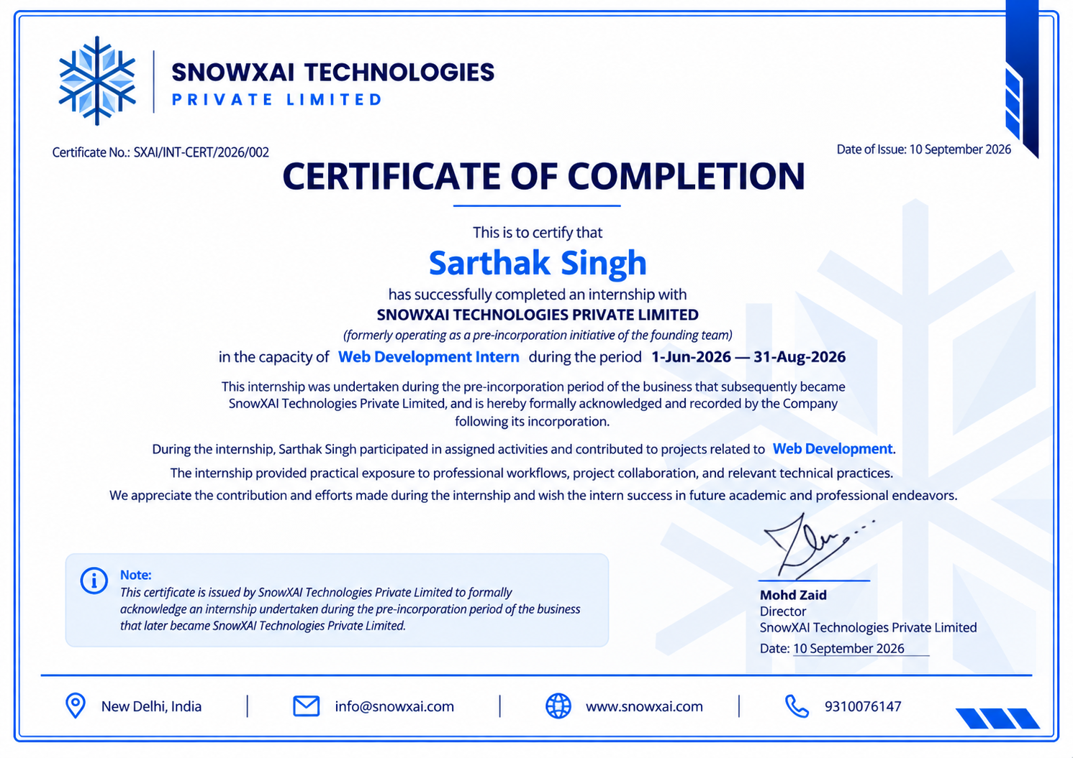
Internship Completion Certificate
Official completion proof
IILM University • School of Computer Science and Engineering | 10

Slide 11
Conclusion
Key takeaways from the Web Development Internship
A valuable bridge between academic learning and practical development.
Completed the internship as a Web Development Intern at SnowXAI Technologies Private Limited.
Received practical exposure to assigned Web Development activities, professional workflows and project collaboration.
Improved problem-solving, debugging, communication and professional working skills.
Built a stronger foundation for future opportunities in Web Development and software engineering.
Thank You
Sarthak Singh • B.Tech CSE • IILM University
IILM University • School of Computer Science and Engineering | 11

