Slide 1

Online Auction System
Stack – Django
Submitted by – Sarthak Dixit

Slide 2
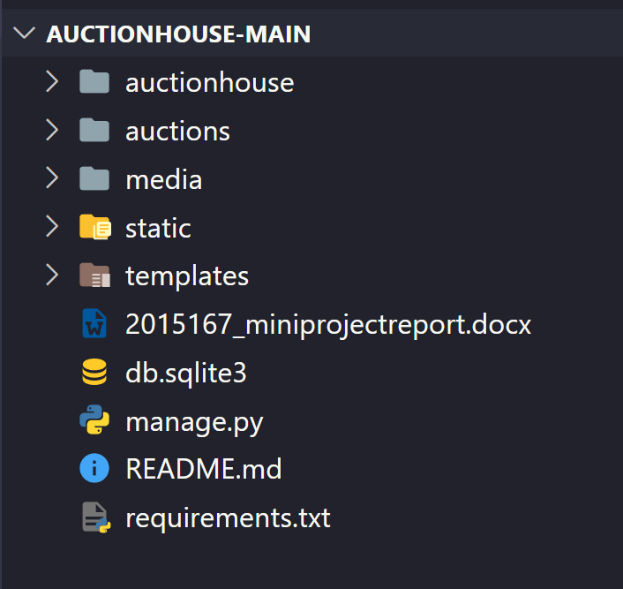
Project Level Configurations

Slide 3
Application-Level Configurations

Slide 4
User Media Files

Slide 5
Static JavaScript/CSS files

Slide 6
Webpages

Slide 7
SQLite Database

Slide 8
Management and Control file

Slide 9
Required Libraries

Slide 10
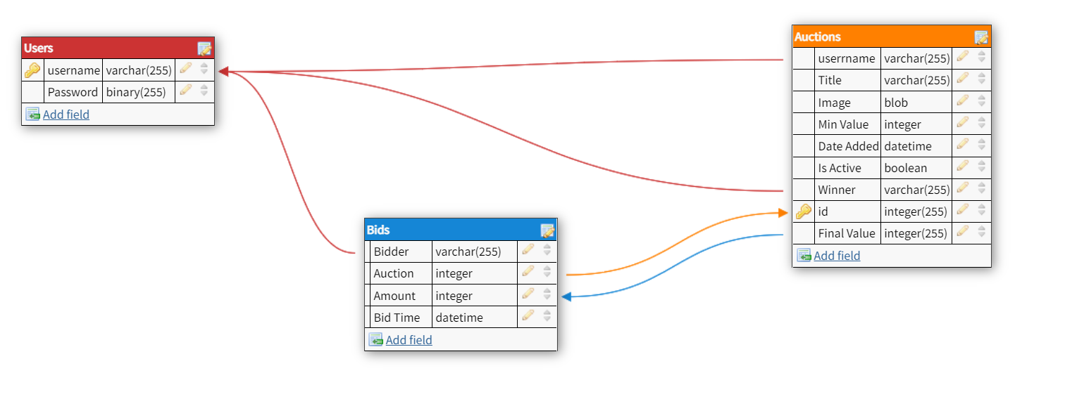
Database Structure

