Slide 1
One month work PPT
Made by Raju Date: 28-08-2025

Slide 2
S.No | Topic | Duration (days)
1. | Specification reading of UART | 2
2. | Extraction featured & testplan | 3
3. | Understanding of DUT & the document related to it | 3
4. | UVM testbench architecture with RAL & debug. | 10
5. | UVM testbench architecture - 2 | 5
6. | Testcases | 3
7. | Debugging of env 2 | 2

Slide 3
What is UART?
UART (Universal Asynchronous Receiver/Transmitter)
A hardware communication protocol for serial data transmission.
Asynchronous → no separate clock line (uses baud rate for synchronization).
Transmits one bit at a time over TX (Transmit) and RX (Receive) lines.
Typical frame format: Start bit + Data bits + Optional Parity + Stop bit(s).
Widely used in embedded systems, SoCs, and peripherals for debugging and low-speed communication.

Slide 4
How it works?
SERIAL
PARALLEL
PERIPHERAL
SERIAL
PARALLEL
CPU

Slide 5
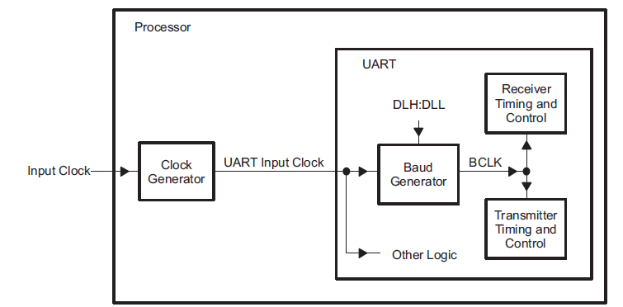
UART Clock Generation Diagram
Note: the bit is sampled in the 8th BCLK cycle for 16× over sampling mode and on the 6th BCLK cycle for 13× oversampling mode.

Slide 6
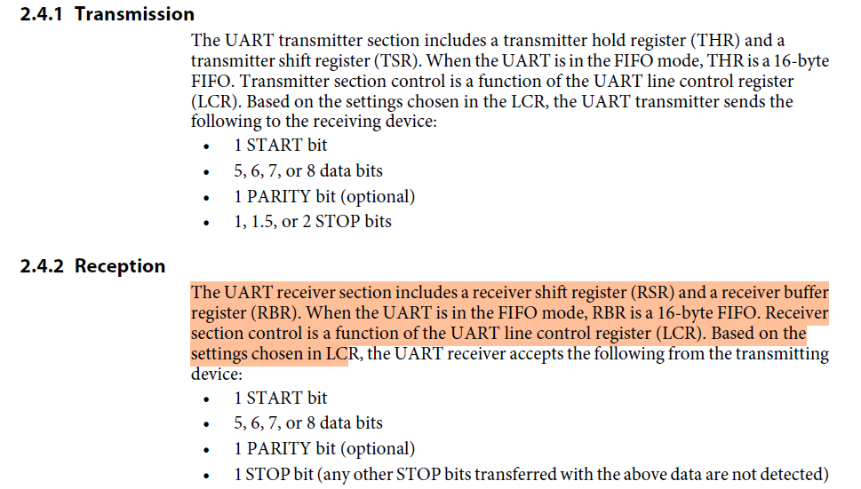

Slide 7
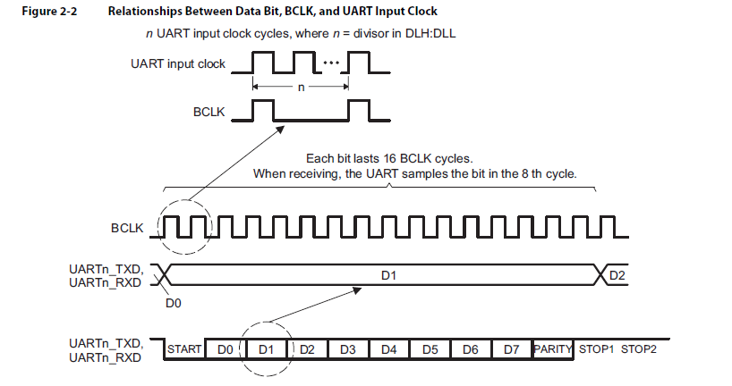
Sampling of data in UART

Slide 8
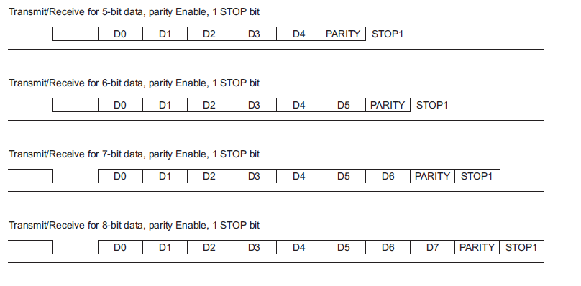
Different format for UART

Slide 9
How starts , and stops

Slide 10
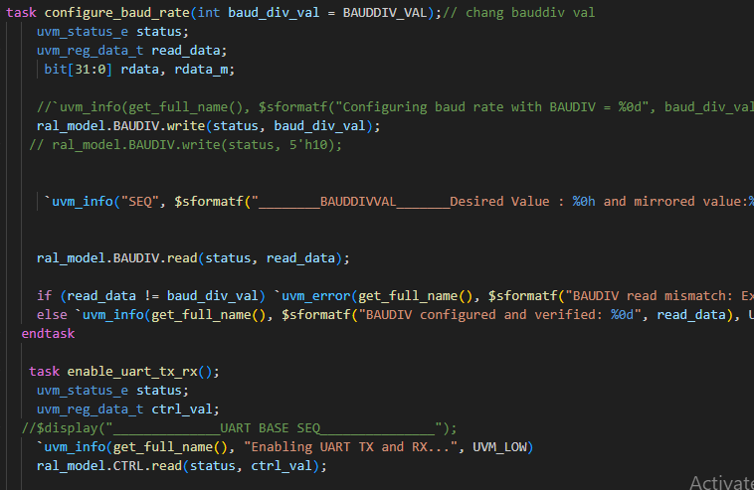
APB_UART TASKS WITH RAL

Slide 11
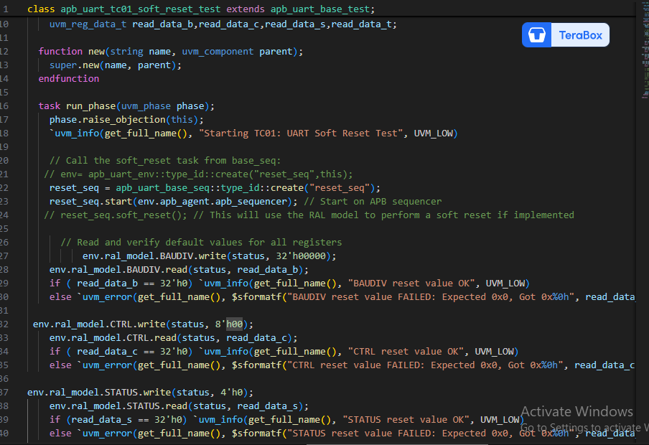
Soft_reset_with RAL

Slide 12
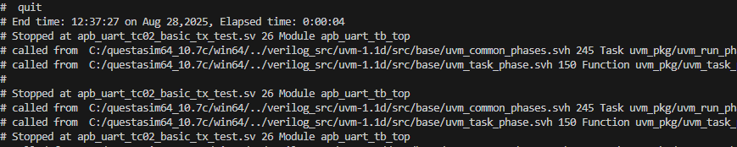
Error encountered

Slide 13
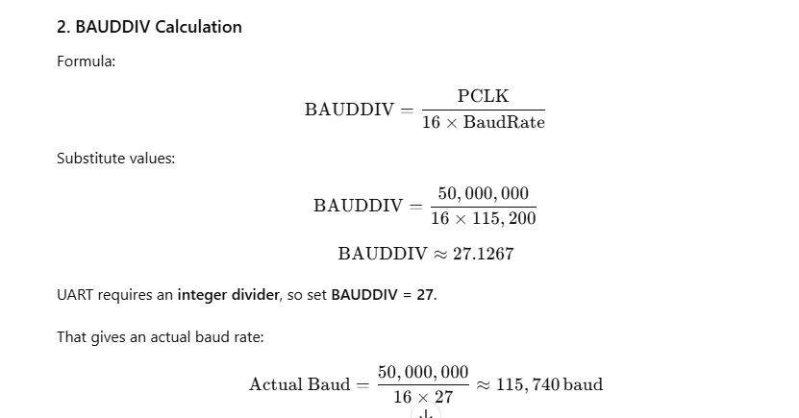
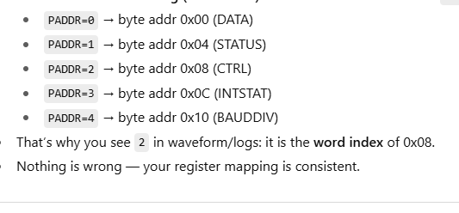
Baud rate is the speed of data transmission in symbols per second.
Register mapping with DUT

Slide 14
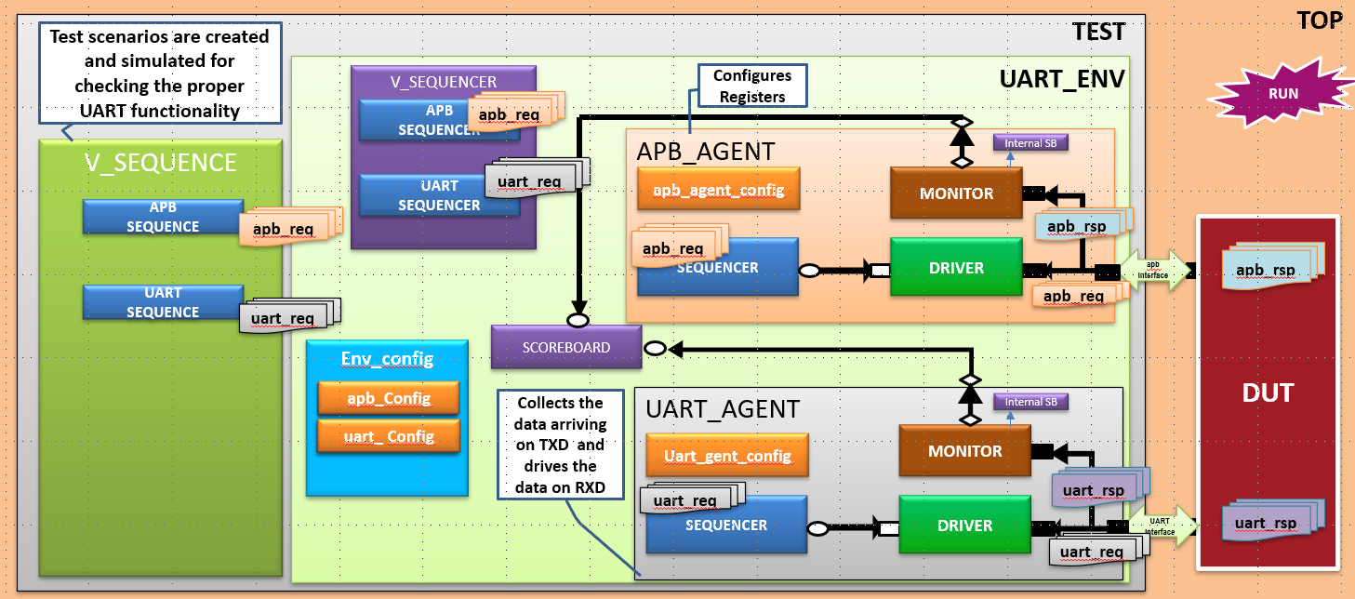
APB_UART_ENV-2

Slide 15
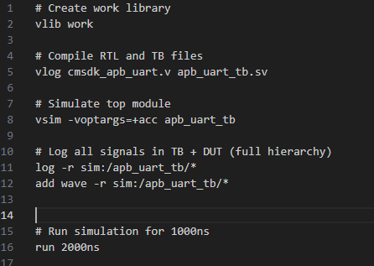
Run.do file

Slide 16
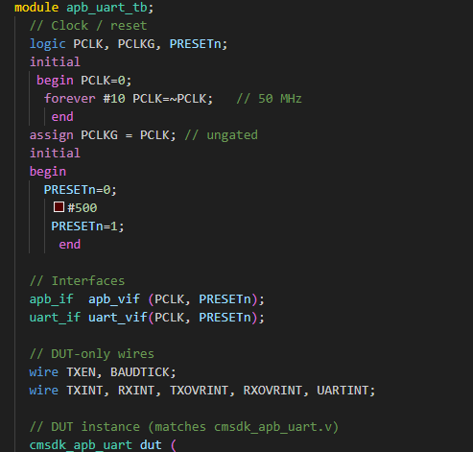
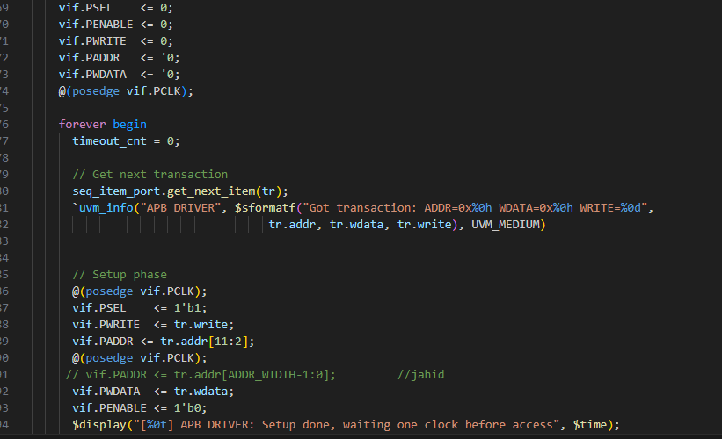
Top and driver

Slide 17
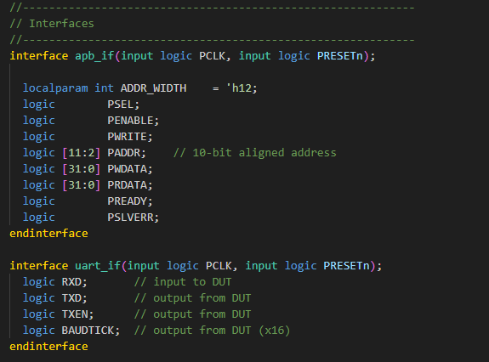
Interface for APB UART

Slide 18
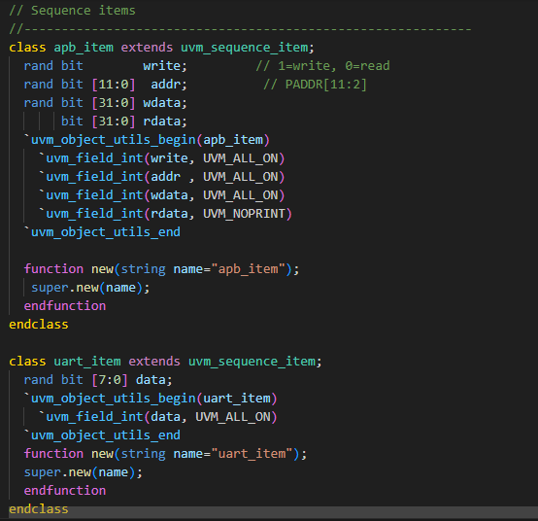
Seq_item

Slide 19
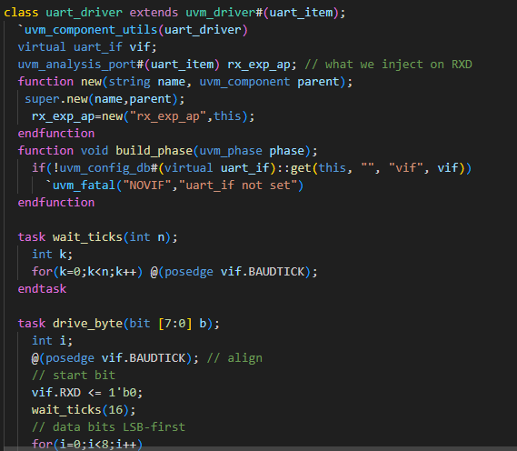
Uart_driver

Slide 20
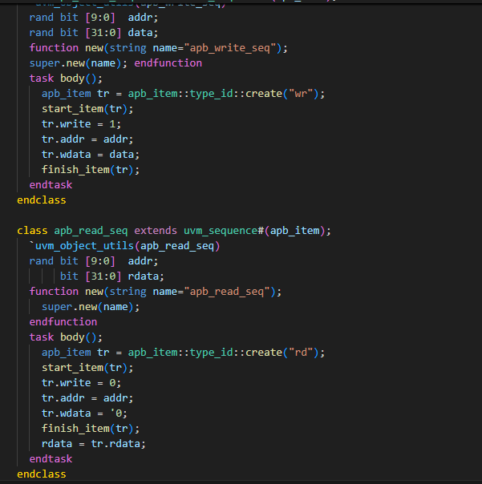
Write and read sequence

Slide 21
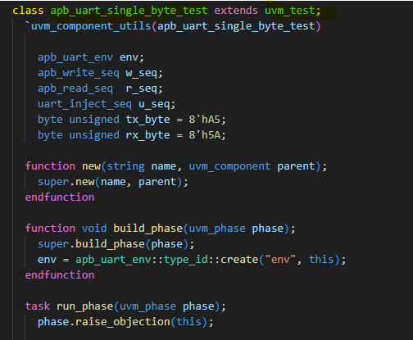
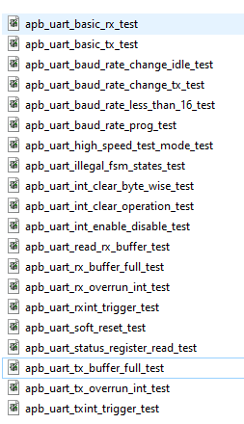
Some test related to APB_UART

Slide 22
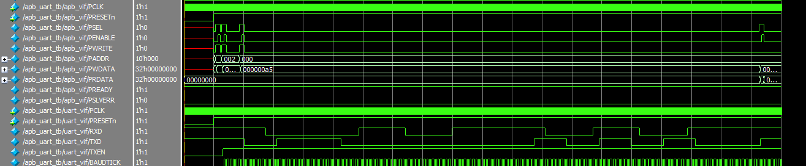
waveform

Slide 23
APB_UART_ENV - 2
Refer the below given document:
General spec
Design related doc.
APB_UART_PROJECT_DOC
APB_UART_VIP_DOC
Verification_plan_doc
Testplan_doc

