Slide 1
Bharati Vidyapeeth
(Deemed to be University),
Department of Information Technology,
College of Engineering, Pune
Presentation on
“Heart Disease Prediction using Machine Learning with Python ”

Slide 2
INTRODUCTION
Heart Disease Prevalence: Heart disease is one of the leading causes of death worldwide, affecting millions of people annually. Early detection can significantly improve treatment outcomes and save lives.
Need for Prediction Models: Predictive models in healthcare play a vital role in identifying at-risk individuals, enabling timely interventions, and optimizing healthcare resources.
Objective: The goal of this project is to develop a machine learning model that can predict the likelihood of heart disease based on patient data (e.g., age, cholesterol levels, blood pressure, etc.).
Why Logistic Regression?: Logistic regression is a widely used classification algorithm for binary outcomes, such as the presence or absence of heart disease. It is well-suited for understanding relationships between various risk factors and disease presence.

Slide 3
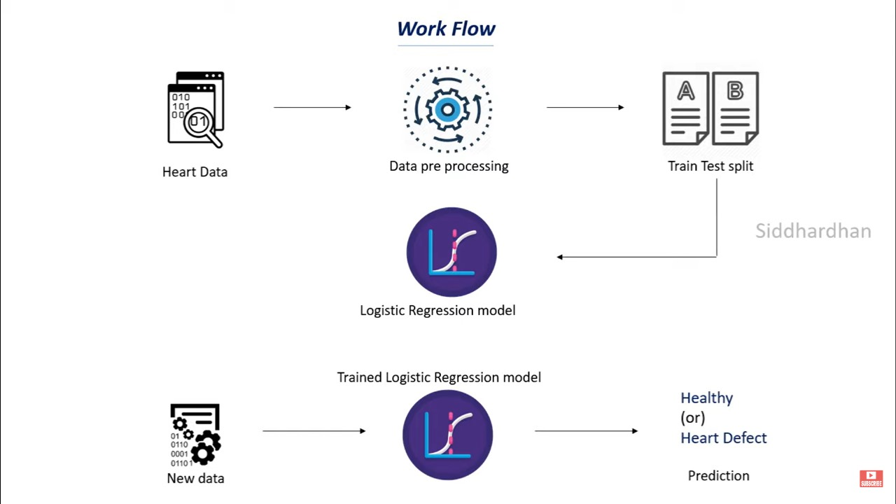

Work Flow
Data Collection: Gather patient data with heart disease risk factors.
Preprocessing: Clean and prepare the data for analysis.
Train-Test Split: Divide the data into training and testing sets.
Logistic Regression: Train a logistic regression model to predict heart disease.
Prediction: Use the model to predict if new data indicates heart disease.

Slide 4
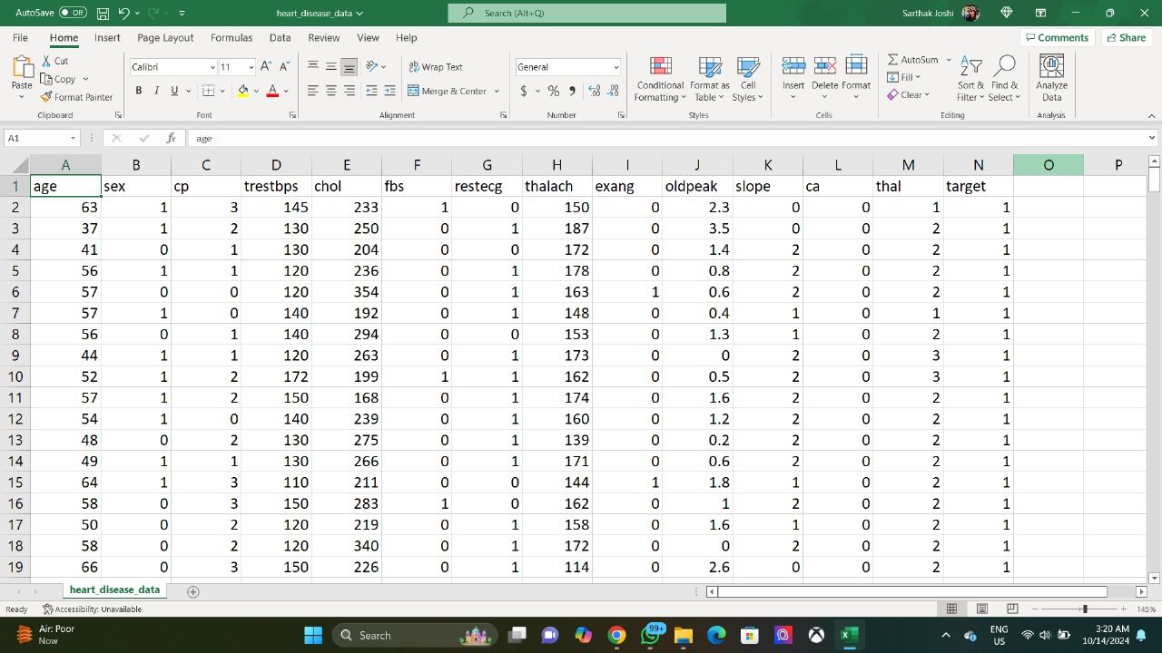
Data Set Image
Columns: The dataset includes key patient features such as age, sex, chest pain type (cp), resting blood pressure (trestbps), cholesterol (chol), maximum heart rate (thalach), and others.
Target Variable: The target column (1 = presence of heart disease, 0 = no heart disease) is used for classification.
Purpose: These features help predict the likelihood of heart disease using logistic regression.

Slide 5
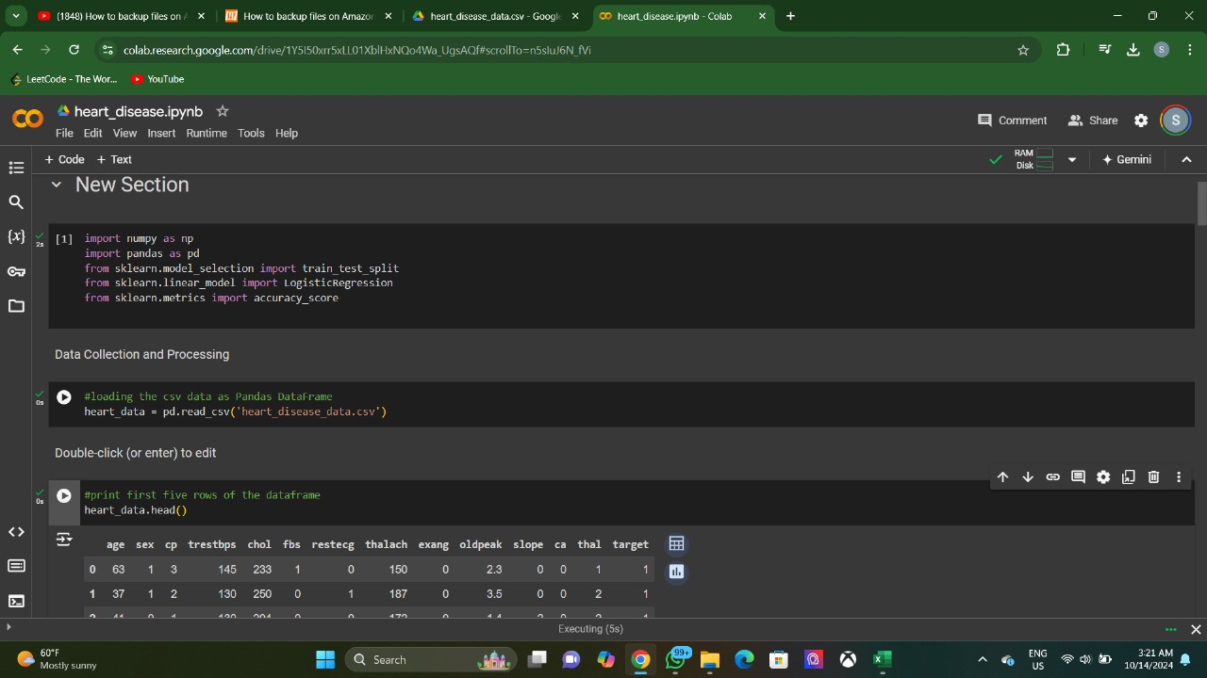
Importing the required libraries
Required Libraries :
Imported essential libraries for data analysis and modeling:
pandas: For data manipulation and analysis.
numpy: For numerical operations.
train_test_split: For splitting the dataset into training and testing sets.
LogisticRegression: For building the logistic regression model.
accuracy_score: For evaluating the model's performance.

Slide 6
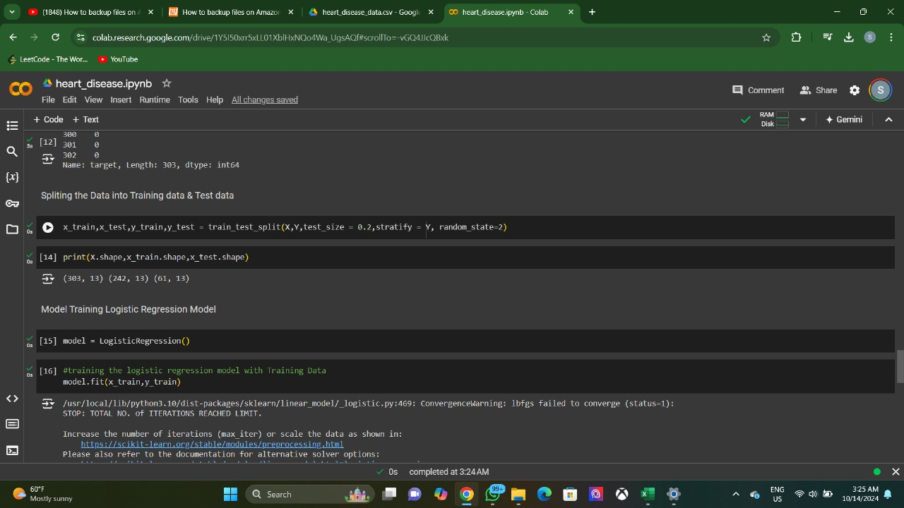
Data Splitting and Training Model
Data Splitting:
Used train_test_split to divide the dataset into:
Training Set: For fitting the logistic regression model.
Testing Set: For evaluating model performance on unseen data.
Training the Model:
Implemented the LogisticRegression algorithm and used model.fit() to train the model on the training dataset, allowing it to learn the relationships between the features and the target variable.

Slide 7
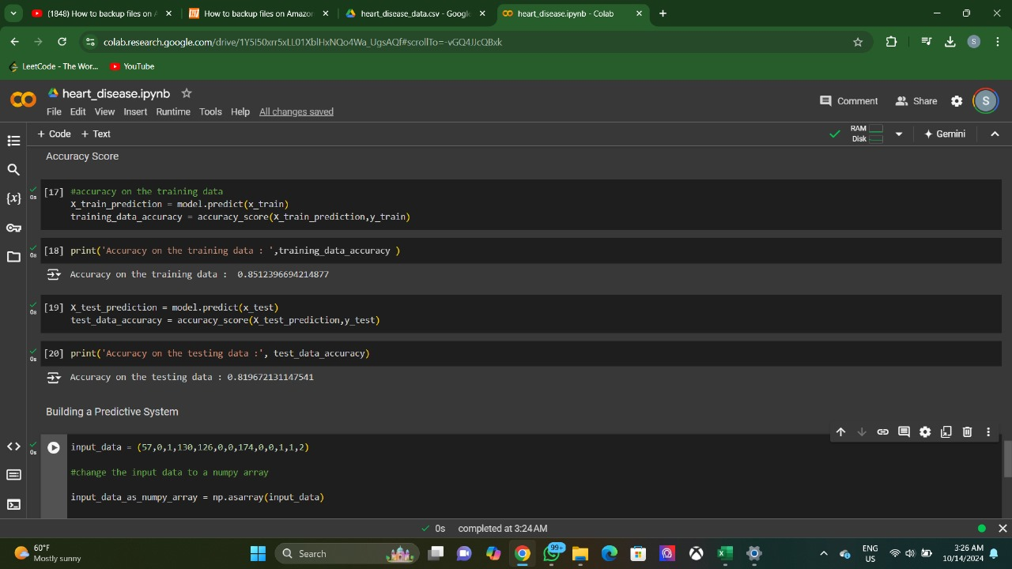
Testing Accuracy
Testing Accuracy:
Evaluated model performance using accuracy_score on both the training and testing datasets:
Training Data Accuracy: Assessed to ensure the model has learned well.
Testing Data Accuracy: Checked to identify overfitting (high training accuracy, low testing accuracy) or underfitting (low accuracy on both).
Using np.asarray:
Converted input data for predictions into a NumPy array format using np.asarray, ensuring compatibility with the model for real-time assessments.
Building the Predictive System:
Developed a system that leverages the trained logistic regression model to predict heart disease risk based on new input data.

Slide 8
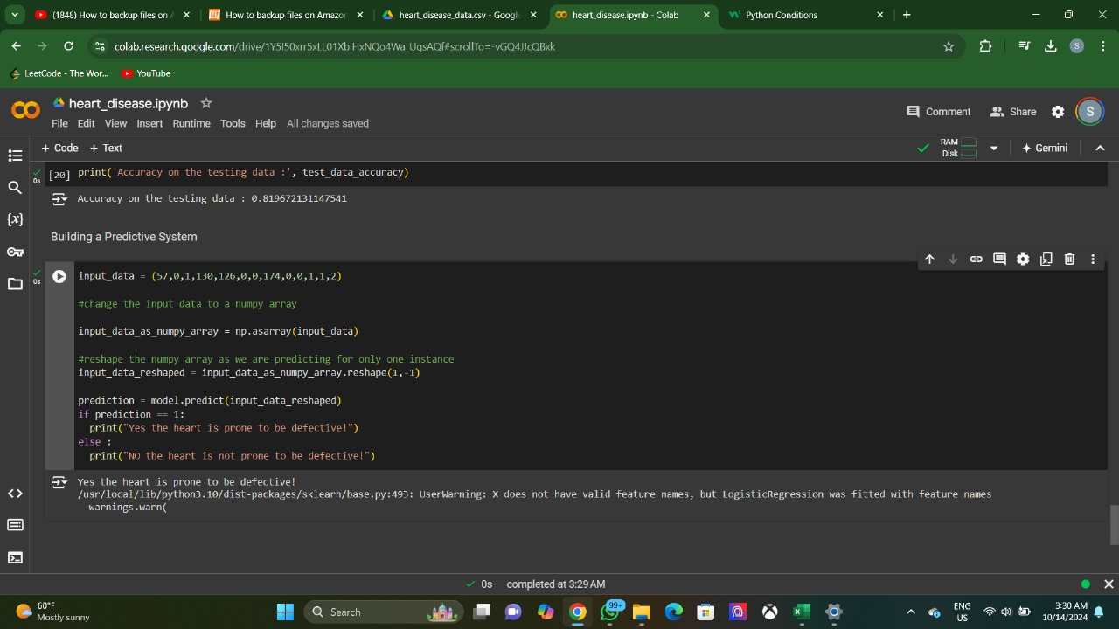
Final Model Output
Final Model Output
Code Functionality:
The model accepts input values for all relevant features (e.g., age, cholesterol, blood pressure, etc.) to predict heart disease.
Output Interpretation:
If the model outputs 1:
“YES, the heart is prone to be defective!”
If the model outputs 0:
“NO, the heart is not prone to be defective!”

Slide 9
Future Innovations
Integration with Wearable Devices: Develop a mobile application that integrates with wearable technology (e.g., smartwatches) to continuously monitor vital signs and update predictions in real-time.
AI-Driven Personalized Health Plans: Utilize machine learning to create tailored health and lifestyle recommendations based on individual risk factors, dietary habits, and exercise patterns.
Incorporation of Genetic Data: Integrate genetic information into the model to improve prediction accuracy and identify individuals at higher risk due to hereditary factors.
Enhanced Data Visualization Tools: Create interactive dashboards for healthcare providers to visualize patient data, model predictions, and trends over time, aiding in better decision-making.

Slide 10
Future Innovations
Natural Language Processing (NLP) for Patient Data: Implement NLP techniques to analyze unstructured patient data from medical records and clinical notes, enriching the dataset for improved model training.
Collaborative Predictive Models: Collaborate with other healthcare institutions to aggregate diverse datasets, improving the robustness and accuracy of the predictive model across populations.
Longitudinal Studies: Conduct long-term studies to track patient outcomes and refine the model based on real-world data, ensuring continuous improvement and relevance.
Real-Time Alerts and Notifications: Develop a system to send alerts to healthcare providers and patients when the model predicts a high risk of heart disease, enabling proactive interventions.

Slide 11
Conclusion
Significance of Early Detection: Heart disease remains a leading cause of mortality worldwide. Effective prediction models can significantly enhance early detection and intervention.
Model Performance: The logistic regression model demonstrated the ability to accurately predict the likelihood of heart disease, providing valuable insights based on patient data.
Impact on Healthcare: Implementing this predictive system can aid healthcare professionals in identifying at-risk patients, allowing for timely preventive measures and personalized care strategies.
Future Directions: By exploring innovations such as real-time monitoring, personalized health plans, and the integration of genetic data, we can enhance the model's accuracy and usability, ultimately improving patient outcomes.
Call to Action: Continued research and collaboration in this field are essential for developing robust predictive systems that contribute to better heart health for individuals and communities.

Slide 12
Thank
you

