Slide 1
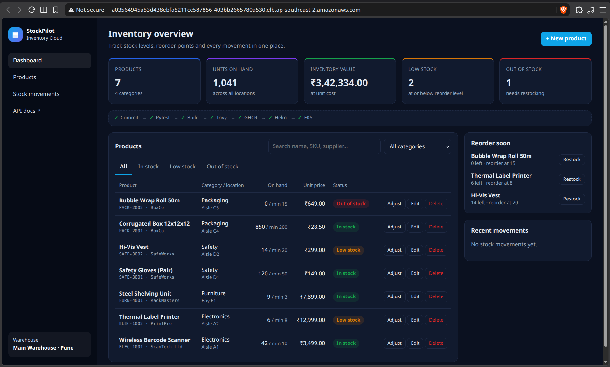
StockPilot
Inventory management, delivered from git push to AWS EKS
DevOps Final Capstone · Sarthak Agarwal · October 2026
FastAPI
React
PostgreSQL
Docker
GitHub Actions
Trivy
Terraform
EKS
Helm
Prometheus
Grafana
Notes:
Hi, I'm Sarthak. My capstone is StockPilot, a small inventory management app for a warehouse. The app itself is simple on purpose; the point of the project is the path it takes from a git push on my laptop to a monitored, autoscaling Kubernetes deployment on AWS. The screenshot on the right is the real app, served from my EKS cluster through an AWS load balancer. The chips list every tool in the delivery chain, and I'll walk through them in that order.

Slide 2
What StockPilot does
1
Product catalog
Every product has a SKU, supplier, warehouse location, unit price and a reorder level.
2
Audited stock movements
Stock only changes through movements: restock, sale, return, damaged or correction. Removing more than is on hand is rejected with HTTP 409.
3
Reorder insight
Live KPIs for inventory value, low-stock and out-of-stock items, plus a 'reorder soon' list and a movement feed.
Running on AWS EKS behind the ingress-nginx load balancer
Notes:
The domain is inventory. Products carry the usual fields. The key design decision is that quantity can't be edited directly: every change goes through an adjustment that is stored as a stock movement with a reason, so there is a full audit trail. The API refuses to take stock below zero and returns 409. The dashboard computes inventory value, low and out-of-stock counts, and shows what needs reordering.

Slide 3
Architecture: from git push to a monitored cluster
Developer
git push
GitHub
main branch
GitHub Actions
pytest · build · Trivy
GHCR
images tagged :sha
Helm
upgrade --install
Terraform
provisions VPC + EKS
AWS ap-southeast-2 · VPC 10.30.0.0/16
EKS cluster · Kubernetes 1.34 · namespace stockpilot
2 public subnets
load balancers · NAT gateway
Frontend
React + nginx · 2 pods
Prometheus → Grafana
ServiceMonitor scrapes /metrics
/
AWS NLB
→ ingress-nginx
2 private subnets
worker nodes, 2 AZs
Backend
FastAPI · 2–6 pods (HPA)
PostgreSQL 16
StatefulSet · 10 GiB gp3 EBS
/api
Node group
2× c7i-flex.large
Notes:
Top row is the delivery path: I push to GitHub, GitHub Actions tests, builds and scans, pushes images to GitHub Container Registry tagged with the commit SHA, then Helm rolls them out. Terraform, in purple, builds everything AWS-side: a VPC with public subnets for load balancers and private subnets for nodes, and the EKS cluster. Inside the cluster an AWS Network Load Balancer feeds ingress-nginx, which routes slash to the React frontend and slash-api to the FastAPI backend. The backend talks to PostgreSQL running as a StatefulSet on an encrypted EBS volume, and Prometheus scrapes the backend's metrics for Grafana.

Slide 4
Application layer
11
2
15
REST endpoints, including /health, /ready and /metrics
tables (products, stock_movements) managed by 3 Alembic migrations
pytest tests on an isolated in-memory SQLite database
Stack
API
FastAPI + Pydantic, SQLAlchemy 2, Alembic
PostgreSQL 16
React 19 + Vite, responsive CSS with dark mode
Both images run as non-root users
GET /health · /ready · /metrics
GET /api/products?search=&stock_status=
GET /api/products/stats
GET /api/products/{id}
POST /api/products
PUT /api/products/{id}
DELETE /api/products/{id}
POST /api/products/{id}/adjust
GET /api/movements
Notes:
Some numbers about the app. Eleven endpoints: the CRUD ones, the stock adjust endpoint, stats and movements, plus the three operational ones Kubernetes and Prometheus use. Health is a cheap liveness check, ready actually queries the database, and metrics is for Prometheus. The schema is two tables, created by Alembic migrations; a third migration seeds demo data. There are fifteen tests, and they run against an in-memory SQLite database through a dependency override, so they never touch the real database.

Slide 5
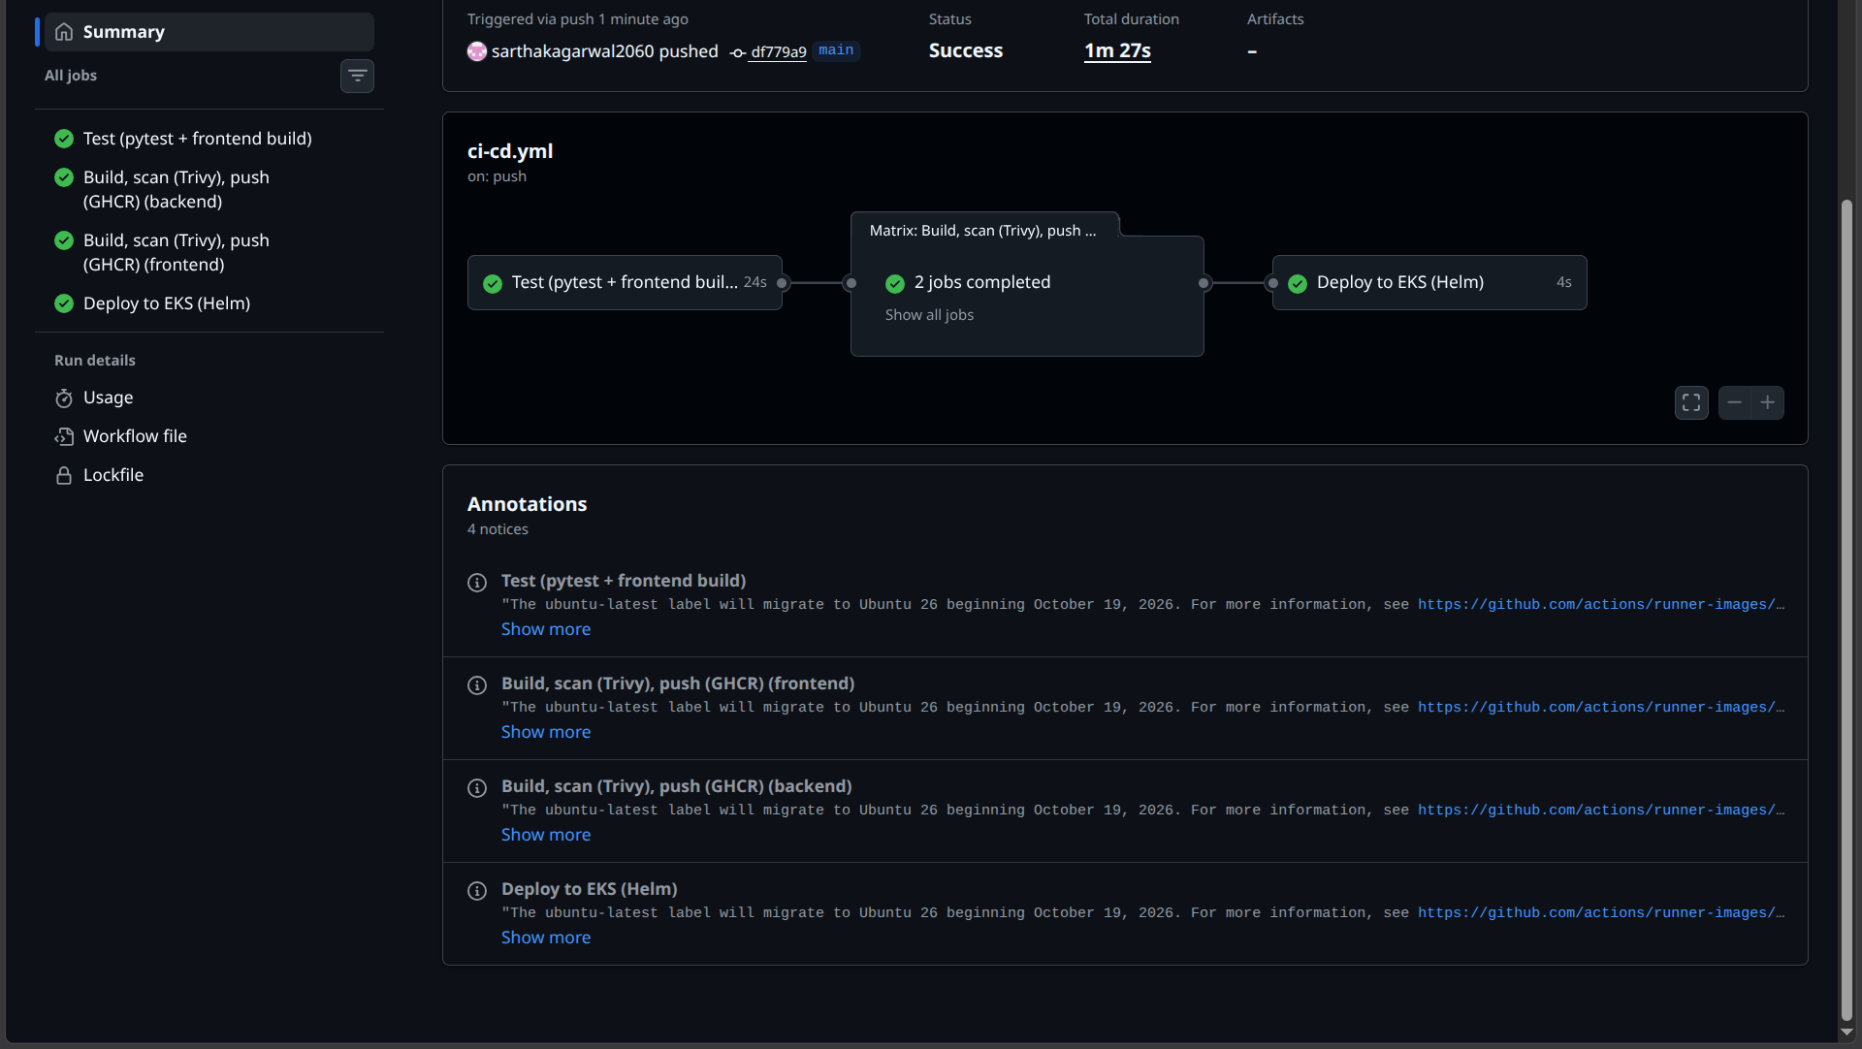
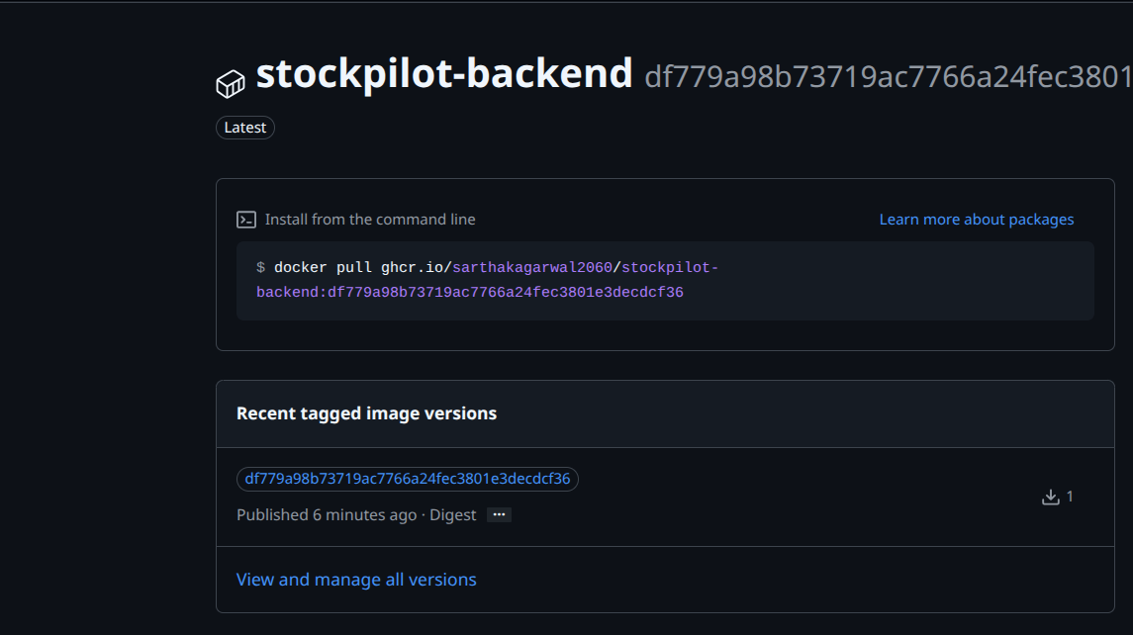
CI/CD: every push is tested, scanned and traceable
Test
pytest + frontend build
Build
2 images, tag = SHA
Scan
Trivy HIGH/CRITICAL
Push
to GHCR
Deploy
helm upgrade on EKS
A failing test stops the run before any image is built
Image tag = git commit SHA, never 'latest', so every pod traces back to its commit
Notes:
The GitHub Actions workflow has three stages. The test job runs pytest and builds the frontend; if a test fails, nothing else runs, so broken code never becomes an image. Then a matrix job builds the backend and frontend images, tags them with the commit SHA, scans them with Trivy and pushes to GHCR. On the right you can see the backend package with the full SHA as its tag. The last job deploys with Helm. Using the SHA instead of latest means I can always tell exactly which commit is running in production.

Slide 6
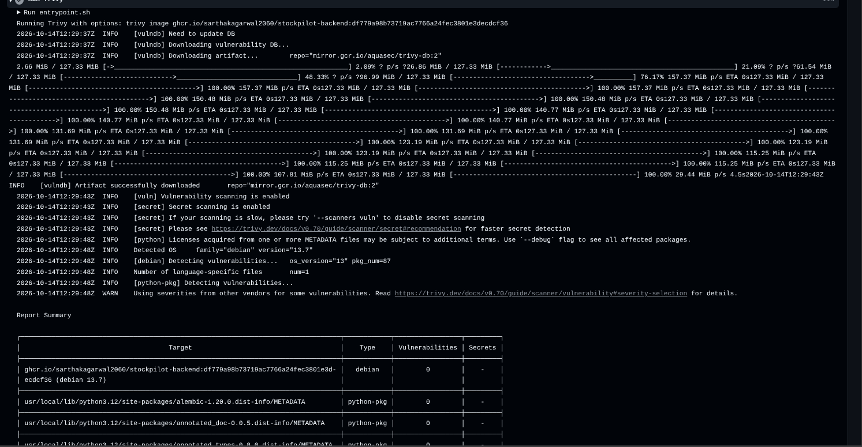
DevSecOps: Trivy blocks known, fixable CVEs
47 → 0
HIGH vulnerabilities across both images
43 HIGH in the nginx Alpine base → newer base image + apk upgrade
4 HIGH in libraries vendored inside pip → pip removed from the runtime image
Pipeline fails on any fixable HIGH or CRITICAL
Trivy action pinned to a commit SHA (tags can be hijacked)
Containers run as non-root with all capabilities dropped
Trivy report for stockpilot-backend:<sha>: Debian 13.7 and every Python package at 0
Notes:
Trivy scans every image for known CVEs in the OS packages and the application libraries, and the pipeline fails on any HIGH or CRITICAL issue that has a fix. My first images failed: 43 HIGH findings in the nginx Alpine base, and 4 in libraries that pip vendors internally. I fixed the first with a newer base plus apk upgrade, and the second by uninstalling pip from the runtime image, since it's only needed at build time. Now both images scan clean. I also pinned the Trivy action itself to a commit SHA, because release tags can be moved by an attacker. A clean scan doesn't prove an image is secure; it's one layer among several.

Slide 7
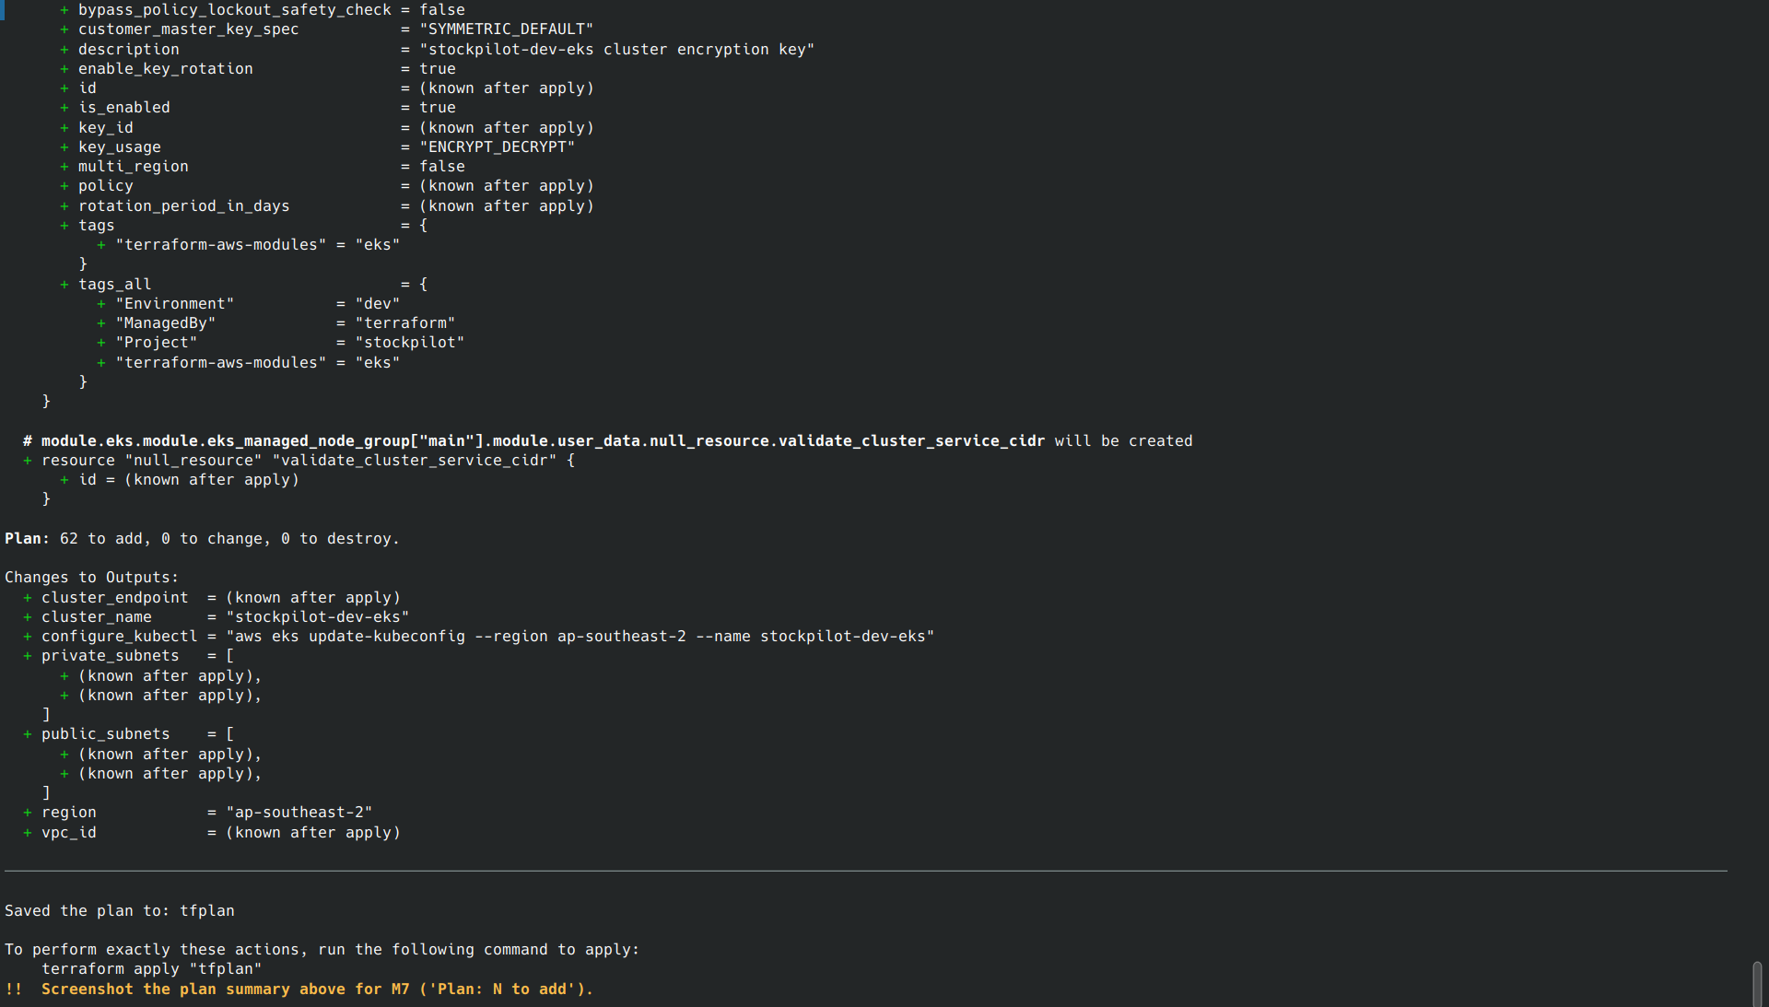
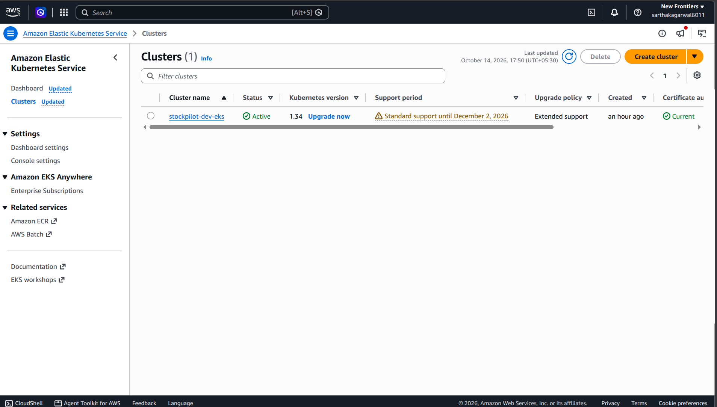
Infrastructure as Code with Terraform
62
AWS resources from one terraform apply
VPC 10.30.0.0/16 across 2 AZs, 2 public + 2 private subnets, single NAT gateway
EKS 1.34 with a managed node group of 2× c7i-flex.large (AL2023)
Add-ons: vpc-cni, coredns, kube-proxy, metrics-server, EBS CSI via Pod Identity
No credentials in the repo; terraform destroy removes everything
terraform plan: Plan: 62 to add, 0 to change, 0 to destroy
EKS console: stockpilot-dev-eks Active, Kubernetes 1.34
Notes:
Kubernetes runs workloads but doesn't create its own network, so Terraform builds that. One apply creates 62 resources: the VPC, subnets in two availability zones, a single NAT gateway to keep costs down, the EKS cluster, a managed node group and the cluster add-ons. The EBS CSI driver gets its AWS permissions through EKS Pod Identity, so no static keys exist anywhere. Instead of clicking through the console, the whole environment is described in code, and terraform destroy removes it cleanly afterwards.

Slide 8
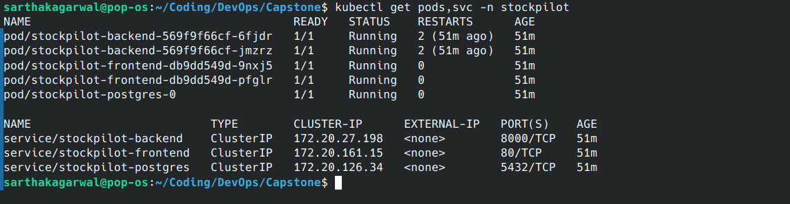
Kubernetes + Helm: one chart, one release
Deployments
StatefulSet
backend + frontend, 2 replicas
PostgreSQL, 10 GiB gp3 PVC
Services
Ingress
ClusterIP for all three tiers
/ → frontend, /api → backend
kubectl get pods,svc: 5 pods Running, 3 ClusterIP services
HPA + PDBs
Secret
2–6 backend pods, 1 always up
generated DB password
helm list + ingress: release deployed behind the AWS load balancer
helm upgrade --install with the commit SHA as image tag
helm rollback returns to any previous revision
Probes
Monitoring
startup, /health, /ready
ServiceMonitor + dashboard
Notes:
Everything in the cluster comes from one Helm chart. It creates the backend and frontend deployments, Postgres as a StatefulSet with its own volume, ClusterIP services, the ingress routes, the autoscaler and disruption budgets, a database secret with a generated password that survives upgrades, and the monitoring objects. Each pod has three probes: startup gives migrations time, liveness hits health, readiness hits ready, which checks the database. CI deploys a new release with helm upgrade, and helm rollback gets me back to any earlier revision.

Slide 9
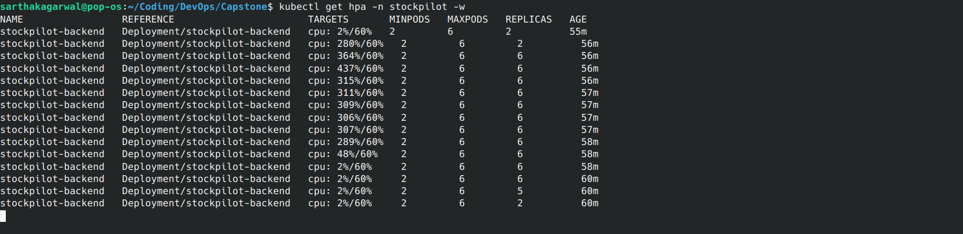
Autoscaling under load
2 → 6
437%
→ 2
backend pods within a minute
peak CPU vs a 60% target
scaled back in after the load stopped
Notes:
To demo the Horizontal Pod Autoscaler I ran a load generator inside the cluster. CPU went to 437 percent of the request, way above the 60 percent target, and the HPA took the backend from 2 to its maximum of 6 pods. When I stopped the load, CPU dropped to 2 percent and after the two-minute scale-down window it went back to 2 pods. The HPA needs CPU requests on the pods and metrics-server; getting metrics-server reachable was one of the problems I'll show in a minute.

Slide 10
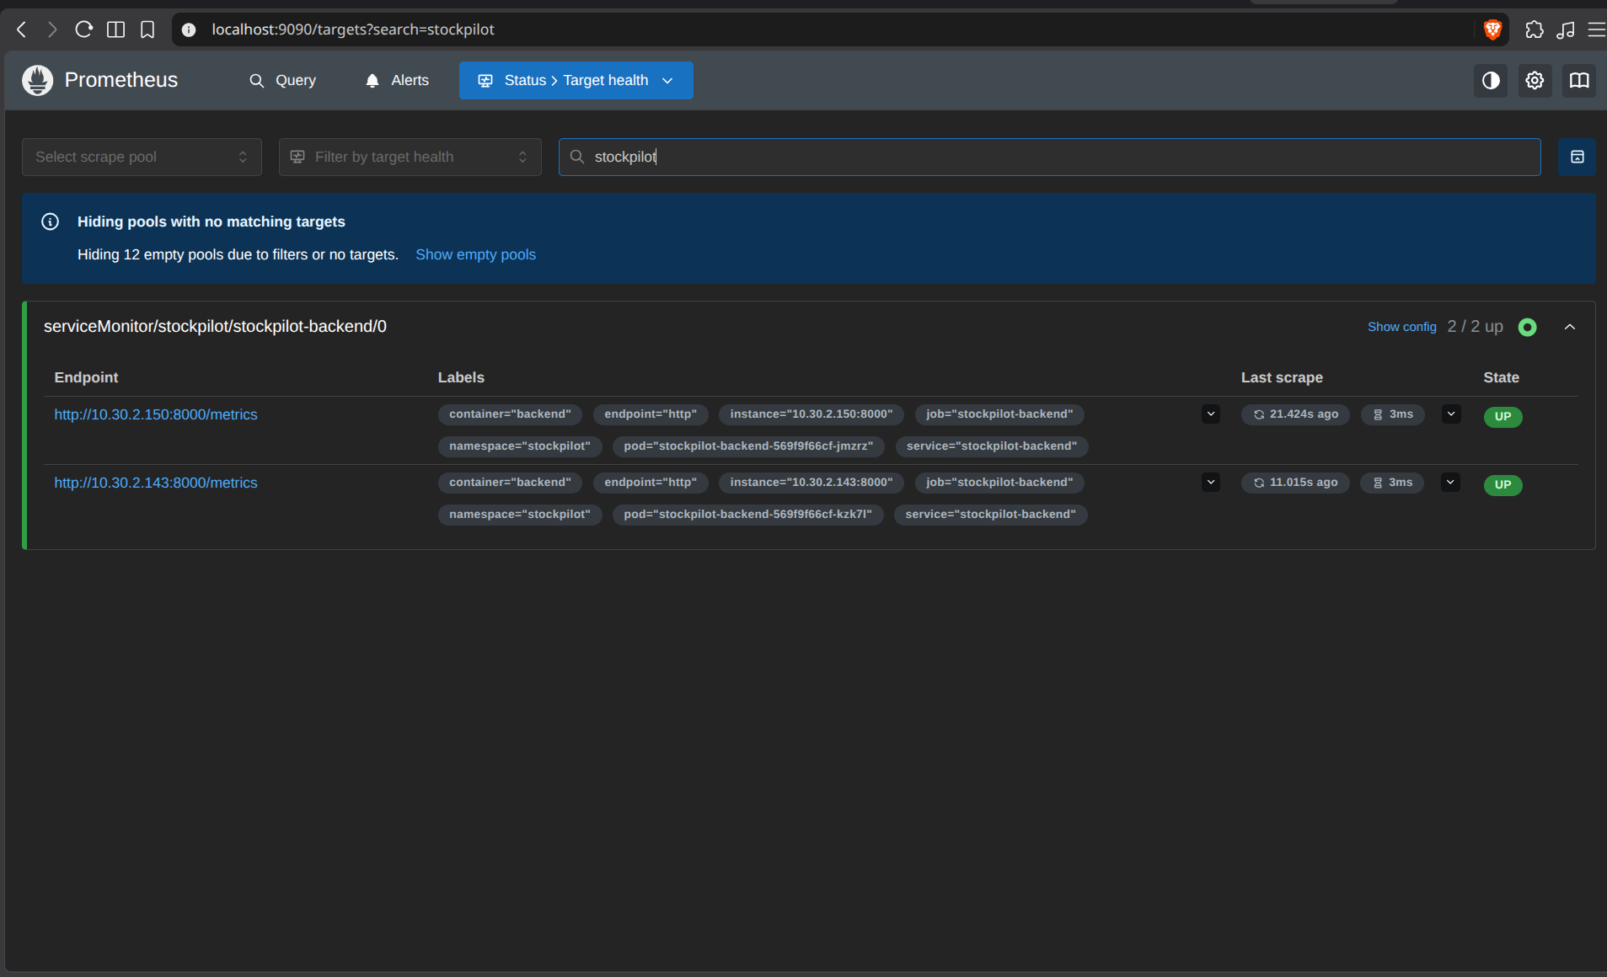
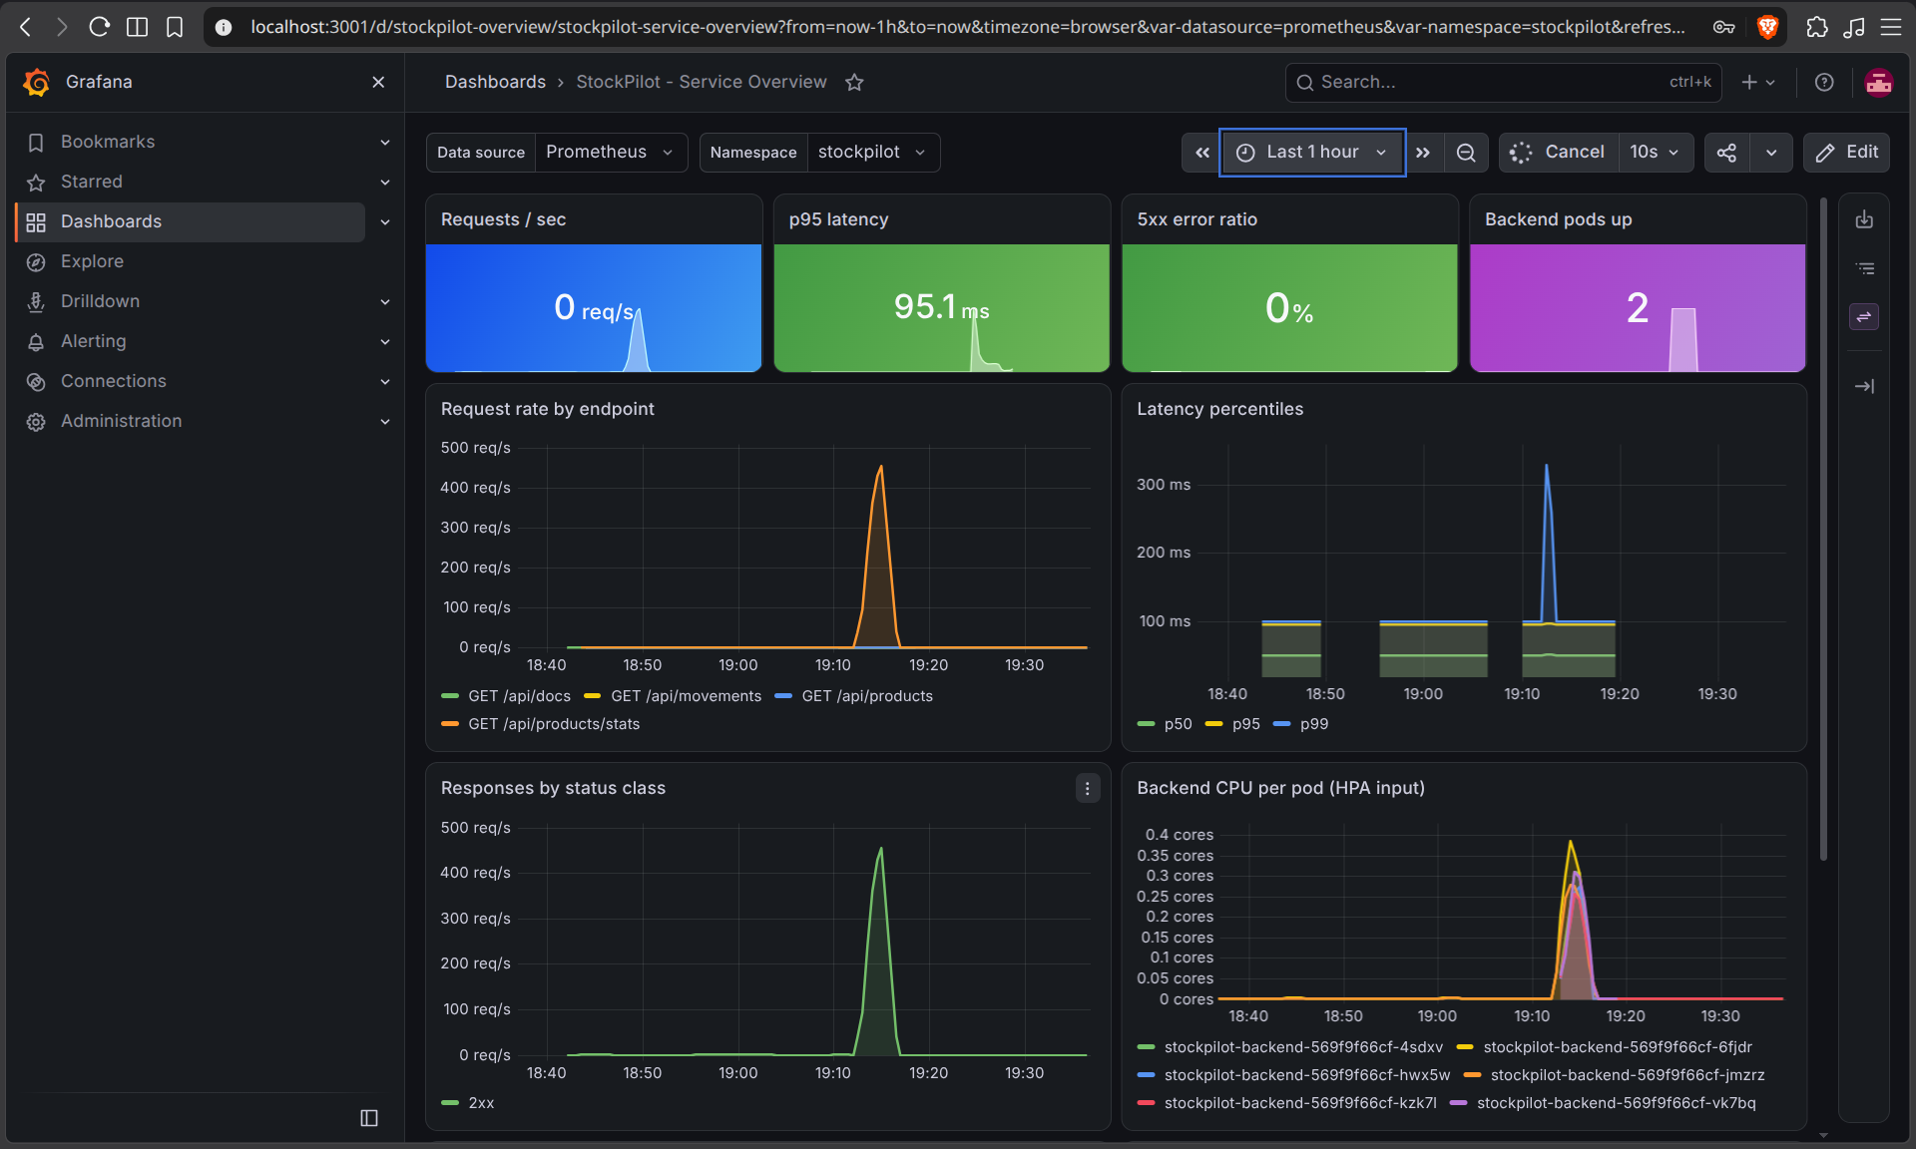
Observability: Prometheus + Grafana
Prometheus: serviceMonitor/stockpilot-backend 2/2 UP
Grafana: ~450 req/s spike, p95 latency, 0% 5xx, CPU per pod
Backend exposes /metrics: request rate, latency histograms, status codes
Custom business counters: stock adjustments by reason, units moved in/out
Dashboard ships in the Helm chart, so Grafana loads it automatically
Notes:
The backend exposes Prometheus metrics through the FastAPI instrumentator: request counts, latency histograms and status codes, plus two business counters I added, adjustments by reason and units moved. A ServiceMonitor in the chart tells Prometheus to scrape every backend pod; both targets show UP. The Grafana dashboard is also part of the chart, so it appears automatically. You can see the load test: about 450 requests per second, p95 latency, zero server errors, and the CPU of each of the six pods during the scale-out.

Slide 11
Real-world problems I hit and fixed
Symptom | Root cause | Fix
Every region but one denied (SCP) | AWS Free-plan accounts are locked to their home region | Moved to ap-southeast-2
Worker nodes never launched | t3.medium is not Free Tier eligible | c7i-flex.large (eligible, same size)
IAM OIDC provider denied | Free plan blocks it; module enables IRSA by default | Disabled IRSA, used EKS Pod Identity
~50% of requests timed out | Nodes only allowed ports 1025–65535; ingress-nginx is on :80 on the other node | Allow all node-to-node traffic
HPA showed cpu <unknown> | Control plane could not reach metrics-server on :10251 | Security group rule in Terraform
Backend restarted twice at start | Started before Postgres was ready | Probes + restarts self-heal; documented
All fixes live in code (Terraform and Dockerfiles), not console clicks
Notes:
This is the part I learned most from. My AWS account is on the new Free plan, which uses service control policies. First, every region except my home region was denied, so I moved to Sydney. Then the node group hung because t3.medium isn't Free Tier eligible; c7i-flex.large is, with the same CPU and memory. The EKS module creates an IAM OIDC provider for IRSA, which the plan blocks, so I switched to EKS Pod Identity. After deploying, half the requests timed out: the load balancer can land on a node whose nginx pod is on the other node, and node-to-node port 80 wasn't allowed. And the HPA had no metrics because the control plane couldn't reach metrics-server on 10251. Every fix went into Terraform, so the environment is reproducible.

Slide 12
Troubleshooting lab: five broken manifests
1
ImagePullBackOff
2
Service has no endpoints
3
CrashLoopBackOff
Image tag does not exist
Selector matches no Pod labels
Wrong database host in DATABASE_URL
kubectl describe pod → Events
kubectl get endpointslices
kubectl logs --previous
4
Running but 0/1 Ready
5
Pending forever
Workflow
get pods → describe → logs → events → fix → re-apply
Readiness probe path returns 404
Requests more CPU than any node has
kubectl describe pod → probe failures
describe → Insufficient cpu
Notes:
The repo includes a troubleshooting lab with five deliberately broken manifests, each with a different symptom. For each, I start with kubectl get pods, then describe to read the events, logs with --previous for a crashed container, and endpointslices plus show-labels for service problems. Live, I can break the image tag or a service selector and walk through finding the cause.

Slide 13
Demo & links
✓
Tested
✓
Scanned
Thank you
✓
Containerised
✓
Provisioned as code
Source code
https://github.com/sarthakagarwal2060/stockpilot
Demo video: Google Drive link in README.md
✓
Autoscaled
✓
Monitored
Notes:
To sum up: StockPilot is tested on every push, scanned for vulnerabilities, containerised, runs on infrastructure defined as code, scales itself under load and is fully monitored. The code is on GitHub at the link shown, and the README links to the recorded demo video, where I commit a change and watch it go through the pipeline to the live cluster. Thank you, I'm happy to take questions.

