Slide 1

Title: Solving Modern IT Challenges with Cloud Computing
ThePhoto by PhotoAuthor is licensed under CCYYSA.

Slide 2
Modern IT Challenges Facing Organizations:
Today’s organizations face a complex array of IT challenges, including:
Managing rapidly growing volumes of data
Ensuring the security and privacy of digital assets
Supporting global business operations and remote workforces
Scaling infrastructure quickly as business needs change
Controlling costs and improving operational efficiency
These challenges often strain conventional IT infrastructure, leading to inefficiencies and bottlenecks.

Slide 3
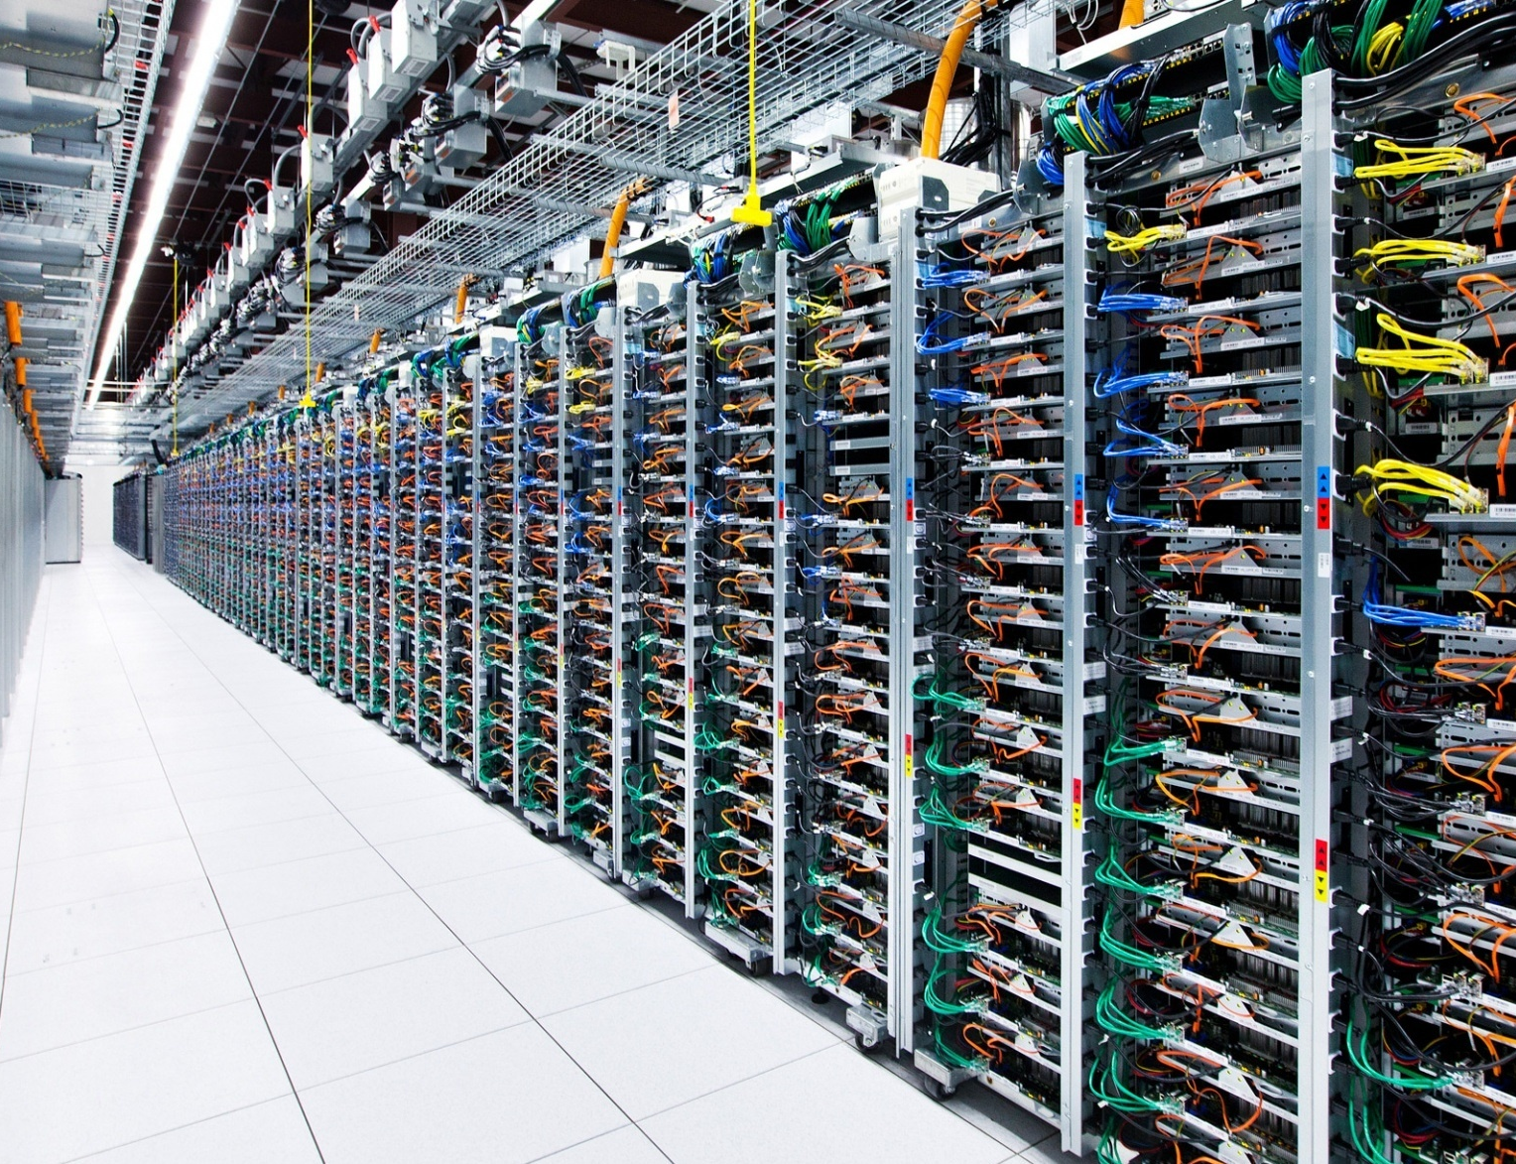
Impact of IT Challenges on Infrastructure & Business
These modern IT issues have significant consequences:
Outdated hardware and limited scalability slow down innovation.
High upfront costs for servers, storage, and networking restrict flexibility.
IT teams must devote excessive time to maintenance, leaving less for strategic growth.
Cyber threats and compliance requirements increase risk.
Rapid changes in demand can overwhelm traditional infrastructure, resulting in downtime or higher expenses.

Slide 4

What Is Cloud Computing?
Cloud computing delivers computing resources—such as servers, storage, and software—over the internet, allowing businesses to rent services instead of building and maintaining their own IT infrastructure. This model is cost-effective, scalable, and flexible, helping organizations:​
Scale resources instantly to match their needs
Reduce upfront investments and ongoing maintenance
Access services securely from anywhere, on any device
Cloud computing underpins faster innovation, remote collaboration, and efficiency for modern organizations. Cloud computing is a technology that provides access to IT resources like servers, storage, databases, and software over the internet instead of relying on local infrastructure. Organizations only pay for what they use and can easily scale services up or down to meet demand. This approach improves flexibility, efficiency, and collaboration while reducing costs and maintenance for businesses.​

Slide 5
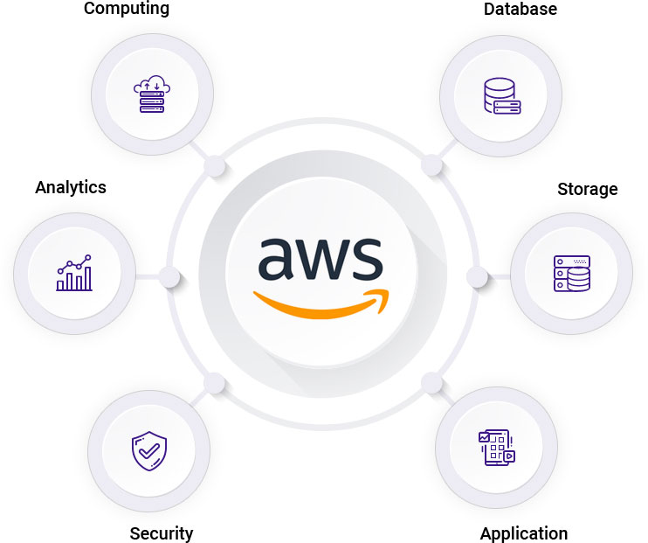
AWS and Its Cloud Services
Amazon Web Services (AWS) is the world’s largest and most popular cloud platform, powering
Businesses of all sizes with secure, scalable, and flexible IT solutions.
Compute: AWS EC2 provides virtual servers (instances) for a wide range of workloads, while Lambda enables serverless computing, letting you run code without managing servers.
Storage: Amazon S3 offers scalable object storage for files and data; EBS provides block storage for use with
EC2 instances. AWS ensures data protection through automated backups and disaster recovery.
Databases: AWS supports both relational (RDS) and NoSQL (DynamoDB) databases, delivering high availability and automated scaling.
Networking: Virtual Private Cloud (VPC) allows you to isolate and control your cloud resources; CloudFront accelerates content delivery globally via edge locations.
Security & Identity: Identity and Access Management (IAM) lets organizations manage and restrict access; Key Management Service (KMS) safeguards encryption keys and confidential data.
Machine Learning & AI: SageMaker powers machine learning model development, while services like Rekognition (image/video analysis) and Comprehend (text analysis) enable easy adoption of AI.
AWS has a global network of data centers, providing high reliability, strong security, and pay-as-you-go pricing, making it a top choice for cloud adoption and innovation.

Slide 6
How Cloud Computing Helps Solve IT Challenges
Cloud computing directly addresses key IT problems:
Scalability: Instantly add or remove resources as needs change
Cost Efficiency: Pay only for what you use; no hardware investments
Remote Access & Flexibility: Collaborate from anywhere with secure access
Disaster Recovery & Backup: Faster recovery from outages or data loss
Security: Advanced security, compliance, monitoring, and threat detection
By leveraging these features, companies become more agile and resilient.

Slide 7

Examples of Cloud Solutions in Practice
E-commerce: Online retailers use the cloud to handle fluctuating website traffic during sales events.
Startups: Launch products quickly without buying servers or hiring specialized IT staff.
Remote Work: Teams collaborate on shared documents and projects from anywhere.
Healthcare: Hospitals store and analyze patient data securely with cloud-based tools.
Finance: Banks process millions of transactions daily with scalable, secure infrastructure.
These real-world cases show how cloud computing is transforming industries.

Slide 8
Key Benefits & Takeaways
Cloud computing enables organizations to:
Be more agile, innovate faster, and adapt to changing needs
Reduce costs and avoid large capital expenditures
Improve security, compliance, and disaster recovery capabilities
Unlock new opportunities through scalable, collaborative platforms
In summary, cloud computing is the foundation for solving modern IT challenges.

Slide 9
Thank You!
We appreciate your attention.
Questions & Answers
Feel free to ask any questions or share your thoughts!

