Slide 1
Visualization Charts in Power Bi

Slide 2
What is Power BI?
A business intelligence (BI) tool by Microsoft
Helps in data visualization, reporting, and analytics
Connects to various data sources for insights
Key Features of Power BI
Interactive dashboards & reports
Multiple data source connectivity
AI-powered insights
Custom visualizations
• Integration with Excel, Azure, and other tools

Slide 3
What is Power BI?
Components of Power BI
Power BI Desktop: Report creation tool
Power BI Service: Cloud-based sharing platform
Power BI Mobile: On-the-go access to reports
Power Query: Data transformation tool
Power Pivot: Data modeling engine
Importance of Power BI
Enables data-driven decision-making
Helps in real-time reporting & monitoring
User-friendly with drag-and-drop features
• Cost-effective for businesses
Secure data handling & governance

Slide 4
Industries using Power BI
Finance & Banking
Healthcare
Retail & E-commerce
Manufacturing
IT & Telecom
Career Opportunities in Power BI
Power BI Developer
Data Analyst
BI Consultant
Data Scientist
Business Intelligence Engineer

Slide 5
Required Skills for Power BI
Data modeling & visualization
DAX (Data Analysis Expressions)
SQL & database knowledge
Power Query (ETL process)
Integration with cloud platforms
Salary & Job Trends
Power BI professionals are in high demand
Competitive salaries globally
Growing adoption in organizations of all sizes

Slide 6
Conclusion
Power BI is a powerful tool for data-driven insights
High demand in various industries
Great career opportunities with lucrative salaries

Slide 7
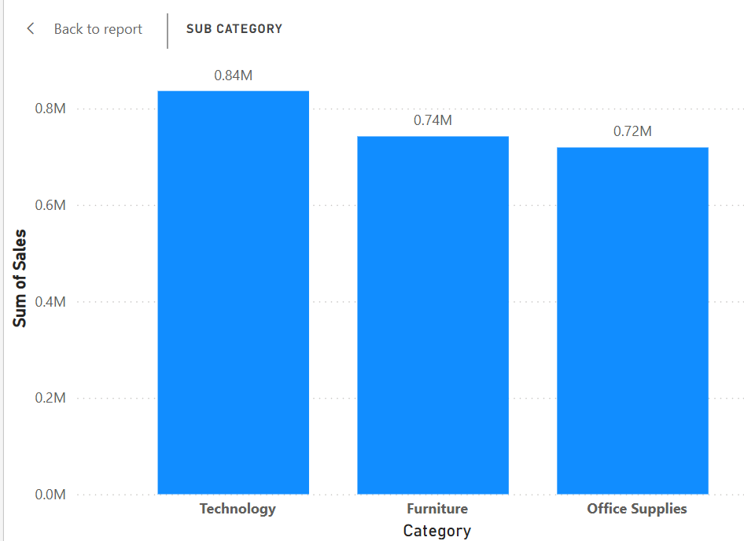
Bar Chart
A bar chart (aka bar graph, column chart) plots numeric values for levels of a categorical feature as bars. Levels are plotted on one chart axis, and values are plotted on the other axis.

Slide 8
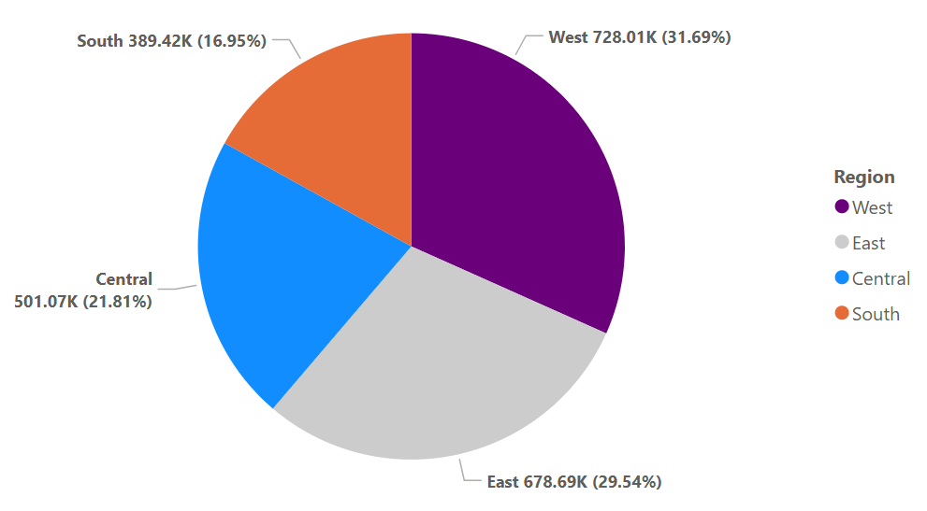
Pie Chart
In Power BI, a pie chart is a visualization tool used to represent data as a circular chart divided into slices, where each slice corresponds to a category’s proportion of the whole dataset. It helps in understanding percentage distributions and comparing parts of a whole

Slide 9
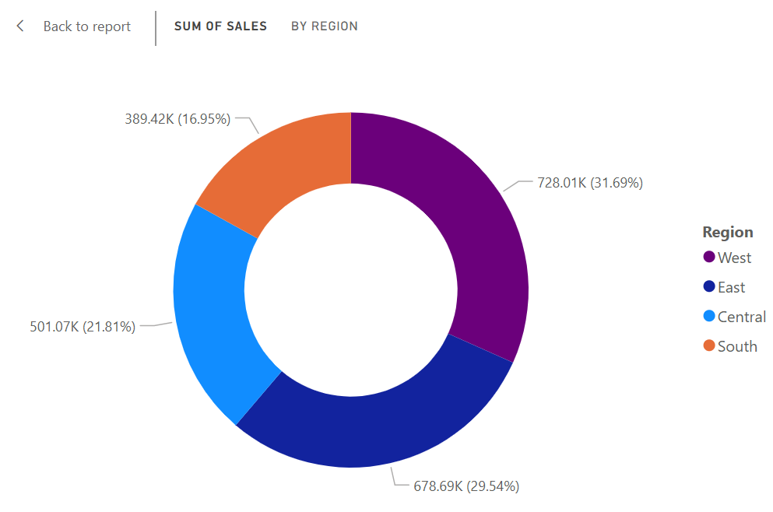
Donut Chart
A Donut Chart in Power BI is similar to a Pie Chart, but with a hollow center, making it visually distinct. It is used to represent proportions of a whole, just like a pie chart, but with additional space in the middle, which can be used for labels or KPIs

Slide 10
Waterfall Chart
Waterfall charts are essentially Bar charts that show a series of profits and losses for a specified time period, with a summary bar showing the amount remaining at the end of the time period. Profits appear as green bars, losses appear as red bars, and start and summary bars appear as blue bars.

Slide 11
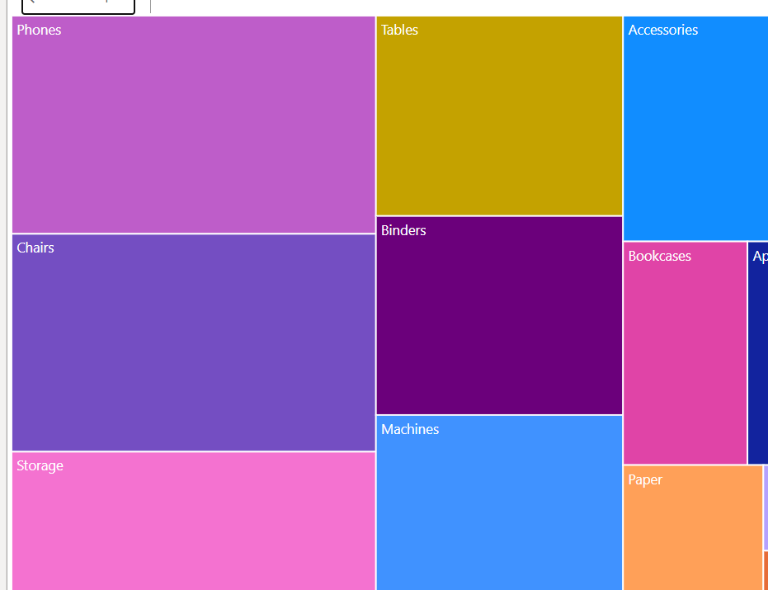
Treemap Chart
TreeMap in Power BI is the hierarchical chart, which is used to show the parent and child data distribution. TreeMap is shown by a group of rectangles, these rectangles are segregated on the basis of the category. The larger numeric values are present at the top, and lower numeric values are present at the bottom.

Slide 12
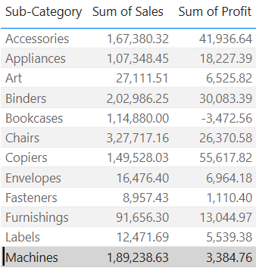
Table and matrix
Table visualization is just a normal grid containing related data in rows and columns. It can have headers and only rows. Users can create tables in reports and cross highlight elements within the table. They can also select individual cells, rows, and columns.

Slide 13
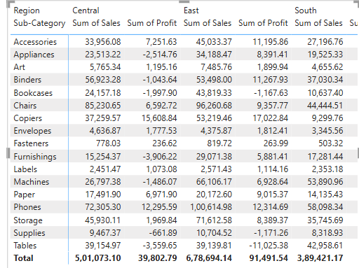
Matrix
Matrix visualization is very similar to table visualization. In table visualization, data is present in a two-dimensional format. But Matrix visualization can display data in multiple dimensions
The Matrix aggregates the data itself and lets users drill down.

Slide 14
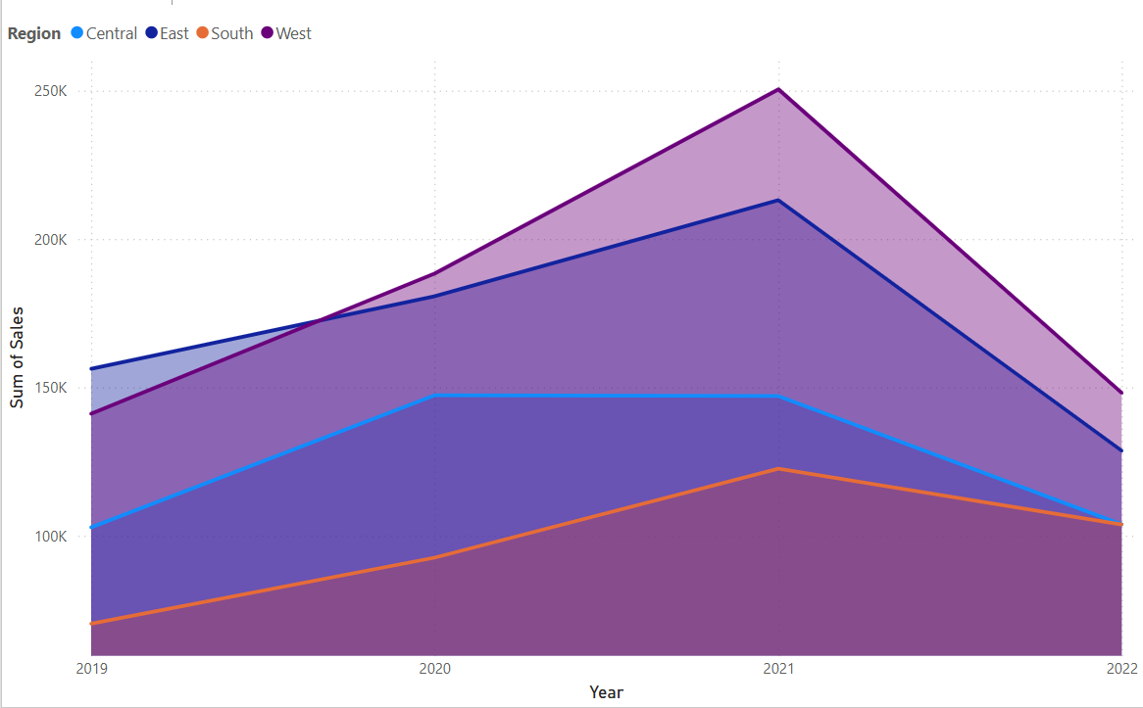
Area Chart
The basic area chart (also known as layered area chart) is based on the line chart. The area between axis and line is filled with colors to indicate volume.

Slide 15
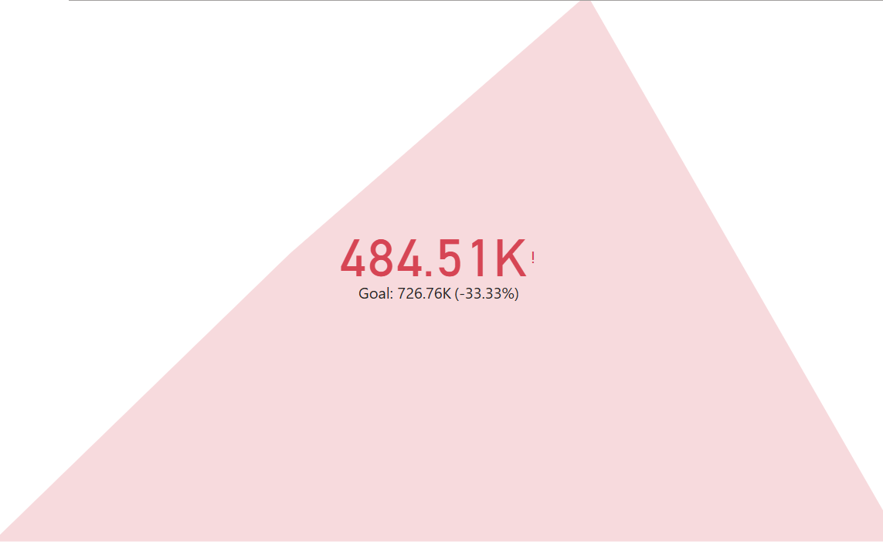
KPI Chart
The KPIs evaluate an association’s performance in different areas by assessing quantifiable measure values. In businesses, KPIs play an essential part as visual cues that indicate growth by assessing values and measurable pretensions. A KPI always has a base value or measure which is estimated against a target value. That is, comparing the factual performance with the target set. You can estimate the performances in an analysis just by seeing the KPIs.

Slide 16
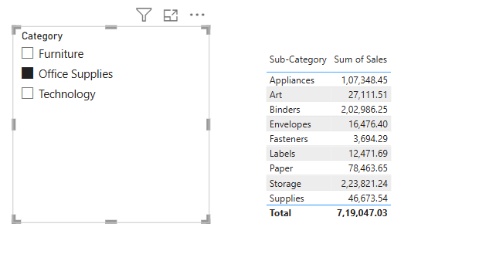
Slicers
Slicers are the interactive filters used to format and analyze the parts of the data more effectively. We can create a slicer easily with 4 steps, as shown in the later stage of the article. We have various options to format slicers, we can change the value of the alt text, title, etc. We can also add various options like slicer headings, hierarchy distribution, and multi-select slicers.

Slide 17
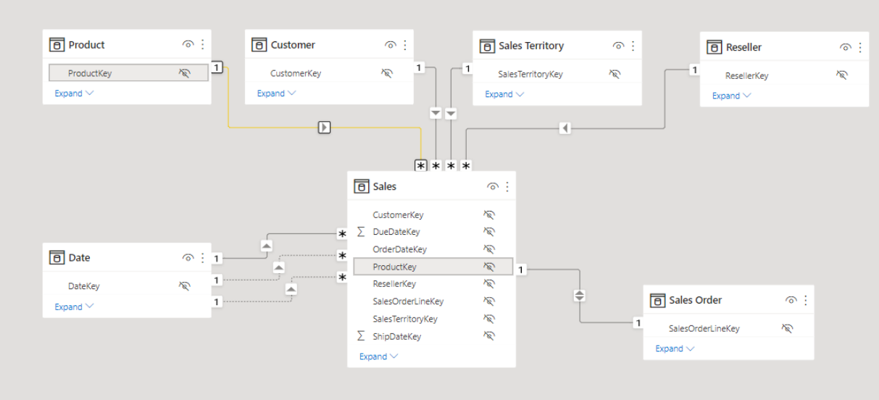
Data model
A data model in Power BI is a logical representation of data structure and relationships. It's a collection of tables and relationships between them.

Slide 18
Importance of Data Model
Defining Tables and Columns:
Identifying the relevant data elements and structuring them into tables with appropriate columns.
Establishing Relationships:
Creating connections between tables based on shared key values to enable data analysis across different datasets.
Data Types:
Assigning appropriate data types to columns for accurate calculations and visualizations.
Measures and Calculations:
Defining custom metrics and calculations based on the data model to answer specific business questions.

Slide 19
Importance of Data Model
Key benefits of a well-designed data model in Power BI:
Improved Accuracy:
By establishing clear relationships between data points, a data model minimizes data redundancy and errors, leading to more accurate reports and insights.
Enhanced Performance:
A properly structured data model optimizes query performance by reducing unnecessary calculations and data retrieval, allowing for faster analysis.
Clarity and Understanding:
A visual representation of the data model helps users easily grasp the structure of the data and how different elements are connected, facilitating better interpretation of results.

Slide 20
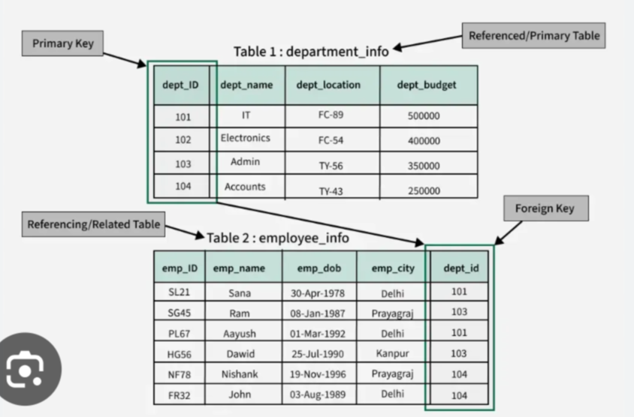
Primary and foreign key
A column or set of columns that uniquely identifies each row in a table
A column or set of columns that references the primary key of another table

Slide 21
Primary and foreign key
A column or set of columns that uniquely identifies each row in a table
A column or set of columns that references the primary key of another table

Slide 22
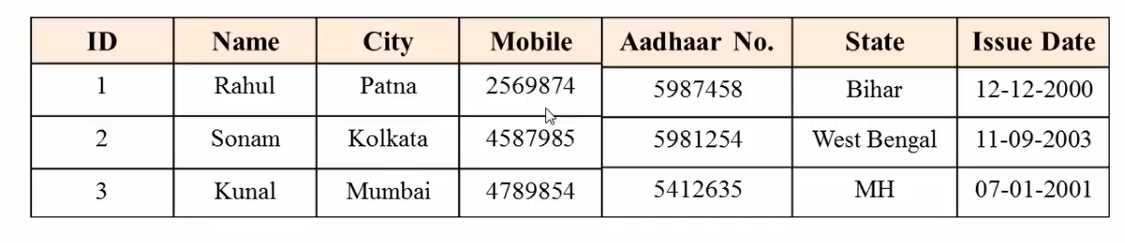
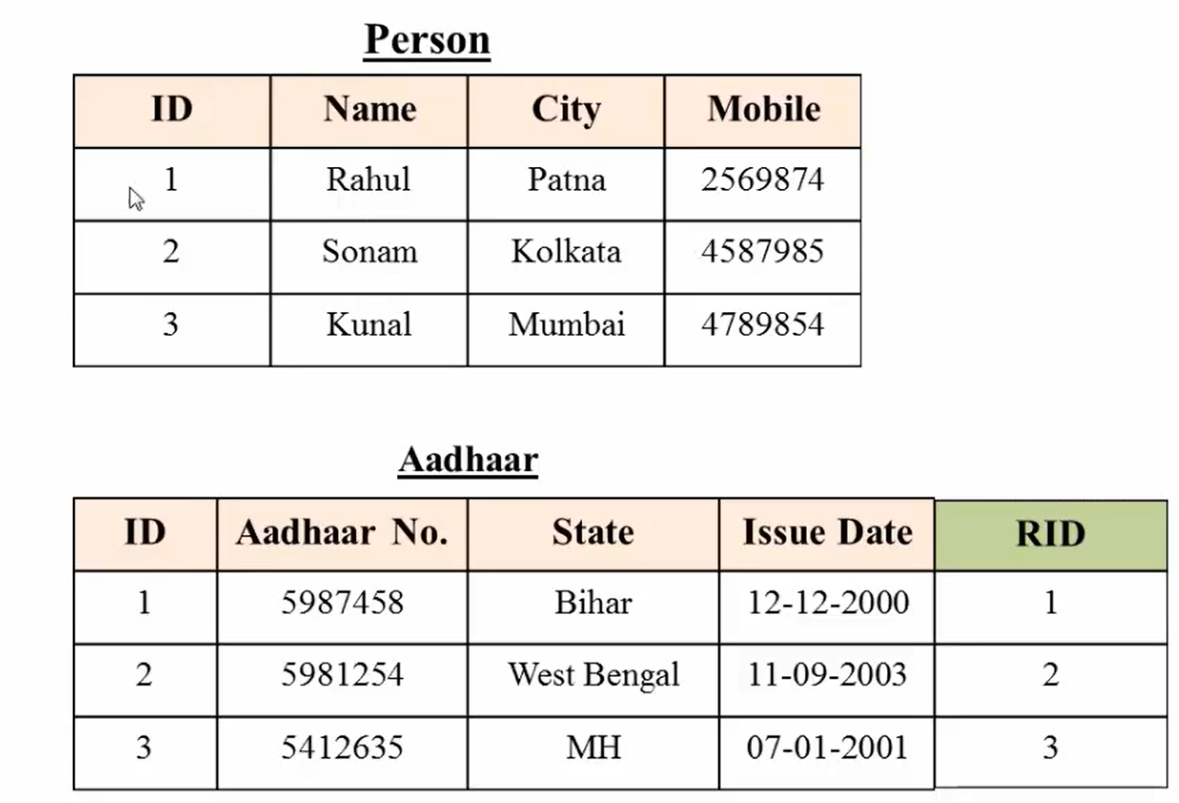
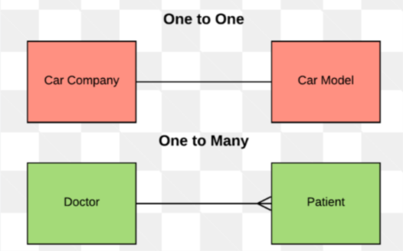
One to One
In One-to-One relationship, one record of the first table will be linked to zero or one record of another table

Slide 23
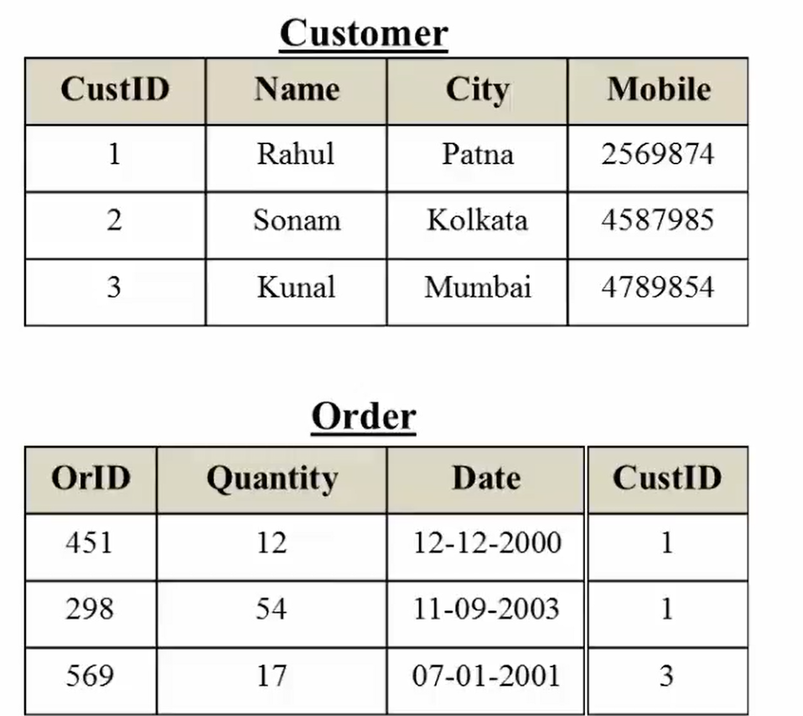
One to Many
One-to-Many is the most commonly used relationship among tables. A single record from one table can be linked to zero or more rows in another table.

Slide 24
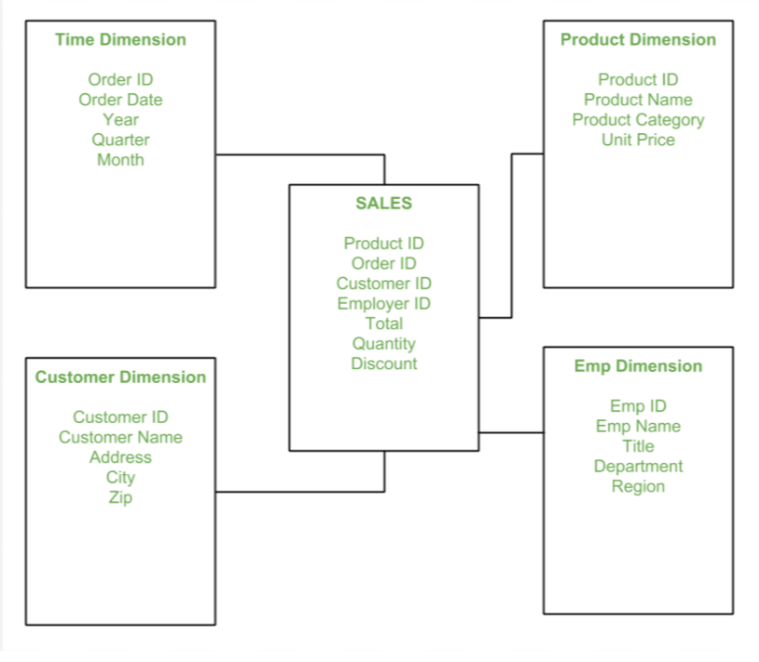
Data modeling-Schema
Star schema
A star schema is made up of a central fact table with multiple dimension tables branching off of this fact table, much like the appearance of a star.

Slide 25
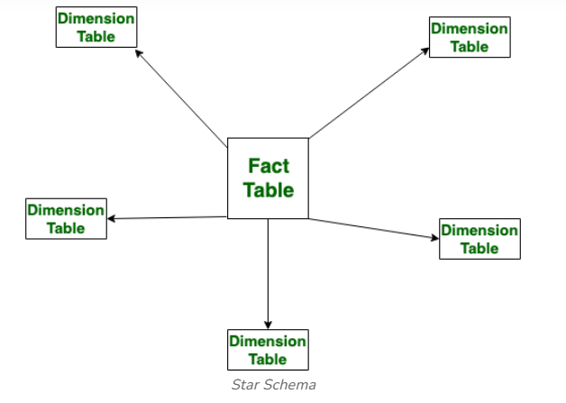
Fact and Dimension
The fact table in a star schema contains the measures or metrics that are of interest to the user or organization.
The dimension tables in a star schema contain the descriptive attributes of the measures in the fact table.

Slide 26
Fact and Dimension
The fact table in a star schema contains the measures or metrics that are of interest to the user or organization.
The dimension tables in a star schema contain the descriptive attributes of the measures in the fact table.

Slide 27
Creating and managing relationship
Creating and Managing table relationships typically refers to the process of defining and maintaining the connections between tables in a relational database. Table relationships are crucial for maintaining data integrity, enforcing referential integrity, and ensuring efficient data retrieval.
Power BI is a powerful tool to understand and then manage and edit the table accordingly. It is used in data visualization which helps in drawing business intelligence reports from data.
Autodetect Tool for creating relationships
If after loading all the tables, still no relationship can be seen between tables, then the Autodetect tool comes in handy. To use Autodetect, on the Modeling tab select Manage Relationships > Autodetect.
Manually Creating Relationships
But sometimes Power BI doesn’t create the correct relationships so there’s also an option of creating relationships between table manually

Slide 28
DAX and its importance
What is DAX?
DAX stands for Data Analysis Expressions.
It is a formula language used in Power BI, Excel, and Analysis Services.
Helps in creating calculated columns, measures, and custom tables.
Why DAX is Important?
Enhances data modeling capabilities.
Allows for efficient calculations and aggregations.
Provides flexibility in analyzing data.
Enables advanced business intelligence solutions.

Slide 29
DAX and its importance
Key Features of DAX
Ability to create custom calculations.
Powerful aggregation functions.
Time intelligence functions.
Relationship and filtering capabilities.
Basic DAX Functions
Aggregation Functions (SUM, AVERAGE, MIN, MAX, COUNT)
Logical Functions (IF, SWITCH, AND, OR)
Text Functions (CONCATENATE, LEFT, RIGHT, MID)
Date & Time Functions (TODAY, NOW, YEAR, MONTH)
Filter Functions (FILTER, ALL, RELATED)

Slide 30
DAX and its importance
DAX in Power BI
Used for creating measures and calculated columns.
Helps in dynamic reporting and data visualization.
Enhances interactivity in reports.
Example Use Cases of DAX
Calculating total sales revenue.
Creating year-over-year growth metrics.
Implementing rolling averages.
Filtering data dynamically based on user selection.

Slide 31
DAX and its importance
Advantages of Using DAX
Improves report performance and efficiency.
Simplifies complex calculations.
Enhances decision-making with advanced analytics.
Challenges and Best Practices
Challenges:
  Learning curve for complex formulas.
  Performance issues with large datasets.
Best Practices:
  Optimize DAX queries for efficiency.
  Use variables for better readability.
  Minimize calculated columns where possible.

Slide 32
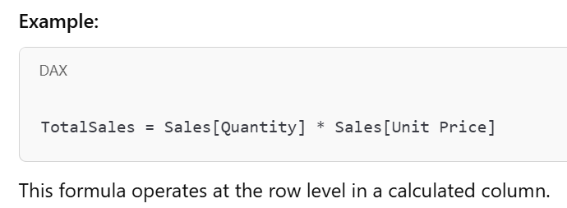
Introduction to Evaluation Contexts
Power BI uses DAX (Data Analysis Expressions) for calculations.
Understanding Evaluation Contexts is key to writing efficient DAX formulas.
Two main types:
  Row Context
  Filter Context
Row context
Definition: Row context applies when a calculation is performed row-by-row in a table.
Created automatically in:
Calculated Columns
Iterating Iterating Functions (e.g., SUMX, FILTER)

Slide 33
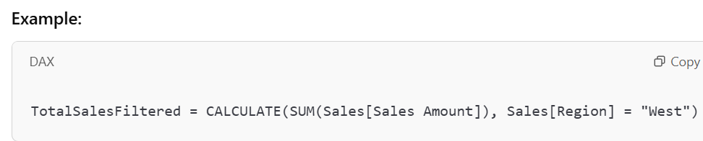
Demonstrating Row Context
Image: A Power BI table showing calculated columns.
Key Points:
  Each row is evaluated separately.
  Cannot automatically access values from other rows.
  Requires iterators (SUMX, AVERAGEX, etc.) to work with multiple rows.
Filter Context?
Definition: Filter context is applied when filters affect a calculation.
Created by:
  Slicers, Filters, and Rows in a Pivot Table
  CALCULATE Function
  Here, CALCULATE modifies the filter context to show only sales from the West region.

Slide 34
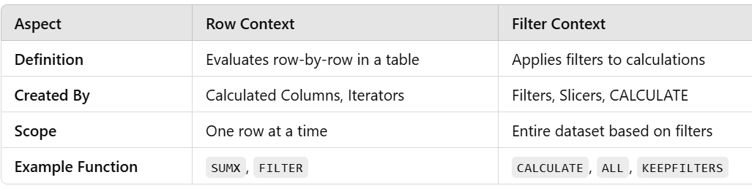
Demonstrating Filter Context
Image: A Power BI report with slicers & filters.
Key Points:
  Filters from visuals, slicers, or DAX affect calculations.
  CALCULATE can modify or override filters.
  Multiple filters can combine to create complex contexts.
  Row Context vs Filter Context

Slide 35
Calculated Columns
Definition: A calculated column is a new column created in a table using DAX.
It is calculated row-by-row at the data model level.
Example:
Pros: Can be used in relationships, filters, and aggregations.
Cons: Consumes storage and affects performance for large datasets.
  .

Slide 36

Calculated Measures
Definition: A measure is a dynamic aggregation calculated at runtime based on user interactions.
Example:
Pros: Optimized for performance, does not increase storage.
Cons: Cannot be used in calculated columns.
Two types of measure:
Implicit measure
Explicit measure
  .

Slide 37

DAX- Sum and sumX
Purpose: Aggregates a single column by adding all values.
Syntax:
Use Case: Total revenue calculation
DAX - SUMX Function
Purpose: Iterates over a table and performs row-wise calculations before aggregation.
Syntax:
Use Case: Useful when multiplication is needed before summation.

Slide 38
DAX- Min,Max,Minx and MaxX
MIN: Returns the smallest value in a column.
Min Price = MIN(Sales[UnitPrice])
MAX: Returns the largest value in a column.
Max Price = MAX(Sales[UnitPrice])
Use Case: Finding the lowest or highest sales price
MINX: Returns the minimum value after performing row-wise calculations.
Min Revenue = MINX(Sales, Sales[Quantity] * Sales[UnitPrice])
MAXX: Returns the maximum value after performing row-wise calculations.
Max Revenue = MAXX(Sales, Sales[Quantity] * Sales[UnitPrice])
Use Case: Finding the lowest or highest revenue per transaction

Slide 39
DAX- Average, AverageX
AVERAGE Function
      Definition:
        Returns the arithmetic mean (average) of a column.
      Syntax:
      AVERAGE(column)
      Example:
      AVERAGE(Sales[Revenue])
        This returns the average revenue.
AVERAGEX Function
      Definition:
        Computes the average of an expression evaluated over a table.
      Syntax:
      AVERAGEX(table, expression)
      Example:
      AVERAGEX(Sales, Sales[price] +Sales[Quantity])

Slide 40
DAX- Count, DistinctCount
Definition:Count
  Counts the number of non-blank values in a column.
Syntax:
COUNT(column)
Example:
COUNT(Sales[OrderID])
  This counts the total number of orders.
Definition:DitinctCount
  Counts the number of unique values in a column.
Syntax:
DISTINCTCOUNT(column)
Example:
DISTINCTCOUNT(Sales[CustomerID])
  This counts the number of unique customers who made purchases.

Slide 41
DAX- Date Time function
Power BI provides a variety of Date and Time functions to handle, manipulate, and analyze time-based data.
Essential for time intelligence, trend analysis, and reporting.
Functions available in DAX (Data Analysis Expressions) and Power Query.
Types of Date/Time Functions
Date Functions (e.g., TODAY, DATE, YEAR, MONTH)
Time Functions (e.g., HOUR, MINUTE, SECOND, NOW)
Date & Time Arithmetic (e.g., DATEDIFF, EDATE, EOMONTH)
TODAY() – Returns the current date.
DATE(year, month, day) – Creates a date from year, month, and day.
YEAR(date), MONTH(date), DAY(date) – Extracts respective components.
Example: YEAR(TODAY()) returns the current year.
DATEDIFF(start_date, end_date, unit) – Difference in days, months, or years.
  .

Slide 42
DAX- Text/String function
CONCATENATE( )
Concatenate function is used to join two columns or to create a text String by joining two text strings. The CONCATENATE function combines two text strings into a single text string.
Syntax: CONCATENATE (<Col 1> , <Col 2>)
LEFT ( )
Left function returns the requested number of text characters from the left side of the given string
Syntax: LEFT (<Text>, <Num_Chars>)
RIGHT( )
Depending on how many characters you enter, this function returns the last characters in the last characters in text string.
Syntax: RIGHT(<Text>, [<Num_Times>])
  .

Slide 43
DAX- Text/String function
MID( )
MID gives a beginning position, length, and a string of characters from the middle of a text string.
Syntax: MID(<Text>, <Start_Num>, <Num_Chars>)
UPPER( )
With the help of the upper function, a text string is changed to all uppercase letters.
Syntax: UPPER(<Text>)
LOWER( )
With the help of the lower function, a text string is changed to all lowercase letters.
Syntax: LOWER(<Texxt>)
  .

Slide 44
DAX- Logical function
DAX The Logical function of Power BI is among its most crucial components. It offers up a result as either True or False.
IF
A condition is checked, and if it is TRUE, one value is returned; otherwise, a different value is returned.
Syntax: IF(<logical_test>, <value_if_true>[, <value_if_false>])
Example: Categorizing sales performance= IF(Sales[TotalSales] > 1000, "High", "Low")
This formula labels total sales as "High" if they exceed 1000; otherwise, it labels them as "Low.“
AND Function:
Syntax: AND(<Logical1>, <Logical2>, ...)
Description: Returns TRUE if all arguments are TRUE
Example: = AND(Sales[TotalSales] > 1000, Sales[Region] = "North")
OR Function:
Syntax: OR(<Logical1>, <Logical2>, ...)
Description: Returns TRUE if any argument is TRUE
Example: = OR(Sales[TotalSales] > 1000, Sales[Region] = "North")
  .

Slide 45
DAX- Logical function
NOT Function
Syntax: NOT(<Logical>)
Description: Reverses the Boolean value of the argument
Example: = NOT(Sales[TotalSales] > 1000)
This returns TRUE if TotalSales is not greater than 1000.
SWITCH Function
Syntax: SWITCH(<Expression>, <Value1>, <Result1>, <Value2>, <Result2>, ..., [<Else>])
Description: Evaluates an expression against a list of values and returns the result corresponding to the first matching value; if no match is found, returns the default value if provided
  .

Slide 46
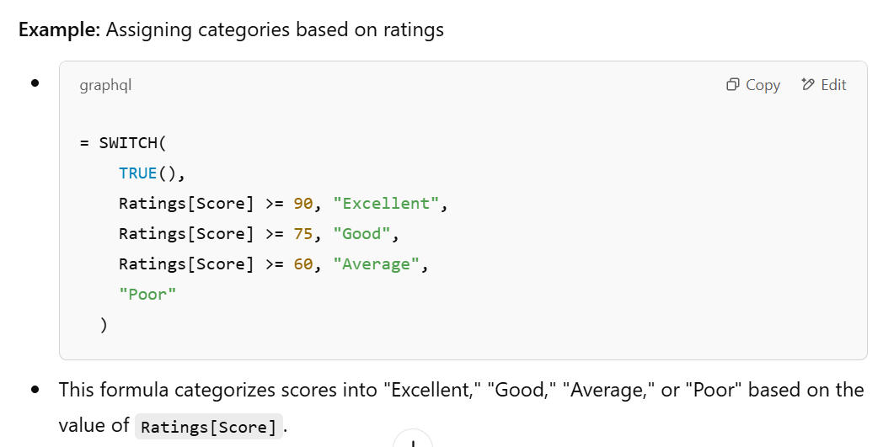
DAX- Logical function
  .
Column 2 = SWITCH(TRUE(),Orders[Quantity]>=12,"excelent",Orders[Quantity]>=9,"very good",Orders[Quantity]>=6,"Good","poor")

Slide 47
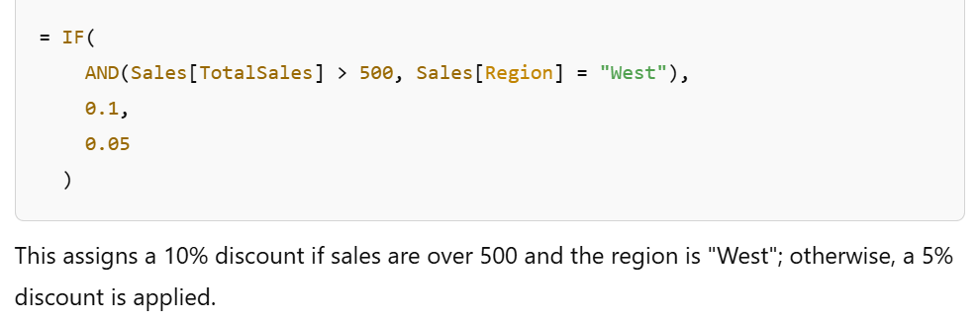
DAX- Logical function
Example: Creating a calculated column that assigns a discount rate based on sales volume and region
  .

Slide 48
Connectivity
Power BI is a powerful business intelligence tool.
It connects to various data sources for analysis and reporting.
Understanding data connectivity is key to efficient data management.
Types of Data Sources in Power BI
  Files (Excel, CSV, JSON, XML)
  Databases (SQL Server, MySQL, PostgreSQL, Oracle)
  Online Services (SharePoint, Google Analytics, Azure)
  Big Data Sources (Azure Data Lake, Hadoop, Spark)
  Other Sources (APIs, Web, OData Feed, SAP)
  Connection Modes in Power BI
    1. Import Mode
          Loads data into Power BI
          Best for performance but large datasets may slow it down
    2. Live Connection
          Connects directly to a live dataset (e.g., SSAS)
          Best for enterprise-scale models
  .

Slide 49
Connectivity
Connecting to Different Data Sources
1. Open Power BI Desktop
2. Click Get Data
3. Choose a data source (Excel, SQL, Web, etc.)
4. Configure connection settings
Load data into Power
Data Transformation with Power Query
• Cleaning & Shaping Data: Removing duplicates, handling nulls
• Merging & Appending Tables
• Creating Calculated Columns & Measures
• Applying Business Rules
  .

Slide 50
Creating Reports
Step 1: Get Your Data
Open Power BI Desktop.
Click Home → Get Data and choose a source (Excel, SQL Server, CSV, API, etc.).
Load the data and check it in Power Query (transform if needed).
Step 2: Model Your Data
Go to Model View to check relationships between tables.
Create relationships if necessary using Manage Relationships.
Add calculated columns and measures using DAX (Data Analysis Expressions).
Step 3: Create Visuals
Open the Report View.
Use visualizations like bar charts, pie charts, line graphs, cards, maps, etc..
Drag and drop fields into visualizations.
Use filters, slicers, and drill-through options for interactivity.
  .

Slide 51
Creating Reports
Step 4: Format and Customize
Change colors, labels, and fonts using the Format Pane.
Use Bookmarks and Buttons for navigation.
Apply conditional formatting for better insights.
Step 5: Publish and Share
Save the report and click Publish to upload it to Power BI Service.
Create a Dashboard in Power BI Service by pinning key visuals.
Share the dashboard with stakeholders by giving access.
  .

Slide 52
Calculate function
CALCULATE function in two parts; the aggregation and the filter. The first part of the expression is the aggregation piece. This is where you can place whatever aggregation function you’d like whether it’s SUM(Sales), AVG(Price), or something else.
The second portion is your filter criteria. This part will define the data set that you are applying the aggregation in the first part to.
  .

Slide 53
ALL, ALL Selected, ALL Except
ALL
Returns all the rows in a table, or all the values in a column, ignoring any filters that might have been applied
ALL Selected
Returns all the rows in a table, or all the values in a column, ignoring any filters that might have been applied inside the query, but keeping filters that come from outside
ALLSELECTED([<tableName> | <columnName>[, <columnName>[, <columnName>[,…]]]] )
ALL Except
Returns all the rows in a table except for those rows that are affected by the specified column filters.
  .

Slide 54
ALL, ALL Selected, ALL Except
ALL
All = CALCULATE(SUM(Orders[Quantity]),ALL(Orders))
ALL Selected
Allselct = CALCULATE(SUM(Orders[Quantity]),ALLSELECTED(Orders[State]))
ALL Except
Allexcept = CALCULATE(SUM(Orders[Quantity]),ALLEXCEPT(Orders,Orders[State]))
  .

Slide 55
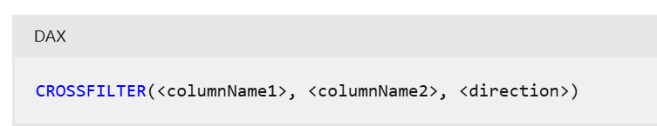
Cross Filter Function
Specifies the cross-filtering direction to be used in a calculation for a relationship that exists between two columns.It is used in calculate function
  .
Crosfiltred =
CALCULATE(DISTINCTCOUNT(customers[customerID]),CROSSFILTER(orders[customerID],customers[customerID],Both))

