Slide 1
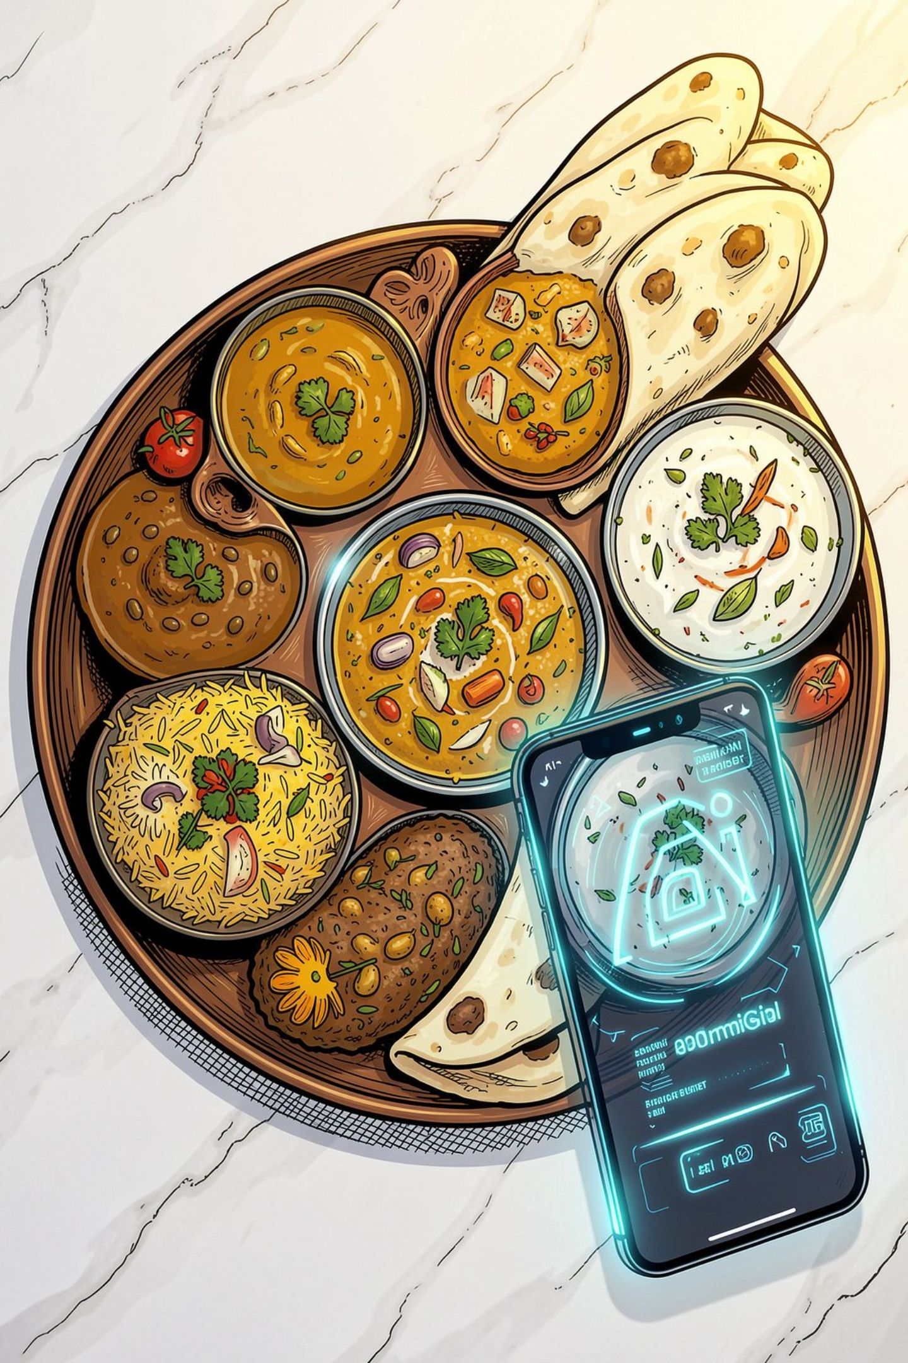
AI-Powered Food Identification & Nutrition Analysis
From a food photo to intelligent nutrition insights.
REACT NATIVE
PYTHON
DJANGO
AI
COMPUTER VISION

Slide 2
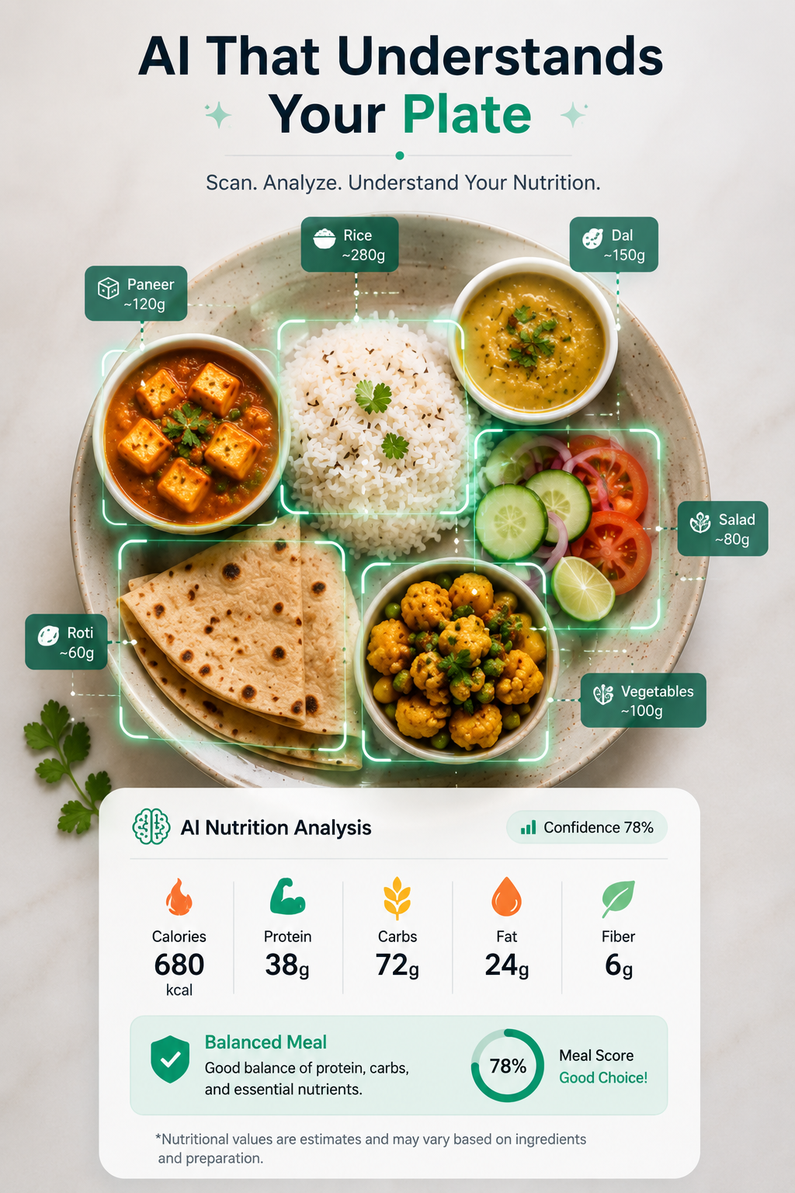
We Know What We Eat. But Do We Know What's Inside?
Time-Consuming
Manual calorie tracking takes minutes per meal — most people give up.
Portion Guesswork
Estimating grams by eye is notoriously unreliable.
Hidden Ingredients
Oil, butter, sugar, and sauces go undetected in homemade and restaurant meals.
No Context
People rarely know the nutritional value of regional or mixed dishes.
Traditional Method
Search → Estimate → Enter → Calculate
Our Approach
📸 Scan → 🤖 AI → 📊 Nutrition

Slide 3
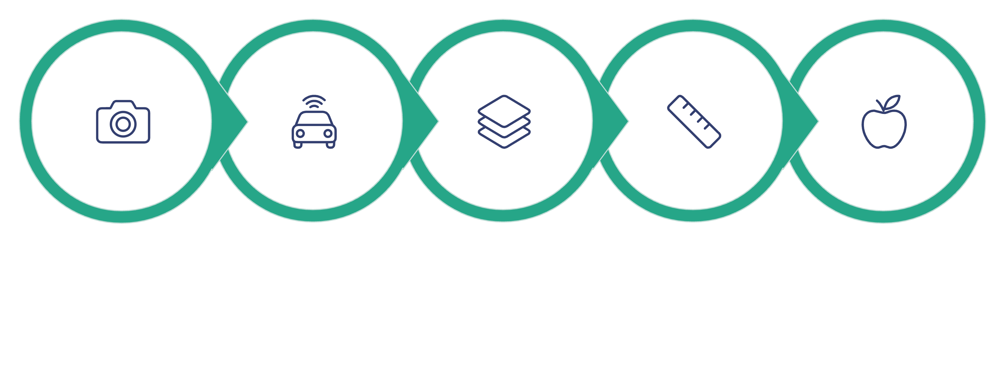
An AI That Understands Your Plate
A single photo triggers an intelligent, multi-stage pipeline — delivering complete nutritional intelligence in seconds.
AI Identification
Component Detection
Upload Photo
Portion Estimate
Nutrition Analysis
Each stage builds on the last — from raw image to actionable, personalized nutrition data.

Slide 4







More Than Just Calorie Counting
AI Food Identification
Component Detection
Portion Estimation
Recognizes thousands of dishes, including regional Indian food.
Breaks mixed dishes into individual ingredients.
AI estimates gram weight from image context — a core innovation.
Calories & Macros
Allergen Detection
Confidence Scoring
Full breakdown: protein, carbs, fat, and fiber per meal.
Flags common allergens — nuts, dairy, gluten, and more.
Every estimate includes a confidence score for transparency.
Healthier Alternatives
AI suggests smarter swaps tailored to your meal.

Slide 5

⭐ FLAGSHIP INNOVATION
Food Twin — Your Meal, Digitally Reconstructed
Chicken Biryani — Deconstructed
Interactive Nutrition Control
Rice — 280g
Chicken — 120g
Gravy — 80g
Fried Onion — 20g
Raita — 70g
Remove gravy → Nutrition recalculates instantly
Ate half the rice → Consumed calories update live
Swap rice for roti → AI compares both meals side by side
Food Twin turns a static photo into an interactive, editable nutritional model.
~680 kcal · 38g Protein · 72g Carbs · 24g Fat

Slide 6
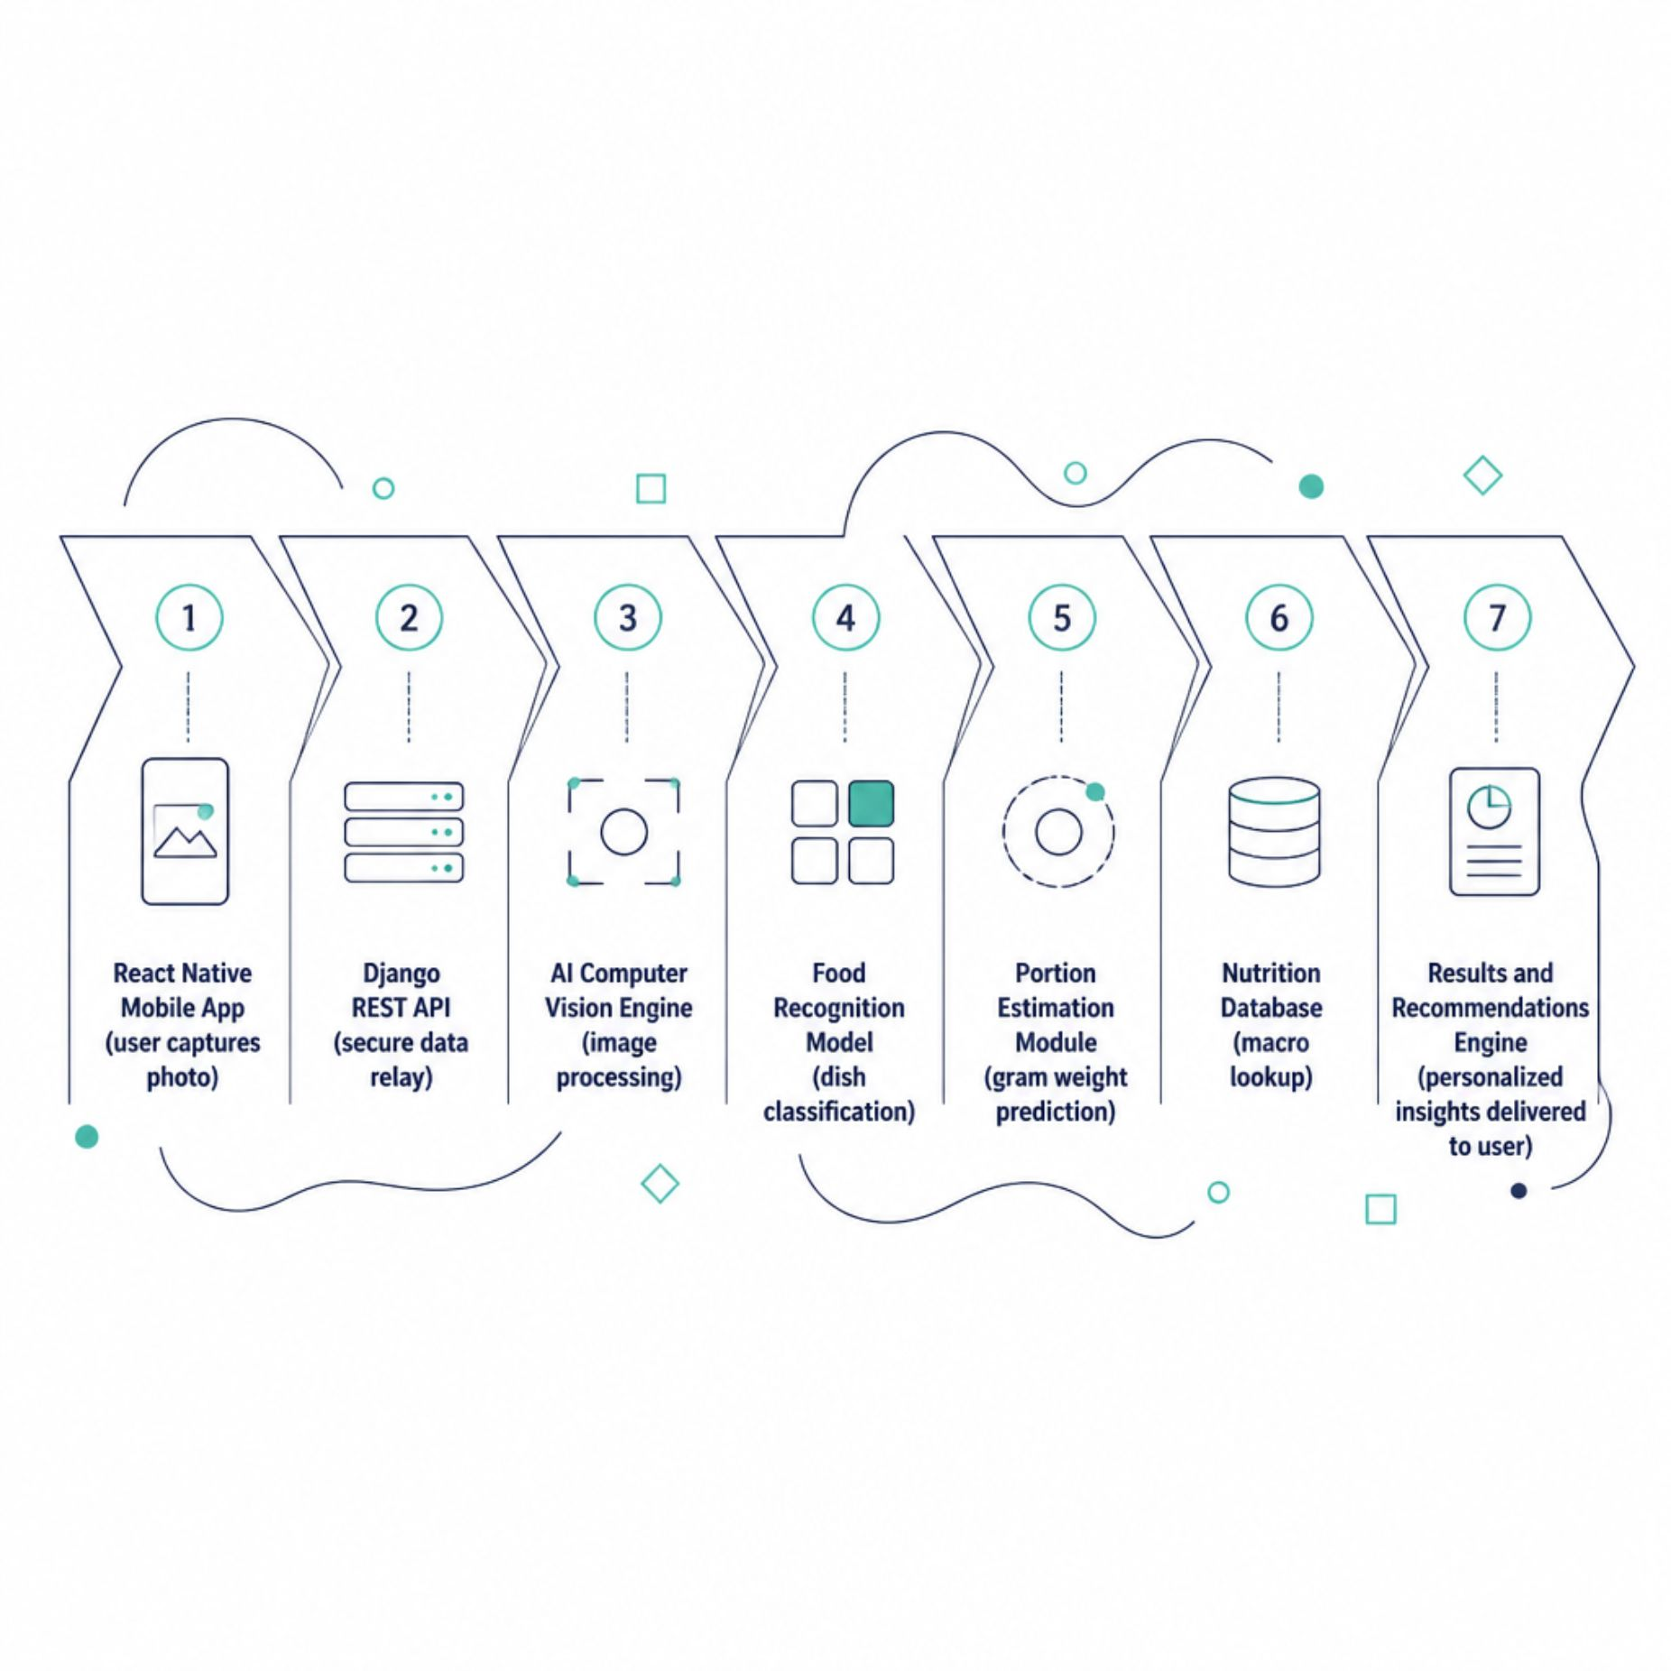
How the System Works
End-to-End Intelligence
The pipeline is designed for speed and accuracy. The mobile app communicates with a Django backend, which orchestrates AI models for recognition and portion estimation, then queries a structured nutrition database to generate personalized, actionable results — all in real time.
Real-Time
Scalable
Results in seconds
Cloud-ready architecture

Slide 7





Technology Behind the System
Frontend
Backend
AI Engine
React Native — cross-platform iOS & Android with a smooth, native UI
Python + Django REST Framework — robust, scalable API layer
Computer Vision & Deep Learning — food recognition and portion estimation models
Database
Deployment
PostgreSQL + Nutrition Database — structured, queryable food data
Cloud Infrastructure — scalable, high-availability hosting

Slide 8
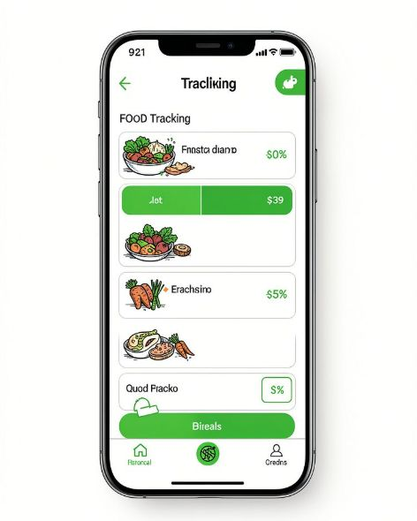
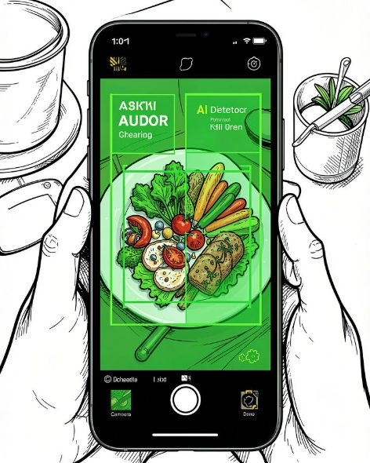
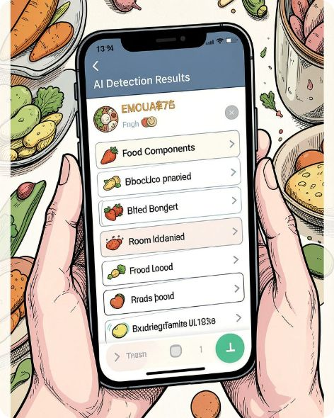
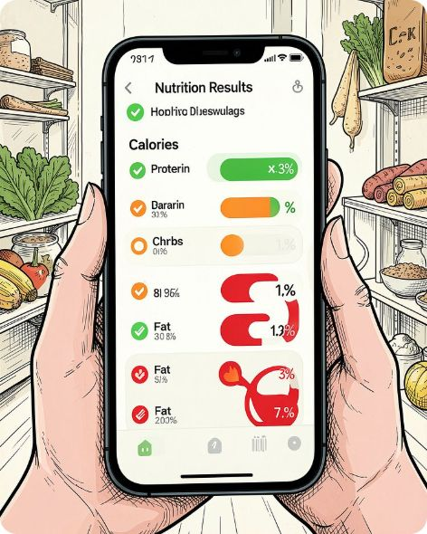
From Scan to Smart Decision
1. Home
2. Scan Food
3. AI Detection
4. Nutrition Results
Quick access to scan, history, and daily goals
Point camera or upload from gallery
Dish identified, components broken down
Full macro breakdown + AI health insights
Sample Result: Chicken Biryani
Why It Matters
680 kcal · 38g Protein · 72g Carbs · 24g Fat
🔴 High sodium 🟠 Moderate fat 🟢 Good protein
Suggested: Reduce gravy + add a side salad
Fast & convenient — seconds, not minutes
Portion-aware, not just dish-level
Personalized, actionable recommendations

Slide 9






Making Every Meal Understandable
Regional Food Recognition
Personalized Meal Planning
Expand coverage to diverse Indian regional cuisines
AI-generated weekly plans based on goals and history
Wearable Integration
Voice-Based Logging
Sync with fitness trackers for holistic health data
Hands-free food entry via natural language
Meal History & Trends
Restaurant Food Analysis
Long-term nutrition patterns and insights
Identify and analyze dishes from popular restaurant menus
Scan. Understand. Improve.

