Slide 1
Instant - Identifier
By Campus Connect

Slide 2
How many times you see a person in a video & you are unable to recognize them?

Slide 3
Our Solution
Google Chrome Plugin
Instant Face & Object detection
Short Summarized Information
Instant-Identifier

Slide 4
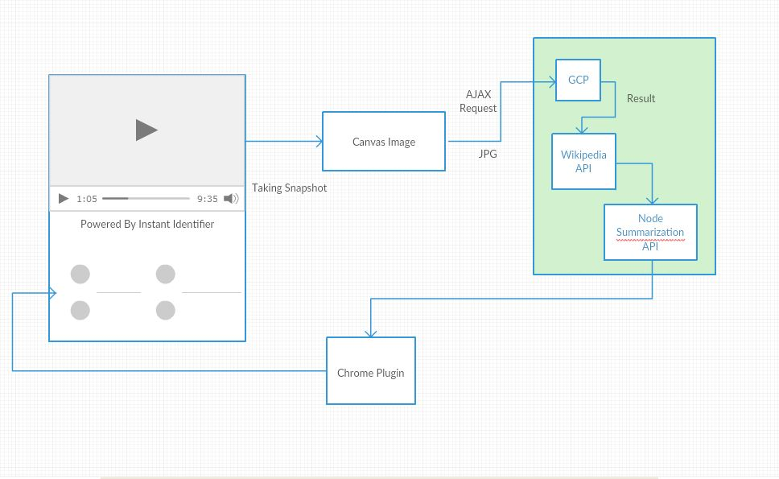

Slide 5
Future Scope:
Contextual Assistance
Short Summarization on Video
Deploying locally on custom trained module
Sentimental Analysis

