Slide 1
Mini Project- Policy Endorsement
Group Number 4
GLC-G103, Talwade, Pune
7th January, 2019
Notes:
Copyright © 2011 IGATE Corporation (a part of Capegemini Group). All rights reserved.
No part of this publication shall be reproduced in any way, including but not limited to photocopy, photographic, magnetic, or other record, without the prior written permission of IGATE Corporation (a part of Capegemini Group).
IGATE Corporation (a part of Capegemini Group) considers information included in this document to be confidential and proprietary.

Slide 2
Team Members
Shariq Anwar Ansari -164344
Swathi Reddy -164353
Umang Rajesh Dave -164359
Samruddhi Kundan Patil -164330
Sarthak Dubey -164340
Siddhesh Ravindra Kadam -164347

Slide 3
Project Details
In property/casualty insurance the term endorsement means a document attached to an insurance contract that amends the policy in some way.
An endorsement may add, remove or alter the scope of coverage under the policy.
The insurance endorsement is a legally binding amendment to the insurance contract.
Technologies Used:
Presentation Layer:
a. WPF 4.5
Business Layer:
a. C#5.0
Database Layer:
a. SQL Server 2012

Slide 4
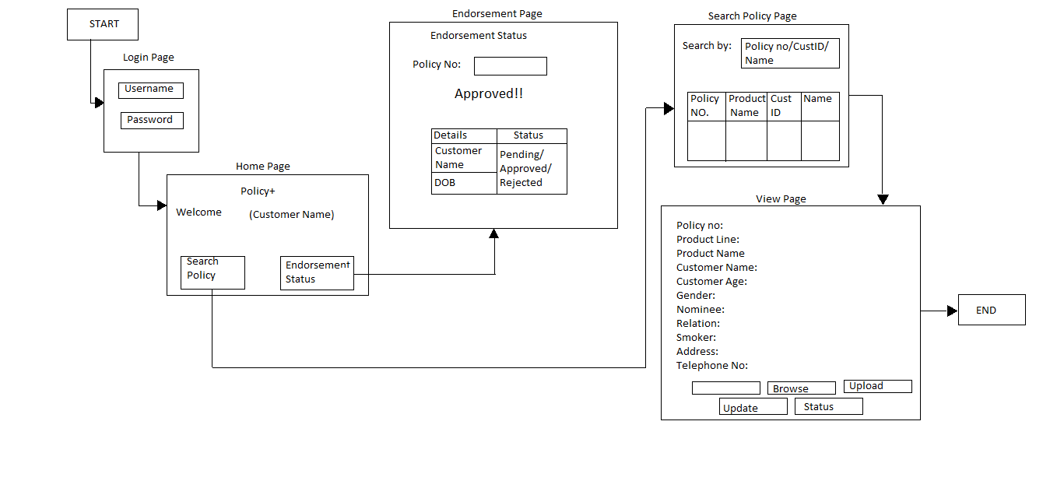
Diagram Depicting Entire Project

Slide 5
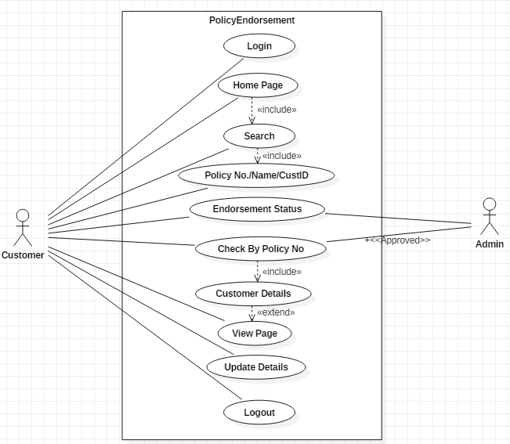
Use Case Diagram

Slide 6
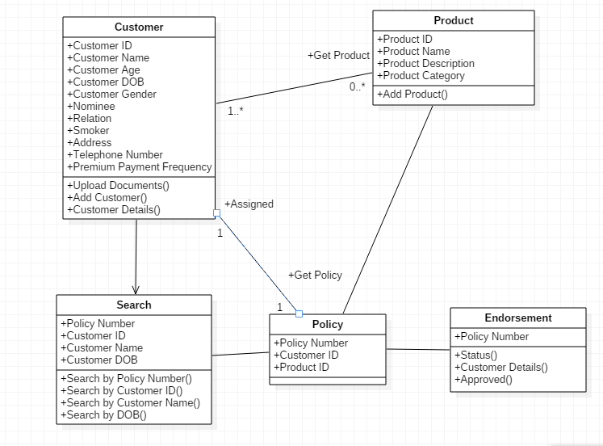
Class Diagram

Slide 7
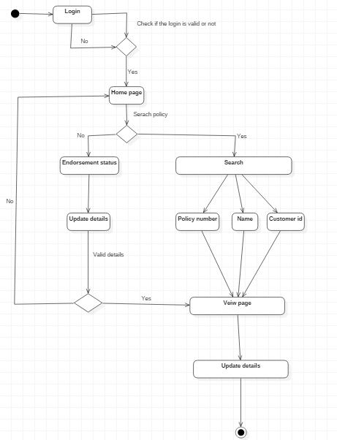
Sequence/Activity Diagram

Slide 8
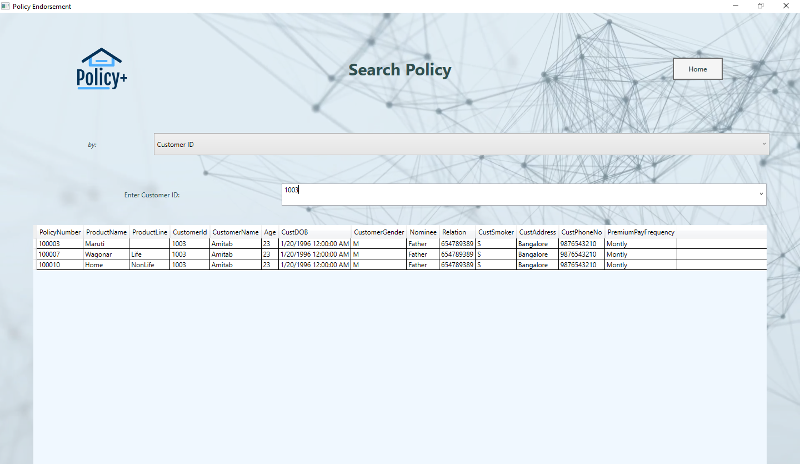
Screen shots

Slide 9
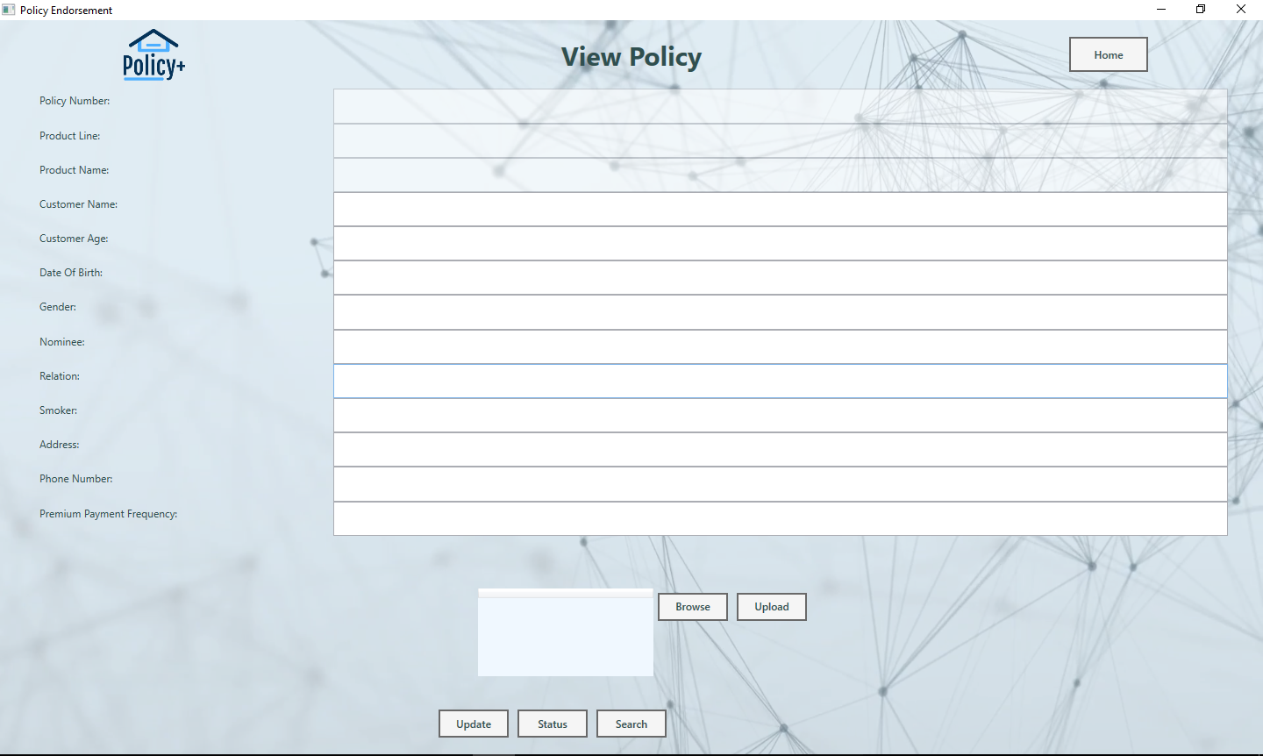
Screen shots

Slide 10
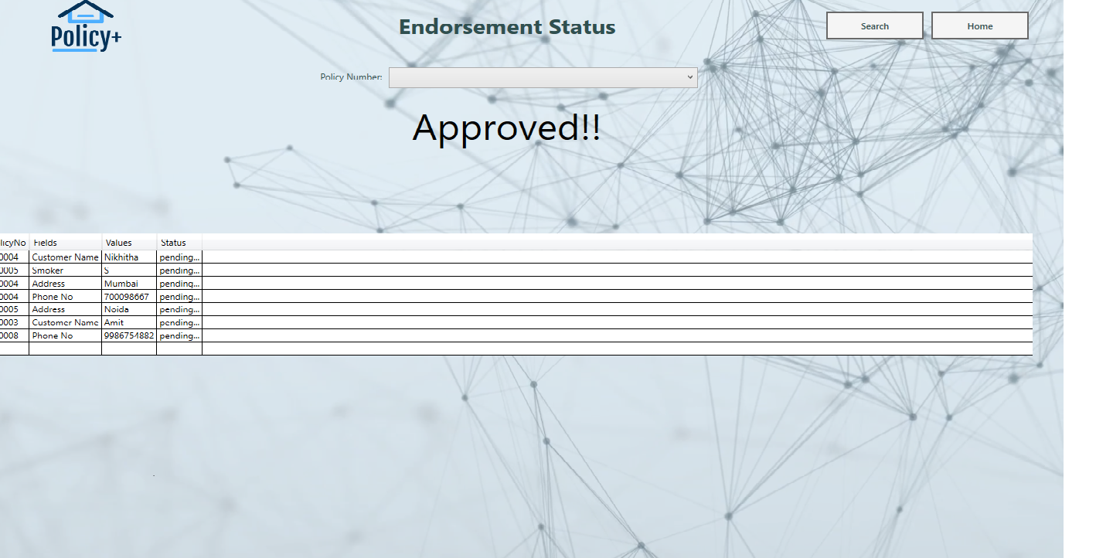
Screen shots

Slide 11
Future Enhancements
The distribution efficiency also leads to cost efficiency. Since the customer buys directly from the insurer, the distributor's margin is saved.
The biggest benefit of online platform is that it offers the customer to make an informed choice.
Moreover, when buying online, you can check the reviews and comments section.
You can download product literature like brochures and policy wordings, get quick premium quotes, renew your old policies, pay premiums online, track your insurance investments and make online claims.

Slide 12
Thanks

