Slide 1
Mini Project- Insurance Policy Endorsement
Group Number 4
GLC-G103, Talwade, Pune
7th January, 2019
Notes:
Copyright © 2011 IGATE Corporation (a part of Capegemini Group). All rights reserved.
No part of this publication shall be reproduced in any way, including but not limited to photocopy, photographic, magnetic, or other record, without the prior written permission of IGATE Corporation (a part of Capegemini Group).
IGATE Corporation (a part of Capegemini Group) considers information included in this document to be confidential and proprietary.

Slide 2
Team Members
Shariq Anwar Ansari -164344
Swathi Reddy -164353
Umang Rajesh Dave -164359
Samruddhi Kundan Patil -164330
Sarthak Dubey -164340
Siddhesh Ravindra Kadam -164347

Slide 3
Project Details
In property/casualty insurance the term endorsement means a document attached to an insurance contract that amends the policy in some way.
An endorsement may add, remove or alter the scope of coverage under the policy.
The insurance endorsement is a legally binding amendment to the insurance contract.
Technologies Used:
Presentation Layer:
a. WPF 4.5
Business Layer:
a. C#5.0
Database Layer:
a. SQL Server 2012

Slide 4
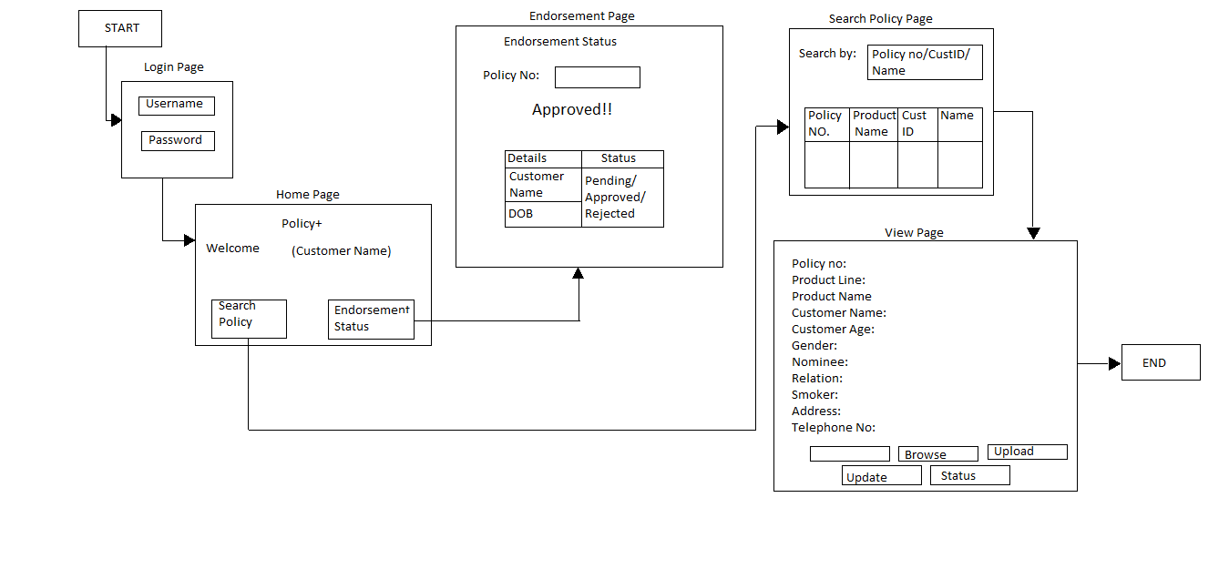
Diagram Depicting Entire Project

Slide 5
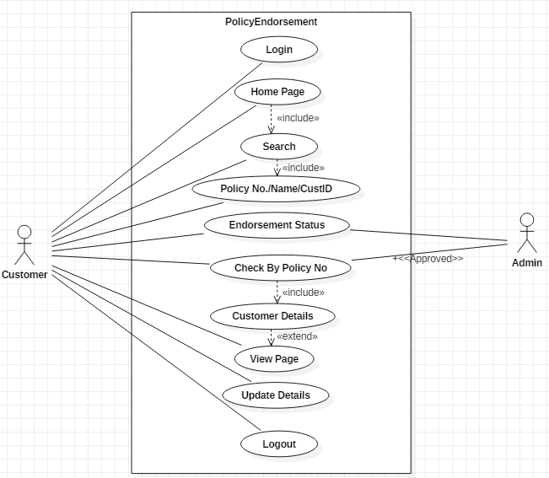
Use Case Diagram

Slide 6
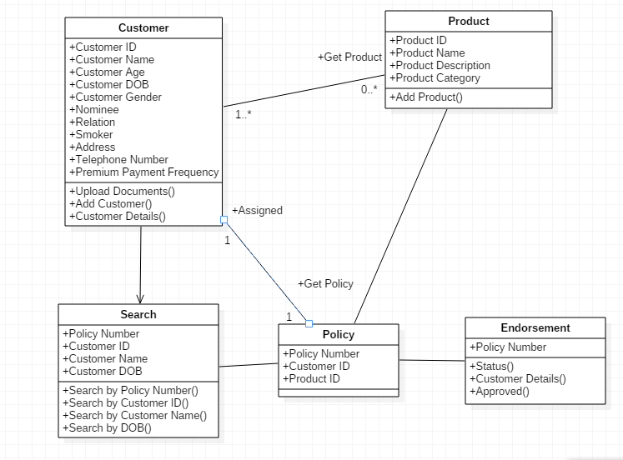
Class Diagram

Slide 7
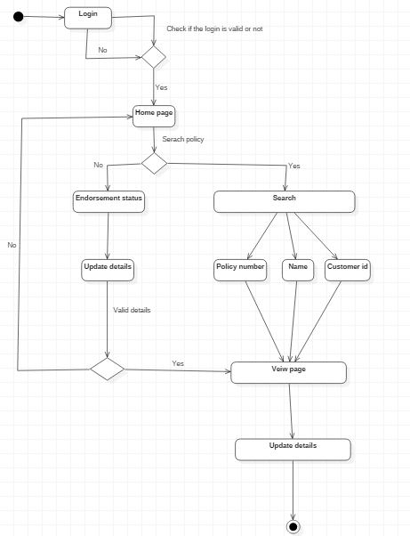
Activity Diagram

Slide 8
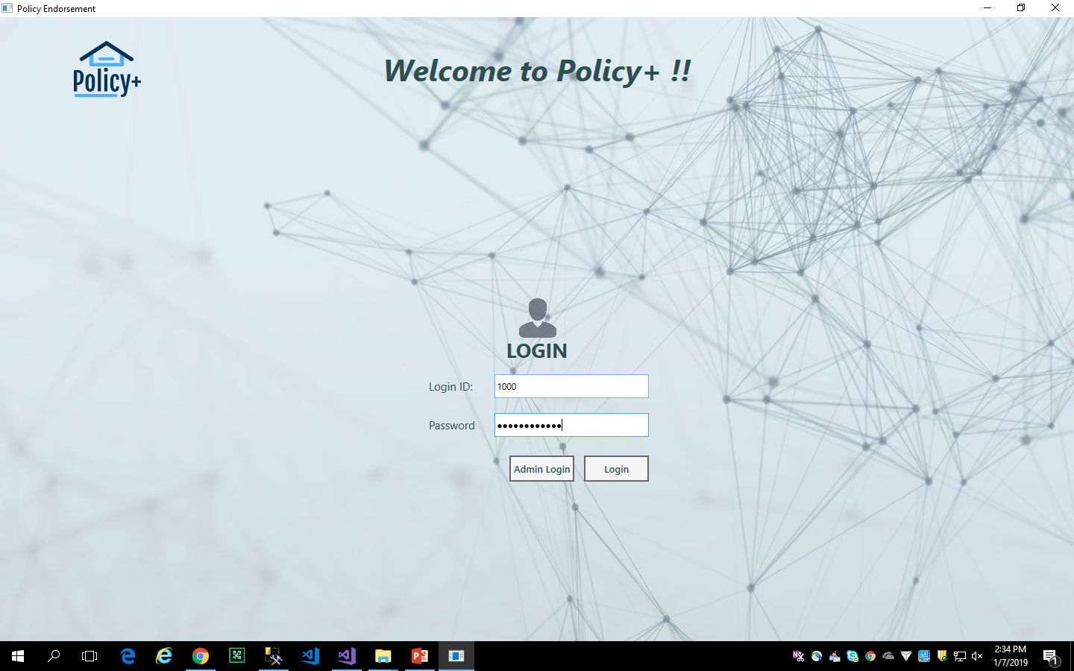
Login Page

Slide 9
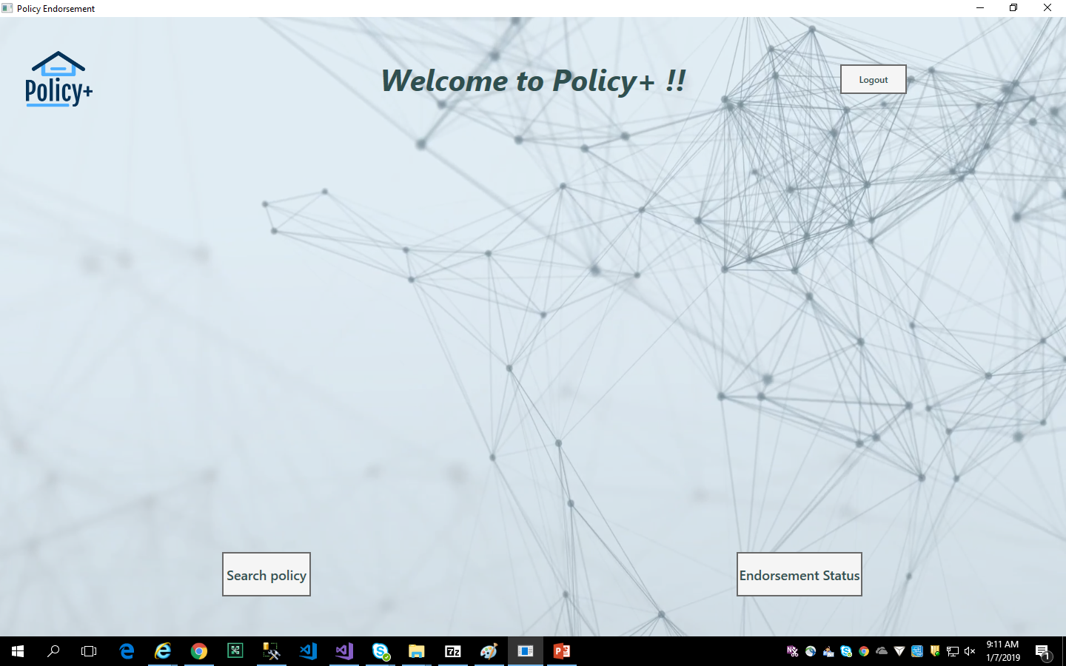
Home Page

Slide 10
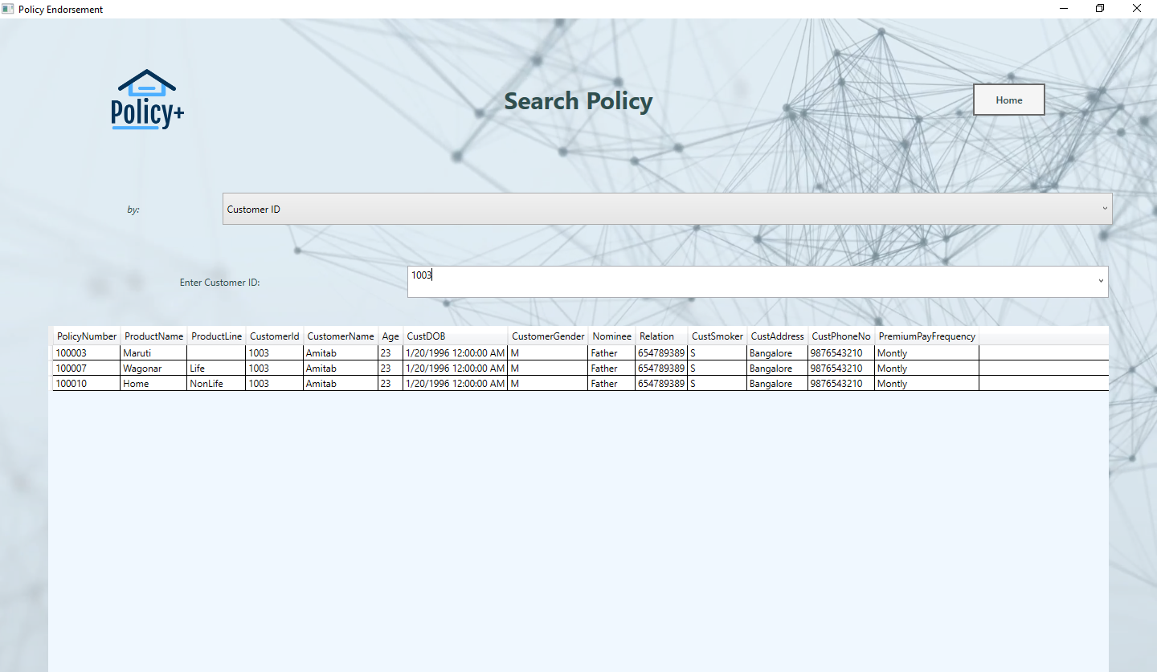
Search Policy Page

Slide 11
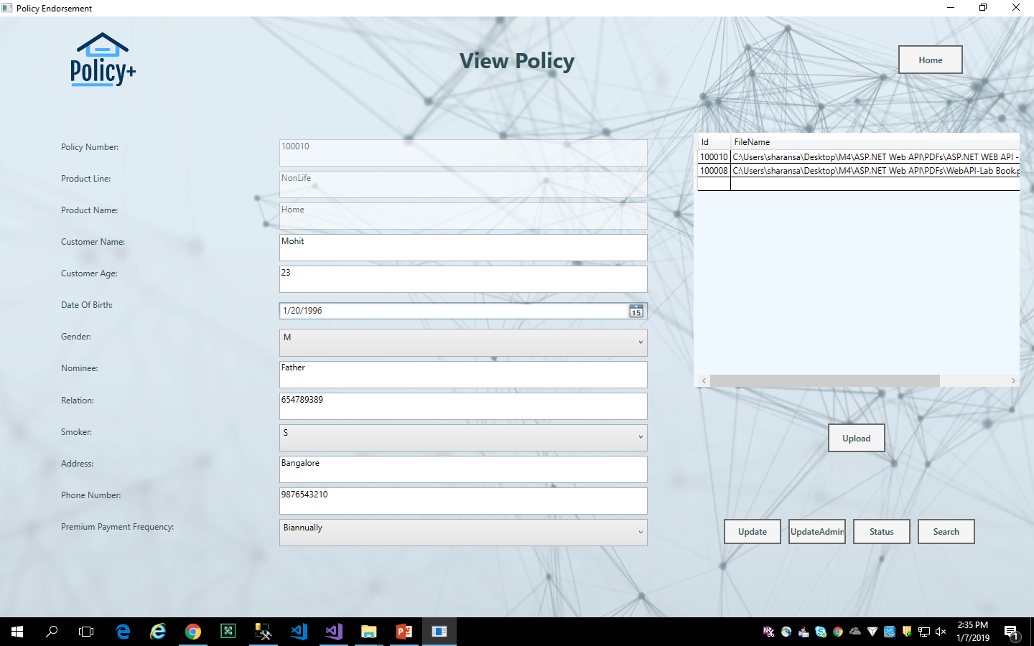
View Policy Page

Slide 12
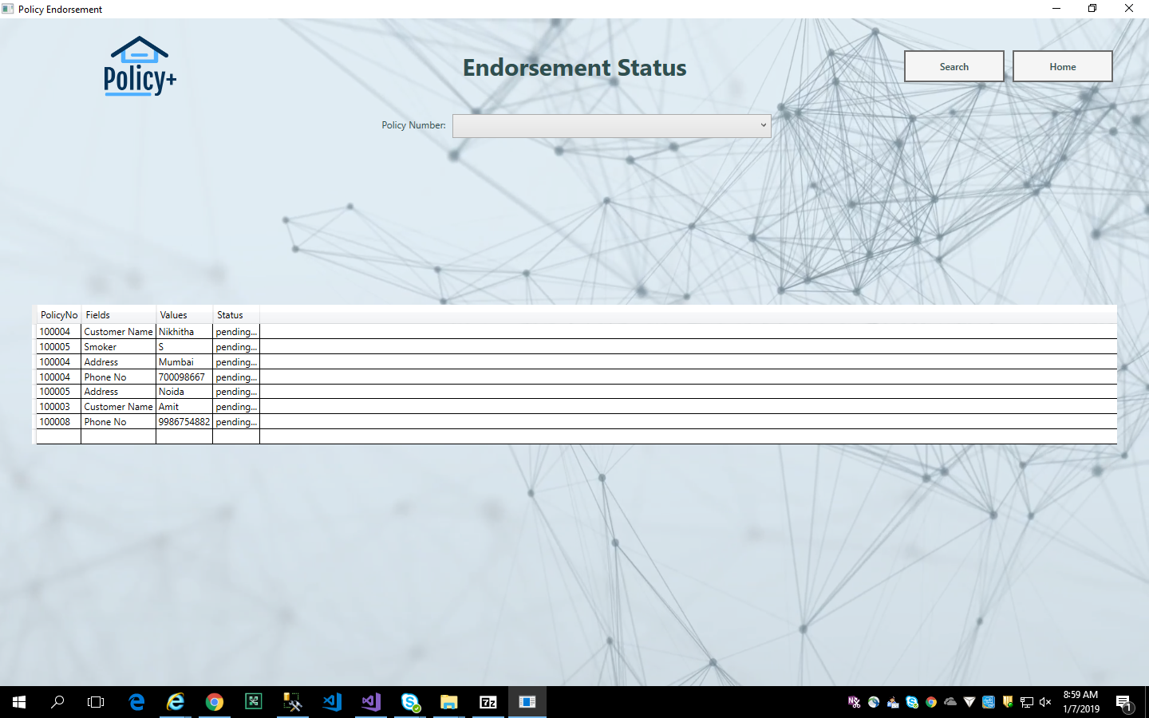
Endorsement Status Page

Slide 13
Future Enhancements
It will be safe to presume that online is the future for the Indian insurance industry.
Digitalization will make people more knowledgeable about various types of insurance policies.
Here you can search for a particular type of insurance and can compare between many brands to get the best deal.
Also, you get an appropriate amount of time to do proper research before buying the policy.

Slide 14
Thanks

