Slide 1
EcoTrace
Gamified Carbon Footprint Tracker & AI Eco-Coach
UN SDG 13: Climate Action Capstone Project
Prepared by: Sarthak Ghag
GitHub Repository: https://github.com/sarthakghag39-glitch/EcoTrace.git

Slide 2
PROBLEM STATEMENT
The Carbon Footprint Visibility Gap
Lack of Personal Footprint Visibility Individuals consume transit, food, and home utilities daily but have zero metrics translating these habits into kg of carbon equivalents (kg CO2e). Dry and Complex Existing Tools Most existing footprint calculators are static spreadsheets or dry questionnaires that fail to engage users or reinforce daily habits. The Personalization Deficit & Eco-Anxiety Generic environmental tips are too broad and ineffective. Users feel overwhelmed by the scale of climate action without localized, customized advice.
EcoTrace Capstone Presentation | SDG 13: Climate Action

Slide 3
PROPOSED SOLUTION
EcoTrace: A Gamified Ecology Companion
Premium Glassmorphic Web App A responsive Single Page Application (SPA) designed to make carbon emissions calculations visually immediate, intuitive, and beautiful. Dynamic Habit Gamification Converts carbon calculations and checked green quests into XP points, streaks, levels, and public standings to reinforce sustainable choices. AI-Driven Eco-Coaching Uses the Google Gemini API to analyze logged data in real-time, delivering localized, context-specific advice with a typewriter visual effect.
EcoTrace Capstone Presentation | SDG 13: Climate Action

Slide 4
KEY SYSTEM FEATURES
Interactive Core Modules
1. Carbon Calculator
2. AI Eco-Coach
A 4-part wizard translating travel, energy, diet, and waste into concrete kg CO2e.
Queries Gemini API for context-specific recommendations with a robust local safety fallback.
3. Daily Quests Log
4. Leaderboards & Charts
Checkable climate quests (e.g. Public Transit) that award XP and monitor carbon offset offsets.
Built with Chart.js to render history lines, category breakdowns, and compare top levels.
EcoTrace Capstone Presentation | SDG 13: Climate Action

Slide 5
SYSTEM ARCHITECTURE
Our Full-Stack Software Ecosystem
FRONT-END LAYER
BACK-END API LAYER
PERSISTENCE LAYER
• SPA Presentation: Client state coordinator (HTML5/CSS3).
• Vanilla JS (ES6+): Client-side event routers and JSON request dispatchers.
• Chart.js: Doughnut category charts and historical tracker logs.
• Typewriter Effect: Typing animation on the AI Insights panel.
• Node.js & Express: Hosts servers and handles JSON body request parses.
• REST Routing: Endpoint routing for auth, quests, and scores.
• Google Gemini API: @google/genai library executes prompt generations.
• Session Guards: JWT token authorization headers.
• JSON Database: db.json flat files storing profiles, logs, and quests.
• Custom ORM engine: db.js handles query search, updates, and inserts.
• Seeded Data: Populated leaderboard rankings and active daily challenges.
EcoTrace Capstone Presentation | SDG 13: Climate Action

Slide 6
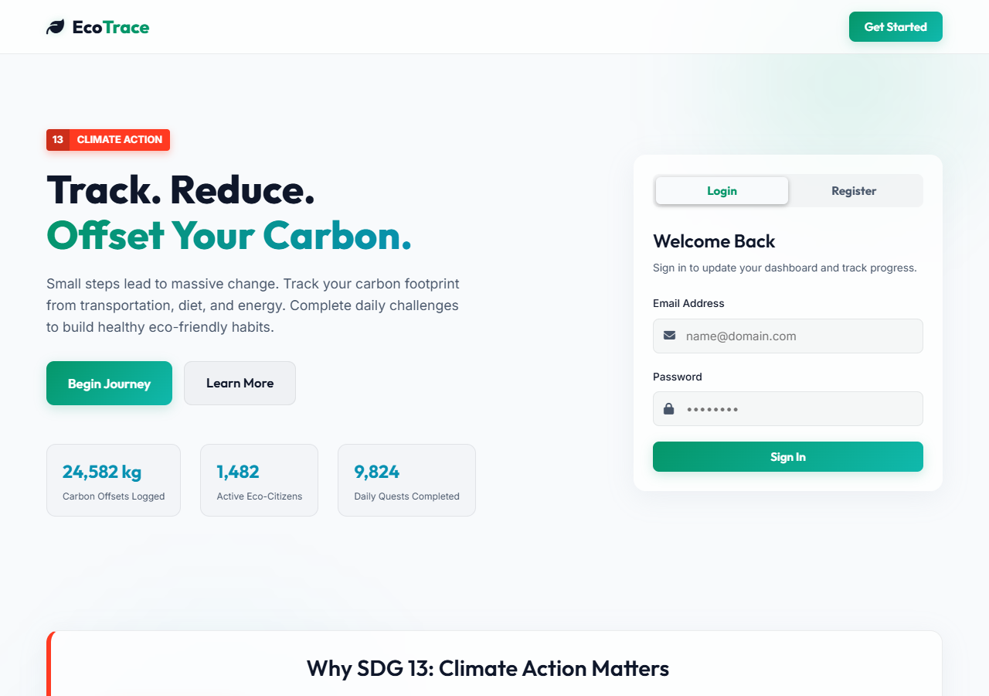
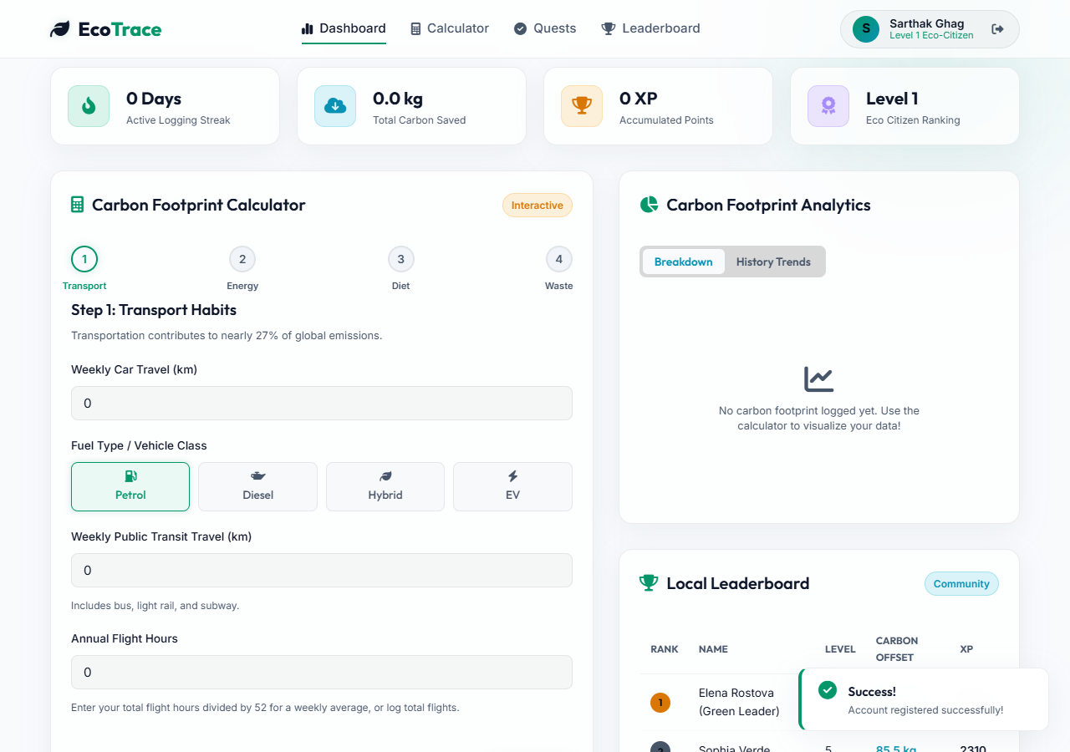
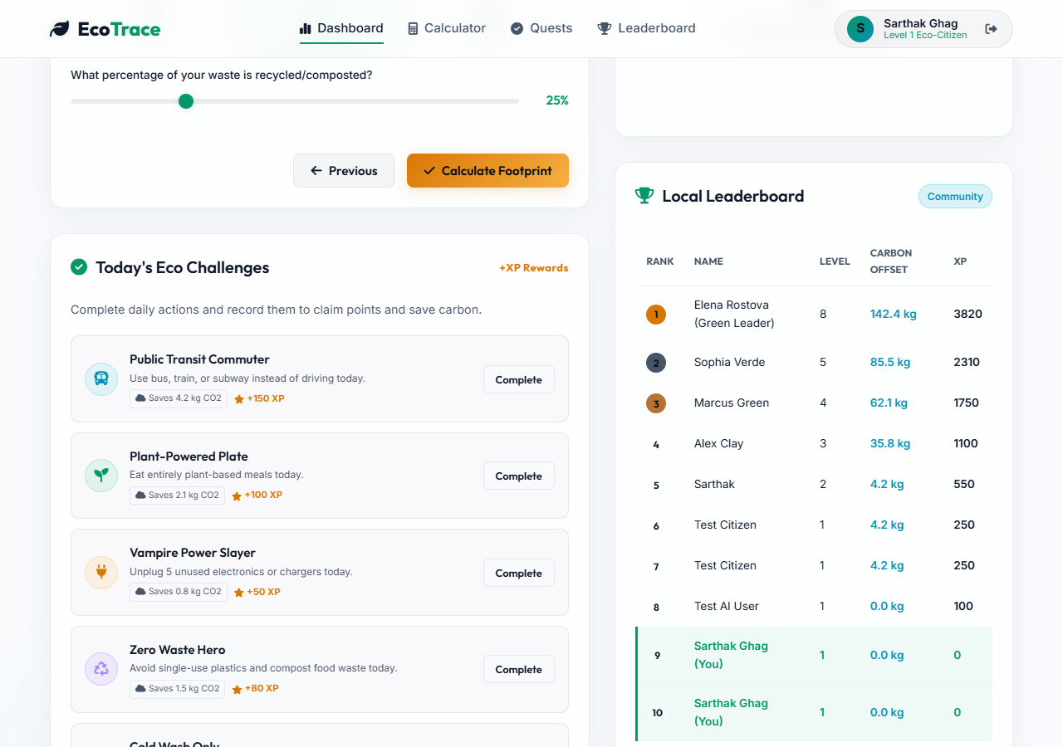
VISUAL TOUR - INTERFACES
Landing Page, Dashboard, and Wizard Calculator
1. Landing Page (Before Login)
2. User Dashboard (Initial state)
3. Input Wizard (Waste Step)
Rigid alignments showcasing the responsive Single Page Application paths.
Calculators use client-side sliders and state checks to direct database inputs.
EcoTrace Capstone Presentation | SDG 13: Climate Action

Slide 7
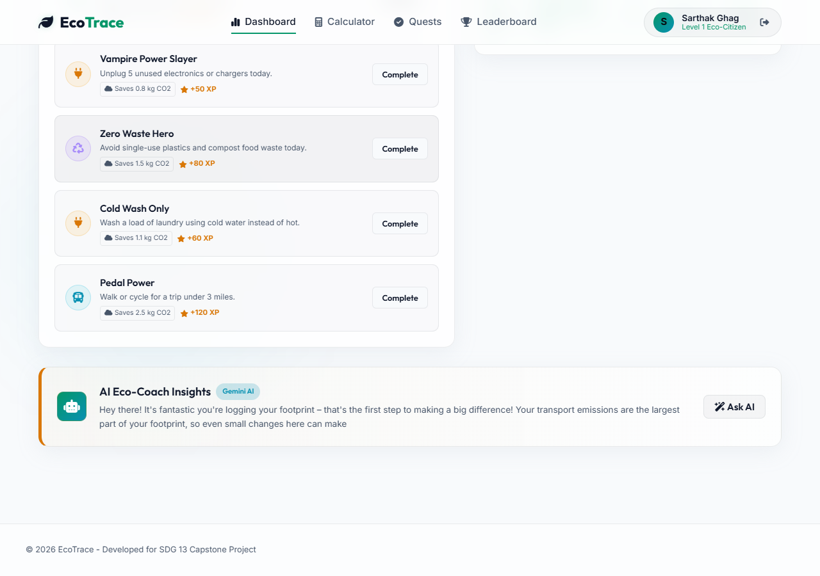
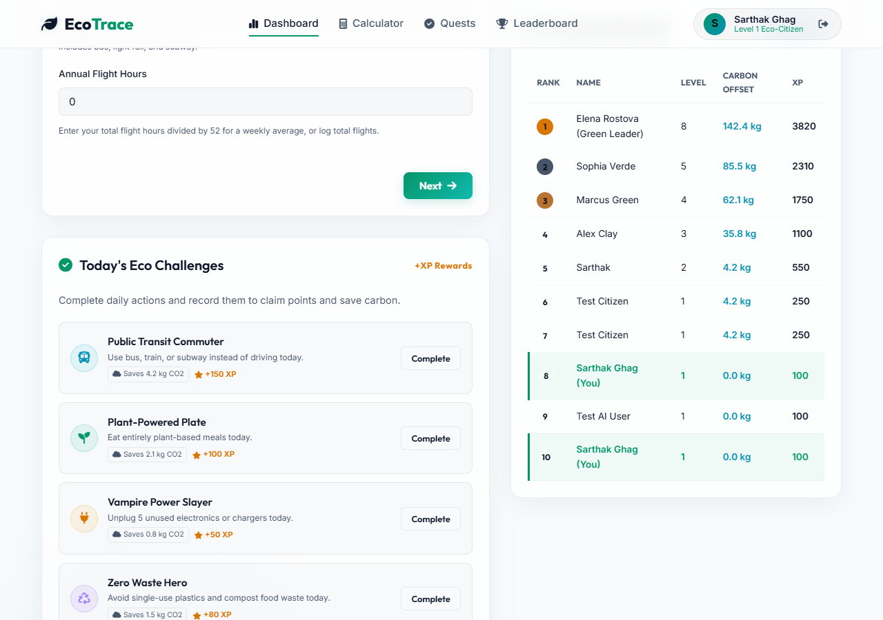
VISUAL TOUR - AI & ANALYTICS
Real-time Gemini Insights and Community Standings
4. AI Eco-Coach insights panel in action
5. Dynamic Chart.js and competitive leaderboard
Once footprint logs are sent, the AI Coach automatically renders typed advice based on categories.
Chart metrics instantly reflect user footprints, streaks, and community leaderboard standings.
EcoTrace Capstone Presentation | SDG 13: Climate Action

Slide 8
FUTURE SCOPE & CONCLUSION
Scaling Climate Action
Dedicated Mobile Applications (iOS & Android) Build native wrappers or specialized mobile views to enable push notifications for daily quests and quick-log calculator widgets. Smart Home IoT Utility Integrations Connect directly with home smart meters and vehicle APIs to automatically sync utility and distance metrics without manual input. Advanced ML Recommendations Train local, lightweight prediction networks to offer micro-tips based on weather trends, local transit grids, and seasonal cycles.
EcoTrace Capstone Presentation | SDG 13: Climate Action

