Slide 1
Software Testing
Unit 1 :Basic Of Software Testing

Slide 2
SOFTWARE QUALITY Fundamentals
DEFINITION
Software quality is the degree of conformance to explicit or implicit requirements and expectations.
Explanation:
Explicit: clearly defined and documented
Implicit: not clearly defined and documented but indirectly suggested
Requirements: business/product/software requirements
Expectations: mainly end-user expectations

Slide 3
What is Software Testing
Finding defects
Trying to break the system
Finding and reporting defects
Demonstrating correct functionality
Demonstrating incorrect functionality
Demonstrating robustness, reliability, security,maintainability, …
Measuring performance, reliability, …
Evaluating and measuring quality
Proving the software correct
Executing pre-defined test cases
Automatic error detection

Slide 4
Definition Of Software Testing
Testing is the execution of programs with the intent of finding defects.
Testing is a the process of exercising a software component
using a selected set of test cases,
with the intent of revealing defects and evaluating quality.
Software testing is a technical investigation of a product, i.e.
an empirical search for quality-related information of value to a
project’s stakeholders

Slide 5
Bug, Fault & Failure
A person makes an Error
That creates a fault in software
That can cause a failure in operation
Error : An error is a human action that produces the incorrect result that
results in a fault.
Bug : The presence of error at the time of execution of the software.
Fault : State of software caused by an error.
Failure : Deviation of the software from its expected result. It is an event.
Defect :A defect is an error or a bug, in the application which is created. A programmer while designing and building the software can make mistakes or error. These mistakes or errors mean that there are flaws in the software. These are called defects.

Slide 6
Nature of errors
Categories of Software Errors:
User interface errors such as output errors or incorrect user messages.
Function errors
Hardware defects
Incorrect program version
Requirements errors
Design errors
Documentation errors
Architecture errors
Module interface errors
Performance errors
Logic errors such as calculation errors

Slide 7
Why do defects occur in software?
Software is written by human beings
􀂾 Who know something, but not everything
􀂾 Who have skills, but aren’t perfect
􀂾 Who don’t usually use rigorous methods
􀂾 Who do make mistakes (errors)
Under increasing pressure to deliver to strict deadlines
􀂾 No time to check, assumptions may be wrong
􀂾 Systems may be incomplete
Software is complex, abstract and invisible
􀂾 Hard to understand
􀂾 Hard to see if it is complete or working correctly
􀂾 No one person can fully understand large systems
􀂾 Numerous external interfaces and dependencies

Slide 8
Sources of defects
Education
􀂾 Developers does not understand well enough what he or she is doing
􀂾 Lack of proper education leads to errors in specification,design, coding, and testing
Communication
􀂾 Developers do not know enough
􀂾 Information does not reach all stakeholders
􀂾 Information is lost
Oversight
􀂾 Omitting to do necessary things
Transcription
􀂾 Developer knows what to do but simply makes a mistake
Process
􀂾 Process is not applicable for the actual situation
􀂾 Process places restrictions that cause errors

Slide 9
Objective of testing
To find defects before they cause a production system to fail.
To bring the tested software, after correction of the identified defects
and retesting, to an acceptable level of quality.
To perform the required tests efficiently and effectively, within the
limits budgetary and scheduling limitation.
To compile a record of software errors for use in error prevention (by corrective and preventive actions)

Slide 10
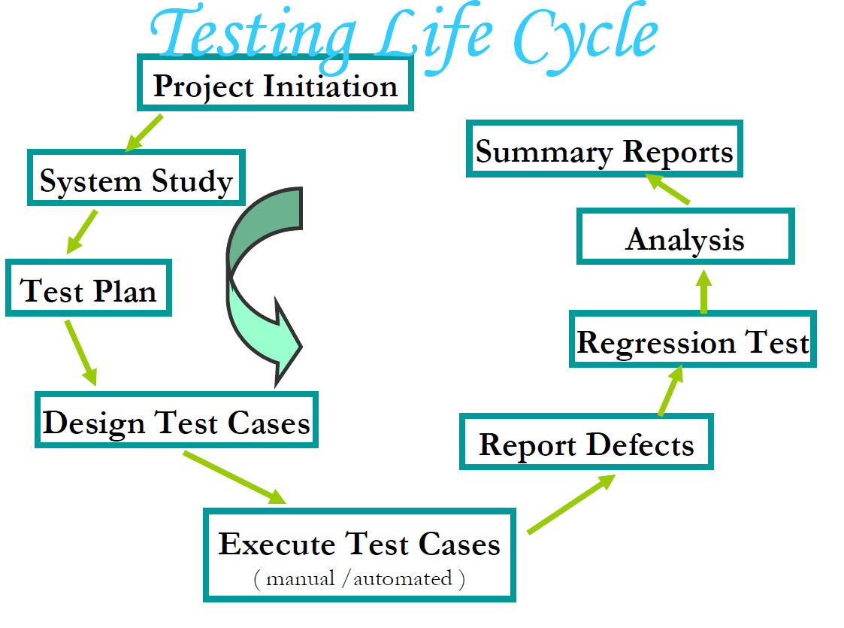

Slide 11
Who is a SoftwareTester??..
Software Tester is the one who performs testing and find bugs, if they exist in the tested application.

Slide 12
Skills Required for Tester
Communication skills
Domain knowledge
Desire to learn
Technical skills
Analytical skills
Planning
Integrity
Curiosity
Think from users perspective
Be a good judge of your product

Slide 13
Software Quality Concept
Quality : Quality means consistently meeting customer needs in terms of requirement, Cost and delivery schedule.
Quality of s/w is reasonably bug free, delivered on time and within budget, meets requirements and exceptions and is maintainable

Slide 14
Software Quality Concept
Quality Control: “All defined work products and Measurable Specifications” are compared with the output of each process.
Quality control focuses on operational technique and activities used to fulfill and verify requirement of quality.
- S/w quality involves – Series of inspection, reviews, and test used through out the s/w process.

Slide 15
Quality Assurance (QA): consist of Auditing and reporting procedure. Which are used to provide necessary data to management. In order to make decision.
Goal of Quality Assurance is to provide adequate confidence that a product or services is of the and quality expected by the customer.
If the data provided through quality assurance identify problems, then it is management’s responsibility to address the problems & apply the necessary resources to resolve quality issues.

Slide 16
S/w Quality Assurance is planned and systematic way to evaluate quality of s/w product standards processes and procedures.
SQA includes the process of insuring that standards and procedures are established and are followed throughout the software acquisition Life cycle.
“ SQA consists of a means of monitoring the s/w engineering process and methods used to insure quality ”

Slide 17
Standards: Standards are the criteria’s to which the s/w product are compared.
Documentations Standards: Specify form and
Contents for planning, analysis and product documentation and consistency through out a project.
Design Standards: Specify forms and contents of design product. They provide rules and methods for translating the s/w requirements into the s/w design.
Code Standards : Specify the language in which code is to written and define any restrictions on use of language features.
They define legal language structures, style conversions, rules for data structure and interface.
Procedure: Expected steps to be followed in carrying out a process.

Slide 18
Cost Of Quality
Cost of Quality is the total amount the company spends to achieve quality of product.
Quality of cost is divided into cost associate with prevention, appraisal and failure.
1. Prevention Cost: Quality Panning, Formal Technical reviews, test equipments, staff training.
2. Appraisal Cost: Equipment Maint. Testing.In process and Inter process Inspection.
3. Failure Cost : It will not consider if there is no defect before shipping.

Slide 19
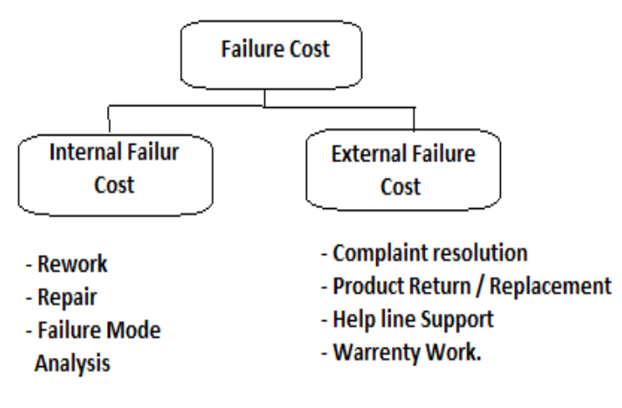

Slide 20
What is Verification?
Definition : The process of evaluating software to determine whether the products of a given development phase satisfy the conditions imposed at the start of that phase.
Verification is a static practice of verifying documents, design, code and program. It includes all the activities associated with producing high quality software: inspection, design analysis and specification analysis. It is a relatively objective process.
Verification will help to determine whether the software is of high quality, but it will not ensure that the system is useful. Verification is concerned with whether the system is well-engineered and error-free.
Methods of Verification : Static Testing
Walkthrough
Inspection
Review

Slide 21
What is Validation?
Definition: The process of evaluating software during or at the end of the development process to determine whether it satisfies specified requirements.
Validation is the process of evaluating the final product to check whether the software meets the customer expectations and requirements. It is a dynamic mechanism of validating and testing the actual product.
Methods of Validation : Dynamic Testing
Testing
End Users

Slide 22
Verification | Validation
1. Verification is a static practice of verifying documents, design, code and program. | 1. Validation is a dynamic mechanism of validating and testing the actual product.
2. It does not involve executing the code. | 2. It always involves executing the code.
3. It is human based checking of documents and files. | 3. It is computer based execution of program.
4. Verification uses methods like inspections, reviews, walkthroughs, and Desk-checking etc. | 4. Validation uses methods like black box (functional) testing, gray box testing, and white box (structural) testing etc.
5. Verification is to check whether the software conforms to specifications. | 5. Validation is to check whether software meets the customer expectations and requirements.
6. It can catch errors that validation cannot catch. It is low level exercise. | 6. It can catch errors that verification cannot catch. It is High Level Exercise.
7. Target is requirements specification, application and software architecture, high level, complete design, and database design etc. | 7. Target is actual product-a unit, a module, a bent of integrated modules, and effective final product.
8. Verification is done by QA team to ensure that the software is as per the specifications in the SRS document. | 8. Validation is carried out with the involvement of testing team.
9. It generally comes first-done before validation. | 9. It generally follows after verification.

Slide 23
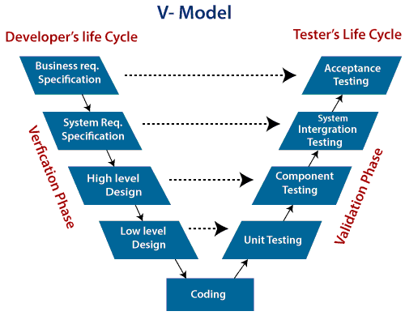

Slide 24
So V-Model contains Verification phases on one side of the Validation phases on the other side. Verification and Validation process is joined by coding phase in V-shape. Thus it is known as V-Model.
There are the various phases of Verification Phase of V-model:
1. Business requirement analysis: This is the first step where product requirements understood from the customer's side. This phase contains detailed communication to understand customer's expectations and exact requirements.
2. System Design: In this stage system engineers analyze and interpret the business of the proposed system by studying the user requirements document.
3. Architecture Design: The baseline in selecting the architecture is that it should understand all which typically consists of the list of modules, brief functionality of each module, their interface relationships, dependencies, database tables, architecture diagrams, technology detail, etc. The integration testing model is carried out in a particular phase.

Slide 25
4. Module Design: In the module design phase, the system breaks down into small modules. The detailed design of the modules is specified, which is known as Low-Level Design
5. Coding Phase: After designing, the coding phase is started. Based on the requirements, a suitable programming language is decided. There are some guidelines and standards for coding. Before checking in the repository, the final build is optimized for better performance, and the code goes through many code reviews to check the performance.

Slide 26
There are the various phases of Validation Phase of V-model:
Unit Testing: In the V-Model, Unit Test Plans (UTPs) are developed during the module design phase. These UTPs are executed to eliminate errors at code level or unit level. A unit is the smallest entity which can independently exist, e.g., a program module. Unit testing verifies that the smallest entity can function correctly when isolated from the rest of the codes/ units.
Integration Testing: Integration Test Plans are developed during the Architectural Design Phase. These tests verify that groups created and tested independently can coexist and communicate among themselves.
3. System Testing: System Tests Plans are developed during System Design Phase. Unlike Unit and Integration Test Plans, System Tests Plans are composed by the client?s business team. System Test ensures that expectations from an application developer are met.

Slide 27
4. Acceptance Testing: Acceptance testing is related to the business requirement analysis part. It includes testing the software product in user atmosphere. Acceptance tests reveal the compatibility problems with the different systems, which is available within the user atmosphere. It conjointly discovers the non-functional problems like load and performance defects within the real user atmosphere.

Slide 28
StaticTesting:
Static Testing is a type of a Software Testing method which is performed to check the defects in software without actually executing the code of the software application.
Static testing is performed in early stage of development to avoid errors as it is easier to find sources of failures and it can be fixed easily. The errors that can’t not be found using Dynamic Testing, can be easily found by Static Testing.

Slide 29
Dynamic Testing:
Dynamic Testing is a type of Software Testing which is performed to analyze the dynamic behavior of the code. It includes the testing of the software for the input values and output values that are analyzed.

Slide 30
Static Testing | Dynamic Testing
It is performed in the early stage of the software development. | It is performed at the later stage of the software development.
In static testing whole code is not executed. | In dynamic testing whole code is executed.
Static testing prevents the defects. | Dynamic testing finds and fixes the defects.
Static testing is performed before code deployment. | Dynamic testing is performed after code deployment.
Static testing is less costly. | Dynamic testing is highly costly.
Difference between Static Testing and Dynamic Testing:

Slide 31
Static Testing involves checklist for testing process. | Dynamic Testing involves test cases for testing process.
It includes walkthroughs, code review, inspection etc. | It involves functional and nonfunctional testing.
It generally takes shorter time. | It usually takes longer time as it involves running several test cases.
It can discover variety of bugs. | It expose the bugs that are explorable through execution hence discover only limited type of bugs.
Static Testing may complete 100% statement coverage in comparably less time. | While dynamic testing only achieves less than 50% statement coverage.
Example:Verification | Example:Validation

