Slide 1
A Case Study of Traffic Demand Response to Broadband Service-Plan Upgrades
Sarthak Grover, Roya Ensafi, Nick Feamster
Princeton University
Published at PAM 2016
CableLabs Conference ’16
Notes:
Replace pixalated logo
Does demand increase w capacity for very high tier users who are already satisfied
how the traffic demands of subscribers who are already on service plans with high downstream throughput respond to an undisclosed service plan upgrade as part of a randomized control trial (RCT)

Slide 2
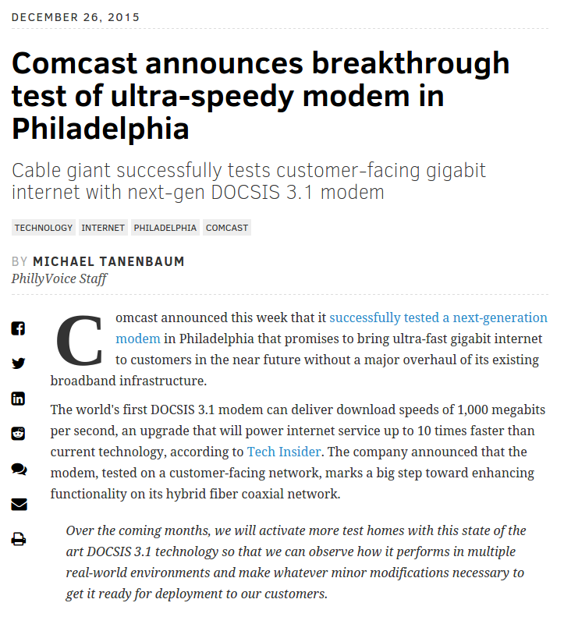
Why Study Traffic Demand Response
Network provisioning
Investments in infrastructure
Notes:
importance

Slide 3
Why Study Traffic Demand Response
FCC has redefined the download broadband benchmark to 25 Mbps from 4 Mbps
A survey of American households shows that the largest deterrent to broadband deployment is that consumers do not want the faster speeds [NCTA report]
Are considering benchmarks based on traffic demand
Notes:
Point 2 - is it consumer sentiment or operator survey
price is the second largest deterrent

Slide 4
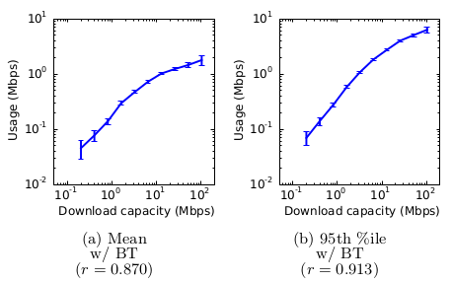
Previous Studies
Bischof et al. show that demand increases with capacity
“usage is strongly correlated with the group’s link capacity”
Notes:
Use natural experiments to explore impact of service upgrades on demand
Bin users that are similar in price, cost to upgrade, and link quality
users who are already maximizing their usage on a given link will continue to do so up to a certain point

Slide 5
Limitations of Previous Studies
Consumers who upgrade service are already unsatisfied
Consumers know they are upgrading, introducing a cognitive bias
Data collection is biased towards peak usage hours
Only consider price and link performance as factors, but there might be hidden factors such as region, ISP, or demographics that are not considered
Notes:
cognitive bias, unsatisfied customer datasets - prone to high correlation between demand and capacity, compounding factor

Slide 6
Traffic Demand Response to Service-Plan Upgrades
How do users adapt their demands when an ISP offers faster speed tiers when they are already satisfied?
Comcast upgraded a group of users from the same city from 105 Mbps to 250 Mbps without their knowledge
Highlights
Moderate subscribers exhibit a large difference in traffic demands
Significant difference during non-prime-time hours
Notes:
Add link to paper
our work complementary, large scale controlled experiment, higher tier (105 Mbps) that has never been studied before. Mitigates price, performance, and other potential biases
there is no performance bottleneck in our work + users don’t know about upgrade
we care about differences in traffic demand for a specific service tier if there is more capacity not the applications/devices contributing more to overall demand

Slide 7
Method: Randomized Controlled Trial
Eliminate biases and study the relationship between traffic demand and capacity for control and treatment groups
Control group and randomly selected treatment group
Same city, price, ISP, and a high service tier
Factor (intervention): unannounced service upgrade
Compare aggregate traffic demand of treatment and control groups during the same time period
Notes:
Mitigated biases: regional, price, cognitive, usage caps, “geek effect”
high tier - no pre-existing bandwidth or latency bottleneck, no unsatisfied customers
cognitive - customers do not consciously change their behavior due to knowledge of the upgrade

Slide 8
Data Characterization
Comcast subscribers in SLC, Utah with 105 Mbps plan
Network usage byte counters every 15 mins for 3 months
10% of 20k subscribers selected randomly were upgraded to a 250Mbps service tier, but they were not informed
Lost data: households with response rate lower than 80%
Finalized dataset
Control: 4845 subscribers
Treatment: 1519 subscribers
Notes:
SLC Utah, Comcast

Slide 9
Limitations of the Data and Method
We are not concerned with applications responsible for traffic. We do not have flow records, source or destinations; only uplink and downlink byte counters
Granularity is 15 min so we can not interpret link utilization
Comparison over the same time period
Notes:
what we can’t answer

Slide 10
Evaluation Metrics
Average traffic demand per subscriber: Bytes transferred in a measurement interval per subscriber
Peak traffic demand per subscriber: 95%-ile downlink traffic demand (per 15 minute interval) for a subscriber over the three month measurement period
Prime-time ratio: Average (hourly) traffic demand during prime-time hours to the average demand in non-prime-time hours
Peak-to-mean ratio: Ratio of daily 95%-ile traffic demand to mean traffic demand per subscriber
Notes:
Gray out might not show
OUTLINE
peak and avg per day
define PT and PT ratio
stats: aggregate per subsc, or per hour in a day, day in a week

Slide 11
Evaluation Metrics
Average traffic demand per subscriber: Bytes transferred in a measurement interval per subscriber
Peak traffic demand per subscriber: 95%-ile downlink traffic demand (per 15 minute interval) for a subscriber over the three month measurement period
Prime-time ratio: Average (hourly) traffic demand during prime-time hours to the average demand in non-prime-time hours
Peak-to-mean ratio: Ratio of daily 95%-ile traffic demand to mean traffic demand per subscriber
Notes:
stats: aggregate per subsc, or per hour in a day, day in a week

Slide 12
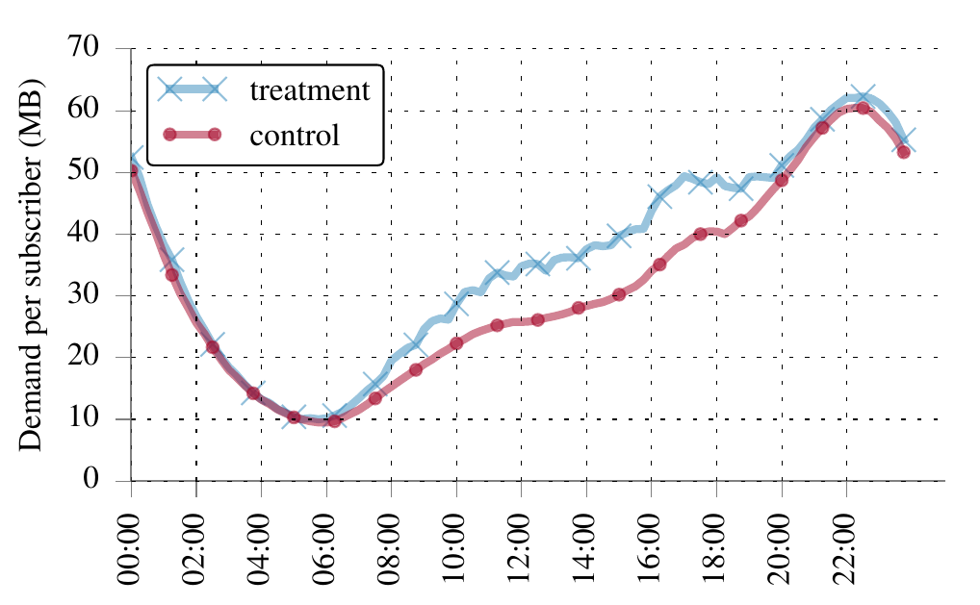
Weekday: Average Traffic Demand per Subs.
Large difference in demand during mid-day hours on weekdays
Notes:
every 2 hours => 8 avg demand per subsc. points
mid day hour increase is frankly surprising - you would expect the peak hours to be utilized more due to the service plan upgrade

Slide 13
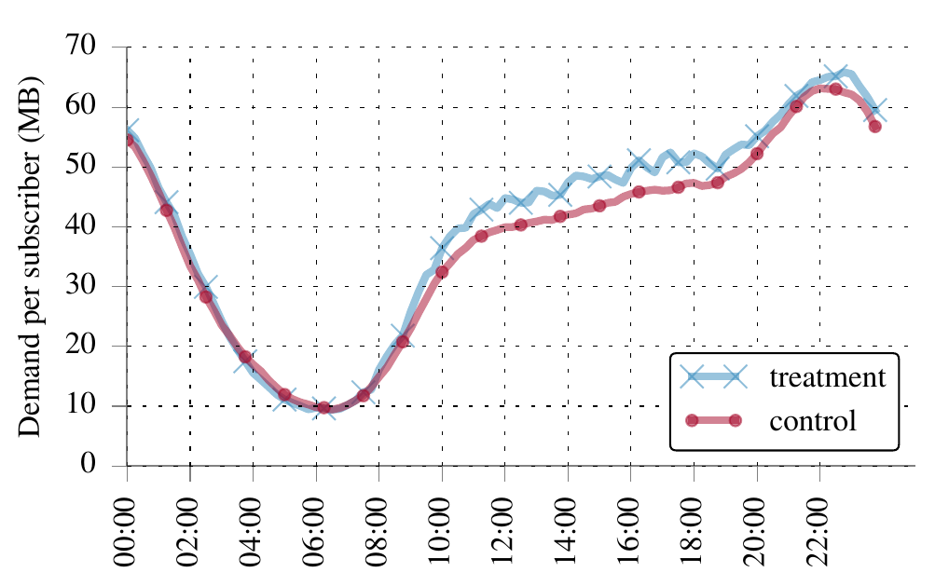
Comparison by Day of the Week
Weekday
Weekend
Median demand over the weekend is 10-13 MB higher for both groups as compared to weekdays due to consistent use over most of the day

Slide 14
Evaluation Metrics
Average traffic demand per subscriber: Bytes transferred in a measurement interval per subscriber
Peak traffic demand per subscriber: 95%-ile downlink traffic demand (per 15 minute interval) for a subscriber over the three month measurement period
Prime-time ratio: Average (hourly) traffic demand during prime-time hours to the average demand in non-prime-time hours
Peak-to-mean ratio: Ratio of daily 95%-ile traffic demand to mean traffic demand per subscriber
Notes:
We expect subscribers who download most bytes in higher service tier would cause the largest difference in demand

Slide 15
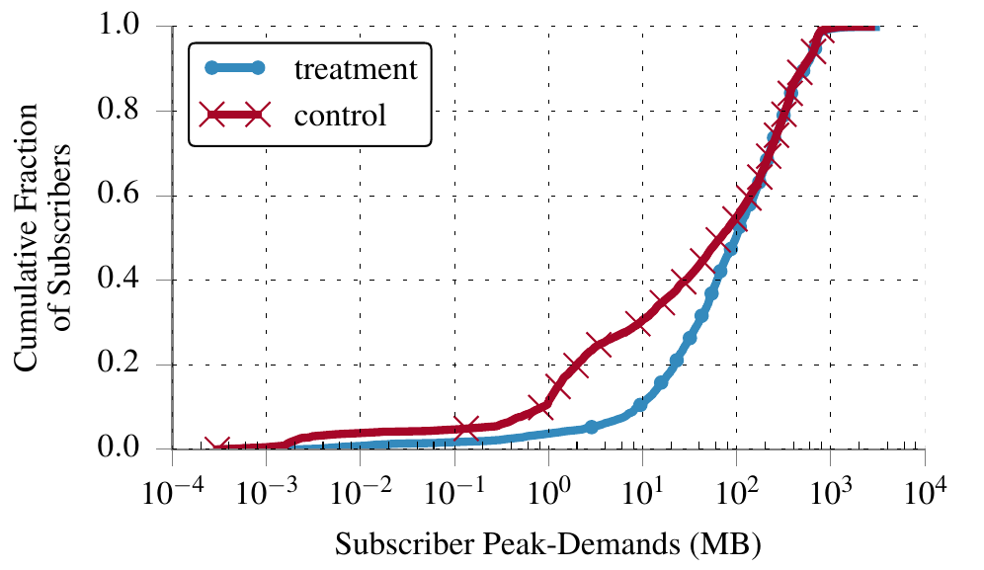
Peak Traffic Demand per Subs.
significant gap
Notes:
median 98.4 MB vs 66.7 MB

Slide 16
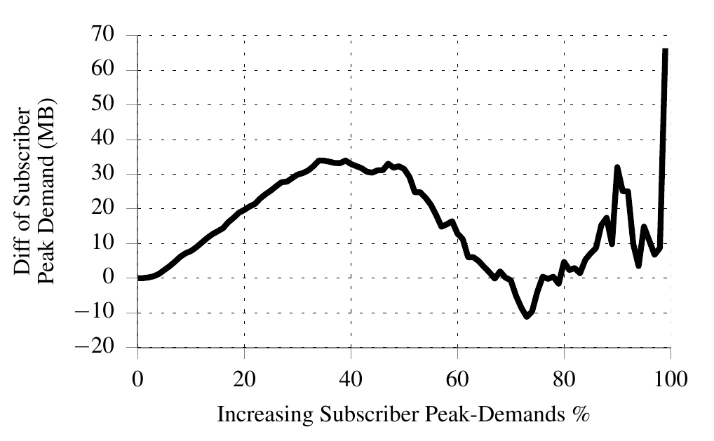
Change in Peak Traffic Demand per Subs.
Moderate subscribers exhibit larger differences in traffic demand
Notes:
70% of users are higher even though they are not using their full capacity in either case. they have peak demand less than 200 MB
This result suggests that even users who are not fully exhausting the available capacity at one service tier may increase usage at higher service tiers, perhaps because the improved performance at the higher tier may cause these subscribers to use the Internet more than they otherwise would.

Slide 17
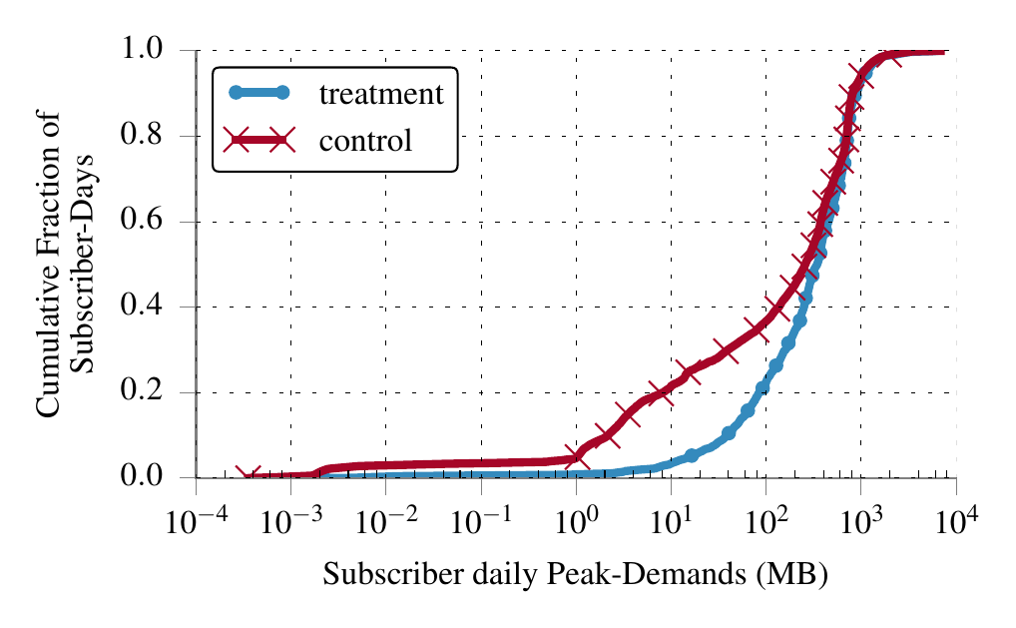
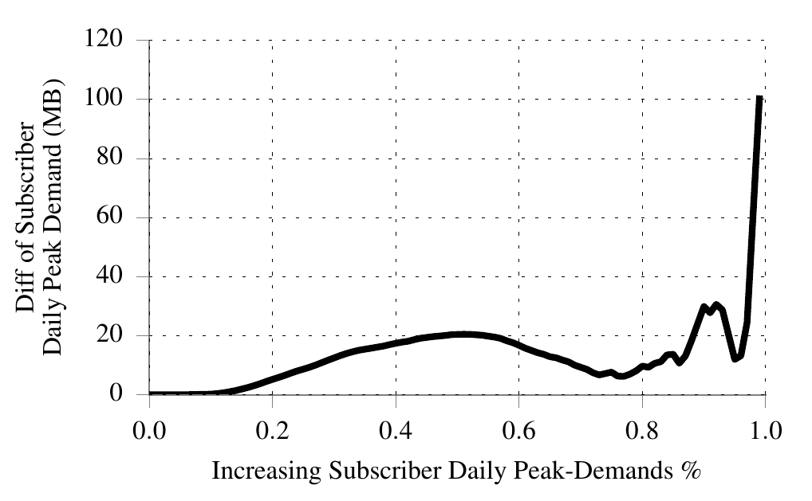
Change in Daily Peak Traffic Demand
70% of subscribers exhibit 5-20 MB difference in peak traffic demand on a daily basis
40% of subscribers with lowest peak demands in treatment have more than double the daily peak demands of control
Notes:
higher service tier may give better user experience (eg faster downloads?) - so maybe treatment group uses the internet more

Slide 18
Evaluation Metrics
Average traffic demand per subscriber: Bytes transferred in a measurement interval per subscriber
Peak traffic demand per subscriber: 95%-ile downlink traffic demand (per 15 minute interval) for a subscriber over the three month measurement period
Prime-time ratio: Average (hourly) traffic demand during prime-time hours (8p-12a) to the average demand in non-prime-time hours
Peak-to-mean ratio: Ratio of daily 95%-ile traffic demand to mean traffic demand per subscriber
Notes:
FCC defines prime-time as local time from 7p - 11p
Sandvine defines prime-time ratio as average (hourly) traffic demand during prime-time hours to the average demand in non-prime-time hours
Our analysis showed that 8p - 12a are the evening hours with the largest prime-time ratio

Slide 19
Comparison of Prime-Time Ratio
per subs. (MB) |  | Hourly traffic in PT | Hourly traffic in Non-PT | PT ratio
Weekday | treatment | 233.12 | 124.18 | 1.88
 | control | 225.40 | 104.30 | 2.16
Weekend | treatment | 246.93 | 143.08 | 1.73
 | control | 238.15 | 133.16 | 1.79
4% higher
19% higher
14% of treatment group and 9% if control group subscribers had prime-time ratio less than 1
Notes:
suggests working from home people who increase demand during non prime time

Slide 20
Summary
RCT to compare subscriber demands between two groups of high service tier subscribers
Users are not exhausting available capacity
However, subscribers with moderate traffic demands have a larger difference in demand between treatment and control, compared to subscribers who were sending high traffic volumes
Most significant differences were observed during non-prime-time hours
Notes:
surprised as intuition and previous work suggest that tier upgrade => exhaust extra capacity due to high volume subscribers

Slide 21

Questions
Thanks!
https://github.com/PrincetonUniversity/comcast-analysis

Slide 22
Backup Slides
Peak-to-mean ratio
Related work
Eval metrics
Change in daily peak demand
Prime time ratio

Slide 23
Evaluation Metrics
Average traffic demand per subscriber: Bytes transferred in a measurement interval per subscriber
Peak traffic demand per subscriber: 95%-ile downlink traffic demand (per 15 minute interval) for a subscriber over the three month measurement period
Prime-time ratio: Average (hourly) traffic demand during prime-time hours to the average demand in non-prime-time hours
Peak-to-mean ratio: Ratio of daily 95%-ile traffic demand to mean traffic demand per subscriber
Notes:
OUTLINE
peak and avg per day
define PT and PT ratio
stats: aggregate per subsc, or per hour in a day, day in a week

Slide 24
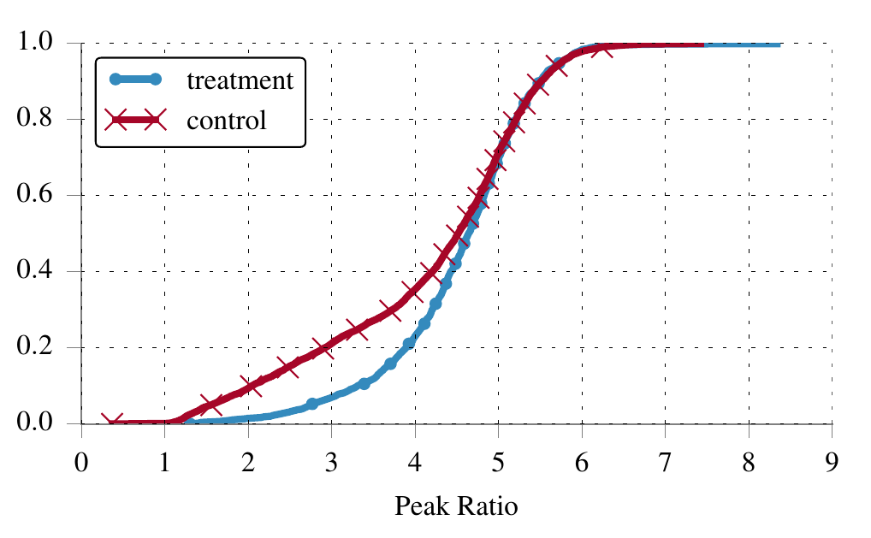
Daily Peak-to-Mean Ratio per Subs.
Subscribers in the treatment group have higher peak-to-mean ratio, however their absolute demand is still low
Notes:
daily ratio per subsc -> averaged -> 1 point per subs.
why choose this metric: many works compare peaks and means of groups separately.
we wanted to show disparity in increase not the absolute increase in peak and mean.
high peak to mean but (1) during non prime time and (2) absolute is low => prime time ratio is not significantly affected by them => do not affect the ISP much

Slide 25
Related Work
Sandvine reports study overall Internet traffic demand and analyze most popular applications during peak periods
Show that video accounts for 63% of overall traffic during peak evening hours
Our work characterizes home network traffic, and shows home users do not saturate their links
Notes:
our work complementary, large scale controlled experiment, higher tier (105 Mbps) that has never been studied before. Mitigates price, performance, and other potential biases
there is no performance bottleneck in our work + users don’t know about upgrade
we care about differences in traffic demand for a specific service tier if there is more capacity not the applications/devices contributing more to overall demand

Slide 26
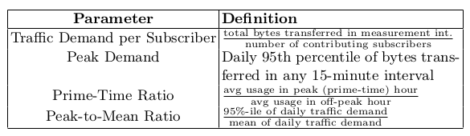
Evaluation Metrics
Notes:
OUTLINE
peak and avg per day
define PT and PT ratio
stats: aggregate per subsc, or per hour in a day, day in a week

Slide 27
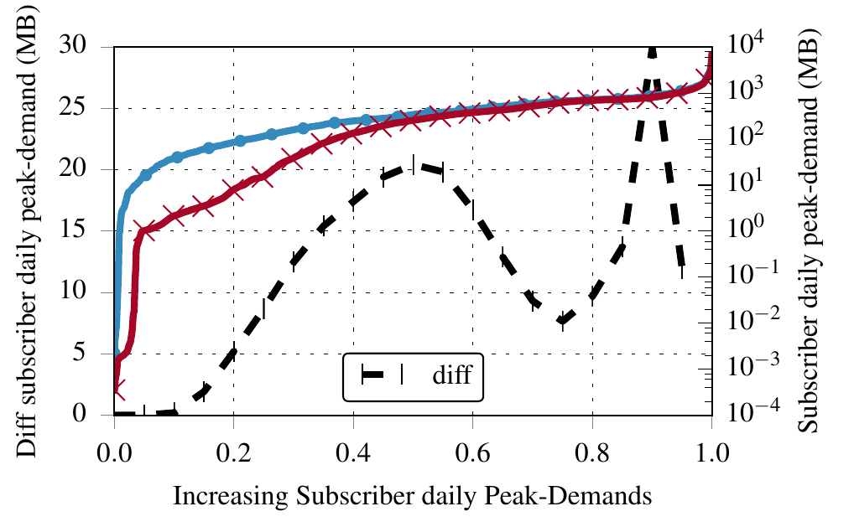
Backup: Change in Daily Peak Demand

Slide 28
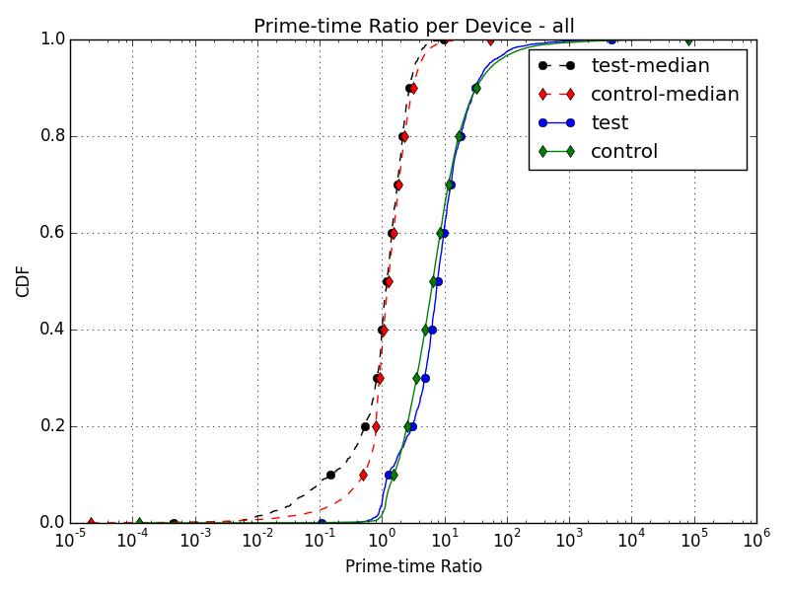
Backup: Prime-Time Ratio

Slide 29
Comparison of Prime-Time Ratio
per subs. (MB) |  | Hourly traffic in PT | Hourly traffic in Non-PT | PT ratio
Weekday | treatment | 233.12 | 124.18 | 1.88
 | control | 225.40 | 104.30 | 2.16
Weekend | treatment | 246.93 | 143.08 | 1.73
 | control | 238.15 | 133.16 | 1.79
Notes:
suggests working from home people who increase demand during non prime time

