Slide 1


Peeking Behind the NAT An Empirical Study of Home Networks
BISmark
Sarthak Grover, Mi Seon Park, Srikanth Sundaresan, Sam Burnett, Hyojoon Kim, Bharath Ravi, Nick Feamster
Georgia Tech
Notes:
This work presents a unique view of Internet connectivity and usage in home networks from the perspective of a gateway.

Slide 2




What is happening in the Home Network?
How are home networks connected to the Internet?
How do different devices connect in the home network?
How do users use the Internet?
Home
Network
Internet
Notes:
To know what's happening inside the home network.
Contrary to what you might think, nobody has this visibility today.
For example, Google can only see from apps, ISPs can only see on the other side of the NAT, etc.

Slide 3
Limitations of Previous Studies
Measured from end-host or server
Not longitudinal
Lacks view of NAT
Design studies rely exclusively on human subject interviews
Not quantitative
Home
Network
Internet
Let’s measure from the gateway
Notes:
There has been some previous effort into studying hns. But they don’t tackle the questions we have asked in this work comprehensively.
Approach – uses server side or end host side measurement platforms so Not continuous measurements over time – look at devices inside the NAT
automatic quantitative measurements are accurate and can reveal observations which are not obvious to users.
We’ve tried measuring from clients inside the HN, we’ve tried measuring from server outside, and we’ve tried measuring from the user itself – but there is one device we’ve neglected – the gateway – a device that talks to the outside, inside, and is the gateway for all user online activity!
We claim that we can conduct better home network measurements by collecting measurements from the home router because it offers a solution to both the problems with existing approaches. In the remainder of this talk I'll introduce the platform we've used for collecting these measurements (BISmark) and give you some examples of the kinds of measurements we can collect

Slide 4
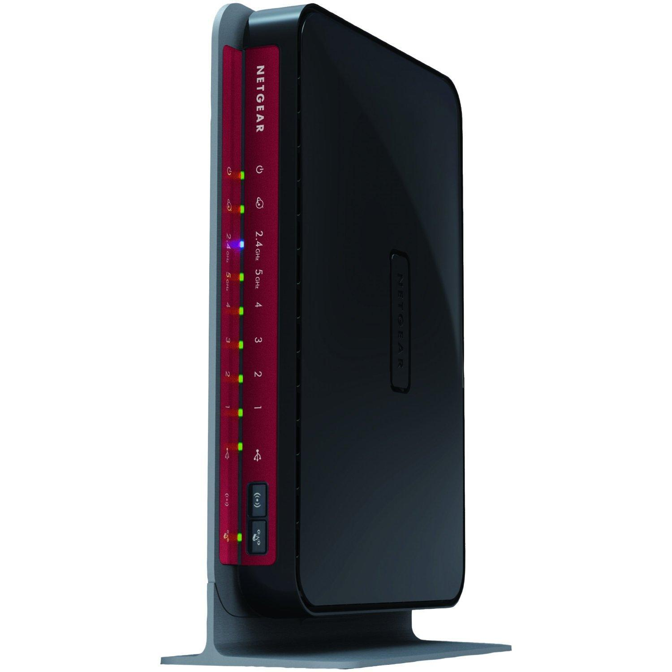

BISmark: Peeking Behind the NAT
A programmable gateway
Can see all devices behind the NAT
Performs continuous measurements
We use 140 routers in 30 countries for this study
Data from October ‘12 – April ‘13
Notes:
You’ve already seen 2 talks about project bismark – so I’ll keep this brief.
What do want: programmable gateway, Why do we want it: to see all devices and to perform continuous measurements
We want to observe the properties of the HN over time – we want to see the connectivity to the outside, all the devices inside, and we want to see user traffic too.
And project bismark gives me the perfect platform to perform these measurements throughout the world.
For this work we had around 140 routers in over 30 countries throughout the world.
We used data from about an year of measurements to study some interesting questions about home networks

Slide 5
Questions
Connectivity to Internet
How frequently do home networks disconnect?
Device connectivity inside the home
Are there connectivity patterns?
How crowded is the Wi-Fi?
Internet usage
Do users saturate their links?
Does usage differ across devices?
Availability
Infrastructure
Usage
Characteristics
Notes:
I've organized this talk in three main sections based on which aspect of the H.N. we study.
1. Availability - connectivity of the network to the internet
> how disconnencted a HN is
2. Infrastructure - connectivity of the devices which make up the HN
> how device connectivity varies, how crowded is the wifi
knowing the connectivity of devices doesn't really mean that a user is using the device - so we want to go deeper - we want to see
3. Usage characteristics - usage across devices to different destinations
> do users saturate the link?, which device is most used? which domains are most popular?

Slide 6
Outline
Availability
Analyze Internet connectivity to home networks
User behavior affects access link connectivity
Infrastructure
Study the wireless spectrum usage in homes
Wireless device connectivity has a diurnal pattern
Usage characteristics
Analyze traffic patterns by device and domains
Users don’t saturate their links
Notes:
Just a few interesting highlights from the paper. I’ll start with a look at the connectivity towards the outside

Slide 7
Availability of Home Gateways
Why measure home network connectivity?
To monitor ISP performance
Connectivity can be measured using periodic heartbeat probes
Missing heartbeats indicates downtime
Access network is offline (network downtime)
Router is offline (router downtime)
Notes:
Why do we want to measure avail of home gateways?
Regulators and users want to monitor ISP performance, connectivity is an important parameter
How we do this – simply ping the server, measure the times you can’t hear the ping – right? Well NO. Not right.
If we don’t get pings for 10 mins we say that a downtime has occurred – and this can happen due to the network being offline or due to the router being offline.

Slide 8
How many downtimes per day?
Median number of downtimes per day = 0.11
Developed
Median freq = 0.06
0.8
Why such a large difference?
0.6
CDF
Developing
Median freq = 0.9
0.4
0.2
0.01
0.1
1
10
Downtime frequency
Notes:
Now that we’ve defined downtime, we can analyze the frequency of downtimes for each bismark router. routers). median num of dt per day = 0.11, so downtime every 9 days.
But this seemed really high to us as a user, so we tried slicing the data to make sense of it and one of the groupings we considered was developed nations v.s. developing nations, defined based on their GDP per capita. So we plotted a distribution of the frequency of downtimes which I show here.
This seems like a huge difference, and one of the reasons could be the access network, but we don’t know. What we ended up finding was a very interesting other reason.
We group these measurements into those from developing nations v/s those from developed, and we do this because there has been previous work indicating that network conditions (such as network infrastructure) varies a lot across these two groups.
So we plotted distributions of downtimes and found that, on an average there are 30 days between consecutive downtimes
first report some aggregate statistic (downtime for *all* for a developed nation. In contrast, routers in developing nations suffered downtime almost every day on average. But why was there such a large difference in the number of days between 2 downtimes? Is it really because access network conditions differ between the two?

Slide 9
User Behavior can Cause Downtime
Always-on
Nights
Access network problem
Connectivity
Days
Some users switch off their routers when not in use
Intermittent
Diurnal
Weekends
Weekdays
Weekends
Days
Notes:
To explore this in more depth we studied connectivity of the routers over a few days.. Here I’ll show a sample of the patterns we saw. Let gray denote night hours, weird olive-green weekends. We could basically classify the access link availability into 3 categories:
Most routers in developed nations had a link which was always connected
Sometimes we saw that the link had intermittent connectivity, and we confirmed that this was due to a problem in the network.
Some routers from developing nations showed us a curious pattern in downtimes – connectivity was observed during evening hours, and on the weekends – i.e. a diurnal connectivity pattern. Turns out, the network was not at fault here but in fact router was being switched off when not in use. The point is, that users may be using home gateways as an electrical appliance – switching it off to save electricity or due to data caps, and this can cause so called downtime.

Slide 10
Highlights of the Talk
Some users switch off their routers causing downtime
Notes:
Implications: Users switch off their routers – never really thought about this – we tend to assume the router is one of those always on kinda devices, like phones. But that’s not really true.

Slide 11
Outline
Availability
Analyze Internet connectivity to home networks
User behavior affects access link connectivity
Infrastructure
Study the wireless spectrum usage in homes
Wireless device connectivity has a diurnal pattern
Usage characteristics
Analyze traffic patterns by device and domains
Users don’t saturate their links
Notes:
#wired in paper
Now what about the connectivity inside the home network.
Next we’ll look at some of the technologies inside the HN infrastructure, in particular the wireless connectivity. Other results on wired connectivity and devices in the home are in the paper.

Slide 12
Infrastructure in Home Networks
Why study devices and technologies used inside the home network?
Reveal connectivity patterns
Measure how crowded the spectrum is
Infrastructure can be studied by monitoring
Devices connected to home router
Other APs seen on the same channel
Notes:
Why is the study of infrastructure important. One reason is
To study connectivity patterns
Users know their wifi is bad due to neighborhood interference, and regulators and ISPs can use the same approach of measuring from the gateway we’ve used to perform a concentrated study of the wireless spectrum in a region and request more spectrum in countries which have only 2.4 GHz open.
We study the infrastructure by regularly recording the number of devices connected to the router to expose connectivity patterns if any, and we monitor other access points seen from the gateway to get a hint about the neighborhood interference on the same channel as the router.
//(Furthermore cognitive radios develop schemes to sense and switch channels [Xeng2009] – this study can provide insight into channel occupancy)

Slide 13
Are there Connectivity Patterns?
3.0
Weekday connectivity is diurnal
Weekend connectivity is consistent
Number of Devices
2.5
2.0
1.5
1.0
0
2
4
6
8
10
12
14
16
18
20
22
Time of Day
Notes:
Looking at connectivity of devices over the day
For weekends the number of devices seemed more consistent throughout the day
For weekdays though, number of devices decreased during the afternoon and went back up again after the evening, presumably because the user is at work during the afternoon phase.
#useful for
ISPs can accumulate this data and use it to engineer the network to be more efficient, for example allocating network resources dynamically to give users at home more
#So we know the kind of pattern we see, what about the number of devices across homes

Slide 14
2.4 GHz Spectrum is Crowded
Number of devices seen
Number of APs seen
>60
10
Neighborhood APs
Devices
5
Bi-modal distribution
20
2.4 GHz
2.4 GHz
Notes:
We look at the 2.4 GHz spectrum, in particular 1. the devices connected on the 2.4 GHz interface, and 2. the neighborhood APs on the same channel as the home gateway on 2.4 GHz.
#By default this is channel 11 but a user may change this as needed.
We see that on an average the router sees 5 connected devices in the home network on 2.4 GHz. In some homes, this number may be as big as 10 devices.
We also see that on an average the router sees 20 other access points on the same channel as itself. In some cases, the number of neighborhood APs seen is more than 60!
Interestingly, this distribution of neighborhood access points seen is actually bimodal – so a small set of homes sees around 3 devices on avg, whereas others see 20!
So 2.4 GHz is crowded for HN
Implications: this may be a cause of bad wifi at times.

Slide 15
Highlights of the Talk
Some users switch off their routers causing downtime
Wireless connectivity is diurnal on weekdays
2.4 GHz is crowded compared to 5 GHz
Notes:
Connectivity pattern is diurnal on weekdays **google will kill for this info
should I add 2.4 GHz is crowded here? ** yes we can confirm some previous results and numbers, but aim was to show an approach to do these measurements. In fact regulators can deploy bismark in a concentrated area to measure the neighborhood, and possibly use the same approach we did to show that the wireless spectrum is too crowded and that there is a need to open the 5 GHz band.

Slide 16
Outline
Availability
Analyze Internet connectivity to home networks
User behavior affects access link connectivity
Infrastructure
Study the wireless spectrum usage in homes
Wireless device connectivity has a diurnal pattern
Usage characteristics
Analyze traffic patterns by device and domains
Users don’t saturate their links
Notes:
We presented an approach to measure crowding in the home network which can be used by others in more concentrated studies.
We’ve seen how to measure outside connectivity, how to measure connectivity in the inside,
#But just being connected does not mean network is being used by the user. To find how the user uses the HN we need to delve deeper into traffic.
In this final section of the talk, I’ll look at network traffic and patterns we observe, and I’ll show how much a user actually utilizes the link.

Slide 17
Home Network Usage Characteristics
Why measure home network traffic?
Compare total traffic utilization to access link capacity
Reveal usage patterns differ by source or by destination
Passive monitoring of traffic (with explicit consent)
Packet and flow statistics
DNS responses to a user customizable whitelist
Notes:
Why do we want to measure usage characteristics. For one,
Important for users to know if their bandwidth is sufficient for their usage, or if they are underutilizing the link.
ISPs may be interested in seeing usage patterns – esp if usage patterns can give us a hint about the device being used.
To measure the actual traffic usage and characteristics, we get consent to collect various kinds of passive usage data (e.g., flow and DNS statistics)
#based on 25 homes which had enough data in the time periods we considered Packet statistics to estimate total traffic utilization of access link, flow statistics to see usage by device,
We explain the information collected by bismark-passive in more detail in the paper.

Slide 18
Do Users Saturate their Links?
100
Capacity
Throughput (Mbps)
Large difference between traffic utilization and access link capacity
80
60
Traffic Utilization
Half the houses saturate less than 50% of the available capacity
40
20
0
04-02
04-04
04-06
04-08
04-10
04-12
04-14
Notes:
So first, we compare the actual traffic in a home network to the estimated capacity of the access link. Using bandwidth measurement tools, we estimated the capacity of the network, for this example in one case it was 100 Mbps. Next looking at precise packet timings and packet lengths, we estimated the traffic utilization of the link in terms of bytes transferred per second. In this toy example I show that the actual traffic usage peaked to only about 20 Mbps, in bursts occasionally. In such cases we see a huge gap between the utilization of the link and the available link capacity.
In fact, out of the 25 homes with bismark-passive installed that we analyzed for this work, 13 used less than half the available capacity in downlink. And only 2 houses actually saturated their uplink, the rest used less than 50% of the capacity in uplink.

Slide 19
One Device Generates Most Traffic
Most traffic is due to a single usage hungry device even in homes with 3+ devices
60%
Usage Fraction
20%
long tail
Most used device
Least used device
Notes:
We observed over our dataset that
#After the overall traffic utilization, we analyzed traffic usage by home device.
What we found was that home networks tend to have a “most used device” which contributes to most of the traffic. In our analysis, the most used device in homes accounted for an average of 60% of the total data passing through the access point. The second most used device contributed 20% of the traffic on an average, and this was followed by a long tail depending on the number of devices .
Thus we can say that most traffic in home networks is due to a single usage hungry device.

Slide 20
More Traffic by Volume, Less by Number of Connections
Most popular whitelisted domain (by volume)
14%
2nd most popular domain
Connections
7%
11%
38%
Traffic volume
Popular domains tend to serve streaming content over long-running TCP connections
Notes:
Up until now, we’ve counted traffic usage in terms of amount of traffic generated from a particular source. We can also analyze traffic to a particular domain based on the domain responses we can look at. Thus another criteria which we can use to analyze traffic usage is the number of connections to a particular domain.
In this graph, we plot the fraction of traffic by volume to the most popular domain, versus the fraction of traffic by number of connections to the same domain. We see that traffic by volume accounts for 38% whereas there were only 14% of the total connections to that same domain. Similarly, traffic to the 2nd most popular domain accounts for 1% of the volume but only 7% connections. This implies that popular domains serve streaming content over long-running TCP connections.
Note that we use a default whitelist to look at domain responses only from the top 200 alexa popular websites. This whitelist is user customizable. Any domain not on the whitelist is anonymized.
** top domains in yesterday’s talk

Slide 21
Highlights of the Talk
Some users switch off their routers causing downtime
Wireless connectivity is diurnal on weekdays
2.4 GHz is crowded compared to 5 GHz
Users don’t saturate their links
Most traffic is due to a single usage hungry device
Traffic to most popular domains from home networks are over long-lasting connections
Notes:
Connectivity pattern is diurnal on weekdays **google will kill for this info
should I add 2.4 GHz is crowded here? ** yes we can confirm some previous results and numbers, but aim was to show an approach to do these measurements. In fact regulators can deploy bismark in a concentrated area to measure the neighborhood, and possibly use the same approach we did to show that the wireless spectrum is too crowded and that there is a need to open the 5 GHz band.

Slide 22
Teasers
Most frequent and long lasting downtimes occurred in countries with lowest GDP per capita.
Even though wireless devices exceed wired devices considerably, more than half the homes have at least one wired device. All four ports are rarely used.
Different types of devices have different most popular domains.
Device Fingerprinting
Notes:
Top domains by volume for a desktop are different than top domains for a roku box which accesses more streaming content

Slide 23
Takeaway
A measurement approach using a home router to study connectivity and usage of a home network
Notes:
# home network measurement from routers work – give us some very interesting observations – might be directly useful for providers, users themselves, or even to know behavioral patterns
Availability – monitor ISPs, design better context aware pervasive applications
Infrastructure – Regulators open 5 GHz spectrum in certain countries, (cognitive radio schemes which switches between channels for one with least interference)
Usage characteristics – cool for users, refutes the claim that only user profiling is important as usage varies across devices, show that home broadband is unsaturated - may be useful for sharing?

Slide 24

Thank you!
Data and code at:
http://projectbismark.net
Get involved:
http://projectbismark.github.io/
Contact:
www.gtnoise.net/~sarthak
sgrover@gatech.edu
Notes:
Our paper gives the gory details about each of the datasets we collect

