Slide 1
Team CoviCare
Project Name - Social Distance Detector
By-
Priyanshu Rishi (RA1911042010041)
Sarthak Gupta (RA1911042010043)

Slide 2
Installing dependencies & libraries
Firstly we will check our NVIDIA Graphic Card version. Then we will install some dependencies like pyyaml. After that we will see the details and versions of the modules and libraries installed in the notebook for our project. Then, we will install the library - Detectron2. After installing this library, we need to restart our runtime to let the installation expressed. Setup Detectron 2 logger with some common libraries (like - numpy, matplot,cv2,etc) and Detectron2 utilities (like - model_zoo, get_cfg, visualizer,etc).

Slide 3
Visualization of the input-video
Now we will specify the path to video from our Google Drive and capture the video by using cv2 library and then will check if it is uploaded successfully or not. If yes then we will proceed and will define the frame rate of the video. Now add project-specific config & find a model from detectron2’s model zoo. Then we will read a random image from the frames folder and then use `Visualizer` to draw the predictions on the image. Now we will specify some instances, like -
0 for person,
2 for car,and
25 for umbrella.

Slide 4
Identification of ‘persons’
Now firstly we will identify total number of ‘persons’ from the clip and bound them into boxes and then will assign the dimensions of a single person in a box. Now we will define a function which compute and return the bottom center of every box and then will call the function and visualize the image.

Slide 5
Computing distance
By using Euclidean’s method we’ll compute distance between a set of two persons. Now using pandas library we will make a table which will show the distance between two persons. Now we will change the boundary box color of each person, if social distance is followed then the color will change into blue else it will change into red.

Slide 6
Editing & Exporting of video
Now this part contains the code where the video will be edited. Now using ‘tqdm’ which is a Python library that allows us to output a smart progress bar by wrapping around any iterable, we will render our output video.
Finally by reading each file and inserting the frames into an image array, we will export the output video into our Google Drive

Slide 7
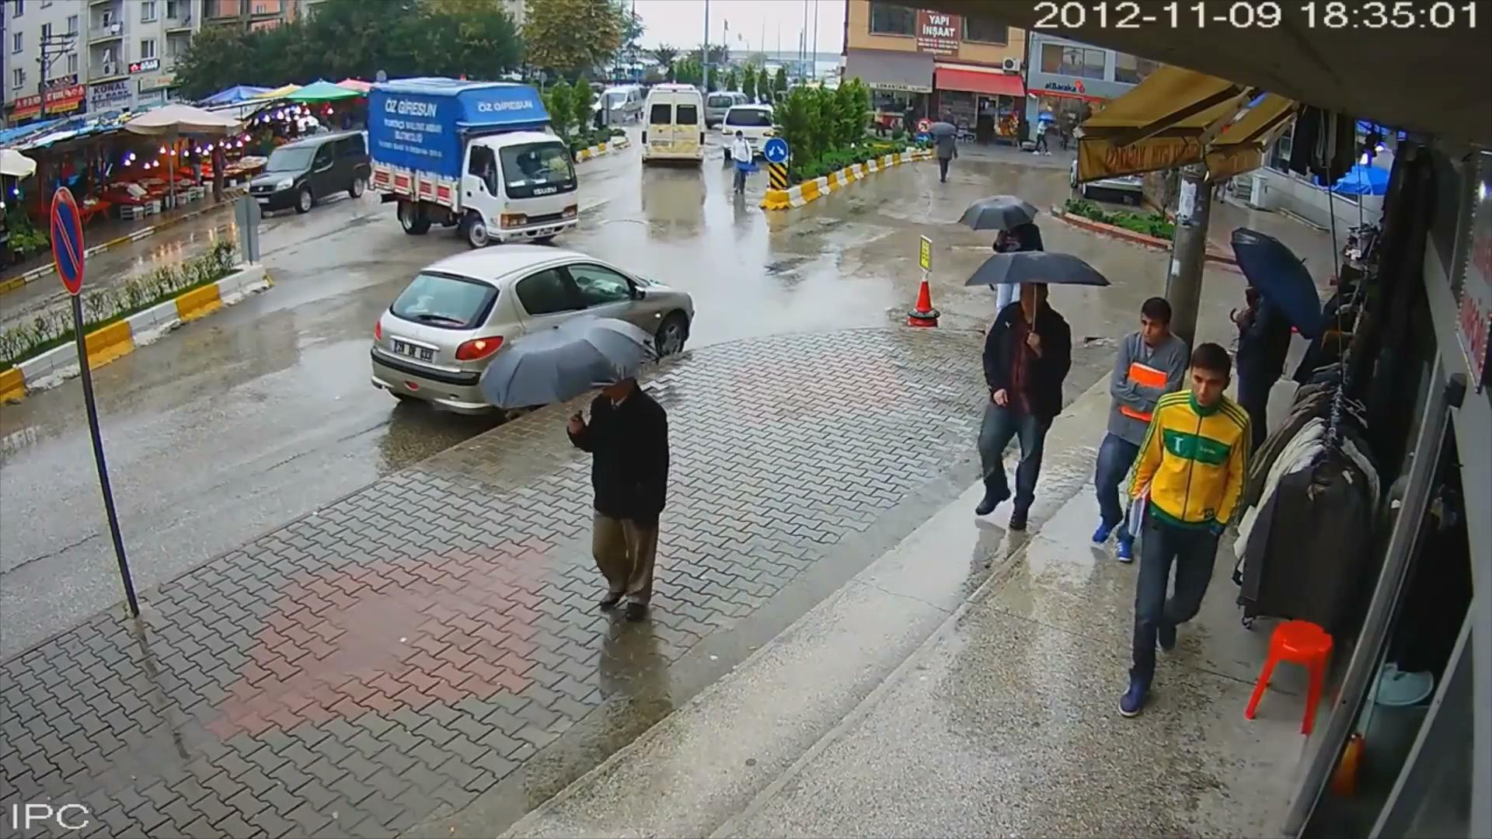
Sample Input video

Slide 8
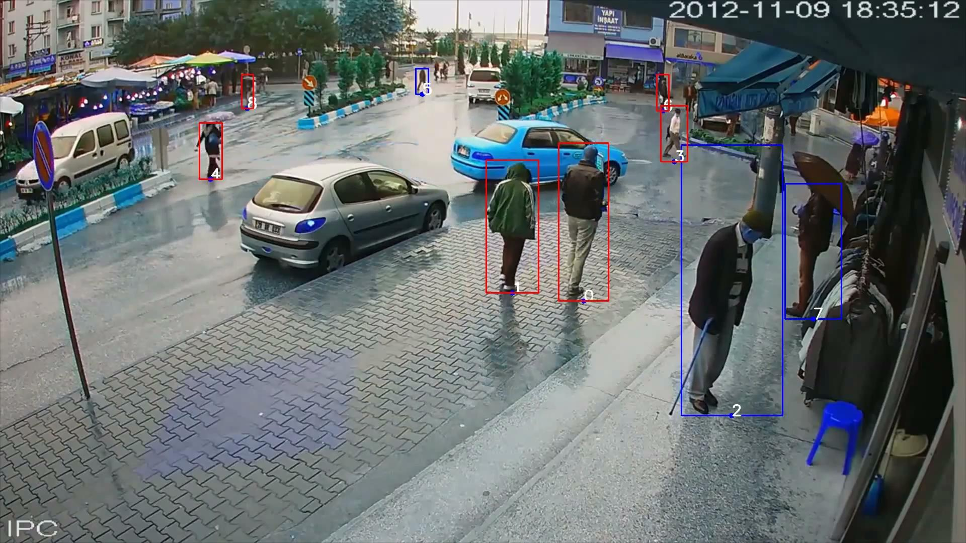
Sample Output video

Slide 9
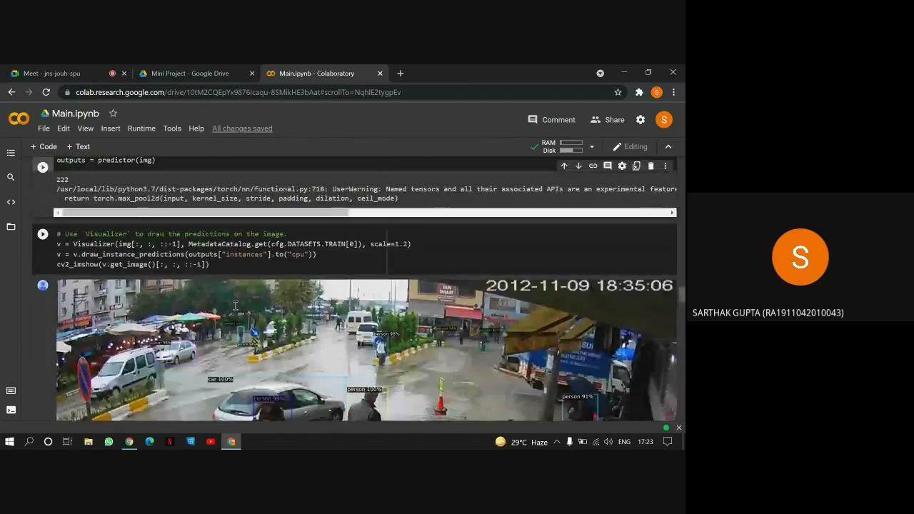
Demo of CODE (video)

Slide 10
THANK YOU

