Slide 1
Sentimental Analysis of Twitter Dataset Using Classification Techniques
By Sarthak Gupte

Slide 2
Project RoadMap
Goal
Dataset Collection
Cleaning
Machine Learning Models
Results
Conclusion

Slide 3
Goals
Identify tweets as positive or negative.
Derive emotions from the text.
Help understanding the emotion of the user.

Slide 4
Data set Collection
Using Tweepy
It is a Python library used to connect to Twitter API.
Should have a Twitter account
We need special key to access it (Keys should not be shared).
Using prelabeled data for this project(Kaggel).

Slide 5
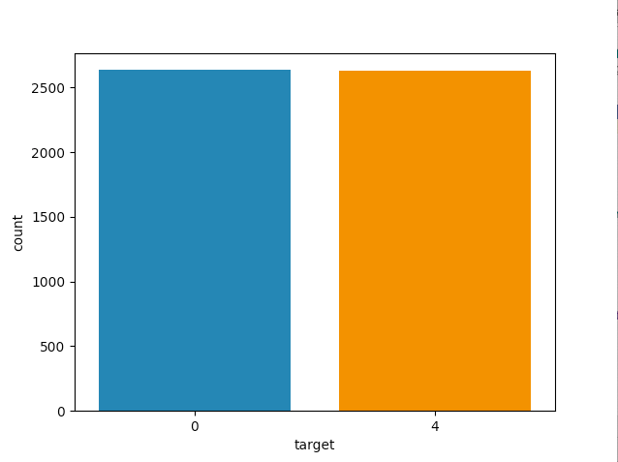
Data Collection

Slide 6
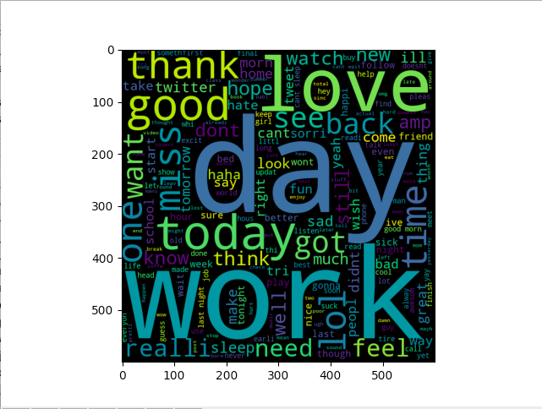
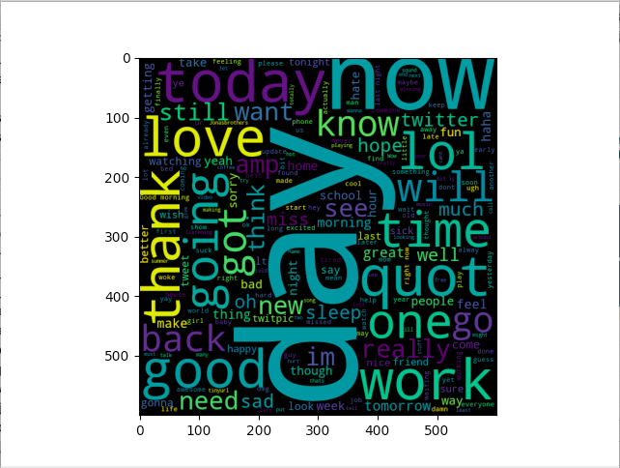
Cleaning
Removing punctuation, stopwords, numbers
Conversion of words to root words (stemming)

Slide 7
Machine Learning Models
Zero classifier
- For all test cases we blindly choose majority class.
- Used as baseline model.
BOW with Random Forest classifier
- Create word bag, and then vectorizing it.
- Using forest ensemble with vectors created.

Slide 8
Machine Learning Model
Naive Bayes Classifier
- Count Words in each tweet
- Compare with the model and find the probability, if positive or negative.
- If P(positive) > P(Negative), word is positive else negative.

Slide 9
Results
Accuracy
Zero classifier - 50%
BOW classifier - 58%
Random Forest classifier - 73%
A good classifier is considered to be in the range of 70 - 75% for sentimental analysis.

Slide 10
Conclusion
Most of the tweets are neither positive nor negative.
Example - “eating pasta.”
The semantic analysis can be used to understand the emotion of the text.
Cleaning of the text is very important in semantic analysis.

Slide 11
Thank You!

