Slide 1

Indian Institute of Information Technology Pune Department of Computer Science Engineering
IR Project Presentation
Searchify - Search Tool To Answer Natural Language Text Based Queries
Sarthak Jain (111915114)
Shrey Dangayach (111916045)
Pasupunuri Bharath Kumar (111915083)

Slide 2
Problem Statement
Develop a robust Search Tool which accepts natural language text based queries as input and displays relevant answers from a given corpus (large collection of documents).
The user shall be allowed to query in Natural Language unlike other IR systems which are restricted to Keyword matching.

Slide 3
Overview of Project
Corpus used for demo - PDF Files based on Car Insurance policies by Digit (A well known Indian startup)
Technologies used:
Python (Flask) for backend
HTML,CSS,JS for Frontend
Haystack (2.6K stars rated open source library on Github) used for developing the end to end query-answering tool.
The top k answers are ranked in decreasing order of probability calculated by the reader which is a complex neural network.

Slide 4
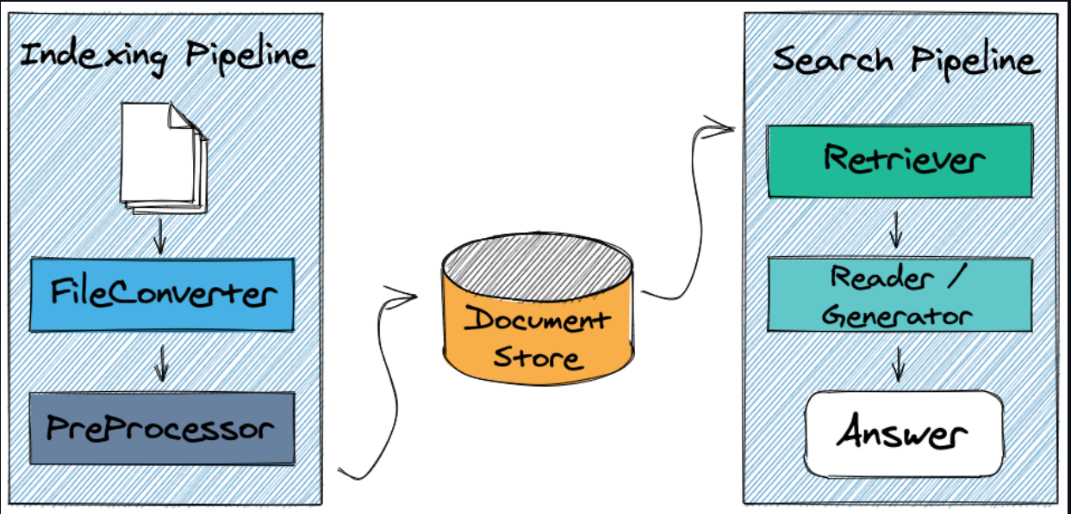
Methodology

Slide 5
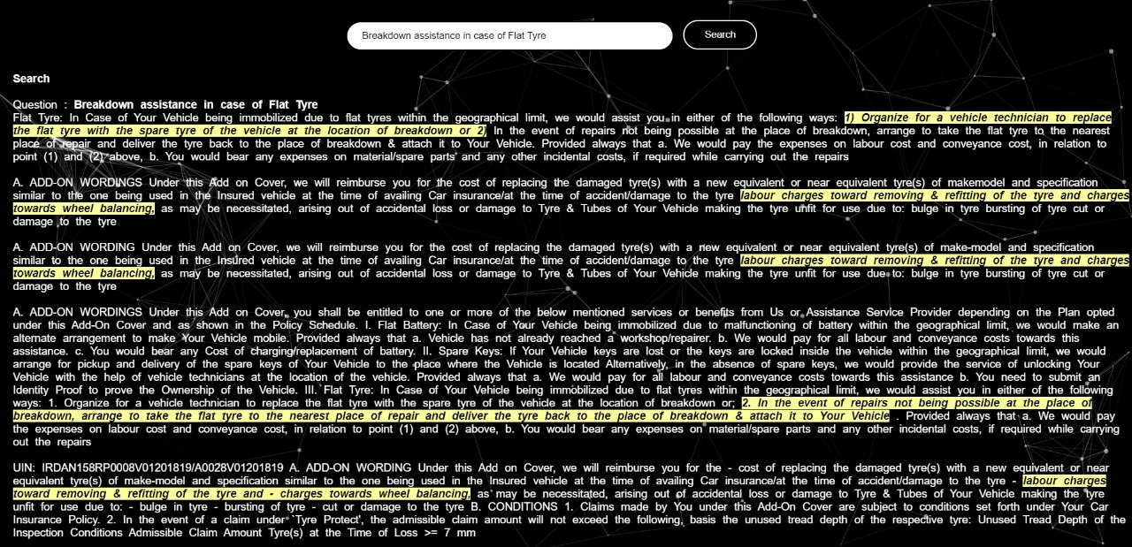
Result And Discussion
Query - Breakdown assistance in case of flat tyres

Slide 6
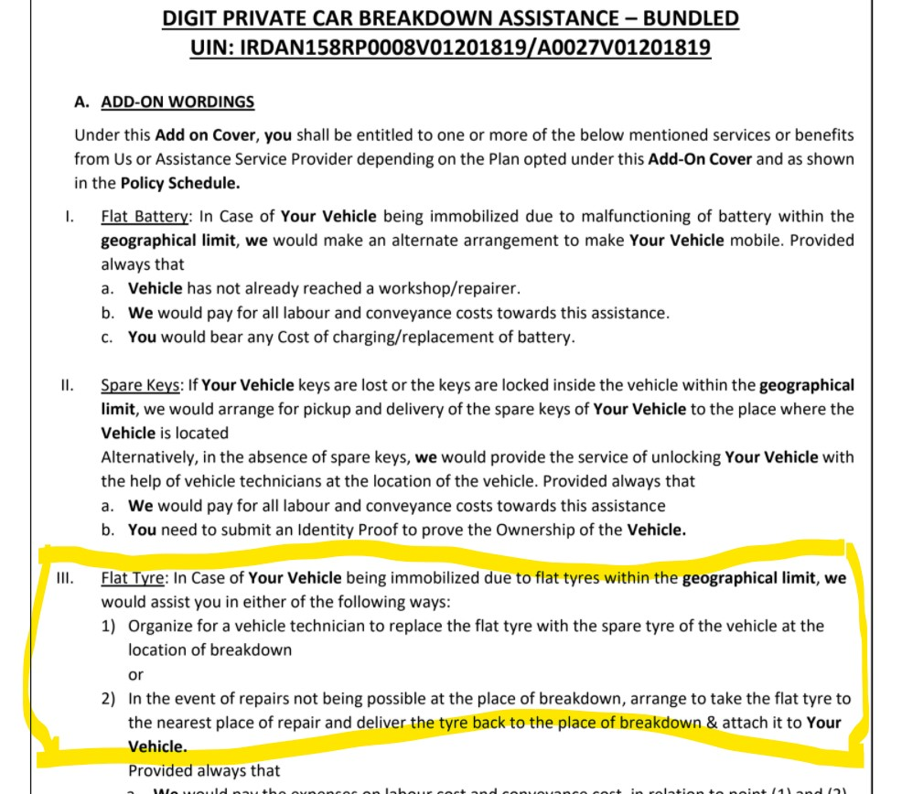
Query - Breakdown assistance in case of flat tyres
Top Answer In The Given Corpus

Slide 7
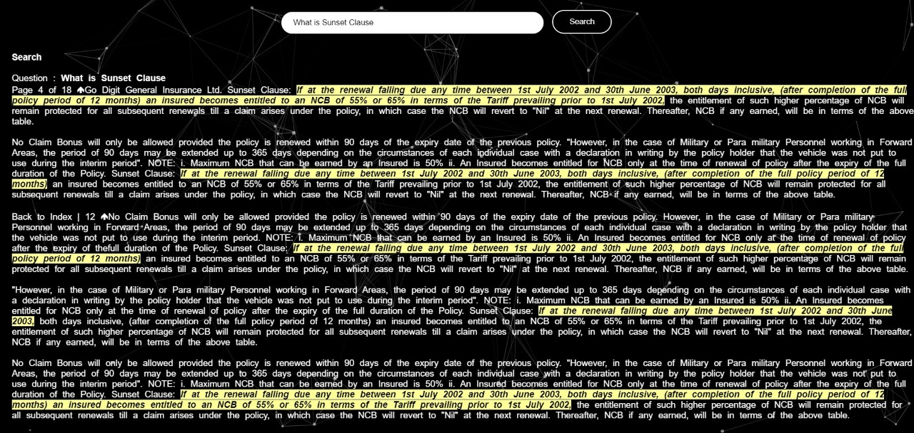
Query - What is Sunset Clause

Slide 8
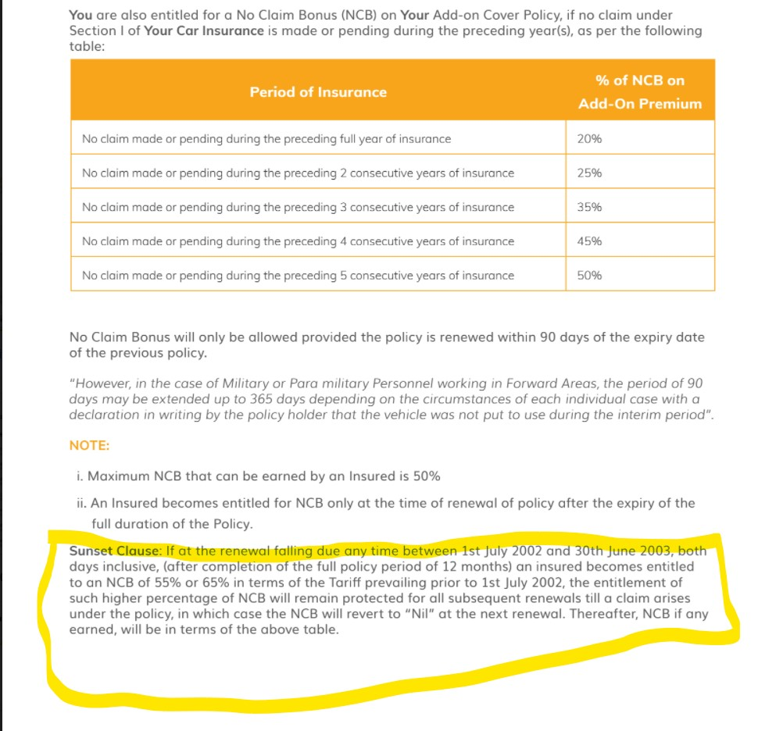
Query - What is Sunset Clause
Top Answer In The Given Corpus

Slide 9
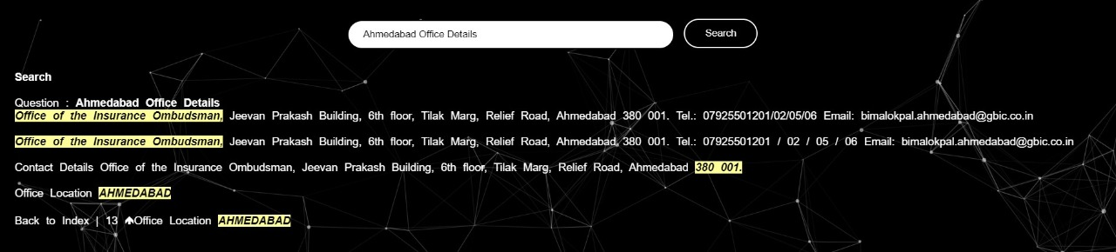
Query - Ahmedabad Office Details

Slide 10
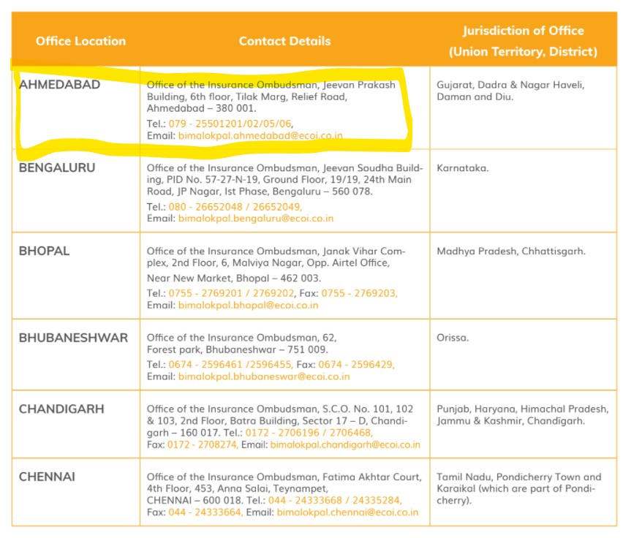
Query - Ahmedabad Office Details
Top Answer In The Given Corpus

