Slide 1



Integrative Multimodal Analysis for Schizophrenia Cause Identification
Jaypee University of Information Technology, Waknaghat - 173234 (India)
Major Project - II (18B19CI891) | AY 2024-25
Mid-Term Evaluation | March 17-22, 2025.
Group No.: 27
Team Members
Sarthak Kurothe (211420)
Shivansh Kushwaha (211308)
Supervisor
Dr. Kushal Kanwar
Assistant Professor(SG)
Department Of Computer Science & Engineering

Slide 2
Outline
Introduction
Problem Statement
Objectives
Work Done (after Major Project - I)
Project Design
Implementation
Experimental Results and Evaluation
Key Learnings
Work Plan (till End – term Evaluation)
Work Contribution and Attendance
Supervisor Interactions
References

Slide 3
Introduction
Schizophrenia[1] represents one of the most challenging mental health disorders, affecting not only the individuals diagnosed but also their families and communities. Its multifaceted nature necessitates a comprehensive approach to understanding its origins and manifestations.
While conventional research has provided insights into various aspects of schizophrenia, many questions remain unanswered due to the disorder inherent complexity.
In recent years, the integration of various data modalities has emerged as a promising avenue for advancing mental health research. By combining visual, auditory, and textual data, researchers can create a more nuanced perspective on the disorder.
Our project, Integrative Multimodal Analysis for Schizophrenia Cause Identification, aims to harness the power of deep learning and multimodal data integration to unravel the complexities of schizophrenia.

Slide 4
Problem Statement
Schizophrenia[1] is a complex mental health condition marked by significant disruptions in cognition, perception, emotional responses, and social behavior. Despite considerable research efforts, the exact causes of schizophrenia[1] remain unclear, largely due to the intricate nature of the disorder and the limitations associated with analyzing data from a single source.
Conventional methods that rely on isolated modalities—such as neuroimaging, auditory, or textual data—often do not provide a complete picture of the various contributing factors.
This project seeks to overcome the challenges posed by single-modal analyses by employing a multimodal approach that combines data from diverse sources, including video, audio, and textual information from patient interviews.
By utilizing advanced deep learning techniques, we aim to uncover new patterns and relationships within these different modalities.

Slide 5
Objectives
The primary objective focuses on creating a robust analytical framework that incorporates audio, visual images, and voice data. By integrating these diverse modalities, we aim to capture a comprehensive view of the factors influencing schizophrenia.
Next, we aim to improve diagnosis accuracy for schizophrenia by utilization of multiple modalities and comparing it with the accuracy of single modality analysis. This enhanced accuracy ensures the appropriate and timely interventions for individuals affected by disorder.
Finally, we aim to uncover the potential biomarkers and causal factors linked to schizophrenia. We hope to pave way for personalized treatment approaches tailored to individual patient profiles.

Slide 6
Work Done (after Major Project - I)
After the Major Project - I evaluation, the project progressed towards refining preprocessing for video, audio, and text modalities and structuring the data into a unified dataset for model training and analysis.
• Data Integration and Synchronization: Ensured precise alignment of video, audio, and text features using timestamp synchronization to maintain consistency across modalities.
• Quality Assurance and Data Augmentation: Conducted thorough quality checks to validate data integrity and applied augmentation techniques such as synthetic speech variations, gesture modifications, and text paraphrasing to enhance dataset robustness.
• Error Handling and Optimization: Text transcripts were processed using natural language processing (NLP) techniques to extract meaningful linguistic features. Sentiment analysis, coherence scoring, and keyword extraction were applied to understand patterns in speech content.

Slide 7
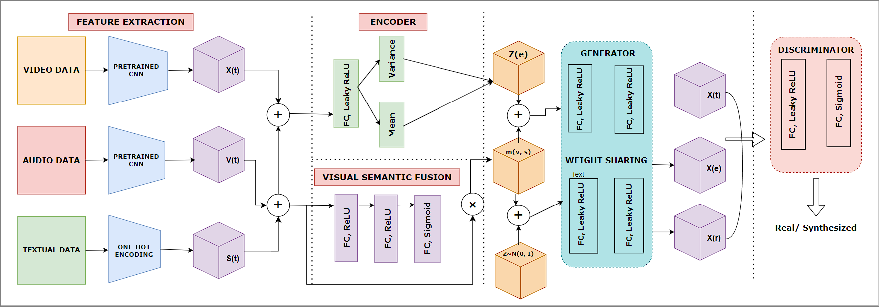
Project Design
Figure 1. Multimodal Transformer Architecture

Slide 8
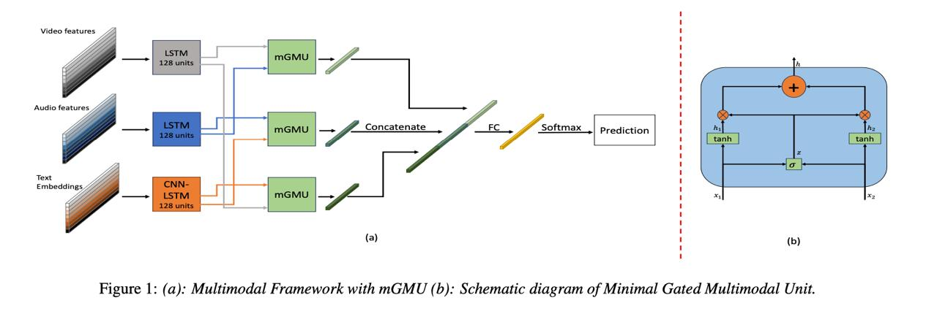
Project Design
Figure 2. (a) Multimodal Framework with mGMU (b) Schematic Diagram of Gated Multimodal Unit

Slide 9
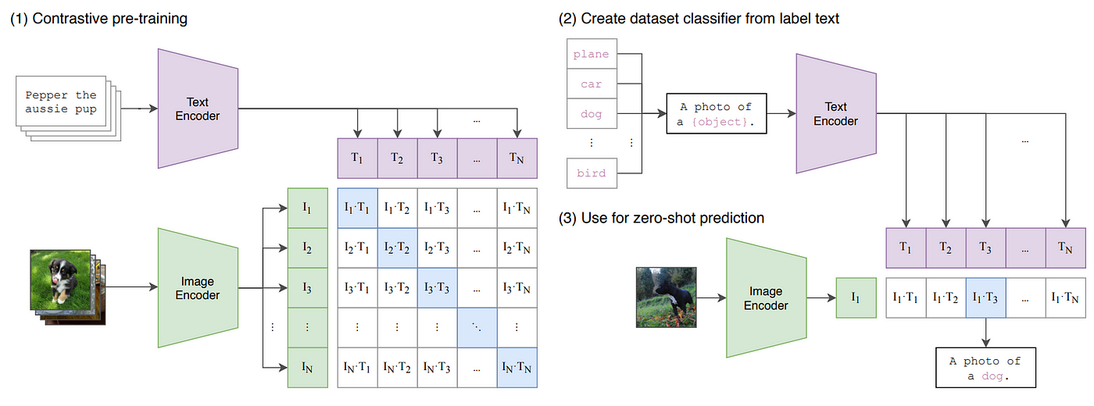
Project Design
Figure 3. Model Analysis Architecture

Slide 10
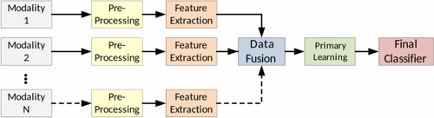
Project Design
Figure 4. Pre-Processing Architecture

Slide 11
Implementation
The preprocessing phase was a critical step in preparing the data for model training, focusing on extracting meaningful features from video, audio, and text modalities.
For video, frames were extracted using OpenCV, and features such as facial expressions, gestures, and gaze tracking were processed using Mediapipe. These visual markers are crucial for detecting schizophrenia-related behaviors.
In the audio pipeline, Librosa was used to analyze acoustic signals, extracting features like MFCCs, pitch variation, and pauses, while noise reduction techniques improved the quality of the input data.
The text data was processed using NLP techniques, including tokenization and sentiment analysis, to extract linguistic features such as coherence scores and key phrases.
All extracted features were synchronized and aligned using timestamps, ensuring seamless integration into a unified dataset for multimodal analysis.

Slide 12
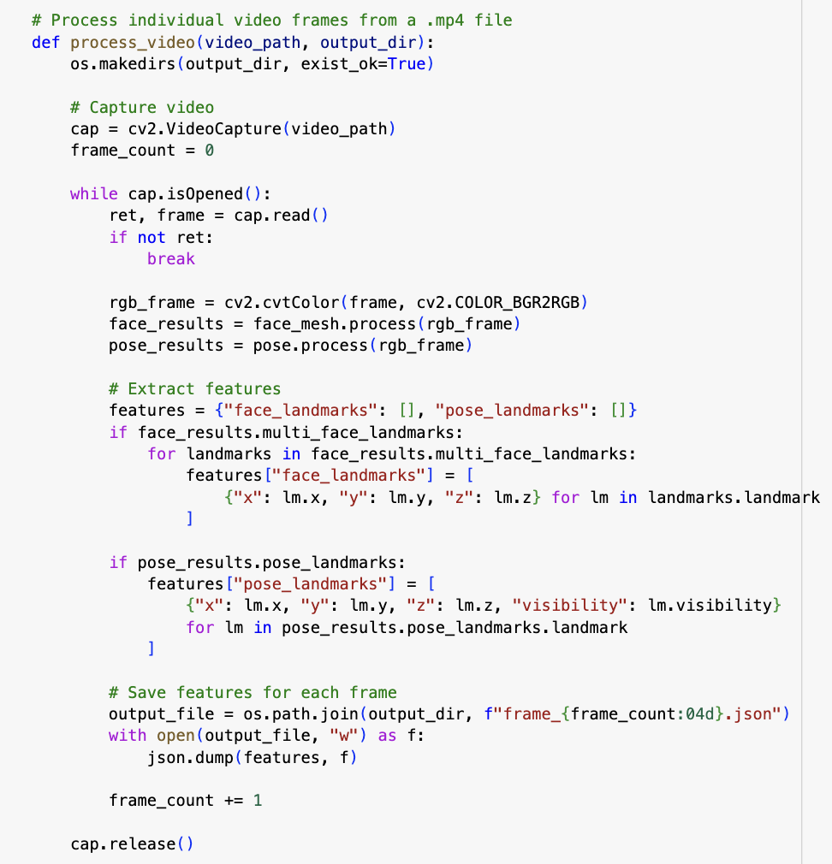
Implementation
Figure 5. Implementation of preprocessing the video frames

Slide 13
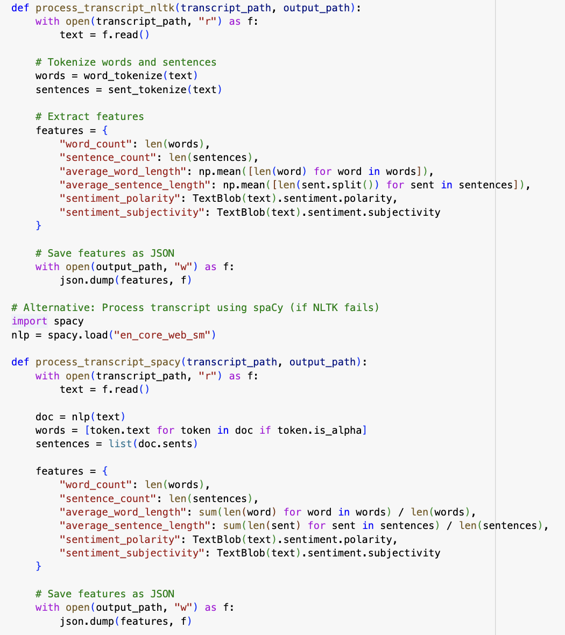
Implementation
Figure 6. Implementation of preprocessing the Transcripts

Slide 14
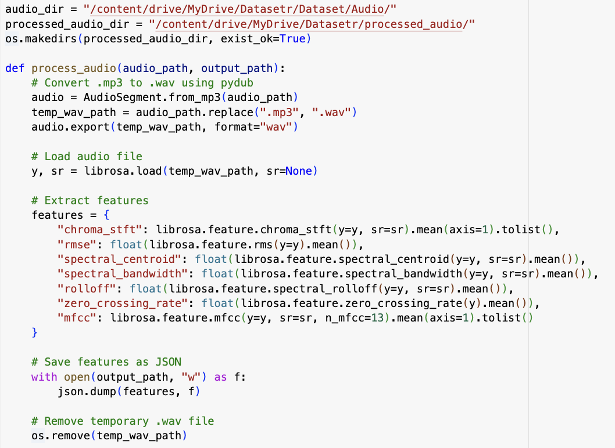
Implementation
Figure 7. Implementation of preprocessing the Audio Files

Slide 15
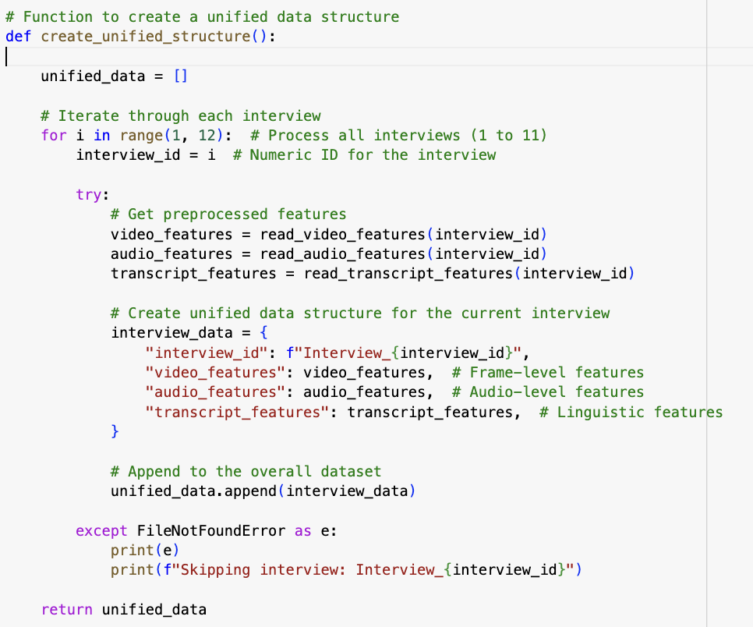
Implementation
Figure 8. Implementation of Unified Dataset

Slide 16
Experimental Results and Evaluation
The experimental results and evaluation of the multimodal schizophrenia detection system will assess the performance of the transformer model trained on the unified dataset, which integrates video, audio, and text features.
Key performance metrics, including accuracy, precision, recall, F1-score, and ROC-AUC, will be used to evaluate the system’s reliability in detecting schizophrenia markers. These metrics will provide insights into the model’s ability to classify schizophrenia-positive and negative cases accurately while balancing sensitivity and specificity.
Each modality will be analyzed for its contribution to the overall performance-video features such as facial expressions and gestures, audio features like MFCCs and pitch variations, and text features including sentiment and coherence.
The robustness of the model will be tested under challenging conditions, such as noisy inputs or incomplete data, to ensure its reliability in real-world scenarios. Comparative analysis with baseline methods using single modalities will highlight the advantages of multimodal integration, showcasing improvements in accuracy and diagnostic precision.

Slide 17
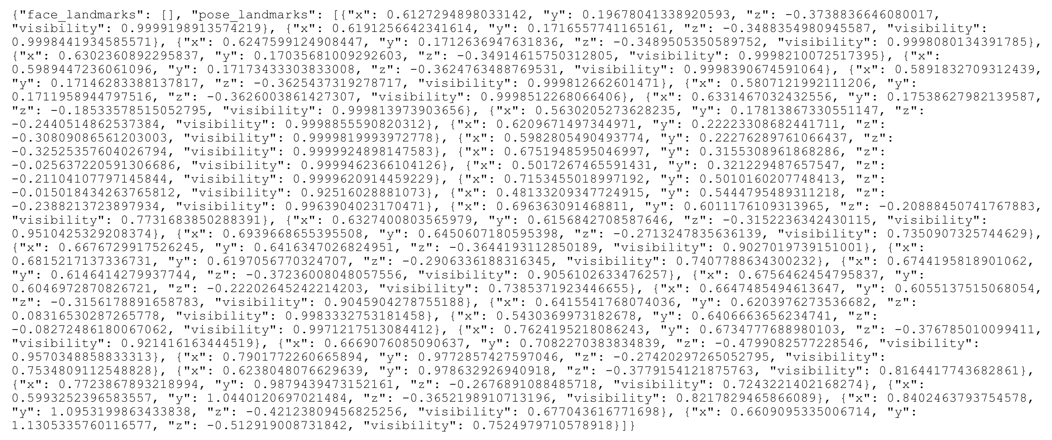
Experimental Results and Evaluation
Figure 9. Face Landmarks and Pose Landmarks Result

Slide 18
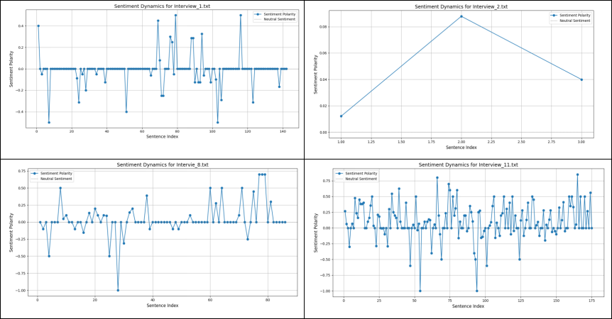
Experimental Results and Evaluation (cont…)
Figure 10. Sentimental Dynamics of The Transcripts

Slide 19
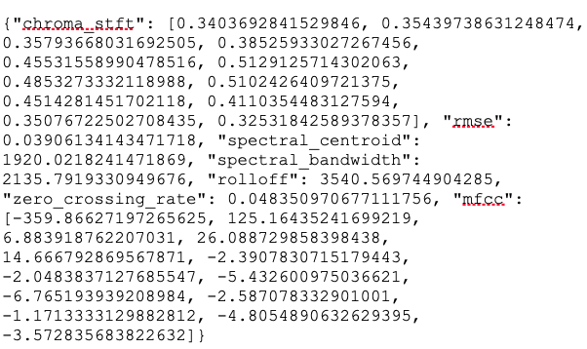
Experimental Results and Evaluation (cont…)
Figure 11. Features Extracted from Audio Data

Slide 20
Key Learnings
Multimodal Data Integration: Gained hands-on experience in integrating multiple data modalities (video, audio, text) and understanding the challenges in synchronizing them for a unified dataset.
Preprocessing Techniques: Learned various preprocessing techniques for video, audio, and text data, including feature extraction (e.g., facial expressions, speech features, and sentiment analysis) to prepare the data for model training.
Model Understanding: Developed a deeper understanding of machine learning models, particularly transformers, and how they can be adapted for multimodal tasks like schizophrenia detection.
Data Management: Gained practical knowledge in organizing large datasets, ensuring that data from different sources is clean, aligned, and ready for analysis.
Research and Development: Conducted thorough research, including reviewing related studies, which helped shape the methodology and inspired innovative solutions for handling multimodal data.
These experiences have provided valuable insights into the complexities of working with multimodal data and machine learning models, helping us to develop essential skills for future stages of the project.

Slide 21
Work Plan (till End-Term Evaluation)
With the groundwork laid in the previous phase, including data preprocessing and the creation of a unified dataset, the following steps will focus on training the model, evaluating its performance, and preparing it for real-world applications. The goal is to enhance the system’s accuracy, scalability, and usability, ensuring it can be deployed effectively in clinical settings. Below are the key areas of focus for the upcoming semester:
Model Development and Training: Focus on implementing and fine-tuning the multimodal transformer model for schizophrenia detection, incorporating one-shot learning techniques and evaluating the model’s performance on the unified dataset.
Performance Evaluation: Conduct comprehensive testing, including functional testing, edge-case testing, and performance measurement (inference time, accuracy, precision, recall), to evaluate the model’s effectiveness and robustness.
Data Expansion and Augmentation: Expand the dataset with additional data from schizophrenia patients, apply data augmentation techniques, and potentially integrate new data sources like EEG or fMRI to improve model accuracy.
Deployment and Integration: Explore deploying the model in real-world clinical settings, including integration into a web or mobile application, ensuring scalability and real-time processing capabilities for healthcare professionals.

Slide 22
Work Contribution and Attendance
GitHub Repository URL - https://github.com/sarthakkurothe/Major-Project-II-18B19CI891
Team Member | Roll No. | Work Done | Work Contribution (%) | Lines of Code (LoC) | Lab Attendance (%)
Sarthak Kurothe | 211420 | Worked on developing and fine-tuning the multimodal transformer model for schizophrenia detection. Main focus was on implementing one-shot learning techniques and optimizing the model using the unified dataset and also conducted rigorous performance evaluations, including functional testing, edge-case testing, and measuring accuracy, precision, recall, and inference time. | 50% | 300 | NA
Shivansh Kushwaha | 211308 | Focused on data expansion, augmentation, and deployment. Gathered additional schizophrenia patient data, applied augmentation techniques, and explored integrating EEG or fMRI data to enhance accuracy. | 50% | 150 | 100%

Slide 23
Supervisor Interactions (as mentioned in weekly log)
No. of Meetings with Supervisor: 7
Week No.. | Duration | Remarks (as mentioned in the weekly log) | Incorporated (Yes/No)
1. | 20/01/2025 to 25/01/2025 | Enhanced video preprocessing for facial expressions, gaze, and gestures. Verified transcript accuracy and sentiment analysis. Improved audio synchronization with video and text. | Yes (Week No.12)
2. | 27/01/2025 to 01/02/2025 | Refined data integration for consistency across modalities. Implemented missing data handling and augmentation techniques. Optimized feature extraction for better dataset quality. | Yes (Week No. 13)
3. | 03/02/2025 to 08/02/2025 | Conducted initial model training using the multimodal transformer. Fine-tuned hyperparameters for optimal performance. Evaluated early model results using confusion matrices. | Yes (Week No. 14)
4. | 10/02/2025 to 15/02/2025 | Assessed individual modality contributions to classification accuracy. Identified and addressed misclassification patterns. | Yes (Week No. 15)
5. | 24/02/2025 to 01/03/2025 | Applied data augmentation for gesture, speech, and text variations. Expanded dataset with additional schizophrenia-related sources. | Yes (Week No. 16)
6. | 03/03/2025 to 08/03/2025 | Fine-tuned multimodal fusion layers in the transformer model. Conducted K-fold cross-validation for improved reliability. Optimized computational efficiency using GPU acceleration. | Yes (Week No. 17)

Slide 24
References
[1] G. Premananth, Y. M. Siriwardena, P. Resnik, S. Bansal, D. L. Kelly, and C. Espy-Wilson, "A Multimodal Framework for the Assessment of the Schizophrenia Spectrum," in Interspeech, 2024.
[2] H. Göker, "1D-convolutional neural network approach and feature extraction methods for automatic detection of schizophrenia," SpringerLink, 2023.
[3] S. Siuly, Y. Guo, and O. F. Alcin, "Exploring deep residual network based features for automatic schizophrenia detection from EEG," SpringerLink, 2023.
[4] C. Y. Chuang, Y. T. Lin, C. C. Liu, L. E. Lee, H. Y. Chang, A. S. Liu, S. H. Hung, and L. C. Fu, "Multimodal Assessment of Schizophrenia Symptom Severity From Linguistic, Acoustic and Visual Cues," IEEE Transactions on Neural Systems and Rehabilitation Engineering, vol. 31, pp. 987-998, 2023.
[5] A. Kanyal, S. Kandula, V. Calhoun, and D. H. Ye, "Multi-modal deep learning from imaging genomic data for schizophrenia classification," in IEEE International Conference on Acoustics, Speech, and Signal Processing Workshops (ICASSPW), 2023.
[6] G. S. Chilla, L. Y. Yeow, and Q. H. Chew, "Machine learning classification of schizophrenia patients and healthy controls using diverse neuroanatomical markers and Ensemble methods," Scientific Reports, vol.12, pp. 1103-1114, 2022.
[7] A. Das et al., "An explainable AI approach for schizophrenia detection using multimodal fusion," IEEEAccess, vol. 10, pp. 78777-78787, 2022.

Slide 25
References
[8] P. Srivastava et al., "Multimodal fMRI and EEG deep learning analysis for schizophrenia diagnosis," Neurocomputing, vol. 476, pp. 73-84, 2021.
[9] C. R. Phang, F. Noman, H. Hussain, C. M. Ting, and H. Ombao, "A multi-domain connectome CNN for identifying schizophrenia from EEG patterns," IEEE Journal of Biomedical and Health Informatics, vol. 24, no. 6, pp. 3109-3119, 2020.
[10] P. T. Krishnan, A. N. J. Raj, P. Balasubramanian, and Y. Chen, "Schizophrenia detection using Multivariate Empirical Mode Decomposition and entropy measures from multichannel EEG signal," Biocybernetics and Biomedical Engineering, vol. 40, pp. 743-754, 2020.
[11] D. Ahmedt-Aristizabal et al., "Identification of children at risk of schizophrenia via deep learning on EEG responses," IEEE Journal of Biomedical and Health Informatics, vol. 24, no. 8, pp. 2125-2135, 2020.
[12] R. Desai, P. Porob, and P. Rebelo, "EEG Data Classification for Mental State Analysis Using Wavelet Packet Transform and Gaussian Process Classifier," Wireless Personal Communications, vol. 112, no. 2, pp. 1157-1174, 2020.
[13] S. K. Tikka et al., "AI-based classification of schizophrenia using EEG and SVM," Indian Journal of Psychiatry, vol. 62, no. 6, pp. 704-710, 2020.
[14] N. Ji, L. Ma, H. Dong, and X. Zhang, "EEG feature extraction using DWT and EMD combined with approximate entropy," Brain Sciences, vol. 9, no. 8, pp. 216-225, 2019.

Slide 26
References
[15] S. Liang et al., "Classification of First-Episode Schizophrenia Using Multimodal Brain Features," Schizophrenia Bulletin, vol. 45, no. 4, pp. 903-914, 2019.
[16] R. Salvador, "Multimodal Integration of Brain Images for MRI-Based Diagnosis in Schizophrenia,"Frontiers in Neuroscience, vol. 13, no. 456, 2019.
[17] M. L. Birnbaum et al., "A Collaborative Approach to Identifying Social Media Markers of Schizophrenia by Employing Machine Learning and Clinical Appraisals," Journal of Medical Internet Research, vol. 19, no. 2, pp. e84, 2017.
[18] E. Olejarczyk and W. Jernajczyk, "Graph-based analysis of brain connectivity in schizophrenia," PLoS ONE, vol. 12, no. 11, e0188629, 2017.
[19] A. Varshney, C. Prakash, N. Mittal, and P. Singh, "A Multimodal Approach for Schizophrenia Diagnosis using fMRI and sMRI Dataset," in Intelligent Systems Technologies and Applications, 2016.
[20]Y. Yin et al., "Analyzing the EEG Energy of Quasi Brain Death using MEMD," in APSIPA ASC, 2011.

Slide 27
Thanks.

