Slide 1
INTERNSHIP PRESENTATION
“ Artificial Intelligence and Machine learning ”
(01/09/2022-01/10/2022)
Zephyr technologies pvt ltd mangalore
Student Name - Sharthak
USN - 4PA19CS089
Project Mentor - Aysha sana
Senior Trainer in machine learning
Ayshasanatth@gmail.com
+91 1234567890
Under the Guidance of
Prof. Mohammed Hafeez
Department of Computer Science
PA COLLEGE OF ENGINEERING
Notes:
<number>

Slide 2
Table of Contents
About the Company
Introduction
About the Technologies learnt with schedule
Internship Project work Assigned
System Requirements
Implementation
Internship Certificate

Slide 3
About the company
ZEPHYR TECHNOLOGIES is a software company delivering high
quality, cost effective, reliable result-oriented web and e-commerce
solutions on time for a global clientele. Professionalism, Skill and
Expertise are the tools we use to make the web work for your business
bringing in maximum return on your investment in shortest possible time.
We have delivered on IT projects of varying complexities for their very
demanding and internet clients spread across the globe. They develop
unique web solutions which ensures increased efficiency and competitive
advantage for your business and thus to your end users.

Slide 4
Their tools are professionalism, skills and expertise that translate into delivering quality work at every step for any project we undertake.
Theywork towards getting better than the best out of every team member at ZEPHYR TECHNOLOGIES, which means when you hire them all round quality is assured off as you want it.

Slide 5
Their Advantage Quality includes protection of intellectual for the source codes developed specifically for your business. They do not sell the source codes to the third parties and all elements that they create for your web solution belongs to you.
ZEPHYR TECHNOLOGIES project managers and business analysts place great value for building a clean communication link with you as they consider it the key ingredient for the success of any project at hand.

Slide 6
INTRODUCTION
Machine Learning Internship is a great way for you to start your data science career. It is designed to, both, test your knowledge and to give you the feel and experience of a real-world data science problem.
Internships also provide you to experience real world corperate culture.
An internship gives a student the opportunity for career exploration and development, and to learn new skills.

Slide 7
Technologies learnt:
Python (01/09/2022-07/09/2022): Python is a widely used general-purpose, high level programming language. It was created by Guido van Rossum in 1991 and further developed by the Python Software Foundation. It was designed with an emphasis on code readability, and its syntax allows programmers to express their concepts in fewer lines of code.
Python is a programming language that lets you work quickly and integrate systems more efficiently.

Slide 8
Python libraries(08/09/2022-16/09/2022):
A Python library is a collection of related modules. It contains bundles of code that can be used repeatedly in different programs. It makes Python Programming simpler and convenient for the programmer. As we don't need to write the same code again and again for different programs.
Python libraries play a very vital role in fields of Machine Learning, Data Science, Data Visualization, etc.
Eg: Matplotlib,Pandas,Numpy,Scikit-learn etc.

Slide 9
Machine learning(18/09/2022-24/09/2022):
Data analysis:
Data analysis is a process of inspecting, cleansing, transforming, and modelling data with the goal of discovering useful information, informing conclusions, and supporting decision-making.
Encoding techniques:Encoding is a technique of converting categorical variables into numerical values so that it could be easily fitted to a machine learning model.
Eg: One-hot encoding,ordinal encoding.

Slide 10
Train Test Split:
The train-test split is used to estimate the performance of machine learning algorithms that are applicable for prediction-based Algorithms/Applications. This method is a fast and easy procedure to perform such that we can compare our own machine learning model results to machine results.
Algorithms:
There are two main sets of machine learning algorithms: Supervised and unsupervised.
Supervised:Most machine learning uses supervised learning algorithms, which are indicated by the use of labeled data (such as time and weather) that entails both input (x) and output (y) variables. You, as the “teacher,” know the correct answer(s) and supervise the algorithm as it makes predictions based on the training data. Eg: Linear regressionLogistic regressionDecision tree Random forest classification algorithm

Slide 11
Unsupervised:
Unsupervised machine learning algorithms are used for unstructured data to find common characteristics and distinct patterns in the dataset. Because this type of ML algorithm does not require prior training or labeled data, it is free to explore the structure of the information.
Eg:kernel methods and k-means clustering.

Slide 12
Internship Project work Assigned:
CAMPUS PLACEMENT PREDICTION:
Placements are considered to be very important for each and
every college. The basic success of the college is measured by the
campus placement of the students.
Hence, in this regard the approach is about the prediction
and analyses for the placement necessity in the colleges that helps
to build the colleges as well as students to improve their
Placements.The main objective of this model is to predict whether the student he/she gets placed or not in campus recruitment.

Slide 13
System Requirements:
Operating systems:
Windows 10 (Intel/AMD 64-bit)
Linux (Intel/AMD 64-bit, kernel 3.10.0 or higher, glibc 2.17 or higher)
RAM: 4gb or more
Processor: intel i3 or more

Slide 14
Implementation:
Importing Libraries:
Python Libraries are a set of useful functions that eliminate the need for writing codes from scratch. There are over 137,000 python libraries present today and they play a vital role in developing machine learning, data science, data visualization, image and data manipulation applications, and more.
Importing dataset(Reading CSV file):
The CSV module implements classes to read and write tabular data in CSV
format.it is the data that we need to load for starting any of the ML project with respect to data, the most common format of data of data for ML projects is CSV.

Slide 15
Checking for NAN values
Data visualisation
Correlation between features
Encoding
Splitting data into Train and Test
Classification models
Evaluating accuracy of model

Slide 16
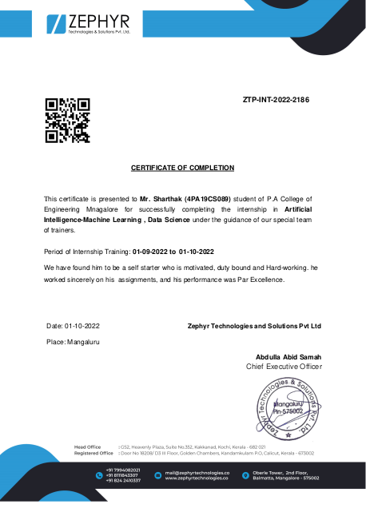

Slide 17
Thank you

