Slide 1

Customer Churn Analysis
Sarthak Verma
Sxv230040 BUAN 6390.001

Slide 2
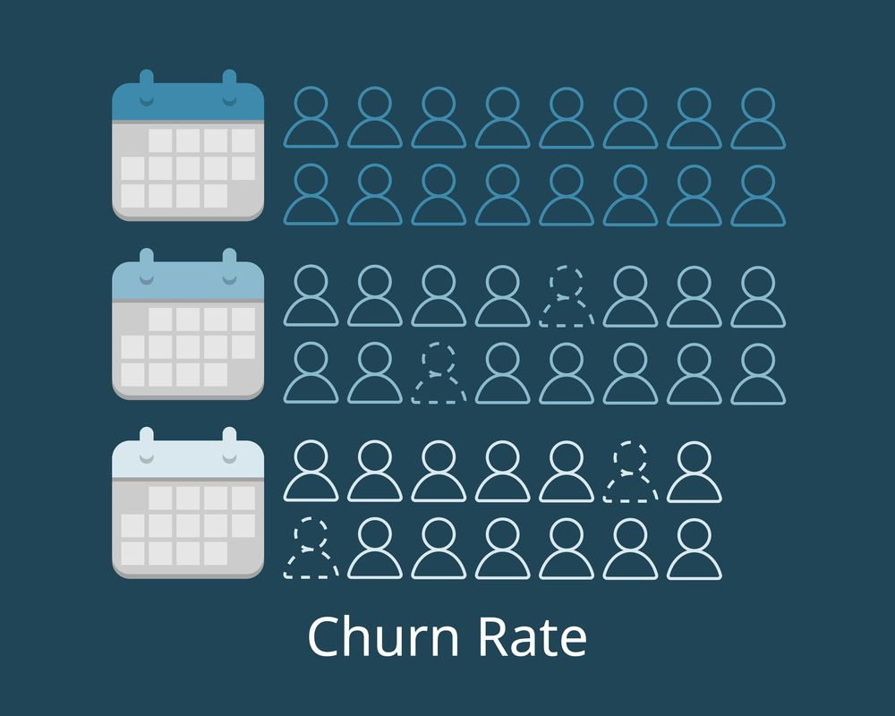
Understanding The Dataset
Demographic Information:
Gender: Identifies the customer's gender.
Age Range: Specifies the age group to which the customer belongs.
Partners: Indicates if the customer has a partner, such as a spouse.
Dependents: Shows whether the customer has any dependents, such as children.
Services Information:
Details the range of services a customer subscribes to, including:
Phone services
Multiple lines
Internet services
Online Security
Online backup
Device protection
Tech support
Streaming TV and movies
Customer Account Information:
Tenure: The duration the individual has been a customer.
Contract: Available contract types, including month-to-month, one-year, and two years.
Payment Method: How the customer prefers to pay; options include electronic checks, mailed checks, and bank transfers.
Paperless Billing: Indicates whether the customer opts for paperless billing.
Monthly Charges: The monthly billing amount.
Total Charges: The total amount billed during the customer's tenure.
Churn (Target Variable):
Determining whether customers discontinued their services within the past month is essential for identifying churned customers.

Slide 3
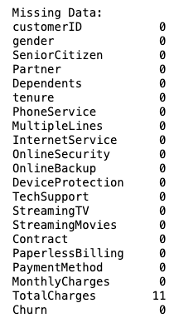
Data Cleaning and preprocessing.
Data Transformation: Enhancing Dataset Usability
Consistency Adjustments: I clarified entries by changing 'No Internet service' to 'No' in all relevant service columns, improving data uniformity and interpretability.
Simplification of Payment Methods: I simplified the 'PaymentMethod' field by eliminating descriptors like '(automatic).'
Feature Streamlining: I removed non-essential columns, such as 'Customer ID' and 'Tenure,' to focus analysis on variables with more significant impact.
Numerical Conversion: I converted the 'SeniorCitizen' field from binary (1, 0) format to categorical ('yes', 'no') to enhance model processing.
Encoding of Categorical Variables: I applied one-hot encoding to categorical variables, creating dummy variables for more effective statistical analysis.
Data Cleaning: Handling Missing Values
In the 'TotalCharges' column, I identified 11 entries with missing values, all with a 'Tenure' of 0 but recorded 'MonthlyCharges.'
Due to their negligible quantity, I opted to remove these entries to preserve the integrity and reliability of the overall dataset.

Slide 4
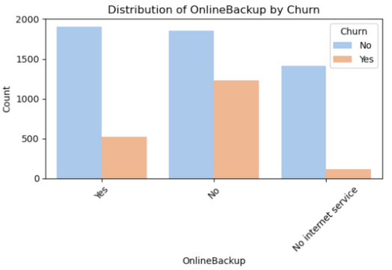
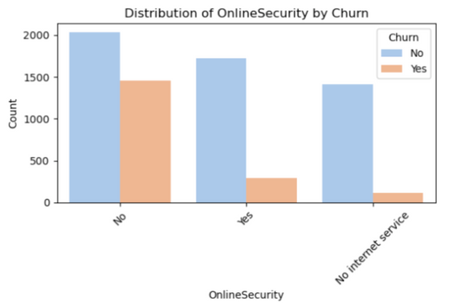
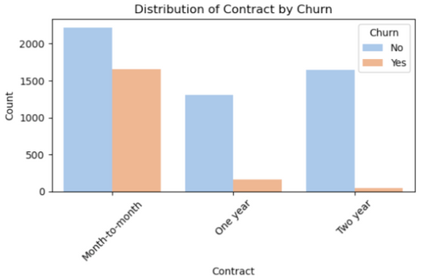
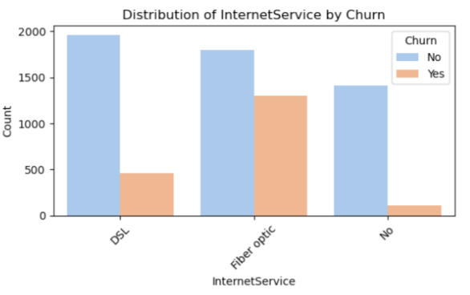
Exploratory Data Analysis
Key Findings
Customers with a one or two-year contract are less likely to churn, indicating a preference for longer-term commitments.
Customers who do not subscribe to the Online Security service are more likely to churn.
Customers who have subscribed to the Online Backup service tend to have a lower churn rate.
The chances of churn increase for customers who have opted for Fiber Optic services, suggesting issues or dissatisfaction with this option.

Slide 5
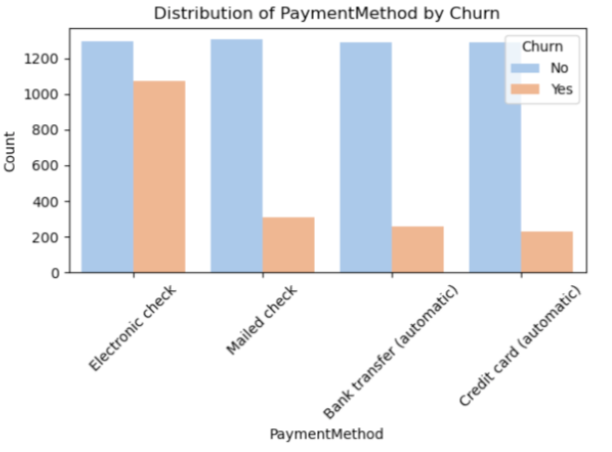
Exploratory Data Analysis
Customers who paid with Electronic Checks tended to churn more frequently, whereas those using Credit Card transfers, Bank Automatic Transfers, or Mailed Checks demonstrated a lower propensity to switch.

Slide 6
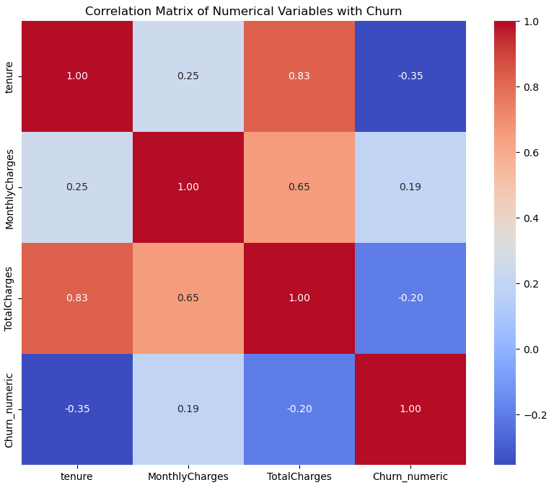
Exploratory Data Analysis of Numerical Variables
The point-biserial correlation results between numerical variables and churn indicate the following:
Tenure: -0.354. A moderate negative correlation exists, suggesting that customers with longer tenures are less likely to churn.
Monthly Charges: 0.1930. There is a positive correlation, implying that higher monthly charges may increase the likelihood of churn.
Total Charges: -0.199. A slight negative correlation indicates that customers with higher total charges, possibly due to longer tenure or greater service engagement, are less likely to churn.

Slide 7
Identifying Key Features and Their Significance
Performed a Chi-square test to assess whether variables significantly influence churn rates
Gender: 𝑝=0.490. No significant association with churn.
Partner: 𝑝≈0. Significant association, indicating that having a partner affects churn likelihood.
Dependents: 𝑝≈0. Significant, suggesting customers with dependents are less likely to churn.
PhoneService: 𝑝=0.350. There is no significant association.
MultipleLines: 𝑝=0.004. Significant, albeit weaker compared to other factors.
InternetService: 𝑝≈0. Very significant, indicating the type of internet service affects churn.
OnlineSecurity: 𝑝≈0. Highly significant, showing a strong association with reduced churn.
OnlineBackup: 𝑝≈0. Significant, suggesting this service affects churn.
DeviceProtection: 𝑝≈0. Significant, indicating an impact on churn.
Contract: 𝑝≈0. Extremely significant, with longer contracts associated with lower churn.
PaperlessBilling: 𝑝≈0. Significant, with paperless billing linked to higher churn.
PaymentMethod: 𝑝≈0. This is very significant, indicating that different payment methods impact churn rates.
SeniorCitizen: 𝑝≈0. This is significant, suggesting senior citizens might have different churn patterns than non-seniors.

Slide 8
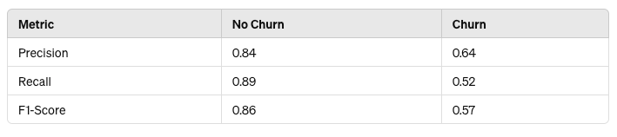
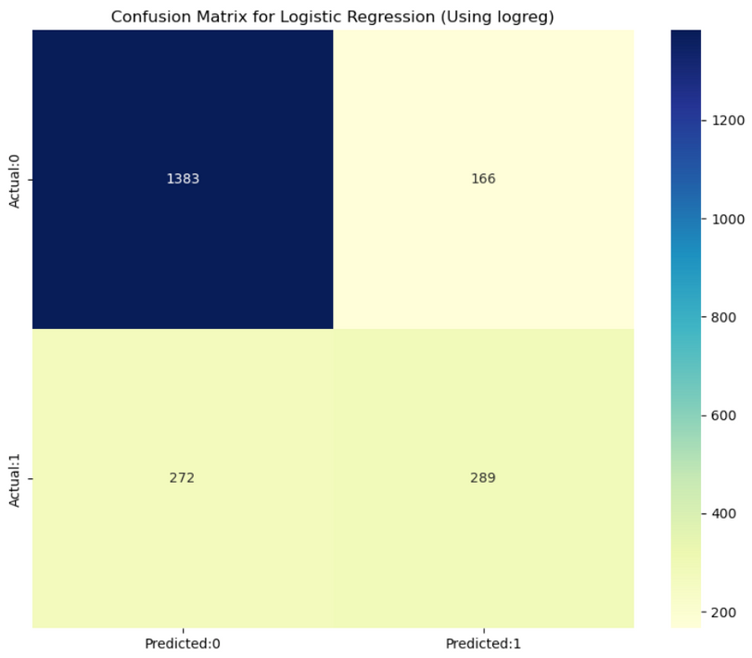
Logistic Regression Model – Accuracy 79 %
The model effectively predicts 'No Churn' instances, as demonstrated by high precision, recall, and F1-score for class 0.
However, the model faces more challenges in accurately predicting 'Churn' instances, evidenced by lower precision, recall, and F1-score for class 1.
The weighted average metrics offer a comprehensive overview of the model’s performance, considering the class imbalance within the dataset. With a weighted average F1-score of 79%, the model demonstrates a solid capability in predicting both classes, although it performs slightly better in predicting 'No Churn' (class 0).

Slide 9
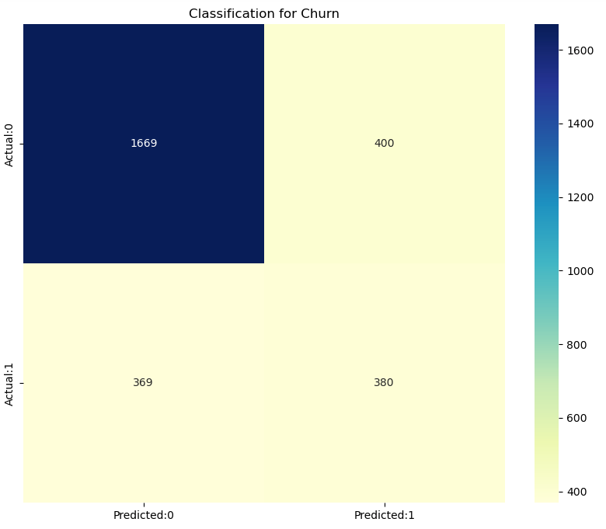
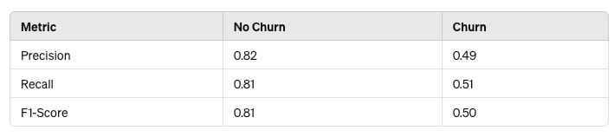
Decision Tree Model – Accuracy 72 %
No Churn Class:
The decision tree model exhibits slightly lower precision, recall, and F1-score than the regression model. This indicates that although the decision tree is reasonably accurate, the regression model outperforms it slightly in predicting customers who will not churn.
Churn Class:
The decision tree model displays significantly lower precision and a reduced F1-score than the other model, although both models show comparable recall rates for the churn class. This suggests that the decision tree is less adept at accurately identifying churn cases, leading to more false positives (i.e., mistakenly predicting churn where it does not exist).

Slide 10
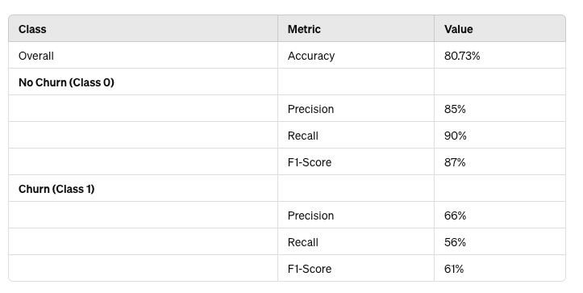
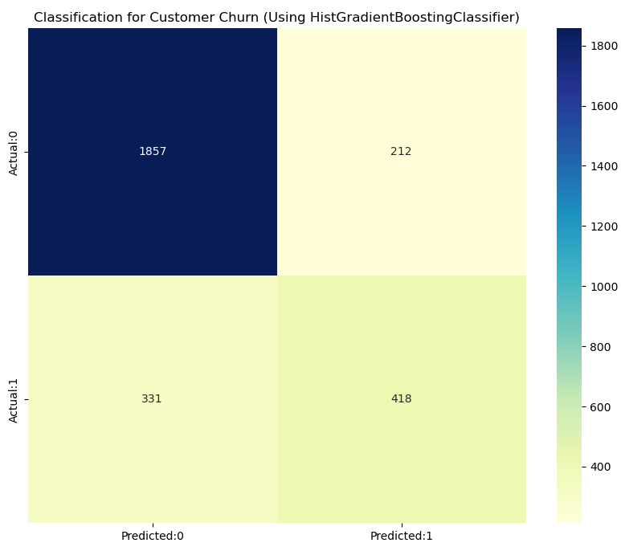
Gradient Boosting Classifier Model – Accuracy 80.73 %
No Churn (Class 0)
Precision (85%): High precision shows that the model is highly effective at accurately predicting customers who will not churn.
Recall (90%): This high recall rate indicates that the model successfully identifies 90% of the customers who will not churn.
Churn (Class 1)
Precision (66%): This is moderately high, indicating that the model accurately predicts churn 66% of the time when it forecasts that a customer will churn.
Recall (56%): The recall rate demonstrates that the model captures 56% of all actual churn cases. Although this is more than half, many at-risk customers may still need to be identified.

Slide 11
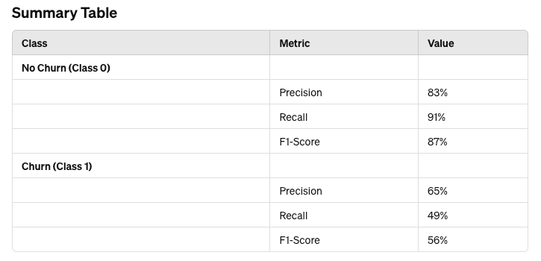

Random Forest Model – Accuracy 80 %
No Churn Prediction: The model demonstrates high effectiveness, with intense precision (83%) and excellent recall (91%), accurately identifying the most loyal customers.
Churn Prediction: Performance is moderate, with a precision of 65% and a lower recall of 49%, indicating that the model fails to detect more than half of the actual churn cases. This underscores a need for enhancements to identify customers at risk more effectively.

Slide 12
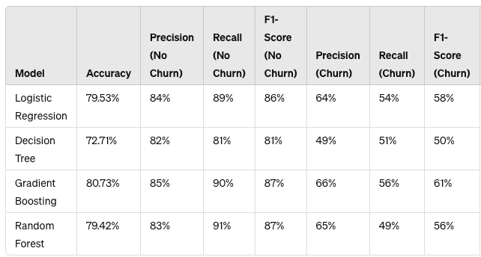
Model Comparison
Overall Accuracy: Gradient Boosting achieves the highest accuracy at 80.73%, ranking it the most accurate model among the four evaluated.
Performance on No Churn (Class 0):
Precision and Recall: Random Forest and Gradient Boosting demonstrate the highest recall rates, at 91% and 90%, respectively, essential for reducing false negatives (missing loyal customers). Both models also exhibit high precision, resulting in fewer false positives in predicting customers who will not churn.
Performance on Churn (Class 1):
Precision: Gradient Boosting offers the highest precision at 66% for predicting churn, making it the most dependable model for accurately identifying actual churn cases.

Slide 13
Conclusion
Gradient Boosting stands out as the top performer, particularly effective in churn, where accurate identification of both classes is critical.
Random Forest and Logistic Regression stand out as formidable contenders, particularly in effectively identifying customers who are unlikely to churn.
While the Decision Tree model exhibits the lowest performance, it could prove valuable in situations where simpler and quicker model execution is needed.

Slide 14
Future Scope
Time Series Analysis: Integrate temporal customer behavior patterns to enhance the accuracy of churn prediction.
Ensemble Methods: Employing a combination of multiple models or leveraging advanced ensemble techniques such as stacking can enhance prediction accuracy.
Deep Learning: Delve into neural networks, particularly beneficial for large datasets, to capture intricate non-linear relationships often overlooked by conventional models.
AutoML: Leverage automated machine learning tools to systematically explore a multitude of models and hyperparameters, aiming to discover optimal solutions iteratively.

