Slide 1
CS4168 Data Mining
Lecture 1 - Introduction

Slide 2
Data and Information
Data – recorded facts
Information - set of patterns, or expectations, that underlie the data
“Data on its own carries no meaning. For data to become information, it must be interpreted and take on a meaning.” Wikipedia
Growing gap between the generation of data and our understanding of it.

Slide 3
Motivation for Data Mining
Looking for patterns in data
An old idea.
What is new is the staggering increase in opportunities for finding patterns in data.
Intelligently analysed data is a valuable resource.
It can lead to new insights and, in commercial settings, to competitive advantages.

Slide 4
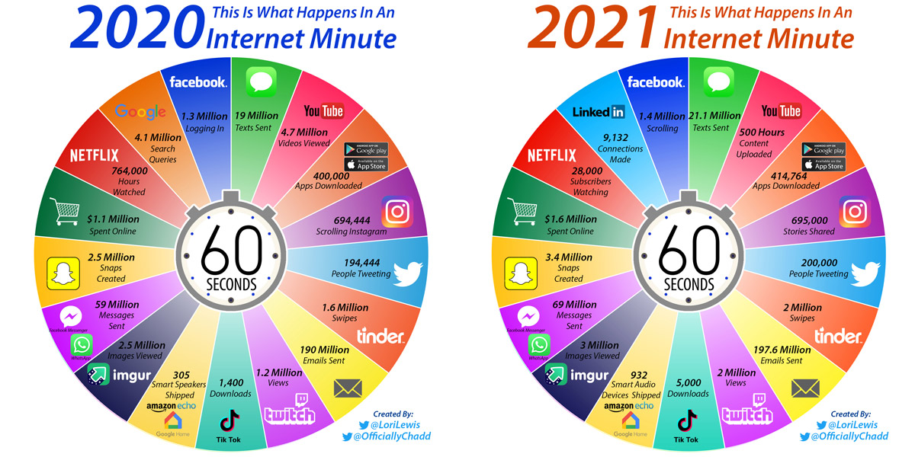

Slide 5
Exploding Digital Universe
Opportunity:
Analyse data to…
satisfy our curiosity
take well-informed decisions
improve quality of life
Solution: data mining

Slide 6
Data Mining is …
… the extraction of:
implicit
previously unknown
potentially useful
information from data.
(Witten and Frank, 2005)

Slide 7

Data Mining Workflow

Slide 8
Data Mining vs Machine Learning
At its most complex level, data mining involves machine learning (ML) methods for extracting structural patterns (typically called models) from data which can be used as a tool for:
Revealing hidden patterns in data (descriptive models)
Making prediction (predictive models)
Discussion: https://www.researchgate.net/post/What_is_the_difference_between_machine_learning_and_data_mining

Slide 9
We Will Keep it Simple!
This module will cover techniques for discovering:
implicit/hidden
previously unknown
potentially useful
information in data.
We will start with exploratory data analysis and data pre-processing for ML and then introduce some popular ML methods.

Slide 10
Simple Example
Input: independent from each other instances/examples of the weather conditions for playing golf.
Output: discovered patterns in the form of if-then rules.
Outlook | Temperature | Humidity | Windy | Play
Sunny | 85 | 85 | False | No
Sunny | 80 | 90 | True | No
Overcast | 83 | 86 | False | Yes
Rainy | 75 | 80 | False | Yes
… | … | … | … | …
If outlook = sunny and humidity > 83 then play = no If outlook = rainy and windy = true then play = no If outlook = overcast then play = yes If humidity < 85 then play = yes If none of the above then play = yes

Slide 11
Data Mining I/O
Input: typically, single table with data
Data rows represent independent from each other instances/examples of a particular concept.
Columns are attributes/features/variables which measure aspects of an instance.
Output: Compact structural patterns (knowledge) that describes the concept
Can be used for automatic decision-making, e.g., to predict the value of a particular [target] attribute of new instances.
Can be used to understand and explain data in a compact way and/or how automatic decision-making is done.

Slide 12
Types of Features/Attributes
Categorical attributes: Values serve only as labels or names.
Nominal
No relation is implied among values (no ordering or distance measure) and only equality tests can be performed.
Example: outlook = {overcast, sunny, rainy}
Ordinal
Ordering among values is implied.
Example: temperature = {cold, mild, hot}
Numerical attributes: discrete or continuous
Distinction between categorical and numerical not always clear

Slide 13
Data Mining Challenges
There needs to be a sufficient amount of data to enable the discovery of useful information.
Large datasets may require specific management: distributed storage and processing.
Discovered patterns in data can be:
Trivial and uninteresting.
Untrue, dependent on accidental coincidences in the particular dataset used.
Real data is imperfect:
Some parts may be distorted or unclear.
Some parts may be missing.
The data mining process needs to be robust enough to cope with imperfect data and to extract patterns that are inexact but useful.

