Slide 1
CS4168 Data Mining
Lecture 10 Introduction to Text Mining

Slide 2
Text Mining
Problem: Massive amounts of unstructured text data stored in electronic form require/create opportunity to automatically:
Classify/rate text documents
Discover previously unknown patterns

Slide 3
Data Mining Tasks
Identify/detect:
Sentiment
Spam
Offensive language/cyberbullying
Authorship
Language
and more…
Descriptive analysis:
Topic Modeling
Document Clustering

Slide 4
Pre-Processing
Tokenization:
Break the document into words or combination of words (n-grams).
Remove prefixes and suffixes from words, i.e. represent each word by its root/stem: stemming.
Normalisation:
Remove stop words: articles, conjunctions and prepositions.

Slide 5
Text Document Modelling
Bag of Words model: A piece of text/document is represented as bag of words, disregarding grammar and word order.
Example:
Document: “Three midterm exams in a week, and I love exams! Can we have another midterm exam this week please?“
Bag of words: {three:1, midterm:2, exam:3, week:2, I:1, lov:1, can:1, we:1, hav:1, another:1, this:1}

Slide 6
Text Document Modelling
N-gram model: represent spatial relationships between words. Generalisation of bag of words.
Example:
Document: “Three midterm exams in a week, and I love exams! Can we have another midterm exam this week please?“
Bigrams: {three midterm:1, midterm exam:1, exam week:2, …}

Slide 7
Document-Term Matrix
A document-term matrix is a matrix whose elements represent the count or frequency of terms (i.e., words or n-grams) that occur in a collection of documents (corpus).
In a document-term matrix, rows correspond to documents and columns correspond to terms.
A term frequency–inverse document frequency (tf-idf) is a weighting scheme to reduce the significance of terms occurring frequently in the corpus.

Slide 8
Document Term matrix
A document-term matrix A(t_{i}, d_{j}) contains the number of times term i appears in document j.
D1 = "I like data mining"
D2 = "I hate data mining, data engineering is interesting"
 | I | like | hate | data | mining | engineering | is | interesting
D1 | 1 | 1 | 0 | 1 | 1 | 0 | 0 | 0
D2 | 1 | 0 | 1 | 2 | 1 | 1 | 1 | 1
 | I | like | hate | data | mining | engineering | is | interesting
D1 | 0.25 | 0.25 | 0 | 0.25 | 0.25 | 0 | 0 | 0
D2 | 0.125 | 0 | 0.125 | 0.25 | 0.125 | 0.125 | 0.125 | 0.125

Slide 9
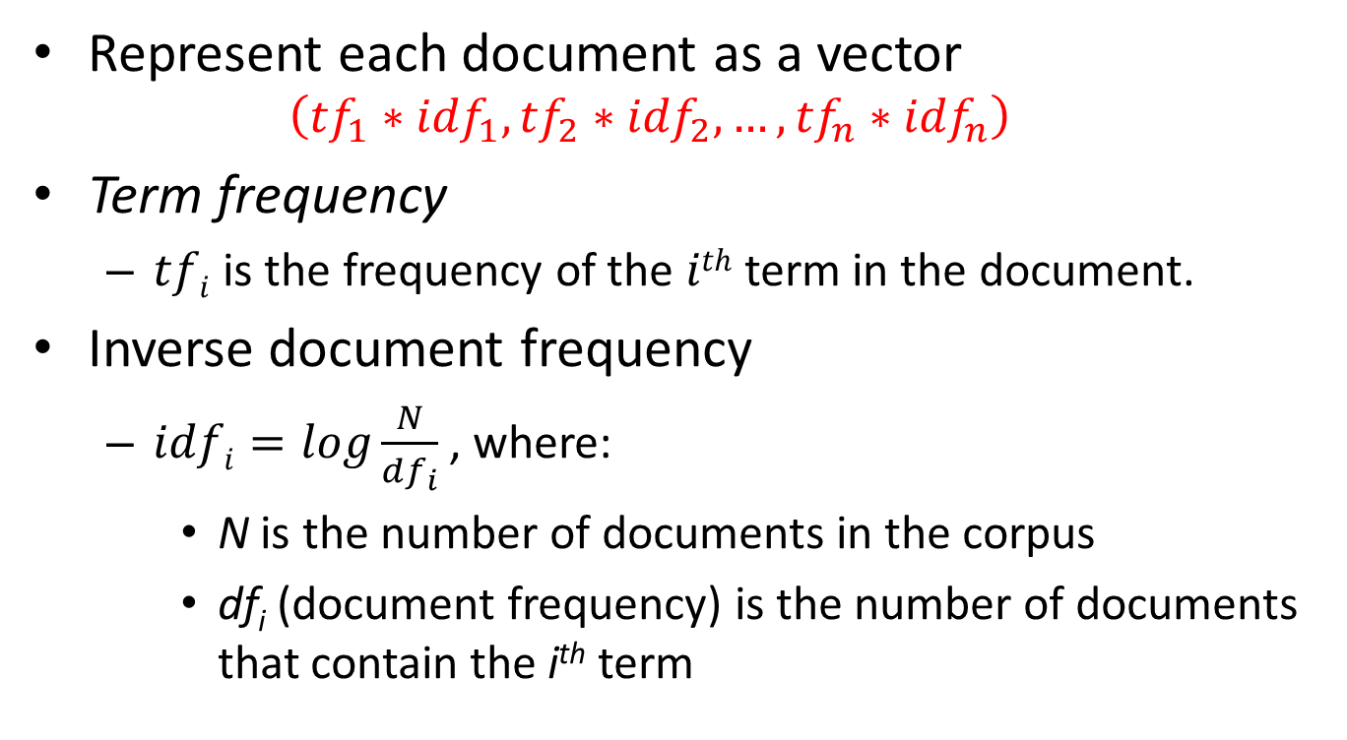
tf-idf Model
Represent each document as a vector
$$\left({tf}_{1}∗{idf}_{1},{tf}_{2}∗{idf}_{2},…, {tf}_{n}∗{idf}_{n}\right)$$
Term frequency
$tfi$ is the frequency of the $ith$ term in the document.
Inverse document frequency
$idfi=\log{\frac{N}{{df}_{i}}}$ , where:
N is the number of documents in the corpus
df_{i} (document frequency) is the number of documents that contain the i^{th} term

Slide 10


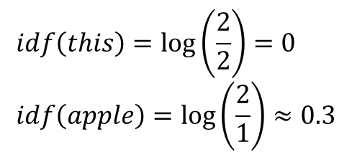
Example
Document 1
Term | Term Frequency
this | 0.2
apple | 0.01
music | 0.05
computer | 0.1
… | …
Document 2
Term | Term Frequency
this | 0.25
weather | 0.1
rain | 0.05
forecast | 0.15
… | …
$$tf\left(this, d1\right)=0.2$$
$$tf\left(this, d2\right)=0.25$$
$$idf\left(this\right)=\log\left(\frac{2}{2}\right)=0 \\ idf\left(apple\right)=\log\left(\frac{2}{1}\right)≈0.3$$

Slide 11
Stop Word Elimination
Stop words are words used frequently in the language, but not providing significant information.
There is no single universal list of stop words. Some tools specifically avoid removing these stop words.
Any group of words can be chosen as the stop words for a given purpose
Example stop words: the, is, at, which, on
Removing such words could improve the performance but also could impair the result.
Example: if we eliminate “the” and “who” we may miss that a document refers to the band “The Who”.

Slide 12
Stemming
Reduce terms to their roots/stems: prefixes, suffixes,…
Example:
“for example compressed and compression are both accepted as equivalent to compress”
becomes
“for exampl compress and compress ar both accept as equival to compress”

Slide 13
Advanced Representation Methods
Word Embeddings (Word2Vec, Google’s BERT)
Low-dimensional vector for each token/word
Similar words have similar vectors
Examples:
the vector of dog will be most similar to the vector of cat
king-men+women would be similar to the vector of queen

