Slide 1
Data Mining
Clustering
Based on the lecture slides accompanying “Data Mining: Practical Machine Learning Tools and Techniques” by Ian H. Witten and Eibe Frank
http://www.elsevierdirect.com/companion.jsp?ISBN=9780120884070

Slide 2
Styles of Machine Learning
Predictive/Supervised
Classification techniques
predicting a discrete attribute/class
Numeric prediction techniques
predicting a numeric quantity
Descriptive/Unsupervised
Association learning techniques
detecting associations between features
Clustering techniques
grouping similar instances into clusters

Slide 3
ClUSTERING: K-MEANS

Slide 4
Clustering
Aim: divide instances into “natural” groups
Clusters can be:
disjoint vs. overlapping
deterministic vs. probabilistic
flat vs. hierarchical
We'll look at a classic clustering algorithm called k-means: k-means clusters are disjoint, deterministic and flat
* Based on Slides for “Data Mining” by I. H. Witten and E. Frank and "Data mining with WEKA, Part 2: Classification and clustering" by Michael Abernethy http://www.ibm.com/developerworks/opensource/library/os-weka2/

Slide 5
k-means Clustering
To cluster data into k groups (k is predefined):
Choose k cluster centers (e.g. at random)
Assign each instance (i.e. data point) to the closest center. All data points assigned to the same center form a cluster.
Compute the centroids of clusters.
centroid of a cluster: the mean of all data points in the cluster.
If one of the following is true then STOP. Otherwise go to step 5.
Centroids of newly formed clusters are the same as the centers used in step 2 OR
Data points remain in the same cluster OR
Maximum number of iterations are reached.
Use the centroids of the clusters as new centers and go to step 2.
k-means minimizes sum of squared distances from the data points to the cluster centers. This sum is also called inertia.

Slide 6
Challenges with the k-Means Clustering Algorithm
Result can vary significantly based on initial choice of centers.
Can get trapped at a local minimum of the inertia
Example:
To increase chance of finding a global minimum of the inertia:
Restart with different random centers. Choose the clustering with the minimum inertia.
Smart choice of initial centers: k-means++.
Heuristic: spreading out the k initial cluster centers is a good thing.
instances
instances
initial cluster centers

Slide 7
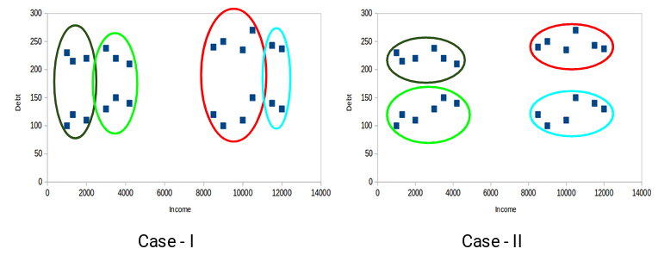
Properties of a Meaningful k-Means Clustering
All the data points in a cluster should be as similar (i.e. close) to each other as possible.
The data points in one cluster should be as different (i.e. far away) as possible from the data points in another cluster.
Taken from https://www.analyticsvidhya.com/blog/2019/08/comprehensive-guide-k-means-clustering/

Slide 8
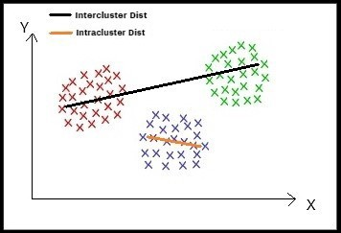
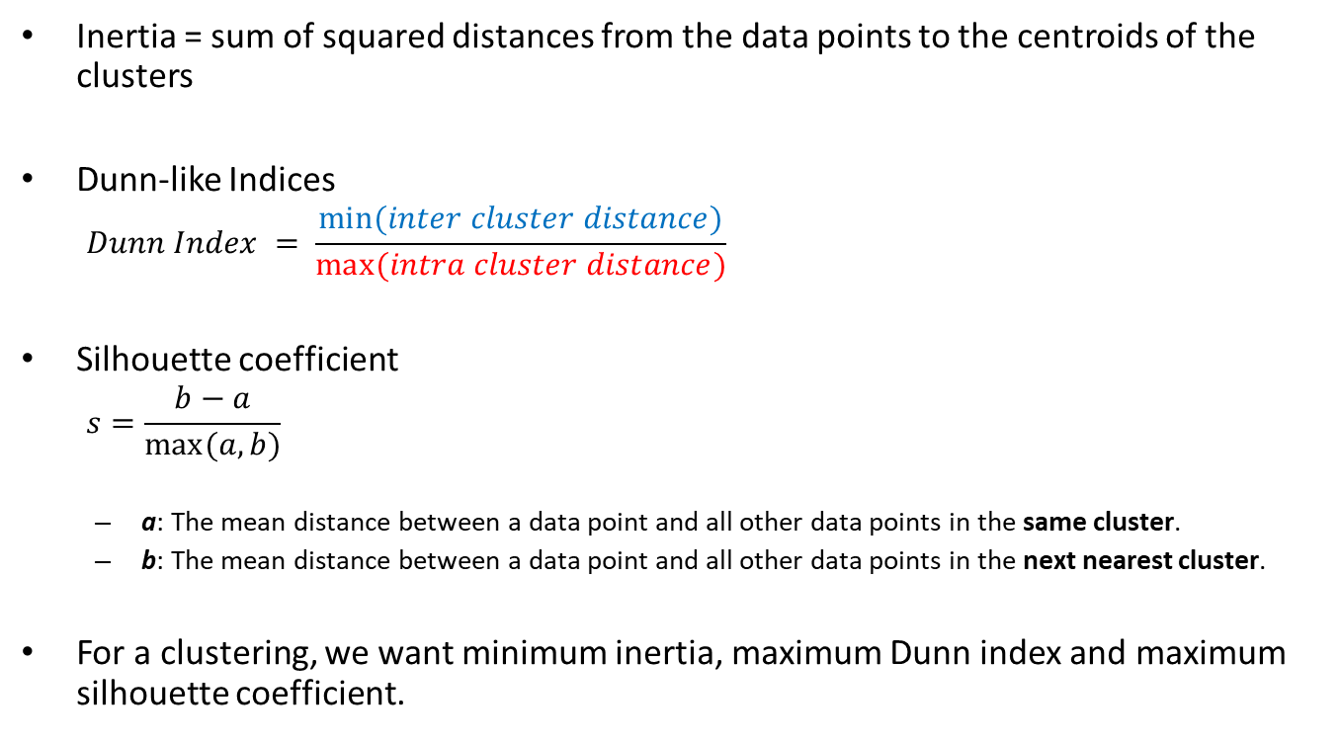
Evaluation Metrics for k-Means Clustering
Inertia = sum of squared distances from the data points to the centroids of the clusters
Dunn-like Indices
$$Dunn Index = \frac{min⁡(inter cluster distance)}{max⁡(intra cluster distance)}$$
Silhouette coefficient
$$s=\frac{b−a}{max⁡(a,b)}$$
a: The mean distance between a data point and all other data points in the same cluster.
b: The mean distance between a data point and all other data points in the next nearest cluster.
For a clustering, we want minimum inertia, maximum Dunn index and maximum silhouette coefficient.

Slide 9
Best Value of k
The values of these metrics (inertia, Dunn index, silhouette coefficient) can be plotted for various values of k in order to choose the best value of k for k-means.
Bisecting k-means
Split one cluster into two sub clusters at each bisecting step (by using k-means) until a meaningful set of clusters is obtained.

