Slide 1
Data Mining
Lecture 5: Basics of Classification
Most slides based on the lecture slides accompanying “Data Mining: Practical Machine Learning Tools and Techniques” by Ian H. Witten and Eibe Frank, https://www.cs.waikato.ac.nz/ml/weka/book.html.

Slide 2
Styles of Machine Learning
Predictive/Supervised
Classification techniques
predicting a discrete attribute/class
Numeric prediction techniques
predicting a numeric quantity
Descriptive/Unsupervised
Association learning techniques
detecting associations between features
Clustering techniques
grouping similar instances into clusters

Slide 3
Classification

Slide 4
Training Set (or Test Set)
dependent variable
class attribute
label
predictors
 |  | …
 |  | …
 |  | …
⁞ | ⁞ | ⁞ | ⁞ | ⁞
 |  | …

Slide 5
Simplicity First
Simple algorithms often work very well!
There are many kinds of simple structures, for example:
One attribute does all the work – OneR (one rule) algorithm
All attributes contribute equally & independently (Naïve Bayes)
A weighted linear combination of attributes might do (logistic regression)
Etc.
Success of method depends on the domain.

Slide 6
Decisions Tree CLASSIFIER

Slide 7
Weather Dataset
Outlook | Temp | Humidity | Windy | Play
Sunny | Hot | High | False | No
Sunny | Hot | High | True | No
Overcast | Hot | High | False | Yes
Rainy | Mild | High | False | Yes
Rainy | Cool | Normal | False | Yes
Rainy | Cool | Normal | True | No
Overcast | Cool | Normal | True | Yes
Sunny | Mild | High | False | No
Sunny | Cool | Normal | False | Yes
Rainy | Mild | Normal | False | Yes
Sunny | Mild | Normal | True | Yes
Overcast | Mild | High | True | Yes
Overcast | Hot | Normal | False | Yes
Rainy | Mild | High | True | No

Slide 8
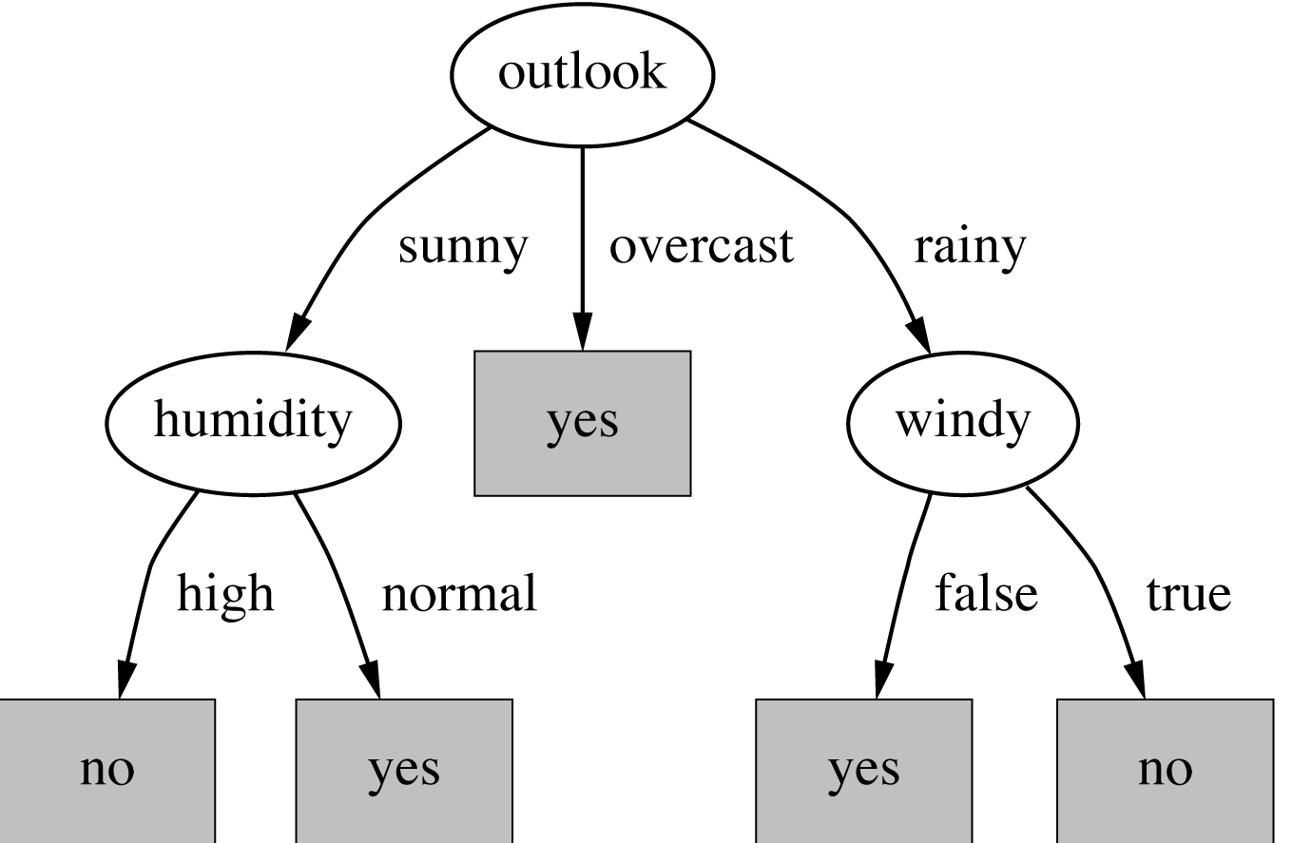
Final decision tree

Slide 9
Constructing decision trees
Strategy: top down Recursive divide-and-conquer fashion
First: select attribute for root node Create branch for each possible attribute value
Then: split instances into subsets One for each branch extending from the node
Finally: repeat recursively for each branch, using only instances that reach the branch
Stop if all instances have the same class

Slide 10
Weather Dataset
Outlook | Temp | Humidity | Windy | Play
Sunny | Hot | High | False | No
Sunny | Hot | High | True | No
Overcast | Hot | High | False | Yes
Rainy | Mild | High | False | Yes
Rainy | Cool | Normal | False | Yes
Rainy | Cool | Normal | True | No
Overcast | Cool | Normal | True | Yes
Sunny | Mild | High | False | No
Sunny | Cool | Normal | False | Yes
Rainy | Mild | Normal | False | Yes
Sunny | Mild | Normal | True | Yes
Overcast | Mild | High | True | Yes
Overcast | Hot | Normal | False | Yes
Rainy | Mild | High | True | No

Slide 11
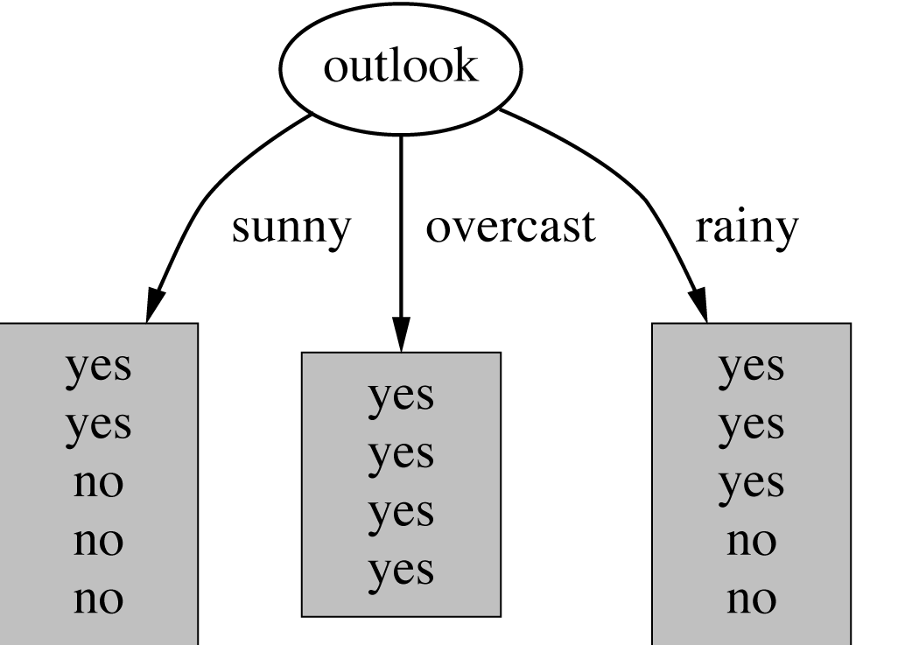
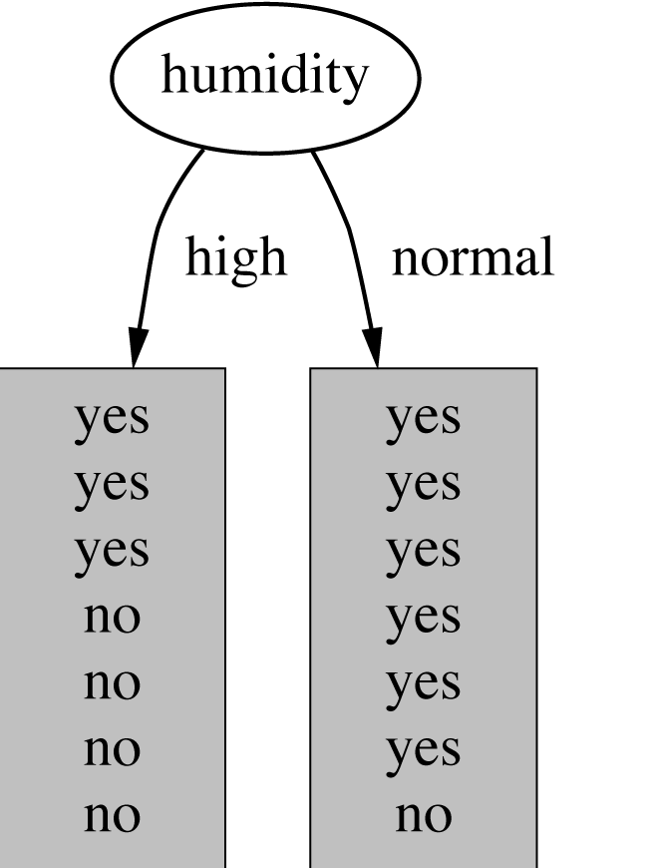
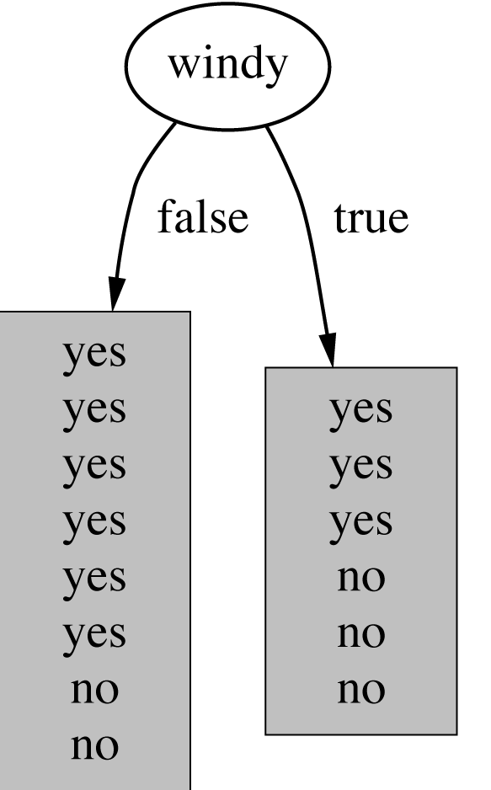
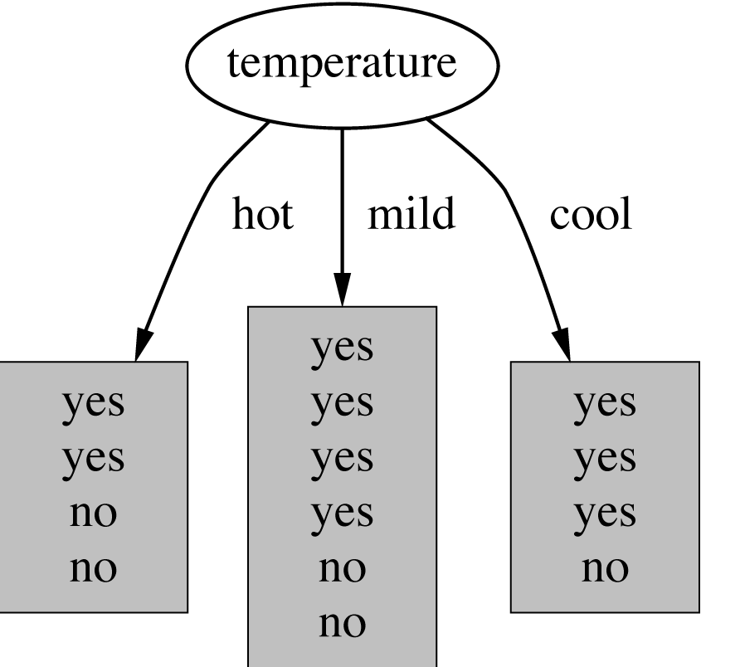
Which attribute to select?

Slide 12
Criterion for attribute selection
Which is the best attribute?
Want to get the smallest tree
Heuristic: choose the attribute that produces the “purest” nodes
Measure of purity:
info[node] - information value of a node measured in bits.
the amount of further information necessary to take a decision at tree_node
Strategy: choose attribute with the lowest information value of its child nodes

Slide 13
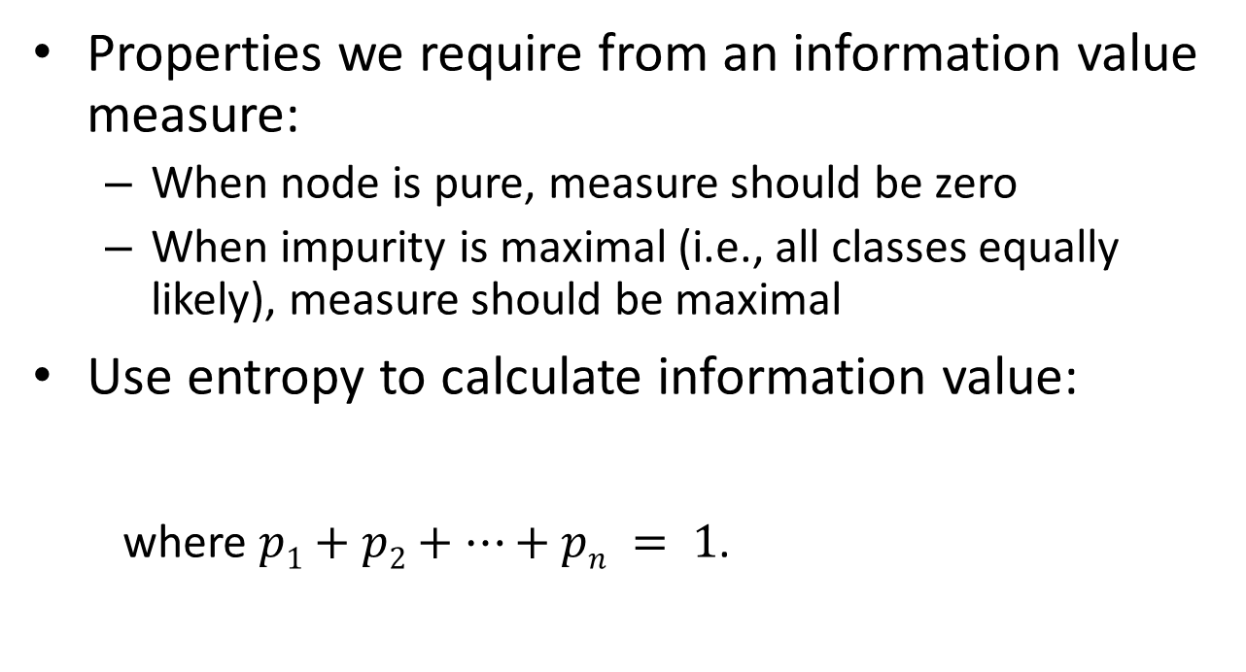
How to measure information value?
Properties we require from an information value measure:
When node is pure, measure should be zero
When impurity is maximal (i.e., all classes equally likely), measure should be maximal
Use entropy to calculate information value:
where $p1+p2+…+pn = 1$.

Slide 14
Example: attribute Outlook
Child node: Outlook = Sunny
Child node: Outlook = Overcast
Child node: Outlook = Rainy
Note: log(0) is normally
undefined.

Slide 15
Example: attribute Outlook
Information value for node Outlook
Before the split info([9,5]) = entropy(9/14, 5/14) = = -9/14log(9/14) – 5/14log(5/14) = 0.940 bits
After the split info([3,2], [4,0], [3,2]) = = (5/14)0.971 + (4/14)0 + (5/14)0.971 = 0.693 bits
Information gain = 0.940 – 0.693 = 0.247

Slide 16
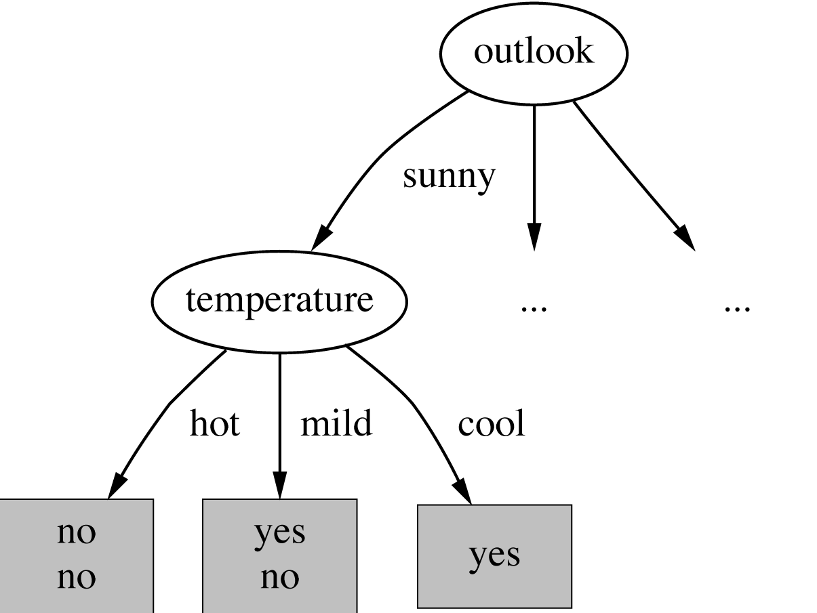
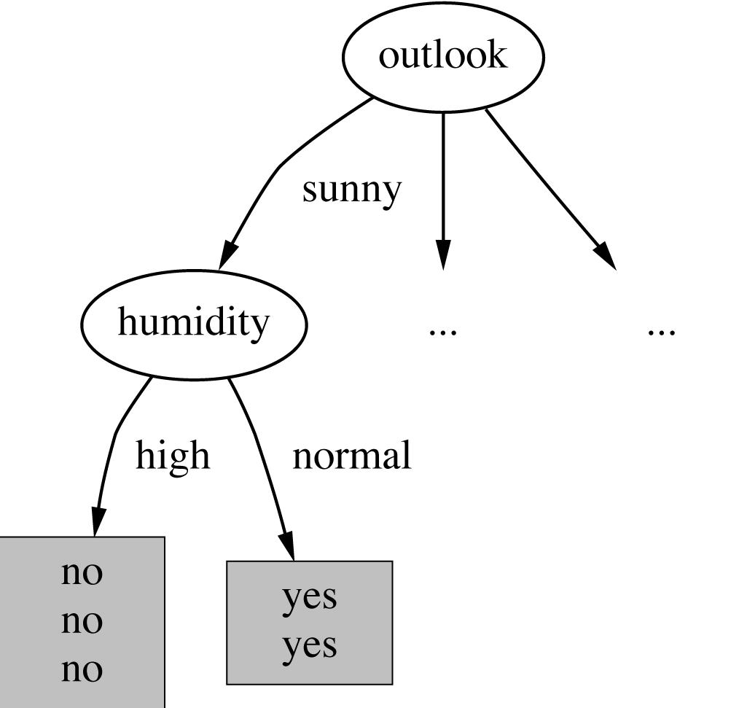
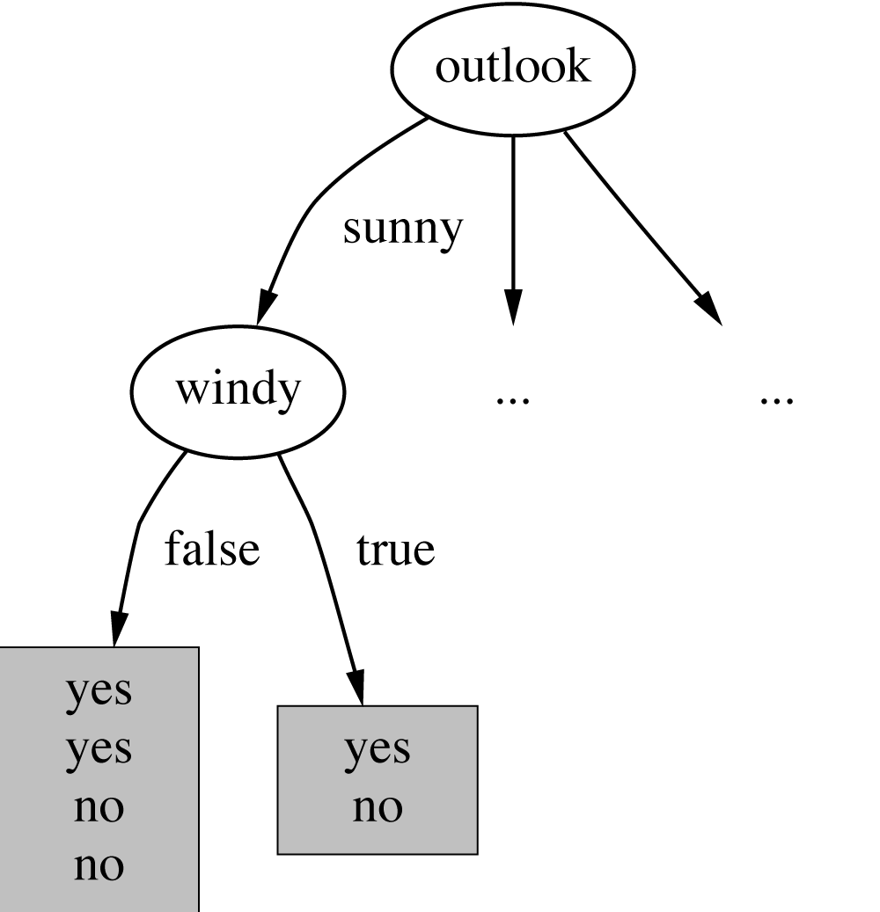
Continuing to split
gain(Temperature ) = 0.571 bits
gain(Humidity ) = 0.971 bits
gain(Windy ) = 0.020 bits

Slide 17
Final decision tree

Slide 18
Discussion
Top-down induction of decision trees: ID3, algorithm developed by Ross Quinlan.
Pruning techniques to avoid overfitting:
Use a validation dataset.
Similar approach: CART
There can be attribute selection criteria! (But little difference in accuracy of result)

Slide 19
Random Forest Algorithm
“Random Forest is one of the most popular and most powerful machine learning algorithms. It is a type of ensemble machine learning algorithm called bootstrap aggregation or bagging.” Source
“The random forest is a classification algorithm consisting of many decisions trees. It uses bagging and feature randomness when building each individual tree to try to create an uncorrelated forest of trees whose prediction by committee is more accurate than that of any individual tree.” Source
“In bagging (a.k.a. bootstrap aggregation), a random sample of data in a training set is selected with replacement — meaning that the individual data points can be chosen more than once.” Source

Slide 20
Ensemble ML
Ensemble learning refers to a group (or ensemble) of base ML algorithms, which work collectively to achieve better predictive performance.
Bagging and boosting are two main types of ensemble learning methods.
Bagging: the base models are trained in parallel.
Boosting: the base models are trained sequentially.
Popular boosting algorithms: AdaBoost, XGBoost, GradientBoost, BrownBoost.

Slide 21
KNN CLASSIFIER (Instance Based Learning)

Slide 22
Instance-Based Learning Algorithm
Training instances (i.e., examples) are searched for the top k instances that most closely resemble a new instance.
A majority vote is taken from the top k instances to classify the new instance.
Similarity (or distance) function defines what’s “learned”.
Simplest form of classification, also called:
rote learning
lazy learning
k-nearest-neighbor (k-NN, kNN, KNN)

Slide 23
The Distance Function
Simplest case: dataset with one numeric attribute
Distance is the difference between the two attribute values involved
Dataset with several numeric attributes: normally, Euclidean distance is used.
Are all attributes equally important?
Weighting the attributes might be necessary.

Slide 24
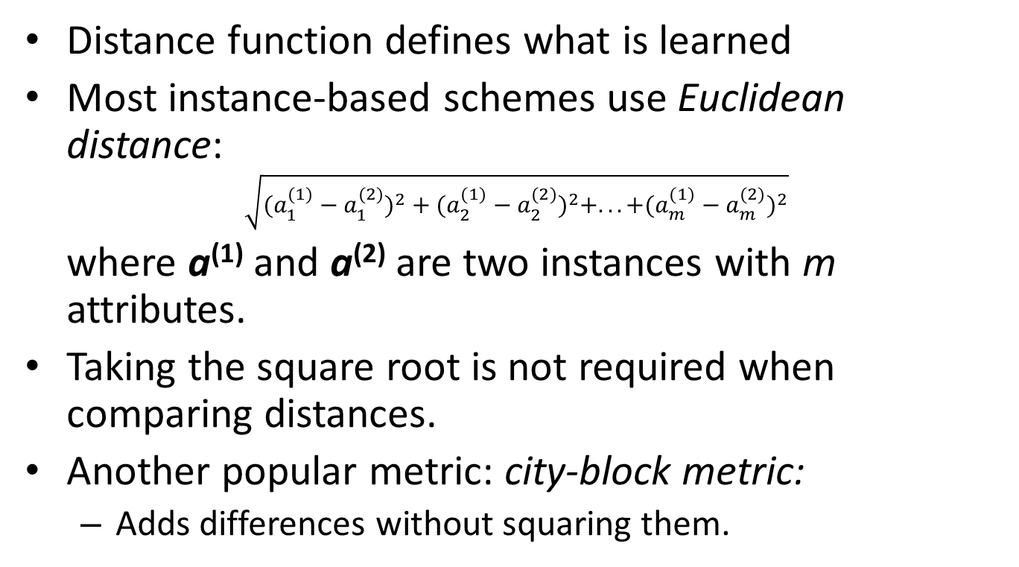
The Distance Function
Distance function defines what is learned
Most instance-based schemes use Euclidean distance:
$$\sqrt{(a_{1}^{(1)}−a_{1}^{(2)})^{2}+(a_{2}^{(1)}−a_{2}^{(2)})^{2}+...+(a_{m}^{(1)}−a_{m}^{(2)})^{2}}$$
where a⁽¹⁾ and a⁽²⁾ are two instances with m attributes.
Taking the square root is not required when comparing distances.
Another popular metric: city-block metric:
Adds differences without squaring them.

Slide 25
Discussion about kNN
Often very accurate … but slow:
Simple version scans entire training data to derive a prediction.
Assumes all features are equally important,
Remedy: feature selection or weights.
Sensitive to noise for k=1.
Statisticians have used kNN since the early 1950s.
For a dataset with n instances, if n → ∞ and k/n → 0, error approaches minimum.

