Slide 1
CS4168 Data Mining
Lecture 7 - Linear Models
Based on the lecture slides accompanying “Data Mining: Practical Machine Learning Tools and Techniques” by Ian H. Witten and Eibe Frank
http://www.elsevierdirect.com/companion.jsp?ISBN=9780120884070

Slide 2
Styles of Machine Learning
Predictive/Supervised
Classification techniques
predicting a discrete attribute/class
Numeric prediction techniques
predicting a numeric quantity
Descriptive/Unsupervised
Association learning techniques
detecting associations between features
Clustering techniques
grouping similar instances into clusters

Slide 3
Numeric Prediction/Regression

Slide 4
Training Instances
Target of regression
 |  |  | …
1 |  |  | …
1 |  |  | …
⁞ | ⁞ | ⁞ | ⁞ | ⁞ | ⁞
1 |  |  | …

Slide 5
Linear Regression
Work most naturally with numeric attributes
Standard technique for numeric prediction: linear regression
Outcome is linear combination of attributes
Weights are calculated from the training data
Predicted value for first training instance a⁽¹⁾
(assuming each instance is extended with a constant attribute with value 1)

Slide 6
Minimizing the squared error
Choose k +1 coefficients to minimize the squared error on the training data
Squared error:
Derive coefficients using standard matrix operations
Can be done if there are more instances than attributes (roughly speaking)
Minimizing the absolute error is more difficult

Slide 7
Evaluating numeric prediction
Same strategies: independent test set, cross-validation, etc.
Difference: error measures
Actual target values: a₁ a₂ …a_{n}
Predicted target values: p₁ p₂ … p_{n}
Most popular measure: mean-squared error
Easy to manipulate mathematically

Slide 8
Other measures
The root mean-squared error :
The mean absolute error is less sensitive to outliers than the mean-squared error:
Sometimes relative error values are more appropriate (e.g. 10% for an error of 50 when predicting 500)

Slide 9
Improvement on the mean
How much does the scheme improve on simply predicting the average?
The relative squared error is ( ):
The relative absolute error is:

Slide 10
Correlation coefficient
Measures the statistical correlation between the predicted values and the actual values
Scale independent, between –1 and +1
Good performance leads to large values!

Slide 11
Which measure?
Best to look at all of them
Often it doesn’t matter
Example:
 | A | B | C | D
Root mean-squared error | 67.8 | 91.7 | 63.3 | 57.4
Mean absolute error | 41.3 | 38.5 | 33.4 | 29.2
Root rel squared error | 42.2% | 57.2% | 39.4% | 35.8%
Relative absolute error | 43.1% | 40.1% | 34.8% | 30.4%
Correlation coefficient | 0.88 | 0.88 | 0.89 | 0.91
D best
C second-best
A, B arguable

Slide 12
Classification - Logistic Regression - Perceptron - Winnow - SVM

Slide 13
Classification
Any regression technique can be used for classification
Training: perform a regression for each class, setting the output to 1 for training instances that belong to class, and 0 for those that don’t
Prediction: predict class corresponding to model with largest output value (membership value)
For linear regression this is known as multi-response linear regression
Problem: membership values are not in [0,1] range, so aren't proper probability estimates

Slide 14
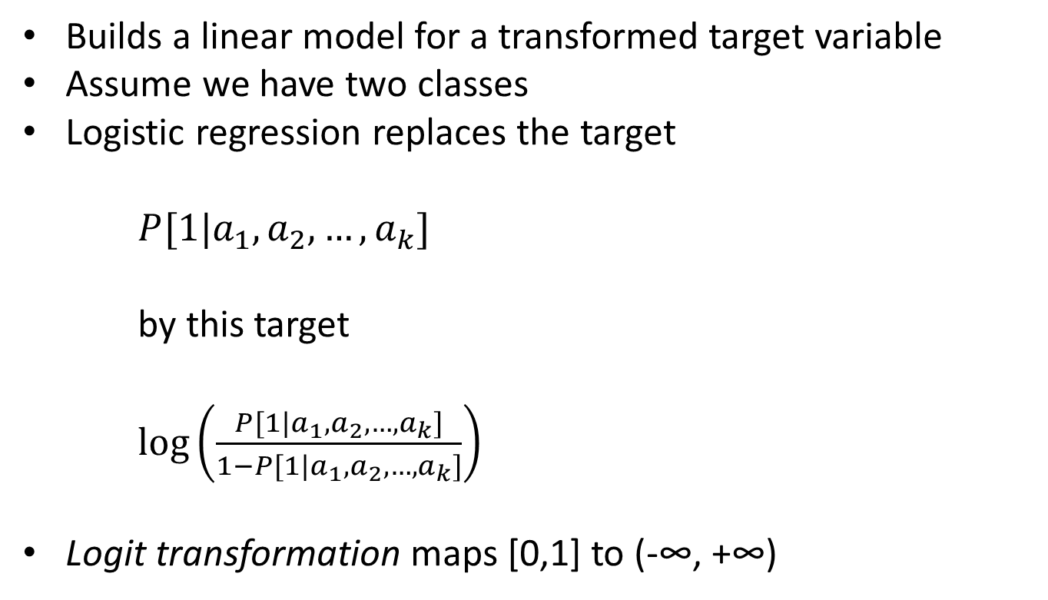
Linear Models: Logistic Regression
Builds a linear model for a transformed target variable
Assume we have two classes
Logistic regression replaces the target
$P[1|a_{1},a_{2},…,a_{k}]$
by this target
$\log\left(\frac{P[1|a_{1}{,a}_{2},…,a_{k}]}{1−P[1|a_{1},a_{2},…,a_{k}]}\right)$
Logit transformation maps [0,1] to (­-∞, +∞)

Slide 15
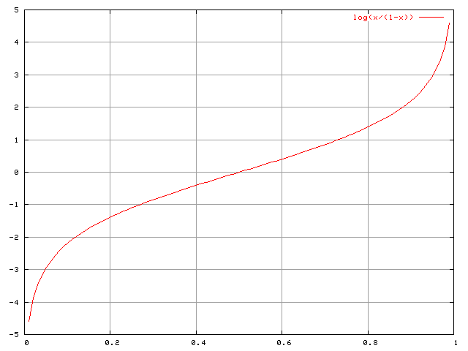
Logit Transformation

Slide 16
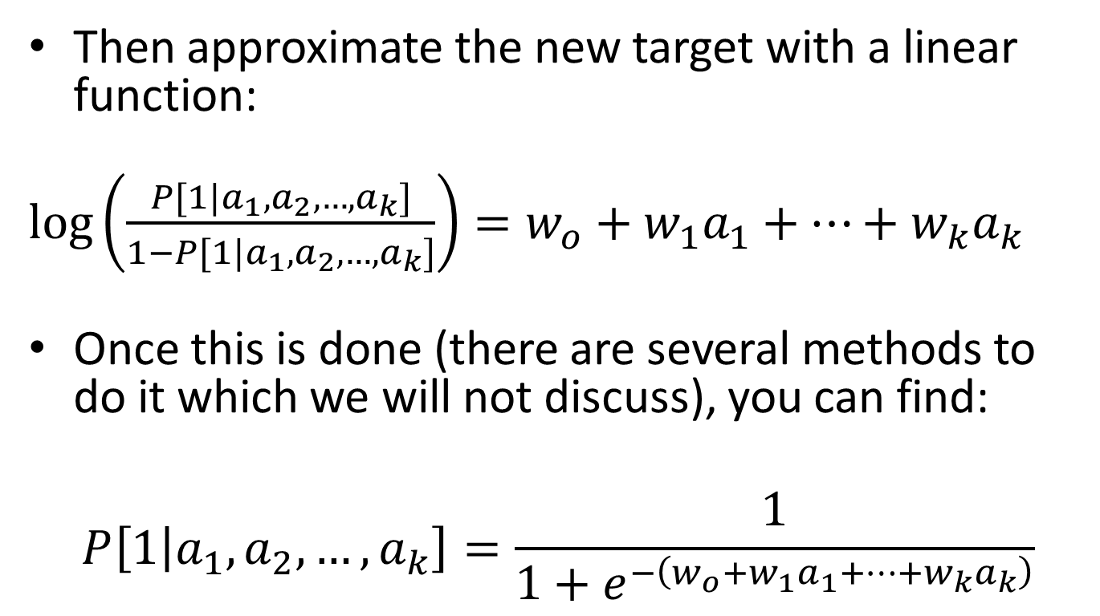
Linear Models: Logistic Regression
Then approximate the new target with a linear function:
$\log\left(\frac{P[1|a_{1}{,a}_{2},…,a_{k}]}{1−P[1|a_{1},a_{2},…,a_{k}]}\right)=w_{o}+w_{1}a_{1}+…+w_{k}a_{k}$
Once this is done (there are several methods to do it which we will not discuss), you can find:
$$P\left[1 | a_{1},a_{2},…,a_{k}\right]=\frac{1}{1+e^{−\left(w_{o}+w_{1}a_{1}+…+w_{k}a_{k}\right)}}$$

Slide 17
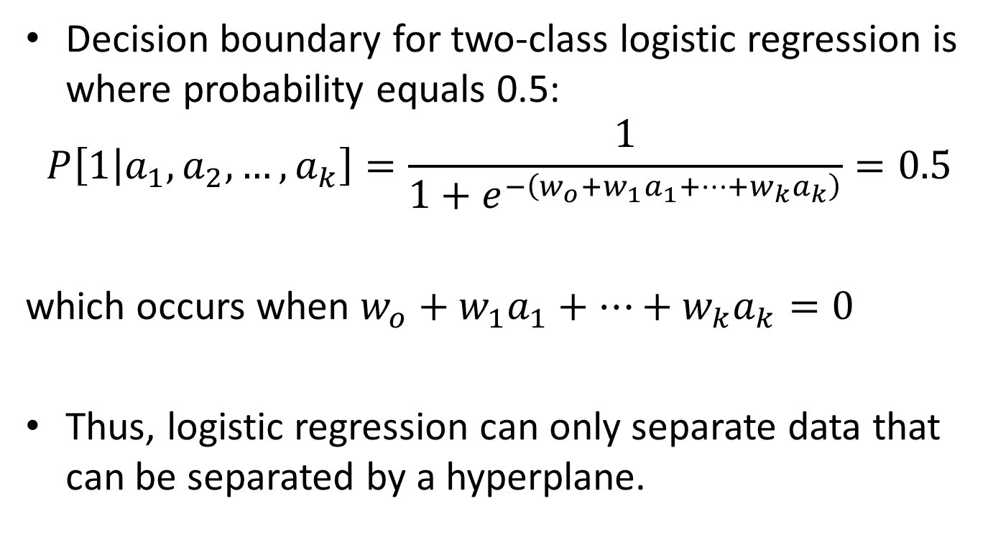
Linear Models are Hyperplanes
Decision boundary for two-class logistic regression is where probability equals 0.5:
$$P\left[1 | a_{1},a_{2},…,a_{k}\right]=\frac{1}{1+e^{−\left(w_{o}+w_{1}a_{1}+…+w_{k}a_{k}\right)}}=0.5$$
which occurs when $w_{o}+w_{1}a_{1}+…+w_{k}a_{k}=0$
Thus, logistic regression can only separate data that can be separated by a hyperplane.

Slide 18
Linear Models: The Perceptron
Don't actually need probability estimates if all we want to do is classification
Different approach: learn separating hyperplane
Assumption: data is linearly separable
Algorithm for learning separating hyperplane: perceptron learning rule
Hyperplane: where we again assume that there is a constant attribute with value 1 (bias)
If sum is greater than zero we predict the first class, otherwise the second class

Slide 19
The Perceptron Algorithm
Set all weights to zero
Until all instances in the training data are classified correctly
For each instance I in the training data
If I is classified incorrectly by the perceptron
If I belongs to the first class add it to the weight vector
else subtract it from the weight vector
Why does this work? Consider situation where instance a pertaining to the first class has been added:
This means output for a has increased by:
This number is always positive, thus the hyperplane has moved into the correct direction (and we can show output decreases for instances of other class).

Slide 20
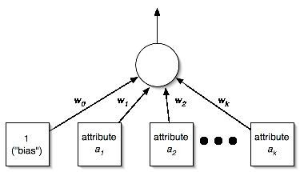
The Perceptron as a Neural Network

Slide 21
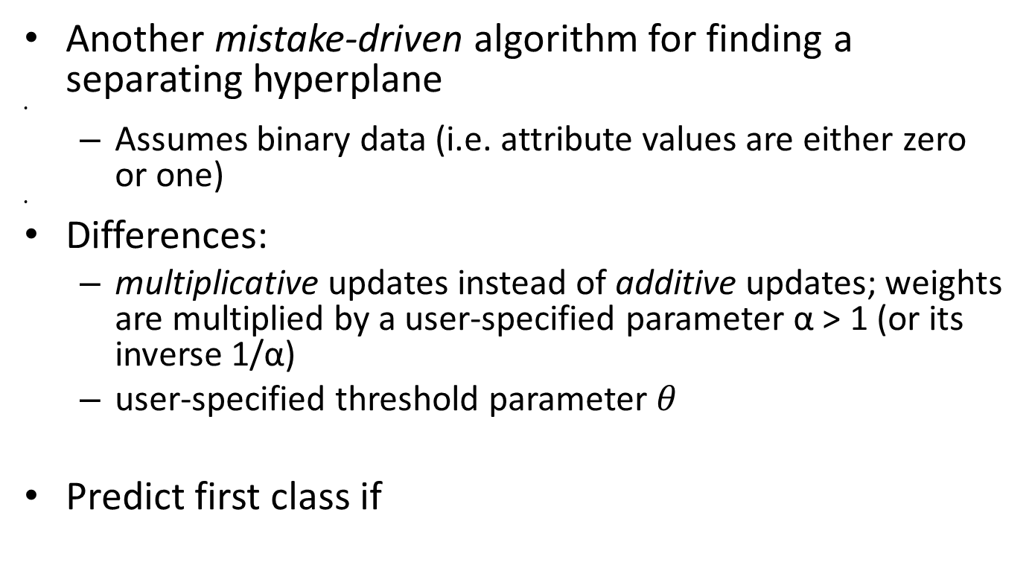
Linear Models: Winnow
Another mistake-­driven algorithm for finding a separating hyperplane
Assumes binary data (i.e. attribute values are either zero or one)
Differences:
multiplicative updates instead of additive updates; weights are multiplied by a user­-specified parameter α > 1 (or its inverse 1/α)
user­-specified threshold parameter $θ$
Predict first class if

Slide 22
The Winnow Algorithm
while some instances are misclassified
for each instance a in the training data
classify a using the current weights
if the predicted class is incorrect
if a belongs to the first class
for each a_{i} that is 1, multiply w_{i} by α (if a_{i} is 0 leave w_{i} unchanged) otherwise
for each a_{i} that is 1, divide w_{i} by α (if a_{i} is 0 leave w_{i} unchanged)
Winnow is very effective in homing in on relevant features (it is attribute efficient)
Both the perceptron and winnow can be used to interactively improve the model as new instances arrive continuously

Slide 23
Linear Models: SVM
Self-study

