Slide 1
CS4168 Data Mining
Lecture 8 - Dimensionality Reduction
Main source: https://machinelearningmastery.com/an-introduction-to-feature-selection/

Slide 2
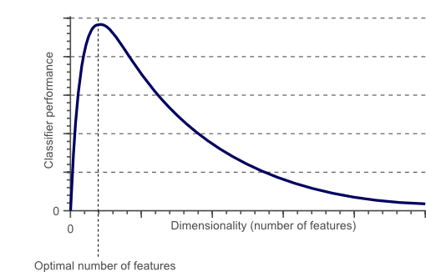
Curse of Dimensionality - Problem
Hughes effect: With a fixed number of training samples, the accuracy of a classifier first increases as the number of features grows, but after some point it starts to decrease dramatically.
Source: https://www.visiondummy.com/2014/04/curse-dimensionality-affect-classification/

Slide 3
Curse of Dimensionality - Solution
Solution:
Feature selection
Select some of the features and use only them for model training and testing
Dimensionality Reduction
Transform features to a lower-dimensional space and use only the transformed features for model training and testing
Note: Feature selection methods also reduce the dimensionality of the feature space
Important: Apply feature selection or dimensionality reduction separately to training and test sets

Slide 4
Feature Selection
Feature Selection Algorithms:
Filter Methods
Wrapper Methods
Embedded Methods

Slide 5
Feature Selection – Filter Methods
Filter feature selection methods apply a statistical measure to assign a scoring to each feature.
The features are ranked by the score and either selected to be kept or removed from the dataset.
The methods are often univariate and consider the feature independently, or with regard to the dependent variable.
Some examples of some filter methods include
Chi squared test
Information gain
Correlation coefficient scores

Slide 6
Feature Selection – Wrapper Methods (1)
Wrapper methods consider the selection of a set of features as a search problem.
Different combinations of features are prepared, evaluated and compared to other combinations.
A predictive model us used to evaluate a combination of features and assign a score based on model accuracy.
An example of a wrapper method is the recursive feature elimination (RFE) algorithm.

Slide 7
Feature Selection – Wrapper Methods (2)
Recursive Feature Elimination
https://scikit-learn.org/stable/modules/generated/sklearn.feature_selection.RFE.html

Slide 8
Feature Selection – Embedded Methods
Embedded methods learn which features best contribute to the accuracy of the model while the model is being created.
The most common type of embedded feature selection methods are regularization methods.
Regularization methods are also called penalization methods that introduce additional constraints into the optimization of a predictive algorithm (such as a regression algorithm) that bias the model toward lower complexity (fewer coefficients).
Examples of regularization algorithms are
LASSO
Ridge Regression
Elastic Net https://youtube.com/watch?v=1dKRdX9bfIo

Slide 9
Feature Transformation
Linear
Principal Component Analysis (PCA)
Non-linear
Multidimensional scaling (MDS)
T-SNE

