Slide 1
CS4168 Data Mining
Lecture 9 - Introduction to Recommender Systems

Slide 2
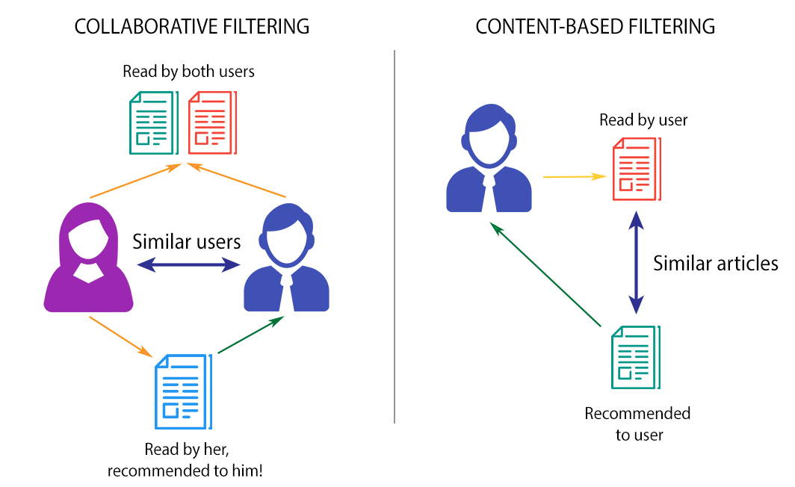
Types of Recommender Systems
Recommender systems can be loosely broken down into three categories: content-based filtering systems, collaborative filtering systems, and hybrid systems (combination of the other two).
http://datameetsmedia.com/an-overview-of-recommendation-systems/

Slide 3
Types of Recommender Systems
Another classification:
Content-based filtering recommenders
Collaborative filtering recommenders
Social and demographic recommenders
Contextual recommenders
Hybrid (combination of any of the above)

Slide 4
Types of Recommender Systems
Content-based filtering algorithms are given user preferences for items and recommend similar items based on [a domain-specific notion of] item content.
Typically, the items are text documents (e.g. product descriptions, articles).
This approach also extends naturally to cases where item metadata is available (e.g., movie stars, book authors, and music genres).

Slide 5
Types of Recommender Systems
Collaborative filtering: you are given a matrix of preferences (explicit or implicit) by users for items, and these are used to predict missing preferences and recommend items with high predicted preferences.
All you need to get started is user and item IDs and a notion of preference by users for items (ratings, views, etc.).

Slide 6
Types of Recommender Systems
Social and demographic recommenders suggest items that are liked by friends, friends of friends, and demographically-similar people.
Contextual recommendation algorithms recommend items that match the user’s current context.

Slide 7
Challenges
Cold start ability - that is, the ability to start making good predictions to a new user/for a new item.
Sparse data handling - often datasets are sparse, and but we still want to make good predictions.

Slide 8
Content-Based Filtering (CBF)

Slide 9
Content-Based Filtering (CBF)
Also known as cognitive filtering.
Based on a comparison between the content of the items and a user profile.
The content of each item is represented as a set of descriptors or terms.
The user profile is represented with the same terms and built up by analysing the content of items which have been seen by the user.

Slide 10
Content-Based Filtering (CBF)
A learning algorithm has to be chosen that is able to make recommendations for a given user profile.
Typical (trivial) choice: kNN
Alternatively:
Relevance feedback
Genetic algorithms
Neural networks
Bayesian classifiers

Slide 11
Content-Based Filtering (CBF)
Examples:
CBF - A Simple Example.ipynb
https://towardsdatascience.com/introduction-to-two-approaches-of-content-based-recommendation-system-fc797460c18c

Slide 12
CBF - Discussion
Neural networks and genetic algorithms are usually much slower compared to other learning methods as several iterations are needed to determine whether or not an item is relevant.
kNN slows down as more training examples become available because every example has to be compared to all the unseen documents.
Among the best performers in terms of speed are the Bayesian classifiers and relevance feedback.

Slide 13
CBF - Discussion
A learning method that requires many training instances before it is able to make accurate predictions is only useful when the user’s interests remain constant for a long period of time:
Bayesian classifiers performs poorly in this respect.
Relevance feedback method and kNN can start making suggestions with only one training instance.

Slide 14
CBF - Discussion
The learning method has to be able to evaluate the training data as instances do not last forever but become obsolete as the user’s interests change.
In kNN and in a genetic algorithms, old training instances will have to be removed entirely.
The user models employed by relevance feedback methods, Bayesian classifiers and neural networks can be adjusted more smoothly by reducing weights of corresponding terms or nodes.

Slide 15
Collaborative Filtering (CF)

Slide 16
Collaborative Filtering (CF)
Based on the assumption that people who agreed in their evaluation of certain items in the past are likely to agree again in the future.
CF methods work with the user-item interaction (or rating) matrix.
Types of CF:
neighbourhood-based (memory-based)
model-based

Slide 17
Neighbourhood-Based CF
Neighbourhood-based algorithms approach the CF problem by using the entire dataset.
User-based: Find users similar to the active user, and use their preferences to recommend items to the active user.
Item-based: Recommends items similar to the items preferred by the active user where similarity is based on item co-occurrences (e.g. users who bought x, also bought y).

Slide 18
Neighbourhood-Based CF
Example
https://buildingrecommenders.wordpress.com/2015/11/18/overview-of-recommender-algorithms-part-2/

Slide 19
Neighbourhood-Based CF
Discussion:
Advantages
Good quality of predictions.
Relatively simple to implement for any situation.
Very easy to take updates in the dataset into accounts, since it uses the entire database every time it makes a prediction.
Disadvantages
It uses the entire database every time it makes a prediction - slow.
Cold-start problem: It can sometimes not make a prediction for certain active users/items. This can occur if the active user has no items in common with all people who have rated the target item.
Hard to avoid overfitting the data.

Slide 20
Model-Based CF
Extract some information from the dataset, and use that as a "model" to make recommendations without having to use the complete dataset every time.
Standard model CF: Matrix Factorization

Slide 21
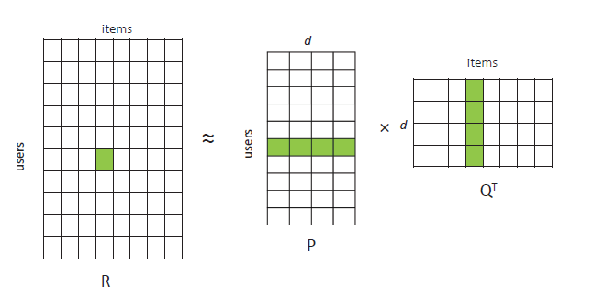
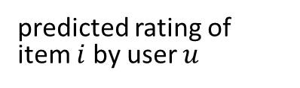

Matrix Factorization (MF)
Consider a rating matrix R. MF-based methods for CF approximate R by two small matrices P and Q with a small number d or columns and rows, respectively. These d columns/rows are called latent factors/features.
unknown,
to be learned
Rating model:
$${\hat{r}}_{ui}={P_{u}Q}_{i}^{T}$$
predicted rating of item $i$ by user $u$

Slide 22
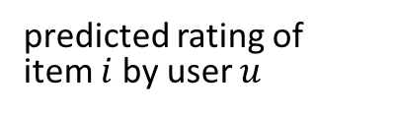

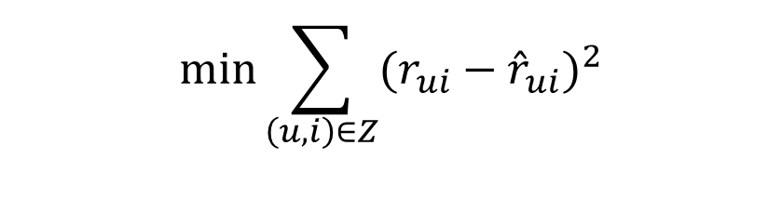

Matrix Factorization (MF)
$${\hat{r}}_{ui}={P_{u}Q}_{i}^{T}$$
Rating model:
Objective Function
predicted rating of item $i$ by user $u$
$$Z=\{\left(u,i\right):r_{ui} is observed\}$$
$$\min{\sum_{\left(u,i\right)∈Z}{{(r_{ui}−{\hat{r}}_{ui})}^{2}}}$$

Slide 23
Model-Based CF: Matrix Factorization (MF)
Optimisation methods:
Stochastic Gradient Descent (SGD)
Alternating Least Squares method (ALS)

Slide 24
Example CF Code
Matrix Factorization: A Simple Tutorial and Implementation in Python by Albert Au Yeung
Comprehensive Guide to build a Recommendation Engine from scratch (in Python) by Pulkit Sharma (Section 7)

Slide 25
Datasets for Recommender Systems
https://github.com/caserec/Datasets-for-Recommender-Systems

Slide 26
References
http://recommender-systems.org/
http://www.cs.carleton.edu/cs_comps/0607/recommend/recommender/
https://www.cs.cmu.edu/~mgormley/courses/10601-s17/slides/lecture25-mf.pdf

