Slide 1
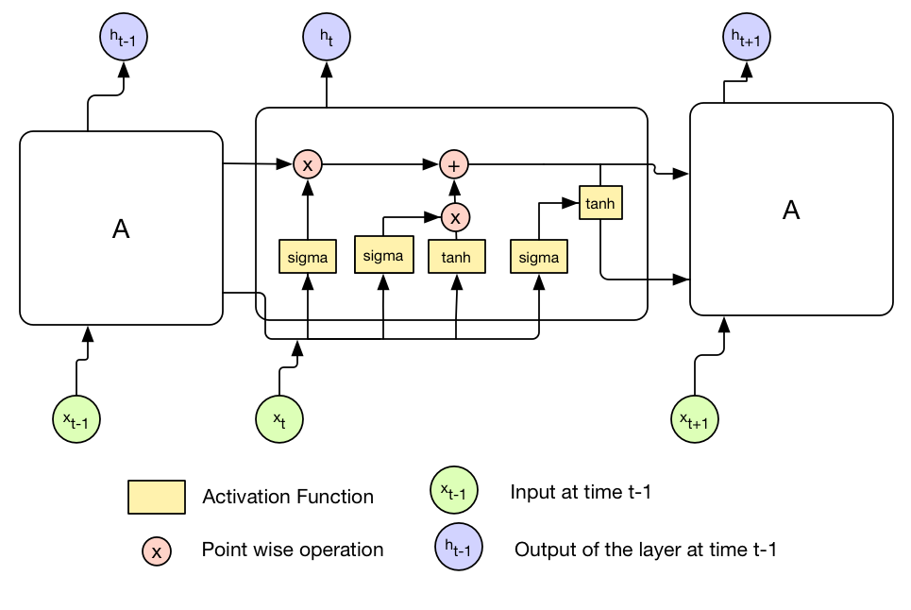
Company’s financial Statements
Tweets mentioning the stock
Dimensionality reduction using PCA
SentenceBERT
Sentence embeddings
Inner join on time series
News headlines about the company
Stock opening and closing prices

