Slide 1
CMS Canteen QR Code Feature

Slide 2
Overview
- Admin QR generation (download/print)
- Customer QR scan with table pre‑fill
- Premium UI with glassmorphism

Slide 3
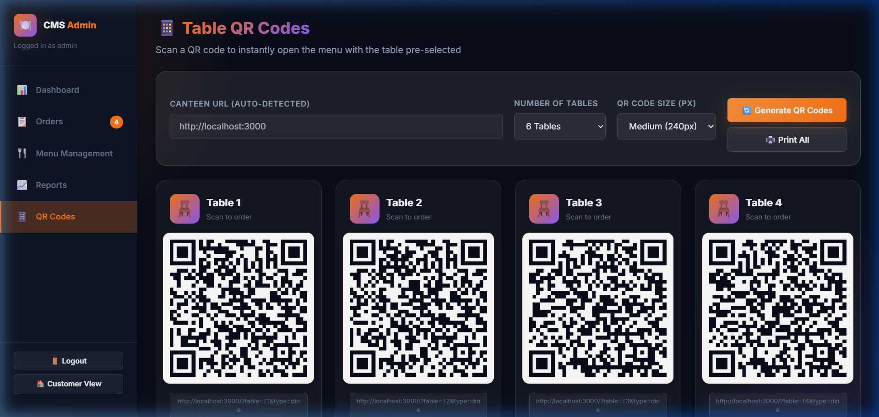
Admin QR Grid

Slide 4
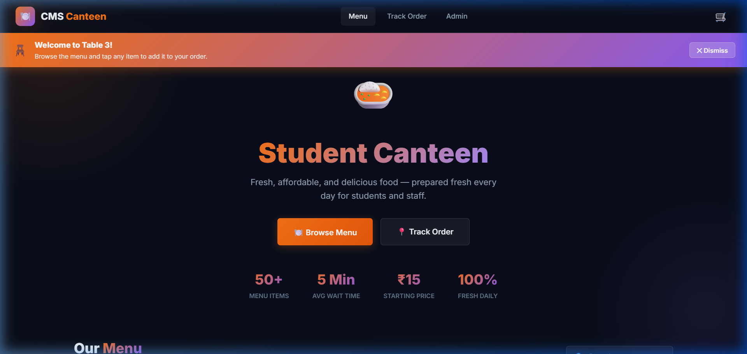
Welcome Banner after Scan

Slide 5
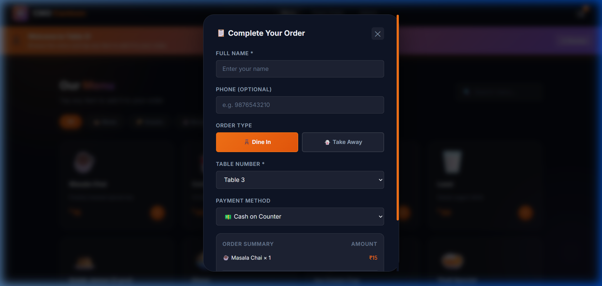
Checkout Pre‑fill

