Slide 1
School of Engineering and Technology (MGMU)
(BE) - Computer Science & Engineering (ICBT)
Project Title: SOET Website With Chatbot
Project Member’s:
Guided By:
Mrs. Sarika Rathi

Slide 2
Content
1. Abstract
2. Introduction
3. Objectives
4. Literature Survey & Review
5. Methodology
6. System Architecture
7. DFD, UML, and ER Diagrams
8. System Modules and Data Flow
9. Tool and Technology
10. Findings
11. Conclusion
12. Future Scope
13. Reference

Slide 3
Abstract
FraudEye is an advanced cybersecurity platform designed to protect users from malicious URLs and deceptive UPI payment requests.
The system utilizes a hybrid approach, combining real-time Threat Intelligence API lookups (e.g., Google Safe Browsing) with deep heuristic analysis (Lexical, SSL/TLS validation, DNS resolution, and Redirect tracing).
By aggregating these discrete security indicators deterministically, FraudEye computes a precise Risk Score and issues a clear verdict (SAFE, WARNING, or DANGEROUS) to mitigate social engineering, typosquatting, and phishing attacks.

Slide 4
Introduction
The internet and digital payment ecosystems (like UPI in India) are increasingly plagued by sophisticated phishing attacks, lookalike domains, and deceptive links.
Users often struggle to visually identify malicious URLs or fraudulent UPI payment requests due to techniques like URL shorteners and Punycode (homograph attacks).
Current defenses rely primarily on static blacklists, which have a severe "time-to-detection" lag, leaving users vulnerable to zero-day phishing attacks.
There is a critical need for a proactive, multi-engine risk analysis platform that deeply analyzes links before the user interacts with them.

Slide 5
Objectives
Develop a Hybrid Risk Engine:To aggregate threat intelligence and local heuristic checks for highly accurate URL classifications.
Analyze UPI Deep Links:To parse and identify missing parameters or malicious payee identifiers in UPI payment URIs.
Provide Transparent Threat Evidence:To show users exactly why a link was flagged.
Support Enterprise-Scale Scans:To enable bulk CSV analysis of thousands of URLs via asynchronous background processing.

Slide 6
Literature Survey / Review
Google Safe Browsing & VirusTotal:Excellent at finding known threats, but strictly reliant on blacklists. Zero-day phishing campaigns often bypass them for hours.
Machine Learning Models:Many research papers propose ML models for lexical analysis. However, they often suffer from false positives on newly registered but legitimate domains.
Browser-based Defenses:Browser warnings are often generic and lack context for the user. They do not analyze mobile-specific intents like UPI links.

Slide 7
Methodology
1. Input Classification:Detects if the input is a standard URL or a UPI string.
2. Lexical & Parsing Engine:Analyzes character patterns, detects punycode, and extracts domains/VPAs.
3. Network Verifiers:Checks live DNS records, validates SSL/TLS chains, and traces redirects.
4. Threat Intel Query:Cross-references the domain against Google Safe Browsing APIs.
5. Risk Aggregation (RiskEngine):Calculates the final Risk Score (0-100) based on accumulated indicators.

Slide 8
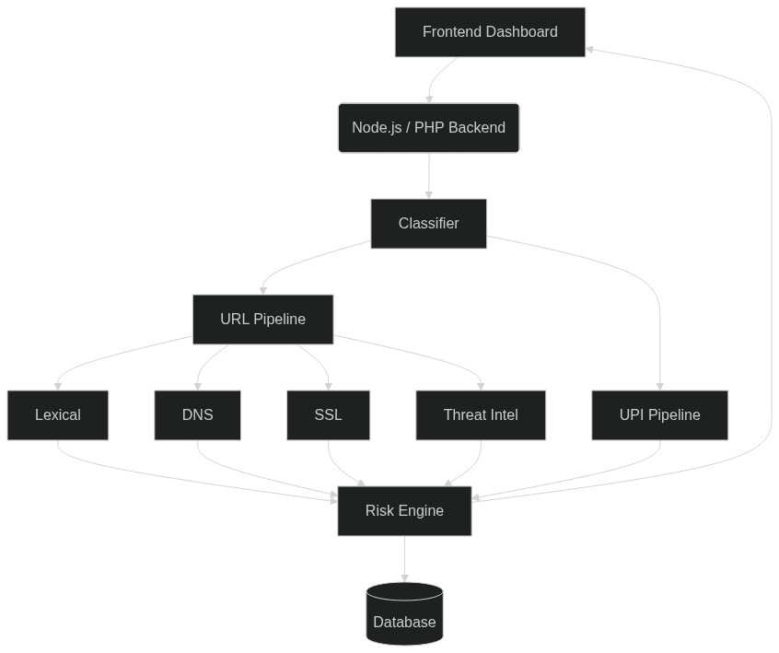
System Architecture
Frontend Layer:React.js / PHP-based UI, providing a dashboard, live scanner, and bulk analysis tools.
Backend API Layer:Node.js (Express) providing asynchronous processing and batch job handling.
Database Layer:SQLite relational database storing historical scans and batch job states.

Slide 9
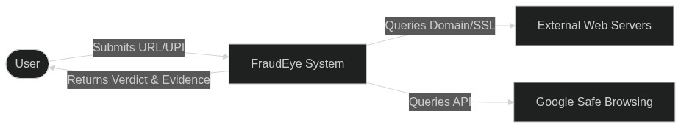
DFD, UML, and ER Diagrams (1/3)
Data Flow Diagram (Level 0)

Slide 10
DFD, UML, and ER Diagrams (2/3)
UML Use Case Diagram

Slide 11
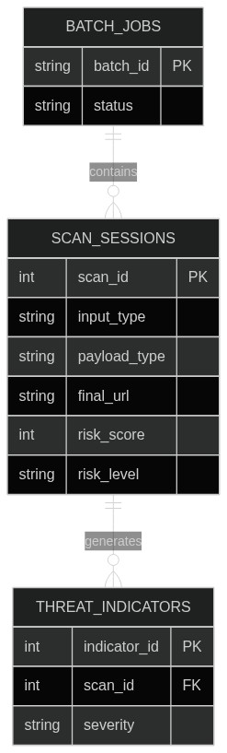
DFD, UML, and ER Diagrams (3/3)
Entity-Relationship (ER) Diagram

Slide 12
System Modules and Data Flow
Input Classifier & Lexical Analyzer:Checks for IP-based hosts, excessively long subdomains, typosquatting patterns, and homograph attacks.
Network Checkers (DNS, SSL, Redirect):Validates domain resolution, certificate expiry/hostname mismatch, and excessive redirects / HTTP downgrades.
Threat Intelligence:Cross-references destination with global threat databases (e.g., Google Safe Browsing).
Risk Scoring Engine:Aggregates indicators deterministically. Errors reduce Confidence; explicit fraud spikes Risk Score.

Slide 13
Tool and Technology
Frontend Technologies:React.js, Vite, Tailwind CSS (for modern UI components and glassmorphism styling). PHP (for legacy rendering views).
Backend Technologies:Node.js, Express.js (for high-concurrency API requests and background batch processing).
Database Management:SQLite (for lightweight, transactional storage of scan histories and reports).
External APIs & Libraries:Google Safe Browsing API (Threat Intelligence), `tls` & `dns` native modules, Axios.

Slide 14
Findings
Accurate Heuristic Detection:The system successfully identifies suspicious traits (e.g., missing SSL, IP-based URLs) even before a domain is blacklisted by threat intel APIs.
Zero False-Positives for "Dangerous":By capping heuristic risk scores at 60 (WARNING) and only elevating to DANGEROUS upon explicit fraud evidence, false alarms are significantly minimized.
Effective Bulk Analysis:The batch processor is capable of handling hundreds of URLs in parallel without blocking the main UI thread.

Slide 15
Conclusion
FraudEye successfully bridges the gap between simple blacklists and complex, opaque security tools by structurally separating technical networking errors from explicit fraud evidence.
It provides a scalable, extensible, and immediate defense against deceptive links by presenting transparent evidence to the user.
The hybrid architecture ensures both high sensitivity to zero-day threats and robustness against false positives, setting a new standard for link analysis.

Slide 16
Future Scope
Machine Learning Integration:Implement a predictive Domain Generation Algorithm (DGA) detection model to identify algorithmically generated malicious domains instantly.
Browser Extension:Develop a Chrome/Firefox extension that automatically scans links on web pages (like WhatsApp Web) seamlessly in the background.
Optical Character Recognition (OCR):Add capabilities to scan QR codes and images for hidden malicious UPI requests or links.

Slide 17
Reference
1. Google Safe Browsing API Documentation, "Checking URLs against Google's constantly updated lists of unsafe web resources." [Online]
2. National Payments Corporation of India (NPCI), "UPI Linking Specification & URI Scheme." [Online]
3. Garera, S., Provos, N., et al., "A framework for detection and measurement of phishing attacks," in Proceedings of the 2007 ACM Workshop on Recurring Malcode.
4. Feroz, M. N., & Mengel, S., "Phishing URL detection using lexical features and blacklist," in IEEE International Conference on Big Data, 2014.

