Slide 1
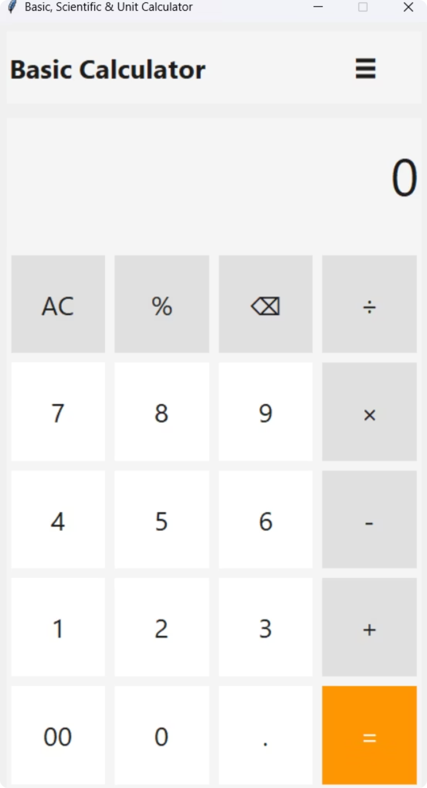
Basic, Scientific & Unit Calculator
Developer: Sarthak Sandhan
Class : SY-Computer Science Engineering (Diploma) B.tech
College : Sanjivani University
Project Description : A Python Desktop Application for Basic, Scientific, and Unit Calculations.
PYTHON
TKINTER
OOP

Slide 2

Problem Statement
Users often need separate tools for basic calculations,
scientific operations, and unit conversions. This
increases time, complexity, and reduces productivity.
Time Consumption
Context switching between apps adds friction during study and coding sessions.
Different Interfaces
Different controls and layouts cause errors and slow learning.
Multiple Tools Required
No single desktop tool combines basic, scientific, and unit conversion needs in one reliable package.
Page 2

Slide 3
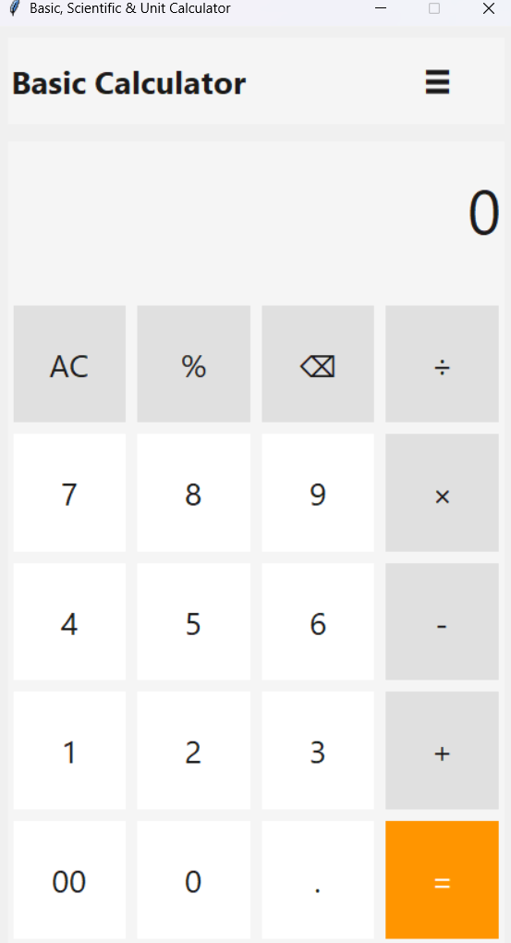
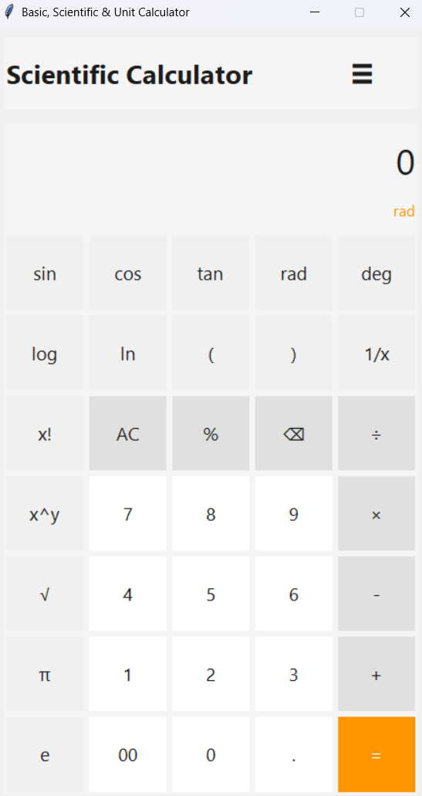
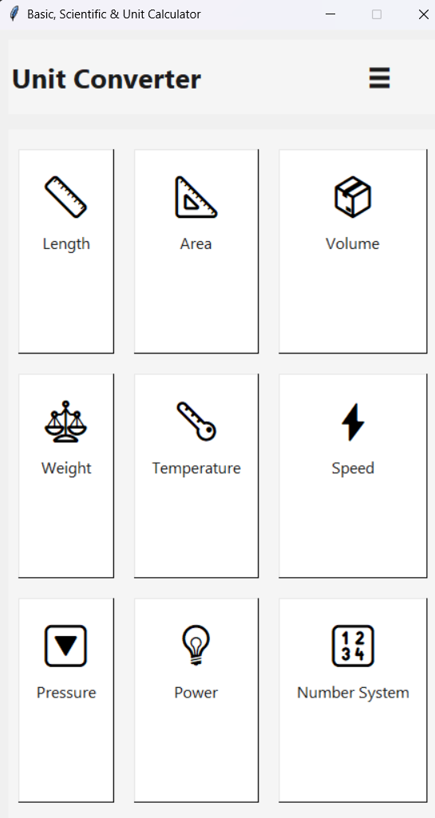
Project Overview
A Python + Tkinter application that combines
Basic Calculator, Scientific Calculator,
and Unit Converter modules in one interface.
Basic Calculator
Scientific Calculator
Unit Converter
Essential arithmetic, percentage, backspace, and a clean numeric keypad for fast entry.
Trigonometry, logarithms, factorials, radians/degrees — designed for engineering coursework and quick prototyping.
Comprehensive categories: length, area, volume, weight, temperature, speed, pressure, power, and number systems — easy selection and accurate results.
Page 3

Slide 4
Technology Stack
Python
Tkinter
JSON
Math Library
Core programming language with
simple syntax and extensive libraries.
Built-in GUI toolkit for creating
desktop applications.
Stores conversion data and
application configurations.
Provides scientific functions such as
trigonometry, logarithms, and factorials.
OOP Architecture
Modular classes separate the GUI,
calculation engine, and converter logic
for better maintainability.
Page 4

Slide 5

System Architecture
GUI Interface
Output Display
User Input
Calculation Engine
The architecture separates the user interface,
calculation logic, and conversion services,
making the application modular and easy to maintain.
Page 5

Slide 6


Basic Calculator Features
Core arithmetic: + − × ÷ with a large keypad and keyboard support
Percentage calculations and double-zero (00) entry for speed
Backspace / clear (AC) and error-safe input handling
Simple and user-friendly interface for everyday calculations
Design emphasizes quick numeric entry and minimal visual clutter — ideal for classroom and interview demonstrations.
Page 6

Slide 7
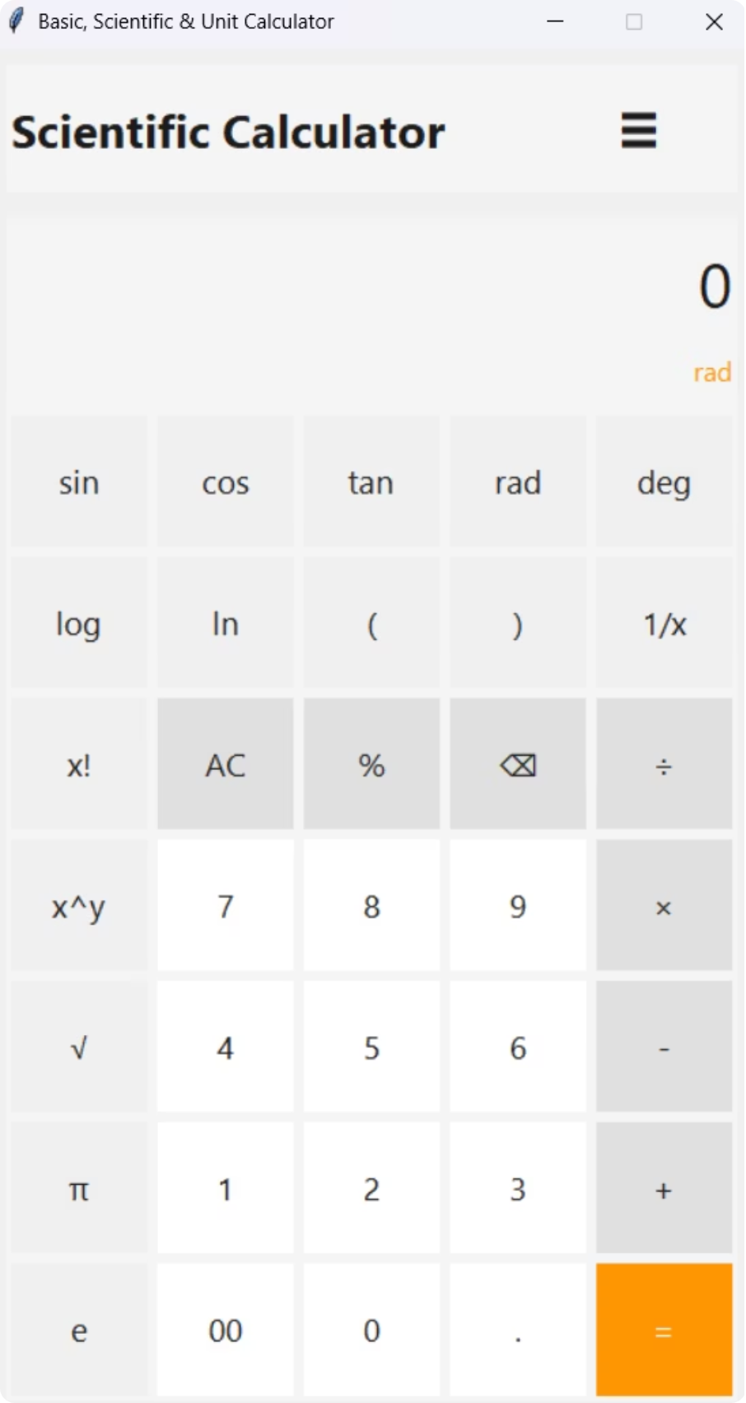

Scientific Calculator Features
Trigonometric functions: sin, cos, tan, with rad/deg toggle.
Logarithmic functions: log (base 10), ln.
Advanced operations: x^y, factorial, reciprocal (1/x), and π and e constants.
Floating-point handling and input validation for robust results.
Mode toggle (rad/deg) and a memory-friendly layout support academic test problems and quick formula verification.
Page 7

Slide 8
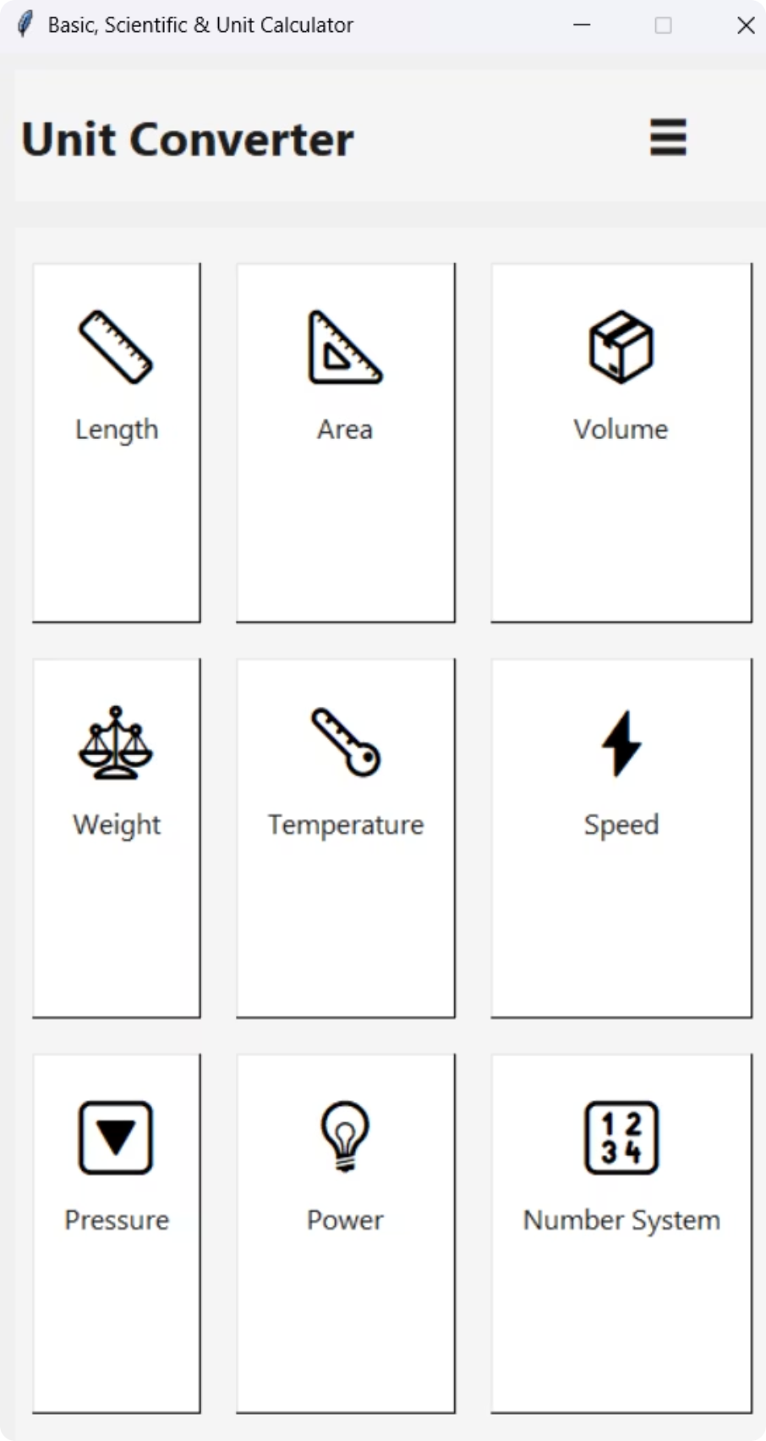

Unit Converter Features
Comprehensive, JSON-driven unit tables enable accurate conversions across common categories:
Length, area, volume
Weight, temperature
Speed, pressure, power
Number system conversions (binary/decimal/hex)
Extensible: add or update units by editing JSON; conversion functions normalize via base units for consistency.
Page 8

Slide 9
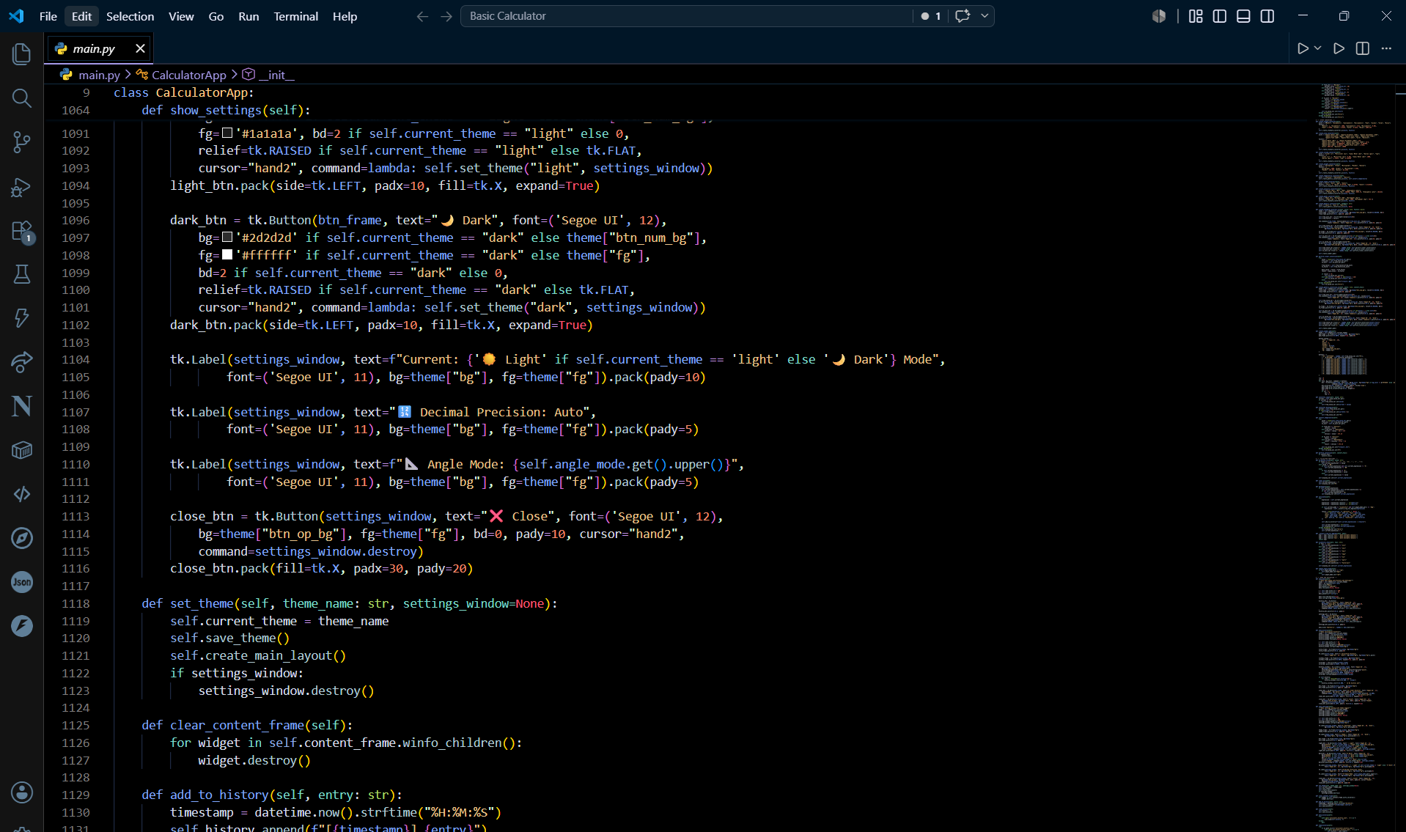

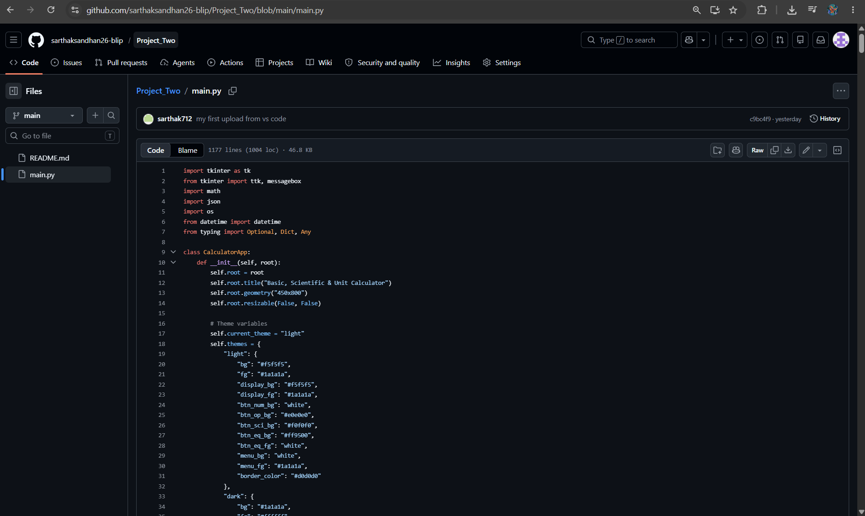

Demo & Results
Live demo highlights real-time calculations,
accurate scientific operations, and fast unit
conversions across all modules.
🎥 Project Demo Video
Scan to Watch Demo
💻 Project Source Code
Scan to Access Repository
Page 9

Slide 10
Conclusion & Future Scope
Project achievements: integrated three calculators into a single, maintainable desktop app that demonstrates Python proficiency and thoughtful UX. Skills demonstrated include OOP design, GUI development, and data-driven configuration.
1
2
3
1. Improve UI/Accessibility
2. Add Persistence & Settings
3. Packaging & Distribution
Keyboard-first navigation, higher-contrast modes, and localization support.
Save user preferences, history, and favorite conversions using JSON or SQLite.
Build installers (PyInstaller) for Windows/macOS and add CI to publish releases.
Contact Information : Sarthak Sandhan
SY- Computer Science Engineering (Diploma) B.tech
LinkedIn Profile : https://www.linkedin.com/in/sarthak-sandhan-19b174378/
Thank You Questions & Discussion
Page 10

