Slide 1
PACKET CAPTURE ANALYSIS
Team Members: Mentor:
Astha Rani Mr. Prabodh CP
Chetan Surya D
Deekshitha
Sarthak Mishra
Shivaneeth P

Slide 2
OVERVIEW
This project aims at capturing packets and generating analysis using specific fields namely Length(bytes), Protocol used, Time of capturing and No. of packets captured.
Furthermore, analyzing the packets captured by establishing the connection between two systems.
To aid us in analyzing the packets, we will be dealing with pyshark and tshark(command line version of wireshark).

Slide 3
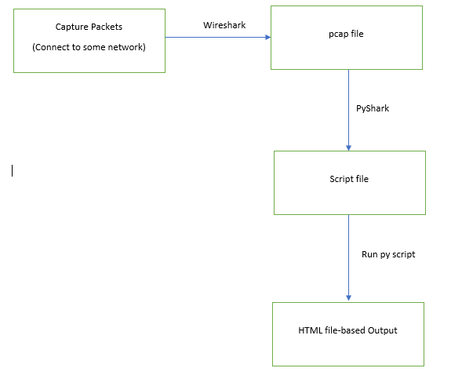
DEVELOPMENT FLOW

Slide 4
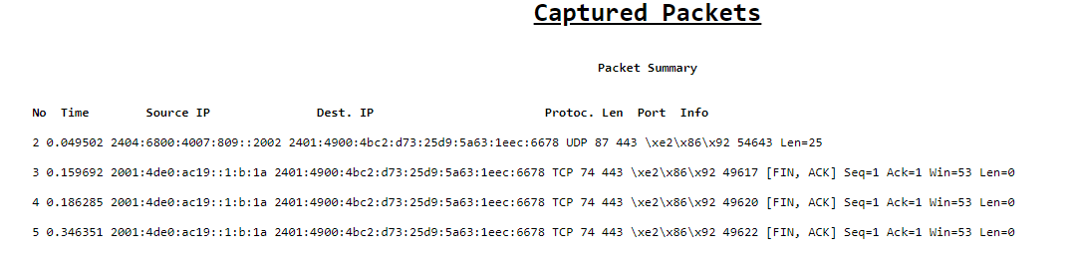
CAPTURED PACKETS SUMMARY Ref: https://github.com/sarthaksarm/Packet_Capture_CISCO/blob/master/Packet_Capture/Scripts/print_script.py

Slide 5
ANALYSIS

Slide 6
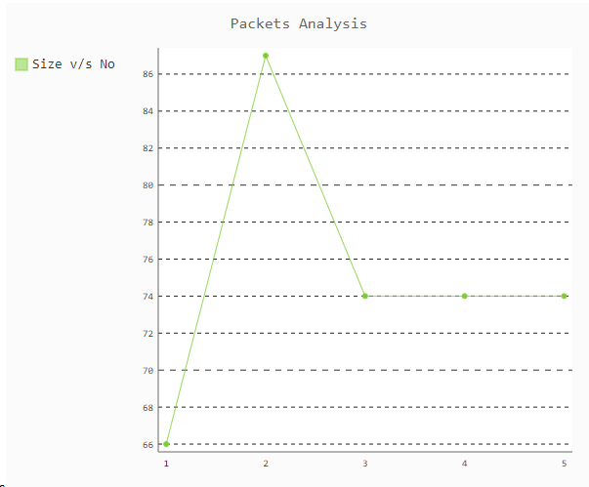
PACKET SIZE vs PACKET NO. Ref: https://github.com/sarthaksarm/Packet_Capture_CISCO/blob/master/Packet_Capture/Scripts/Len_No_script.py

Slide 7
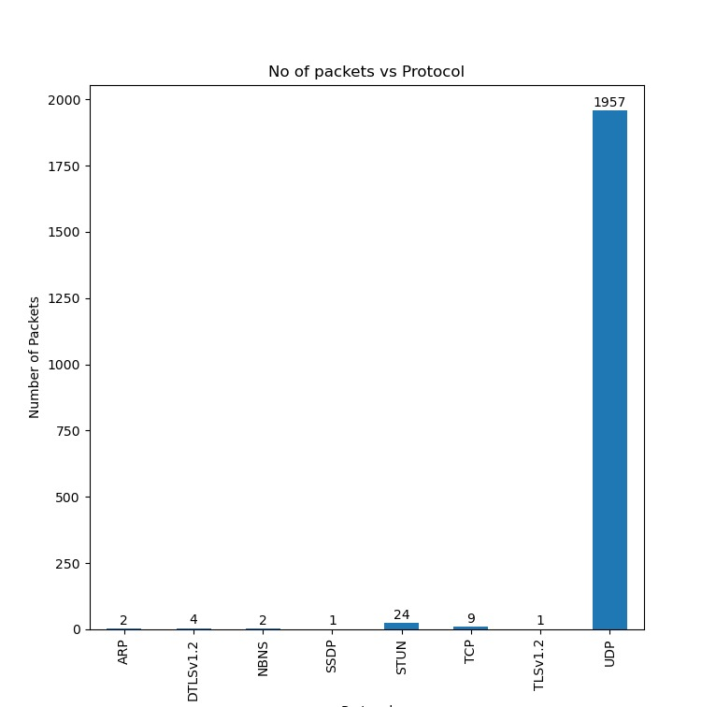
NO. OF PACKETS vs PROTOCOL USED Ref: https://github.com/sarthaksarm/Packet_Capture_CISCO/blob/master/Packet_Capture/Scripts/Protocol_PacketNo_script.py

Slide 8
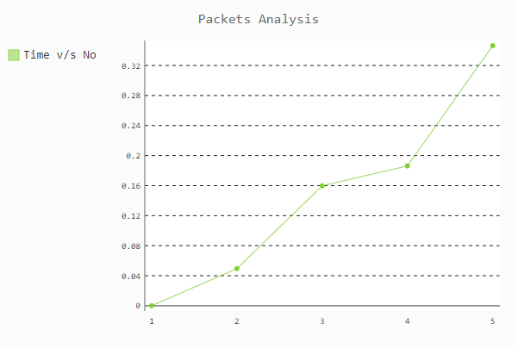
CAPTURED TIME vs PACKET NO. Ref: https://github.com/sarthaksarm/Packet_Capture_CISCO/blob/master/Packet_Capture/Scripts/Time_No_script.py

Slide 9
ESTABLISHING CONNECTION

Slide 10
How did we really do it? Ref: https://github.com/sarthaksarm/Packet_Capture_CISCO/tree/master/Packet_Capture/Scripts
Using FTP as the application layer protocol and establishing the connection between two systems by making one as client and other as server.
Filezilla is the application used to make one machine serve as server listening for connection requests.
Transferred multiple files between the two, and captured the packets.

Slide 11
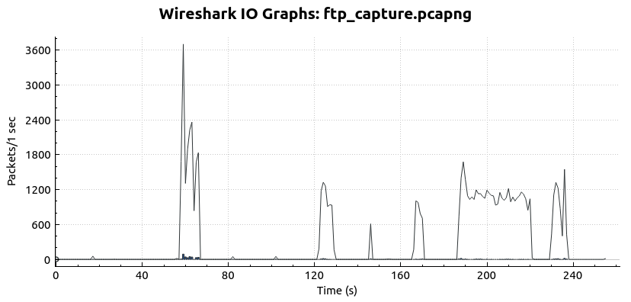
IO GRAPH Ref: https://github.com/sarthaksarm/Packet_Capture_CISCO/blob/master/Packet_Capture/Output/IO_Graph.PNG

Slide 12
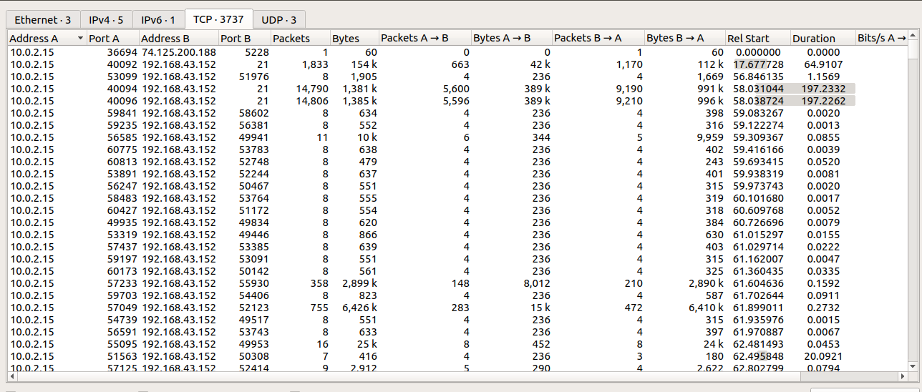
CONVERSATIONS Ref: https://github.com/sarthaksarm/Packet_Capture_CISCO/blob/master/Packet_Capture/Output/Conversations.PNG

Slide 13
THANK YOU

