Slide 1
Investment Analysis
Project Report

Slide 2
Project Details
Project Title | Investment Analysis
Technology | Business Intelligence
Domain | Finance
Project Difficulty level | Intermediate
Programming Language Used | Python
Tools Used | Jupyter Notebook, MS-Excel, Tableau

Slide 3


Project Report
ANALYSIS
SPECIFICATION
IMPLEMENT
PROJECT
DESIGN
TESTING
DEVELOP

Slide 4
Problem Statement
Maximum value of FDI and its sector in the latest year
Minimum value of FDI and its sector in the latest year
Trend of FDI over the years
Grouping of sectors for comparison
High growth FDI sectors in the last five years
High decline FDI sectors in the last five years
Sectors which have most variation in FDI
Proportion of FDI in each sector
Specific Clusters
Forecast for the next year – line chart

Slide 5
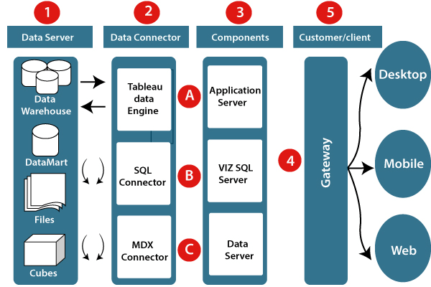
Architecture

Slide 6
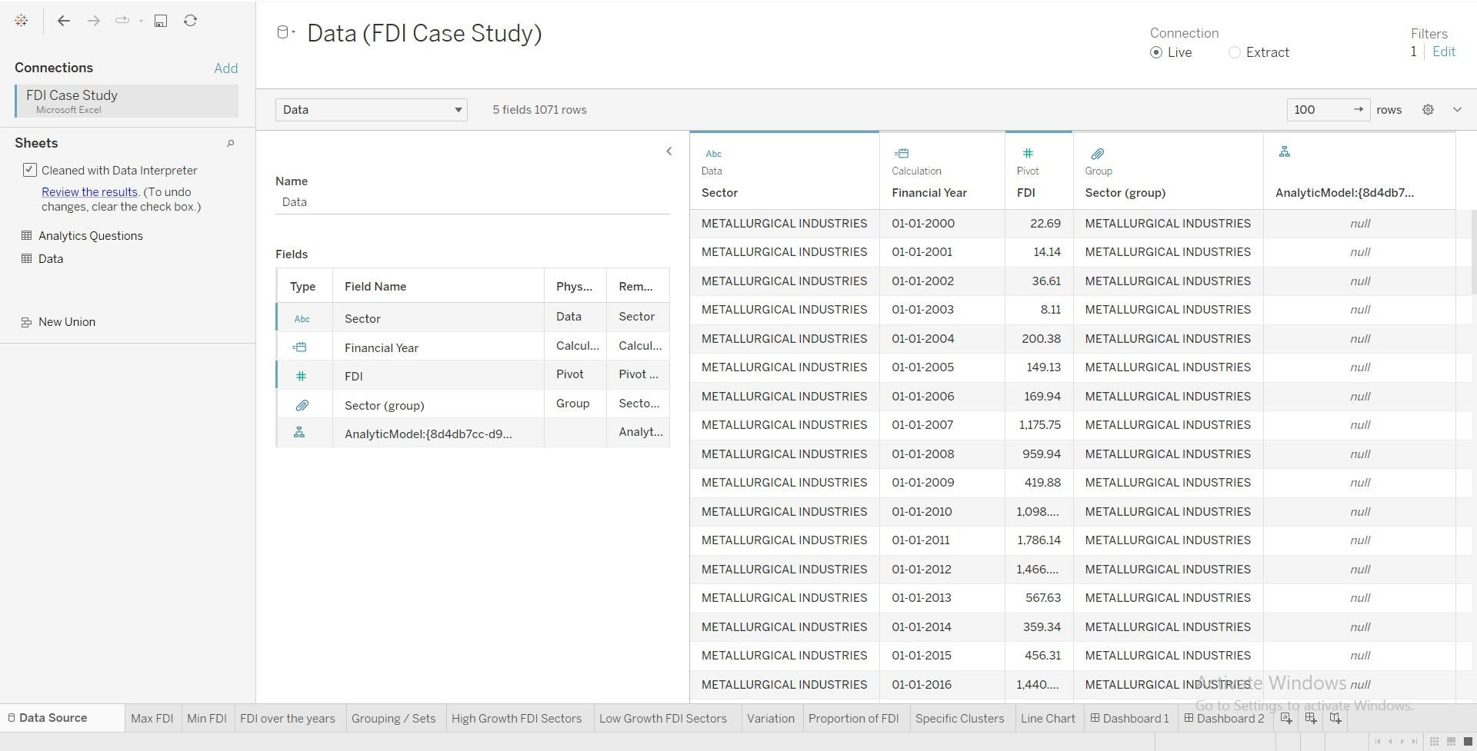
Data Source

Slide 7
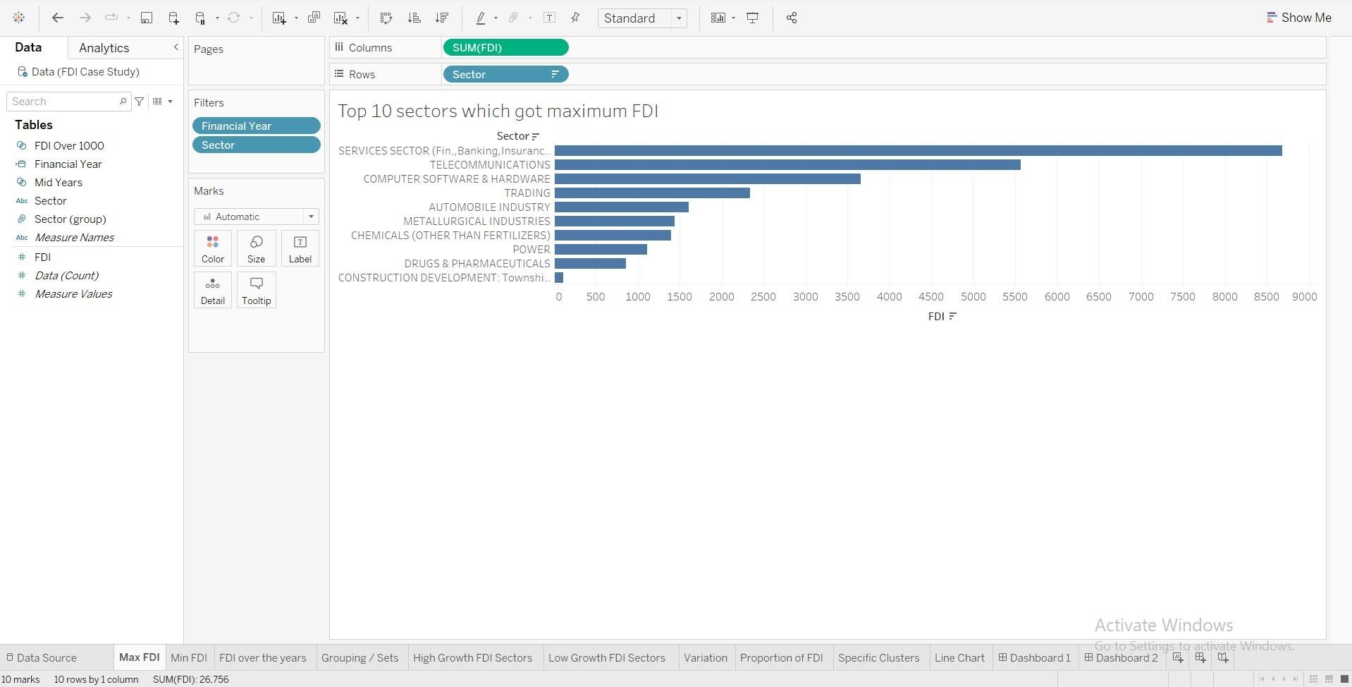
Maximum value of FDI and its sector in the latest year

Slide 8
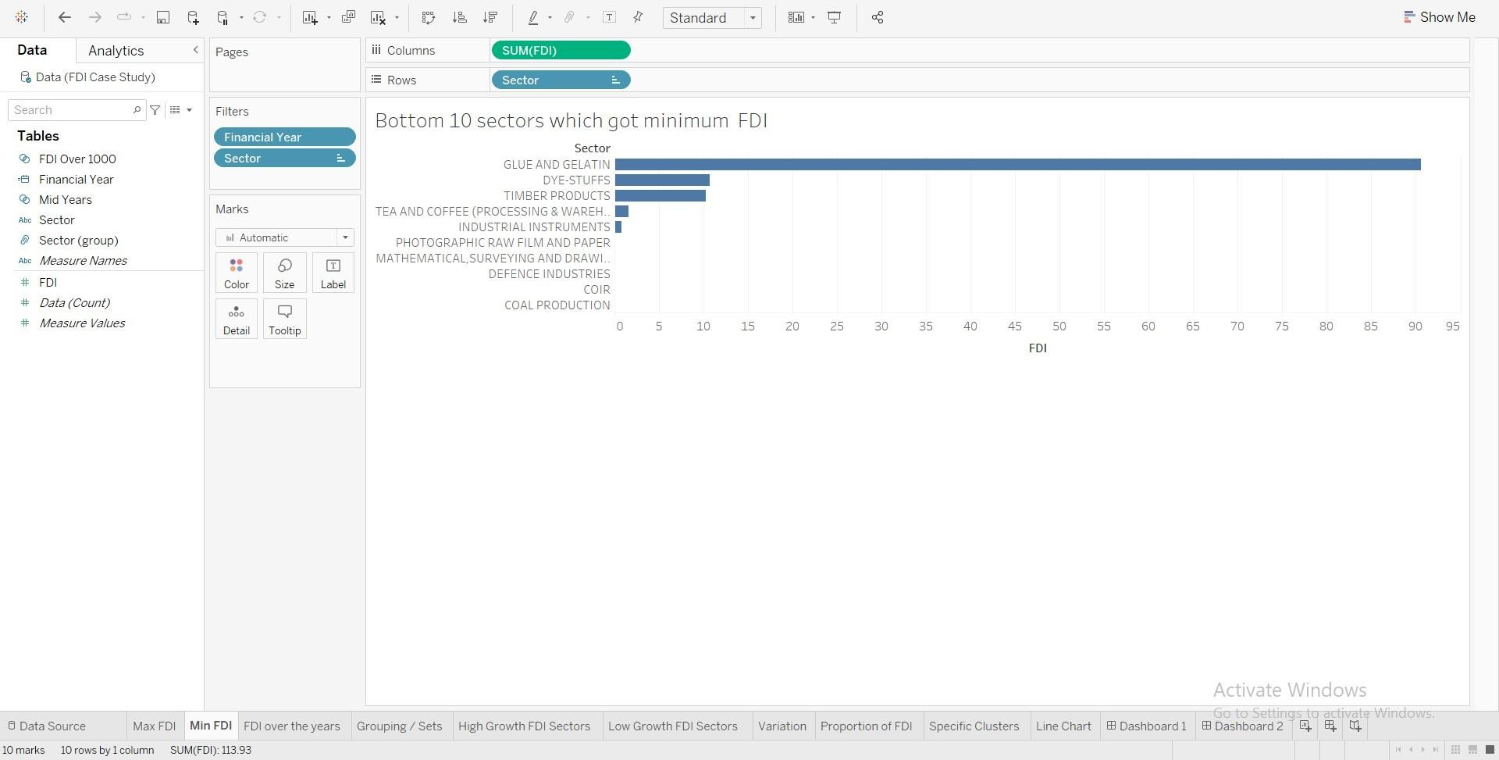
Minimum value of FDI and its sector in the latest year

Slide 9
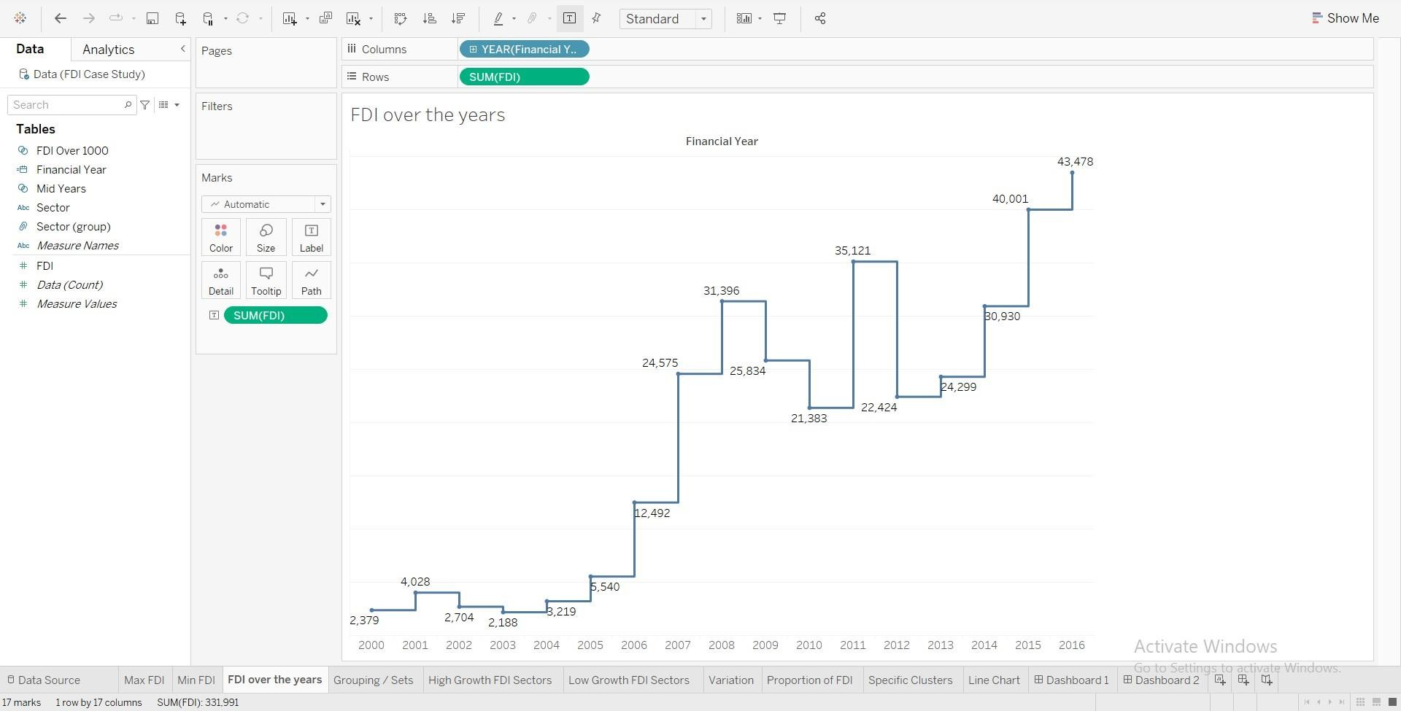
Trend of FDI over the years

Slide 10
Observations
The maximum investment was made in the services sector during 2016-17, while the minimum investment was made in the coir sector.
In 2000-01, no investment was made in 23 out of the 63 sectors, which is the highest number of sectors with no investment in any year.
Out of the 63 sectors, the average investment was less than 100 in 36 sectors.
The market recession in 2008-09 resulted in significant losses for investors, but these losses were covered by 2011-12.
Despite the impact of the market crash, the service sector continued to be the highest-performing sector throughout all the years.

Slide 11
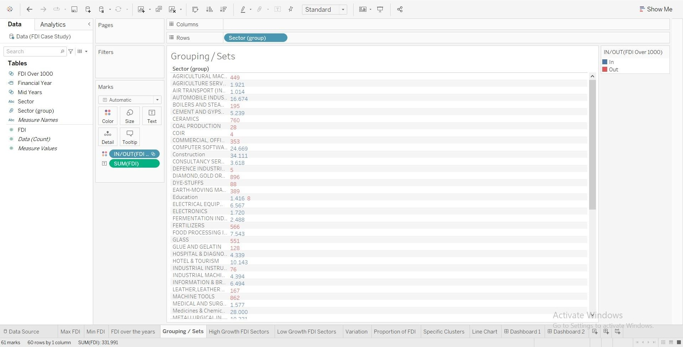
Grouping of sectors for comparison

Slide 12
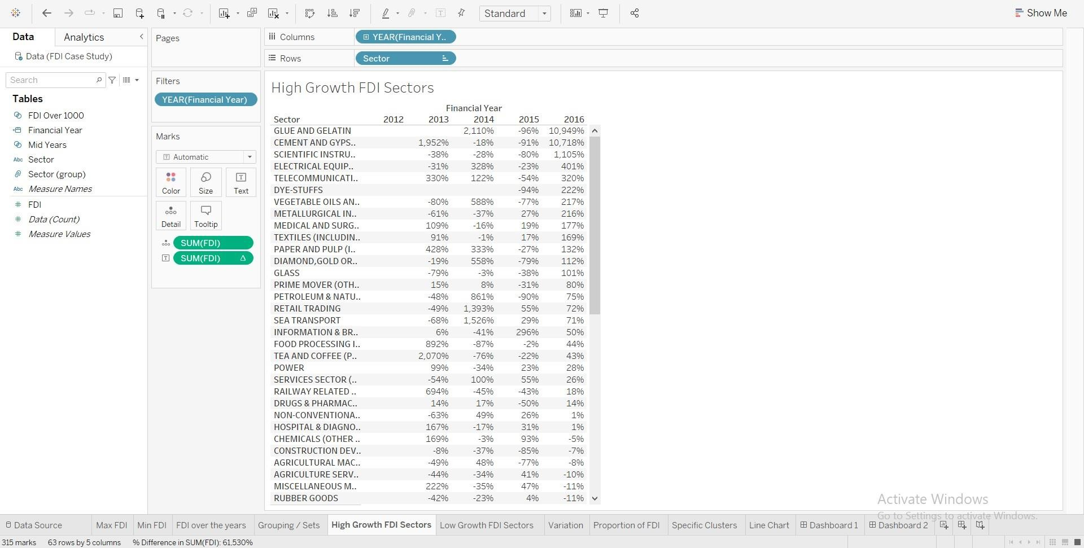
High growth FDI sectors in the last five years

Slide 13
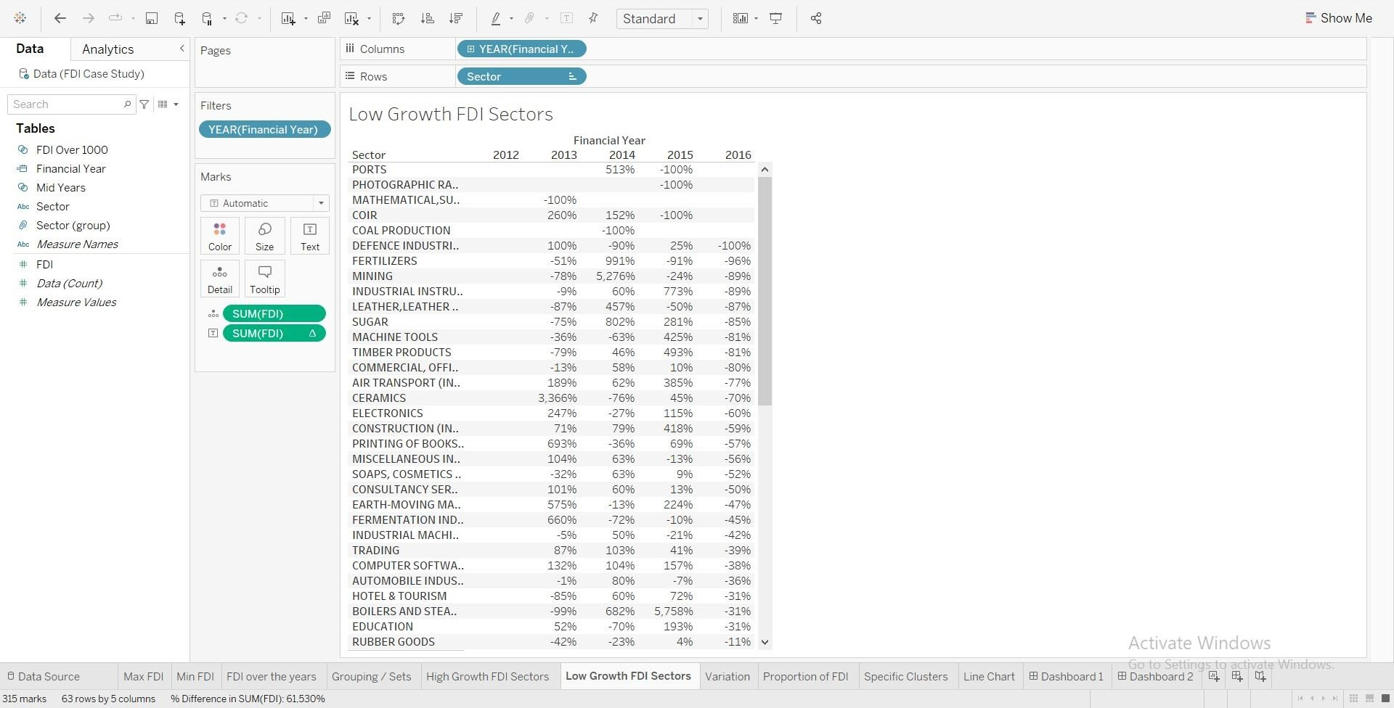
High decline FDI sectors in the last five years

Slide 14
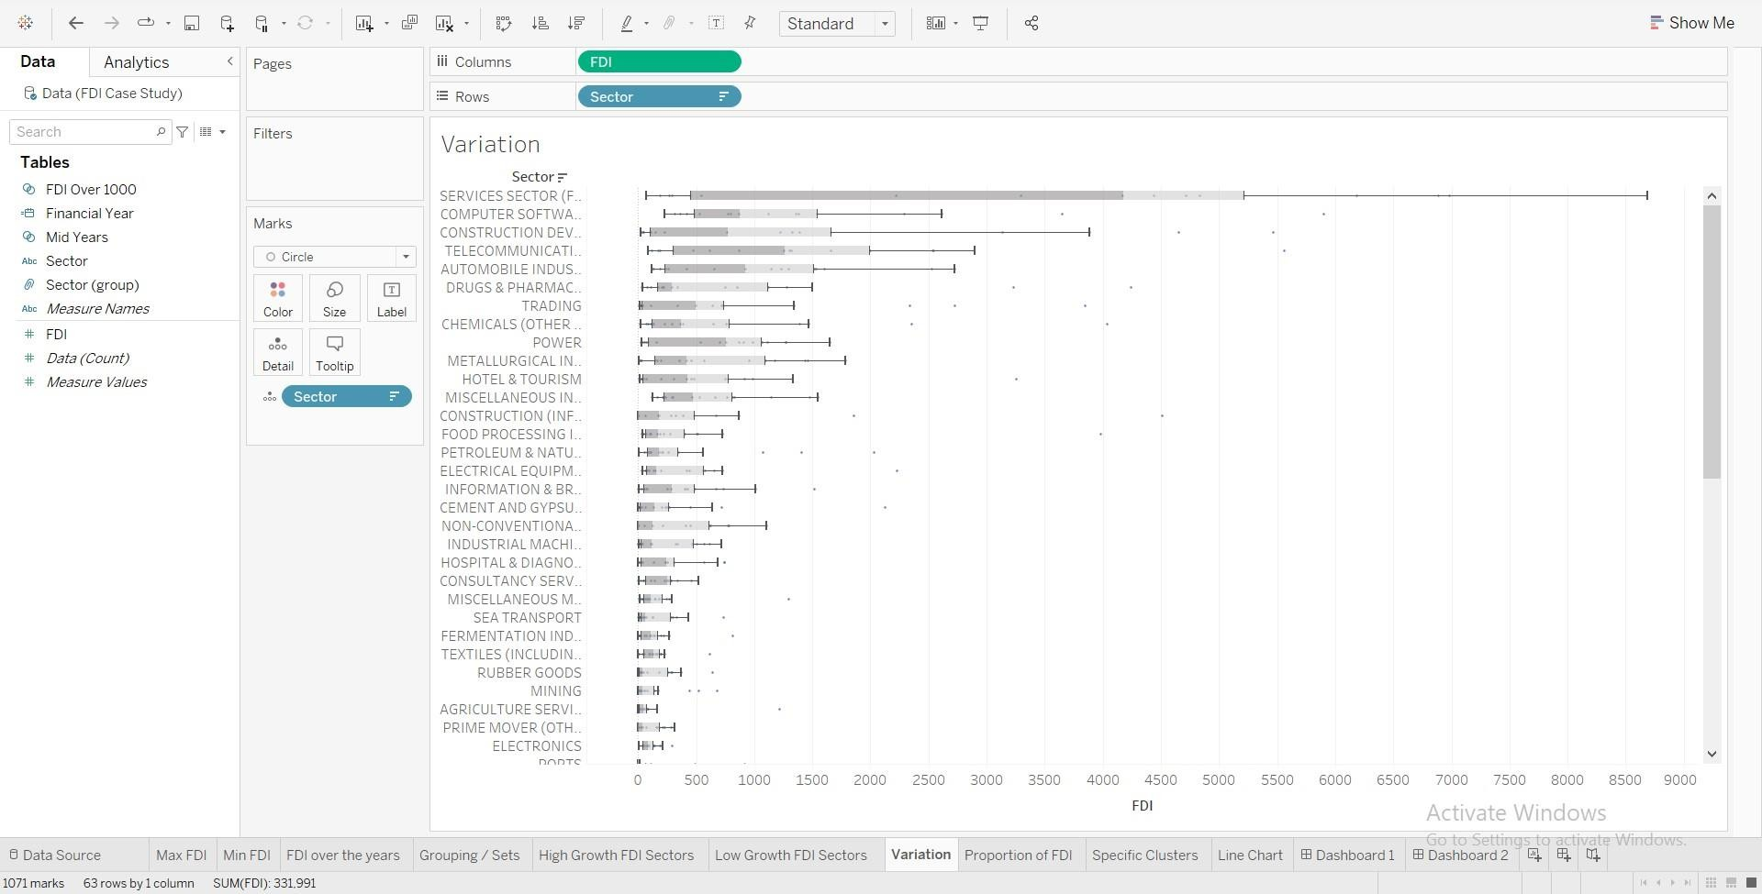
Sectors with most variation in FDI

Slide 15
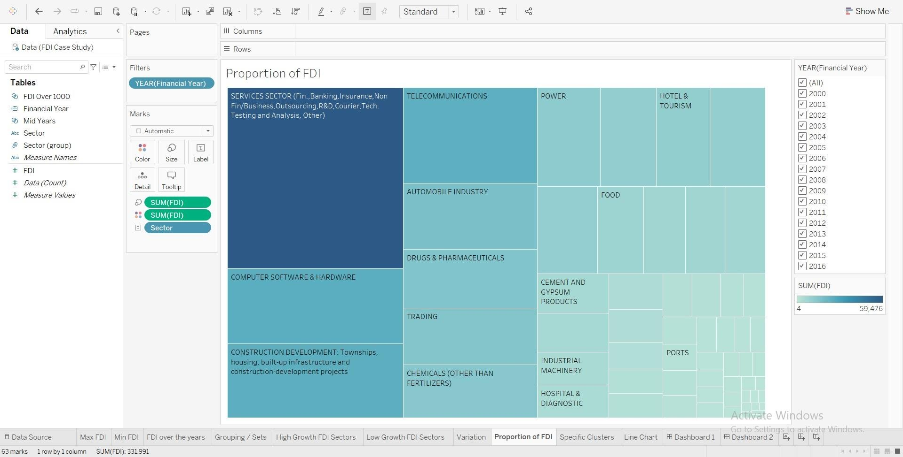
Proportion of FDI in each sector

Slide 16
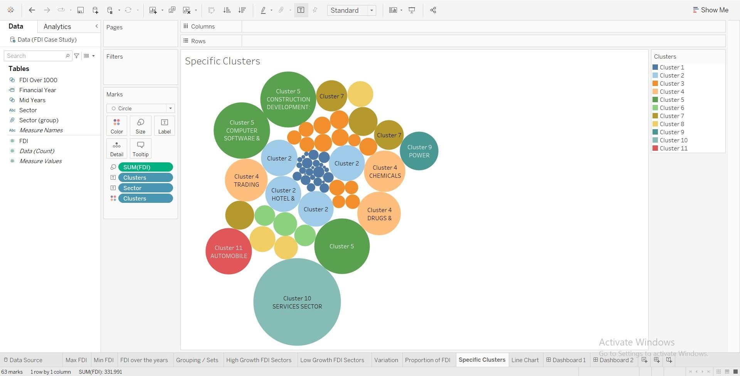
Specific Clusters

Slide 17
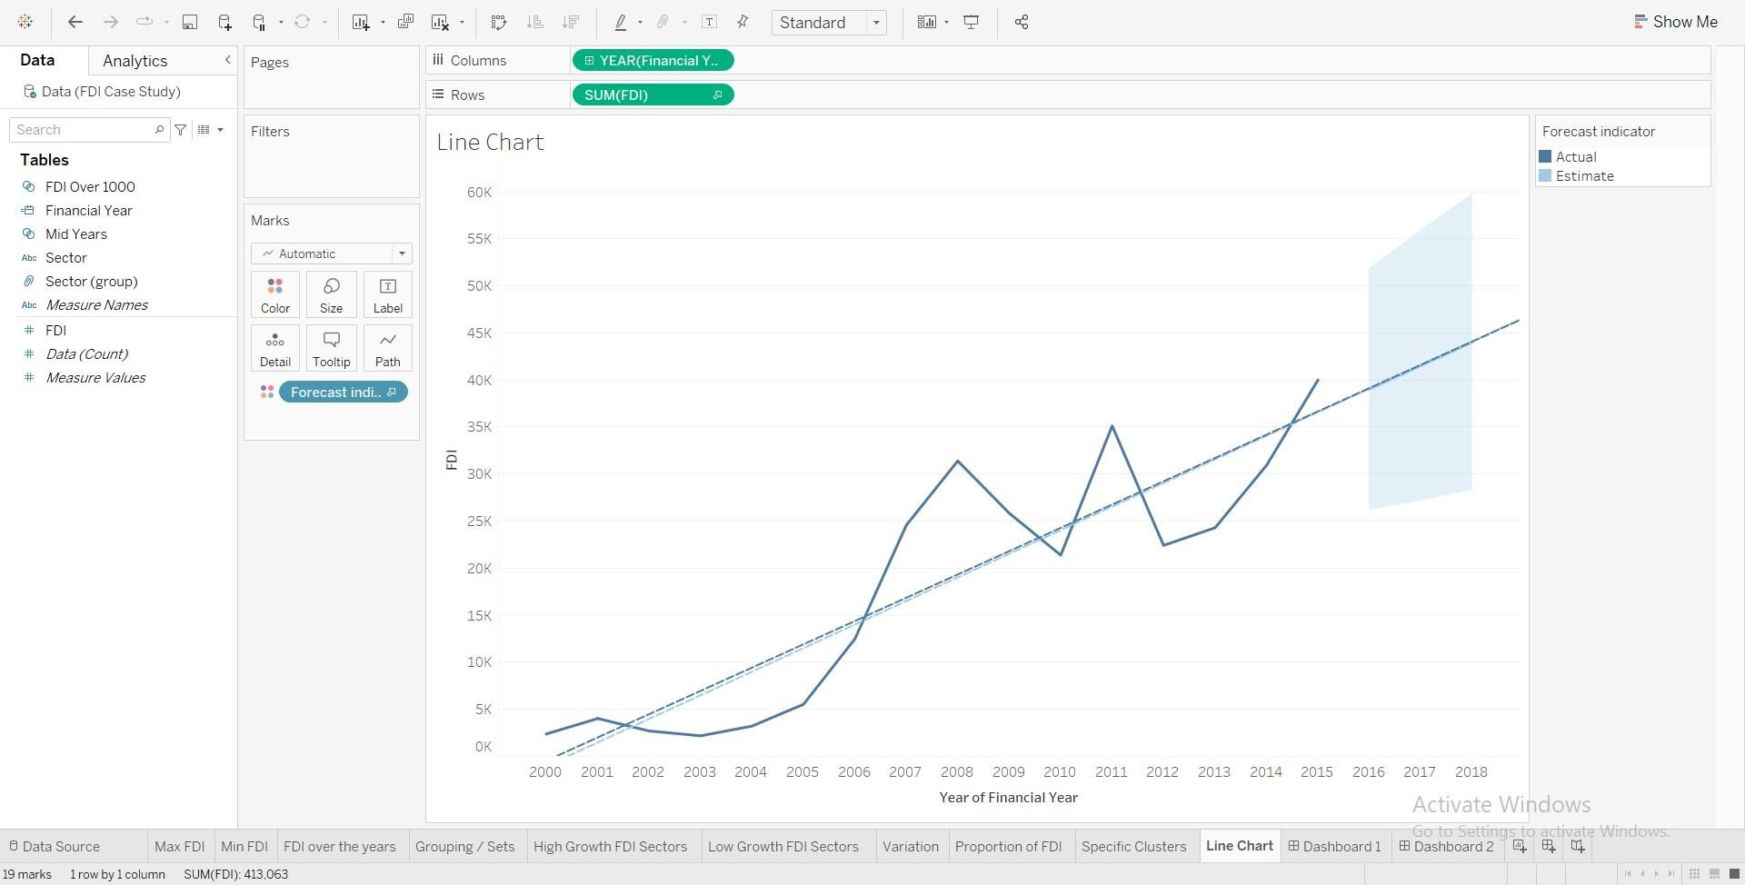
Forecast for next year – line chart

Slide 18
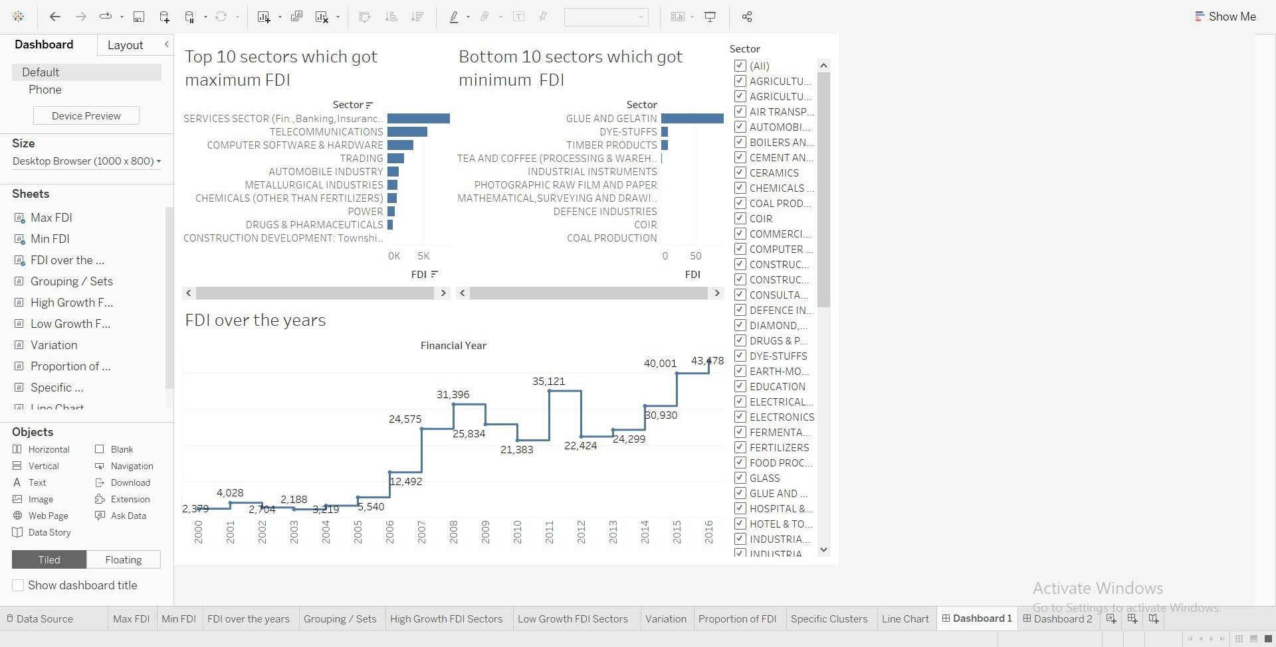
Dashboard - 1

Slide 19
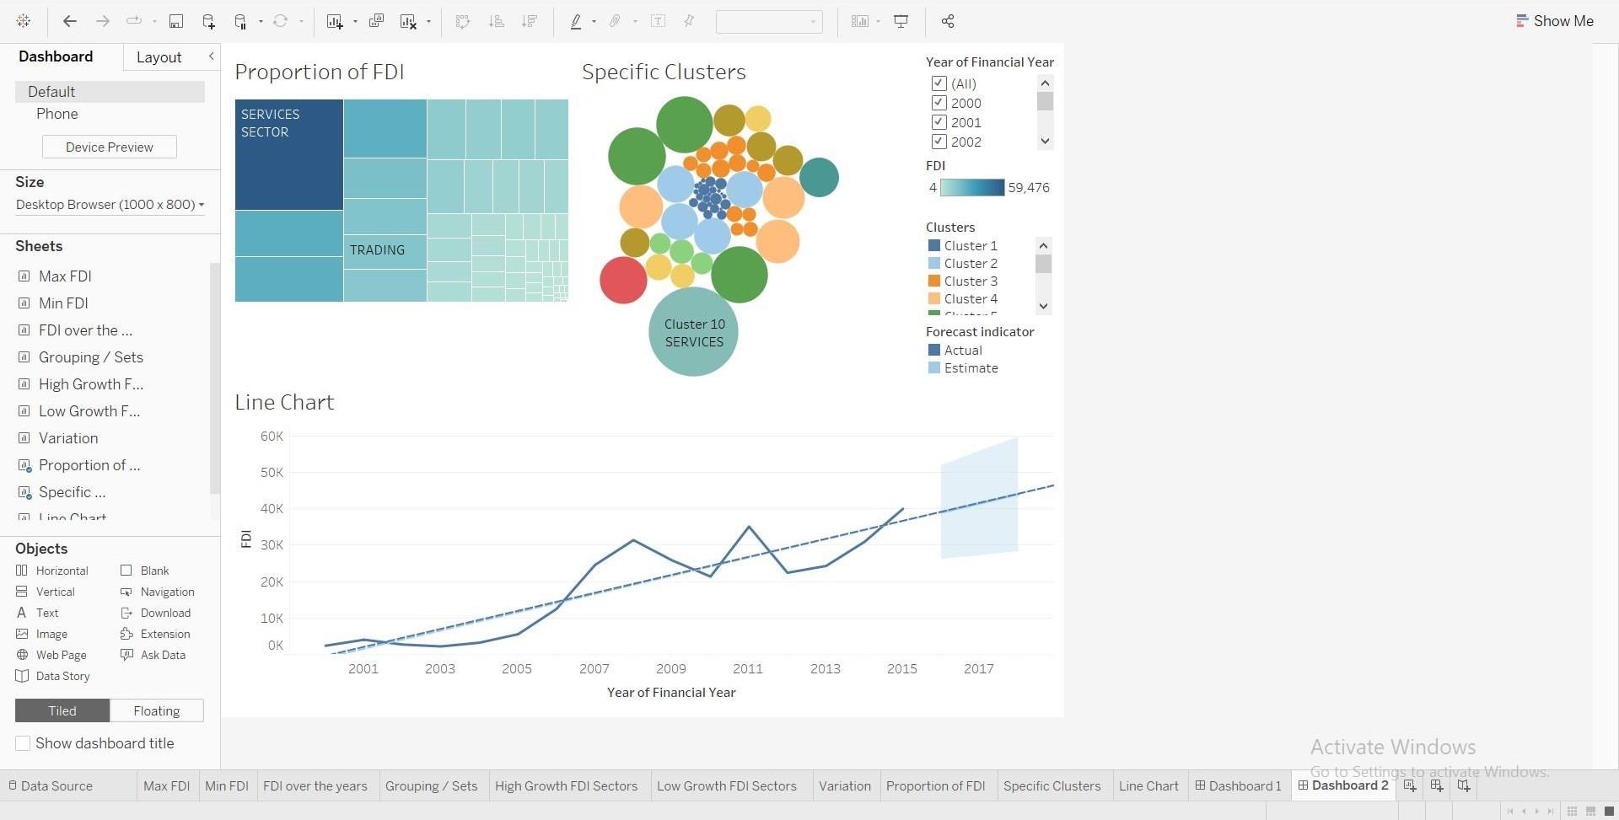
Dashboard - 2

Slide 20
Thank You

