Slide 1
Lane Detection
using Classical Computer Vision (OpenCV)
AI Mini Project – Provisional / Draft Review
[Student 1] • [Student 2] • [Student 3]

Slide 2
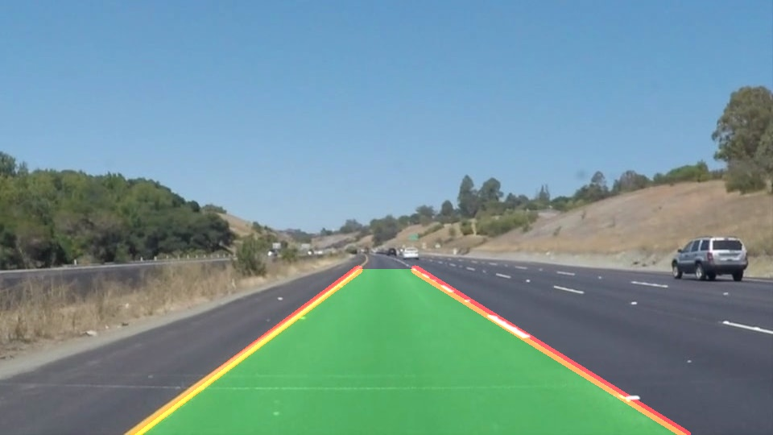
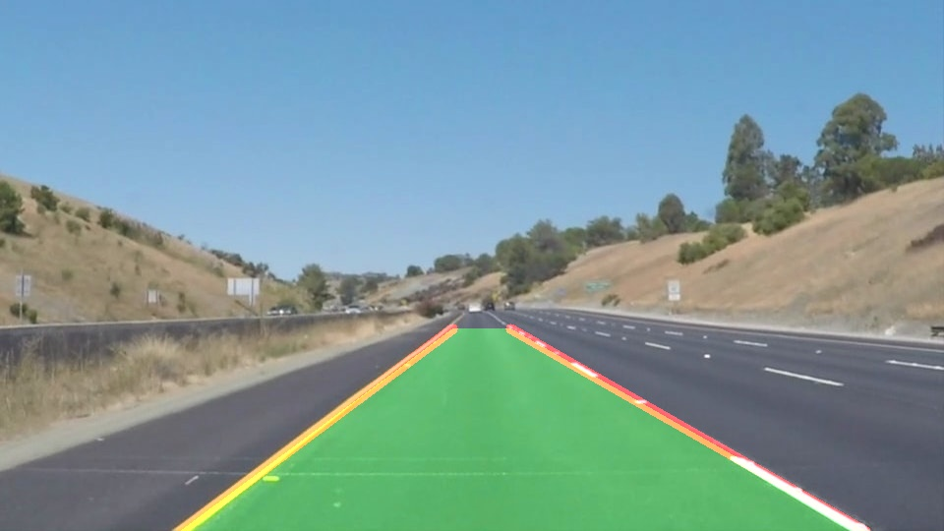
1. Project Introduction
Lane detection finds the left and right lane boundaries from a front-facing camera.
Core to lane-departure warning, lane keeping and self-driving cars.
Hard because of shadows, worn paint, curves, and white vs yellow markings.
Our approach: a fast OpenCV pipeline as a baseline, then labelled evaluation and a deep learning comparison.

Slide 3
2. Problem & Objectives
Problem
Objectives
Detect lane lines reliably and stably in road video, in real time, across varied lighting and road conditions.
Build the OpenCV lane pipeline
Analyse the dataset
Stabilise video output
Report measurable results
Next: TuSimple + deep learning

Slide 4
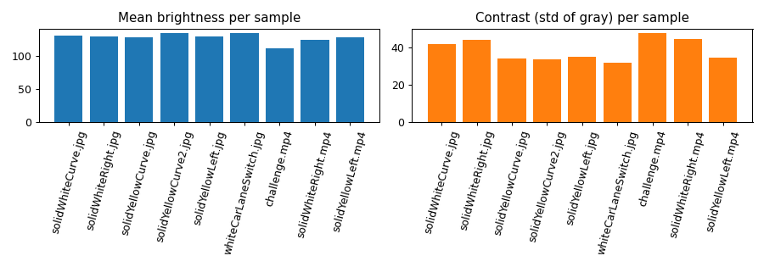
3. Dataset
Working set: Udacity CarND Lane Lines (GitHub)
6 images + 3 videos, 1,153 video frames
960×540 and 1280×720
White/yellow, solid/dashed, curves, lane change
No ground-truth labels in this set
Planned: TuSimple (1280×720, labelled)
The challenge video is darkest and highest-contrast (tree shadows) – our hardest case.

Slide 5
3b. Dataset Details & Observations
Sample | Type | Size | Frames | Brightness | Contrast
solidWhiteCurve | image | 960×540 | 1 | 131.2 | 41.7
solidWhiteRight | image | 960×540 | 1 | 130.1 | 43.8
solidYellowCurve | image | 960×540 | 1 | 129.1 | 34.0
solidYellowLeft | image | 960×540 | 1 | 130.4 | 35.0
whiteCarLaneSwitch | image | 960×540 | 1 | 135.5 | 31.9
solidWhiteRight | video | 960×540 | 221 | 124.7 | 44.4
solidYellowLeft | video | 960×540 | 681 | 128.3 | 34.5
challenge | video | 1280×720 | 251 | 112.2 | 47.7
Daylight highway scenes; white and yellow, solid and dashed markings
Challenge video: darkest, highest contrast (tree shadows, road colour change)
Not covered: night, rain, occlusion, heavy traffic

Slide 6
4. AI Tool Used
OpenCV (Python): blur, Canny, Hough transform – classical computer vision, not a learned model
NumPy / Pandas / Matplotlib: computation and results
Jupyter: reproducible notebook
Claude (AI assistant): code help, debugging, report drafting
Planned learning component: U-Net segmentation, compared to the baseline

Slide 7
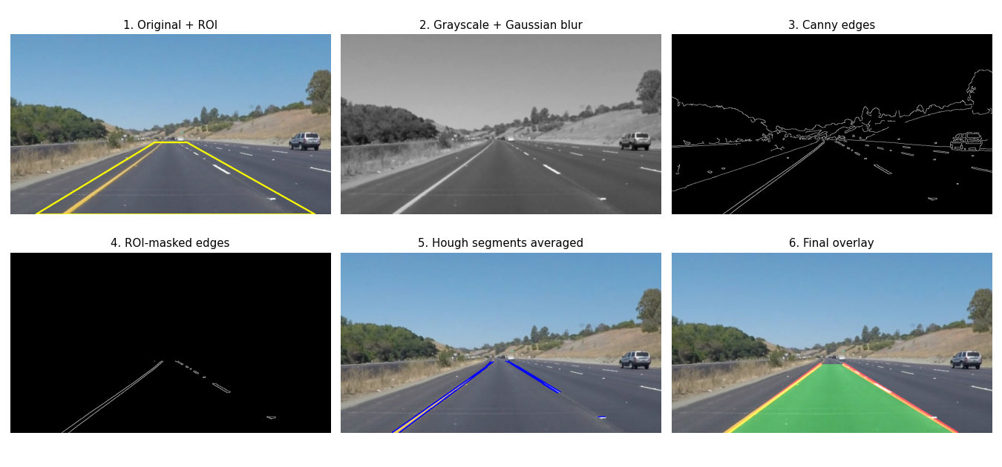
5. Method / Work Done
Gray + Gaussian blur
Canny edges
ROI mask
Hough segments
Slope split, weighted average
Overlay + temporal smoothing (video)

Slide 8
5b. Pipeline Steps & Parameters
Step | OpenCV function | Setting | Purpose
Grayscale + blur | cvtColor, GaussianBlur | 5×5 kernel | Remove colour, suppress noise
Edge detection | Canny | thresholds 50 / 150 | Find strong intensity edges
Region of interest | fillPoly, bitwise_and | trapezoid, 60%–100% of height | Ignore sky and roadside
Line detection | HoughLinesP | ρ=2, θ=1°, thresh 20, minLen 20, gap 100 | Find line segments
Left/right fit | slope sign + weighted mean | |slope| ≥ 0.45, weight = length | One stable line per side
Video smoothing | exponential average | α = 0.2 | Reduce flicker between frames
Why classical first: fast, explainable, no training data needed – a baseline to beat with deep learning.

Slide 9
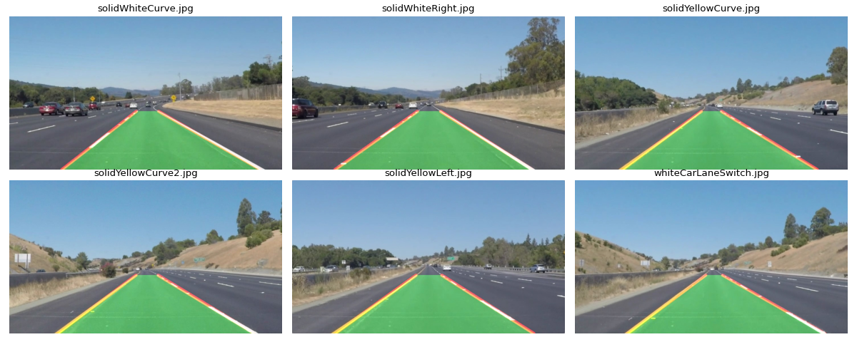
6. Results / Output
6/6
images: both lanes found
~80 FPS
on 960×540 video (36 FPS at 720p)
Smoothing cuts jitter ~4–5× at no speed cost.

Slide 10
6b. Video Results in Detail
Video | Mode | Frames | Both lanes found | Jitter (px/frame) | FPS
solidWhiteRight | raw | 221 | 100.0% | 4.34 | 82.5
solidWhiteRight | smoothed | 221 | 100.0% | 0.90 | 83.7
solidYellowLeft | raw | 681 | 100.0% | 5.29 | 84.2
solidYellowLeft | smoothed | 681 | 100.0% | 0.98 | 81.0
challenge | raw | 251 | 98.8% | 27.67 | 36.5
challenge | smoothed | 251 | 98.8% | 6.60 | 36.9
Jitter = mean frame-to-frame change of lane position at image bottom
Smoothing reduces jitter ~4–5× with no speed loss
Real-time capable on CPU (80+ FPS at 960×540)

Slide 11
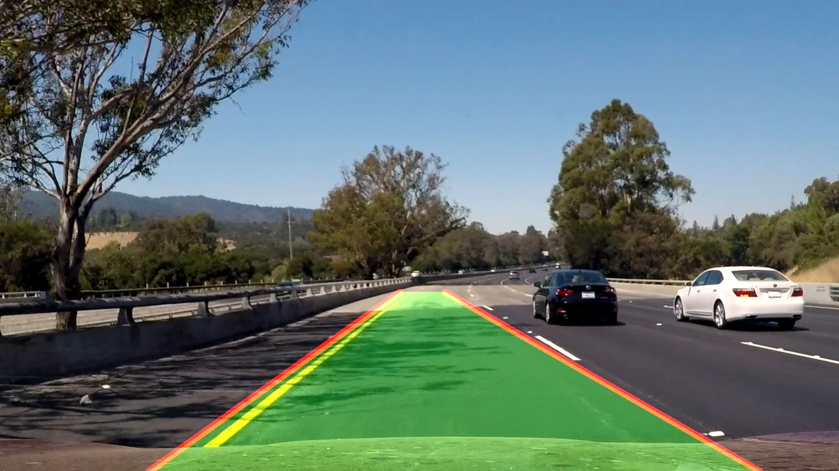
6c. Limitations & Observations
Failure: left line pulled onto shadowed road edge instead of yellow marking
"Both lanes found" does not mean correct – no labels in this set
Straight-line model only approximates curves
Fixed ROI assumes a centred camera and flat road
No night or rain data tested
Challenge frame 90

Slide 12
7. Current Progress
Classical pipeline (images) | Done
Video + temporal smoothing | Done
Dataset analysis | Done
Notebook, code, README | Done
TuSimple + labelled accuracy | To do
Curved lanes / shadow robustness | To do
Deep learning comparison | To do
Known failure: on challenge.mp4 the left line is pulled onto the shadowed road edge. "Both lanes found" ≠ correct; labels are needed to measure true accuracy.

Slide 13
8. Future Work (Roadmap)
Move to TuSimple; report TuSimple accuracy, false positives / negatives
Perspective (bird’s-eye) transform + polynomial fitting for curves
Shadow robustness: colour-space thresholds (HLS), CLAHE
Train a U-Net lane segmentation model; compare against baseline
Final report, demo video and GitHub repository

Slide 14
9. Evaluation Plan & Team Roles
Planned evaluation (TuSimple)
Team roles
Accuracy: share of predicted lane points within a pixel threshold of labels
False positives / false negatives per frame
Compare classical baseline vs U-Net
Test on shadow and curve subsets
Member | Focus
[Student 1] | Dataset loading, analysis
[Student 2] | Image pipeline, tuning
[Student 3] | Evaluation, report, slides

