Slide 1
Expense Tracker
A Full-Stack Personal Finance Management App
By Sarthak Sinha

Slide 2
Project Overview
Objective:
To provide users with an intuitive platform to track their income and expenses, visualize financial data, and gain insights into their spending habits.

Slide 3
Key Features
User authentication (Sign up, Login)
Add, edit, and delete expenses and income
Dashboard with financial overview
Recent transactions list
Interactive charts (bar, line, pie)
Profile photo upload
Responsive and modern UI

Slide 4
Tech Stack
Frontend: React, Vite, Tailwind CSS
Backend: Node.js, Express.js, MongoDB
Other: JWT Auth, Multer (file uploads), Chart libraries

Slide 5
System Architecture
Frontend: Handles UI, user interactions, and API requests
Backend: REST API, authentication, business logic
Database: MongoDB for storing users, expenses, and income
Simple architecture diagram (placeholder)

Slide 6
User Flow
Register or log in
Add income/expense entries
View dashboard and charts
Manage transactions and profile

Slide 7
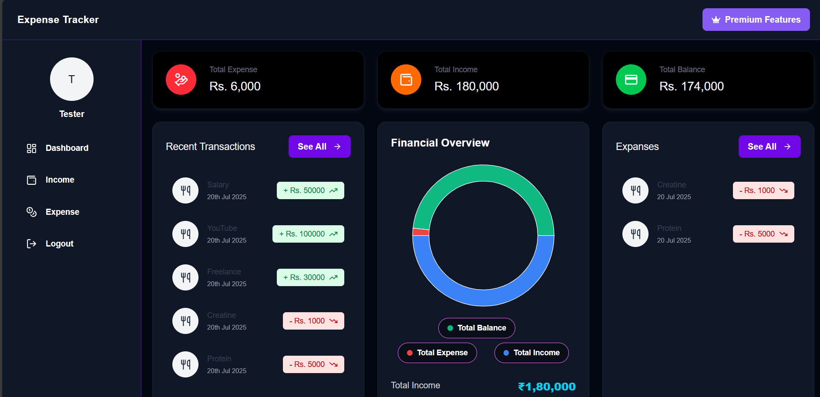
Screenshots / Demo

Slide 8
Future Enhancements
Introduce a Premium Version with features like: • Voice Input • AI Stock Suggestions • Multi-Account Sync
Budget planning and alerts
Mobile app version

Slide 9
Conclusion
Simplifies personal finance management
Provides actionable insights
Secure and user-friendly

Slide 10
Thank You
GitHub: https://github.com/sarthaksinha2003/Expense-Tracker

