Slide 1
PROJECTS
This is a description presentation for the projects created by SARTHAK TANDULJE. This mainly includes 3 projects :-
AgroVision-AI
Healthinfo-AI
Disaster Dataset
In the following slides, all the information related to the projects mentioned above is provided and the way to run the projects locally or where to visit the projects is given as well.

Slide 2
AgroVision-AI
AgroVision-AI is a smart AI diagnosis model which tells us about the disease a tomato leaf is suffering from and also tell us its preventive measures with just a photo of it!
The project currently focuses on tomato leaf diseases to ensure high accuracy, with scope for extension to multiple crops in future.
There are a lot of farmers unaware of such diseases which results in bad harvest, this AI tool is created to solve that problem from its root.
The model was trained on a plant village dataset available on Kaggle which have more than 10 thousand images across 9 class.
AgroVision-AI is for project work ONLY and not to replace the government provided AI diagnosis tools for Agriculture.

Slide 3
We use a confidence gap heuristic to detect ambiguous predictions.
AgroVision-AI have achieved the accuracy of 94.97% without softmax’s overconfidence.
Out-of-distribution images are filtered using confidence thresholding. Confidence is calibrated to avoid softmax overconfidence.
The model used is Mobile-NetV2; which was chosen because it is considered to be one of the best when it comes to the ease for the training of a model at a small scale and efficient at the same time.
The frontend is made by using HTML, Java-Script, CSS while the backend is integrated with Flask and TensorFlow.
Current model is limited to a specific dataset and Future work includes expanding crop variety / diseases.
To run this locally you can visit my Git account’s repository: https://github.com/sarthaktandulje/AgroVision-AI.git ; clone it and the project can be executed locally using a Flask-based inference pipeline.

Slide 4
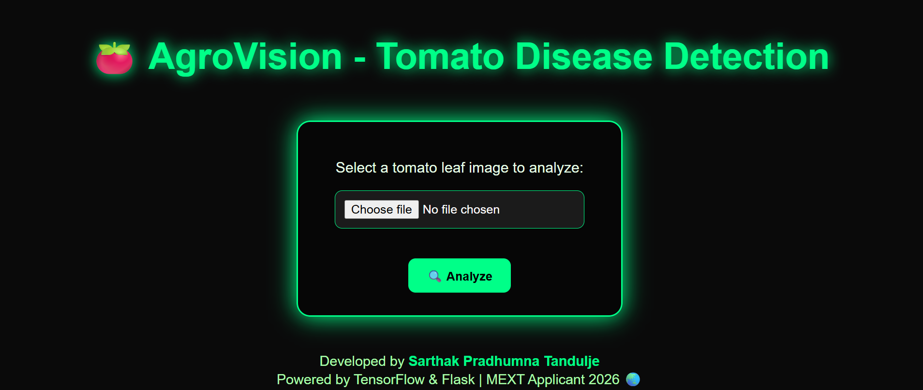
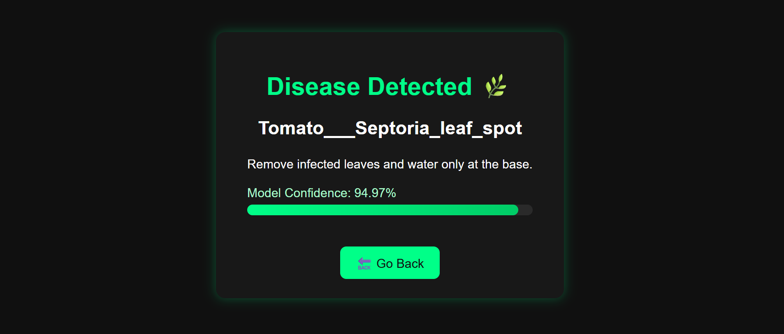
Here are some photos of the actual web interface of AgroVision-AI :
Starting Interface
Result interface

Slide 5
Healthinfo-AI
Healthinfo-AI is a smart AI health diagnosis tool which mainly have 2 AI model within. One of those takes the Xray images of chest as input and tells us that if the patient is suffering from pneumonia whereas the other model takes images of the skin infection part as its input and tell us what kind of disease is it and what should be our next steps for its cure or treatment or if needed visit a doctor.
This system is strictly intended as a decision-support tool only and not a replacement for professional medical diagnosis tools and doctors.
The models were trained on “publicly available dermatology image datasets from Kaggle with more than 20000 images while the skin dataset have about 6 classes.
A rejection mechanism prevents misuse and unsafe predictions. Future work includes visual explainability using Grad-CAM.
Binary probability is converted into confidence using distance from decision boundary.

Slide 6
.
The models used are Mobile-NetV2 which makes it easier to train individually and is also good when it comes to accuracy and precision
The frontend is made by HTML, Java-Script and CSS with colour changing background and neon colour while the backend is integrated by Flask and Tensorflow .
There is also a choose language option given in the interface of the web app, it mainly includes 3 languages; English(Default), Hindi and Japanese by which you can choose whichever language that you want with more language incoming in near future.
To run this locally you can visit my Git account’s repository: https://github.com/sarthaktandulje/Healthinfo-AI.git and clone it while to activate it, you have to run the basic flask integration command in the terminal of the same folder you have the repos. in.

Slide 7
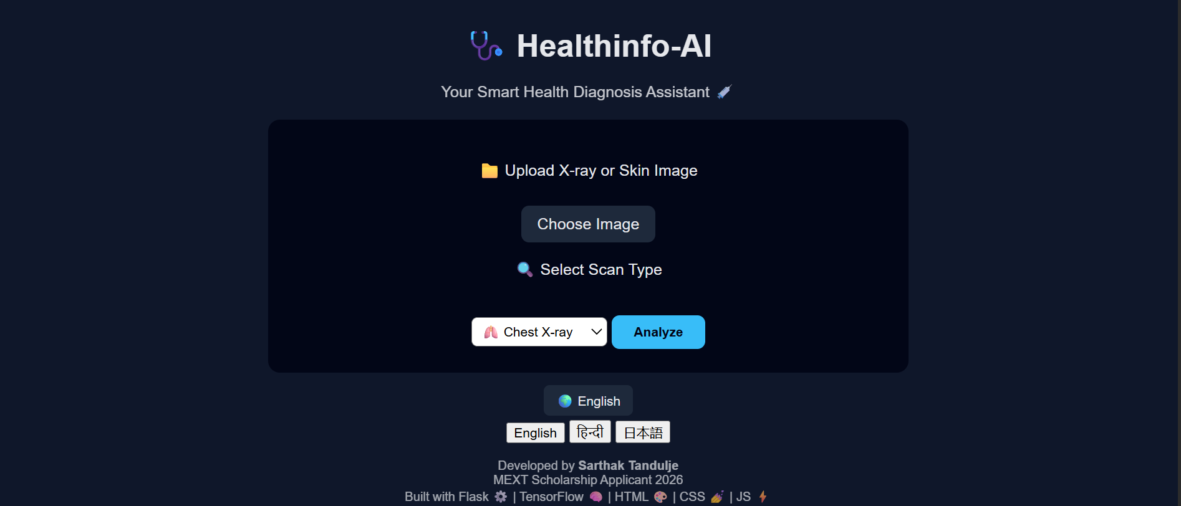
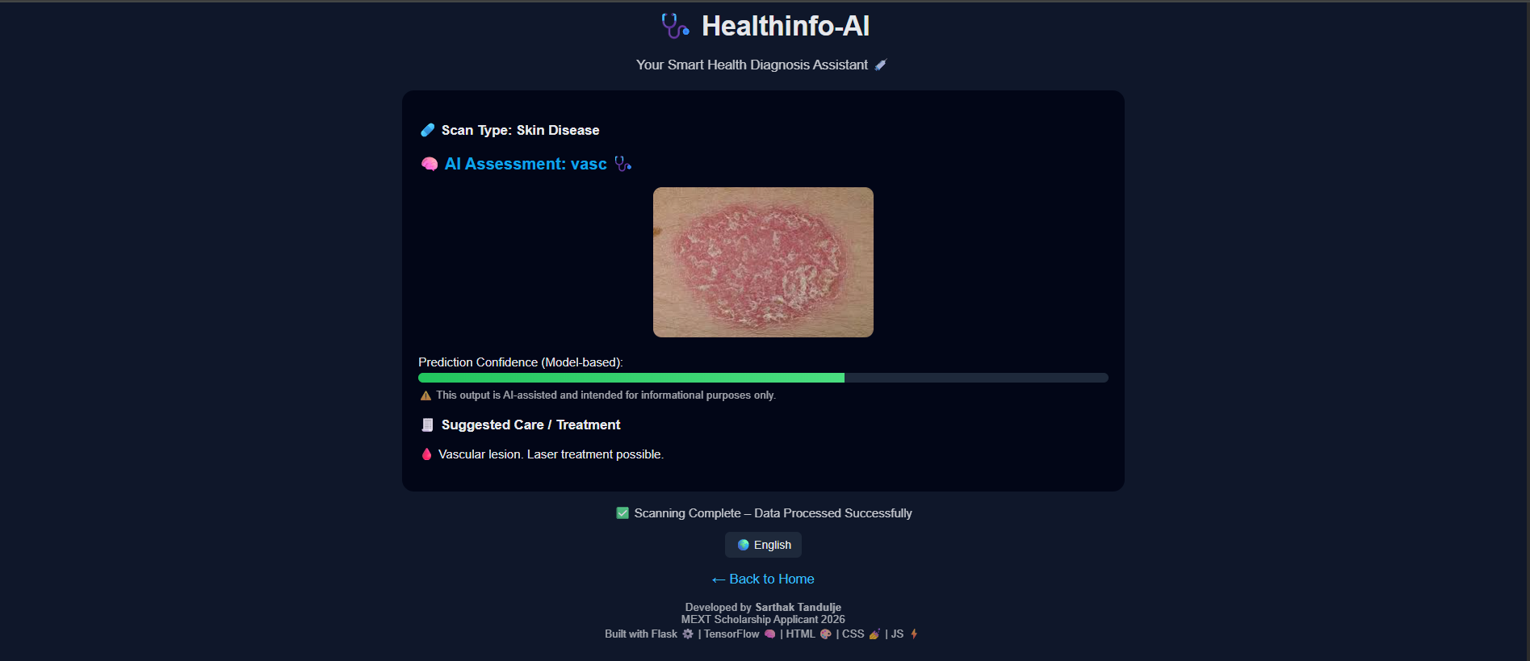
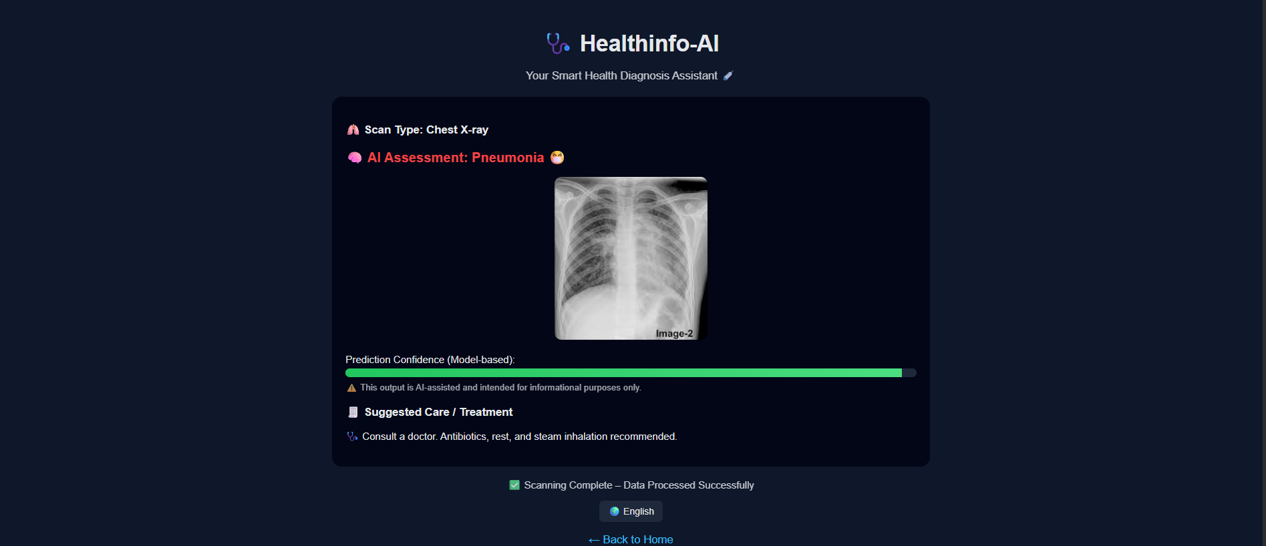
Here are some photos of the actual web interface of Healthinfo-AI :
Starting interface
Skin Diagnosis Model
Xray Diagnosis Model

Slide 8
Disaster Dataset
The dataset is organized into five primary disaster classes; fire, smoke(only), flood, landslide and earthquake(newly added), with an additional ‘Normal’ class included for baseline comparison and will be extended further in future.
This dataset in total have more than 9000 images, all of which was collected from official sources like Google images, Bing images, Researches, News reports and etc. manually and none of which is animated.
The objective behind creating this particular dataset is that it can help to train AI models to identify and differentiate between calamities.
Images were sourced from multiple geographic regions to avoid bias.

Slide 9
.
The disaster dataset is officially posted on “Kaggle” and have gain recognition by several people which have visited, downloaded and also have upvoted the dataset while the dataset itself can be extended for real-time disaster monitoring.
Classes were chosen to minimize visual overlap while maximizing real-world usefulness. The dataset will be used to train multi-class disaster detection models for drone and CCTV feeds.
To download or see the dataset go to: https://www.kaggle.com/datasets/sarthaktandulje/disaster-damage-5class

Slide 10
Name of Classes and number of Images:-
CLASSES | IMAGES
FIRE | 2537
FLOOD | 2706
EARTHQUAKE | 1000
LANDSLIDE | 310
SMOKE(no fire) | 302
NORMAL | 2226
No. of Images:- | 9081

Slide 11
My Research Vision
My long-term goal is to develop AI systems that assist non-expert users in critical decision-making, especially in agriculture, healthcare, and disaster response and management.
I aim to develop AI systems that can assist farmers, patients, and emergency responders by providing fast, accurate, and explainable visual intelligence.
My research focus is on making deep learning models reliable in real-world conditions, including low-quality images, uncertainty, and limited resources.
The main ambition behind all this is to not just keep the use of AI limited to the urban areas but instead promote it in rural areas as well for example; in farming, use of AI can increase the efficiency of farming significantly if used properly.

Slide 12
“What I personally did”
Designed and constructed a 9,000+ image multi-class dataset from scratch.
Cleaned and labelled dataset
Designed UI
Built Flask APIs
Trained & evaluated models
Wrote this Description presentation
For more information about me, you can check out my GitHub, LinkedIn, Kaggle; username- sarthaktandulje
To contact, email:- sarthak.tandulje.official@gmail.com
Phone no.:- 9270438995, X(twitter), LinkedIn, Facebook, Instagram, Discord.

