Slide 1
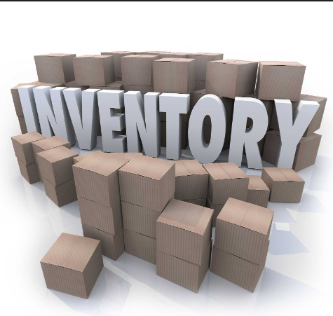
Billing & Stock Management
Project Title: Billing and Stock Management
Dhruvrajsinh Chavda

Slide 2
Introduction to project
This project is an Billing and Stock Management which bills and stores inventory.
This project is an Billing and Stock Management System (BMS) built using Python and Tkinter, with SQLite as the database. It provides a graphical user interface (GUI) for managing different aspects of inventory, including: Employee Management, Supplier Management, Category & Product Management, Sales Tracking, Billing System.

Slide 3

Disadvantages of Existing System
Static Report Generation.
Lack of Online Access.
No support for local businesses

Slide 4
Proposed System
Better price and wholesale items.
No sell pressure.
The system has provided facility of online billing the bills rather than pen and paper.
The system provide easier and quickiest was to provide products related information to customers.

Slide 5
Tools & Technologies
Tools: Vscode
Technology:
Front-end:Python
Back-end: Sqlite

Slide 6
Class Diagram
A class diagram is an illustration of the relationships and source code dependencies among classes in the unified modelling language.

Slide 7
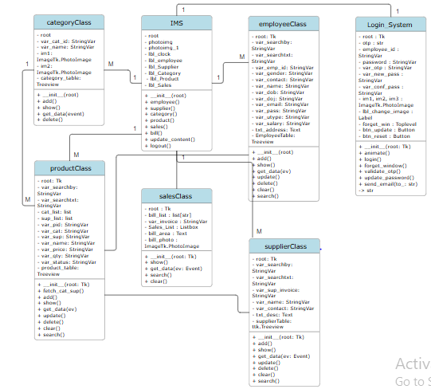

Slide 8
User diagram
Use Case Diagram Displays the relationship among actors use cases.
A use case diagram shows a set of use cases and actors (a special kind of class) and their relationships.
These diagrams are especially important in organizing and modeling the behaviors of a system.

Slide 9
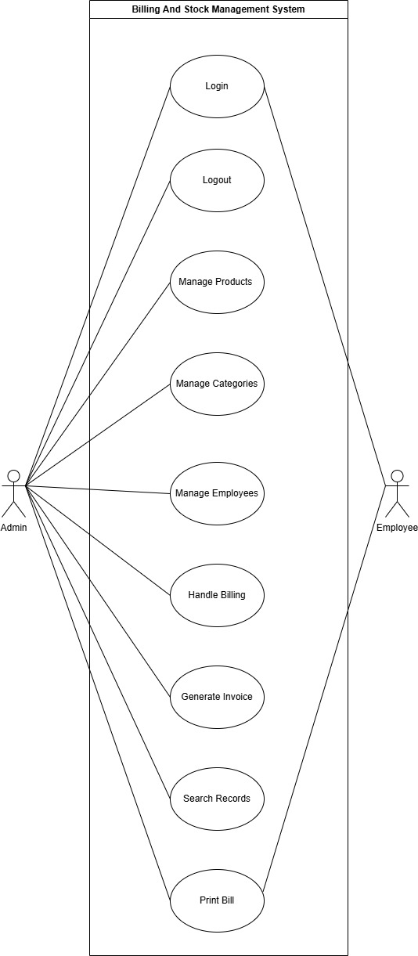

Slide 10
Data Dictionaries:
Table: employee
Table: supplier
Table: category
Table: product

Slide 11
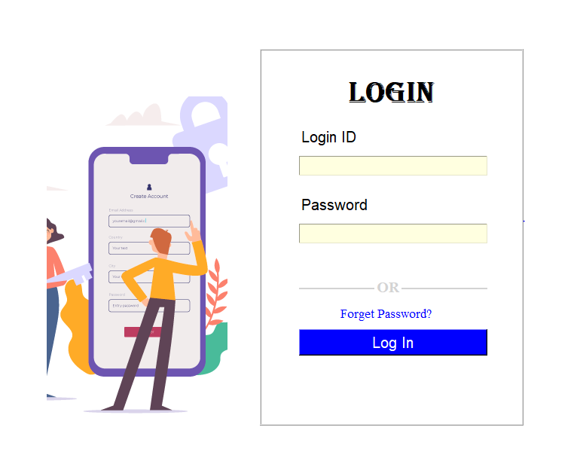
Screen Layout
Login Page

Slide 12
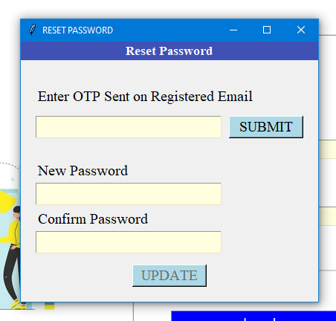
Forget Password Page

Slide 13
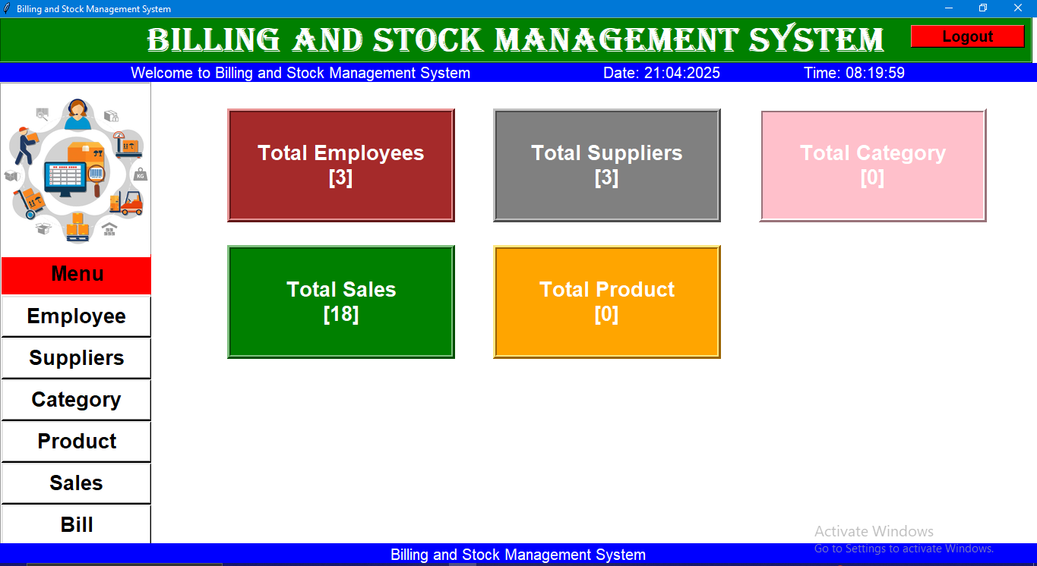
Dashboard Page

Slide 14
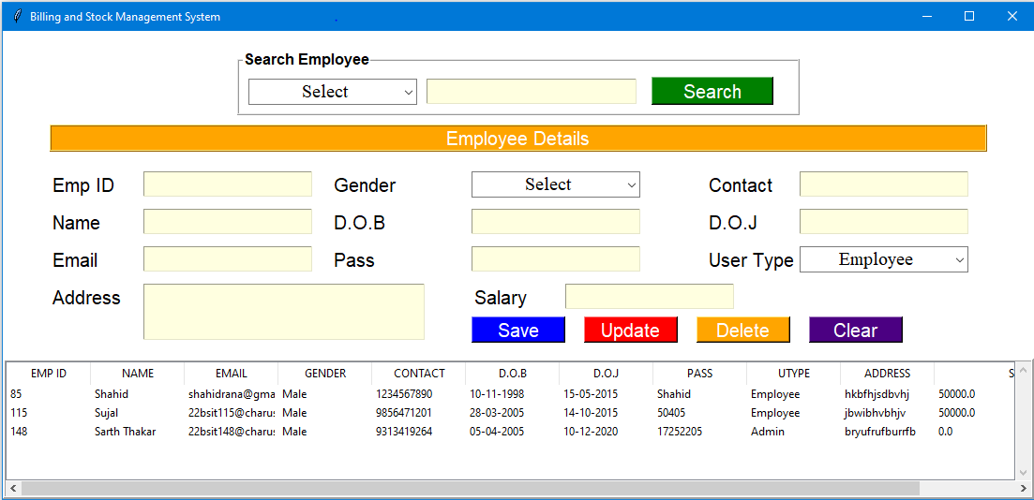
Employee Page

Slide 15
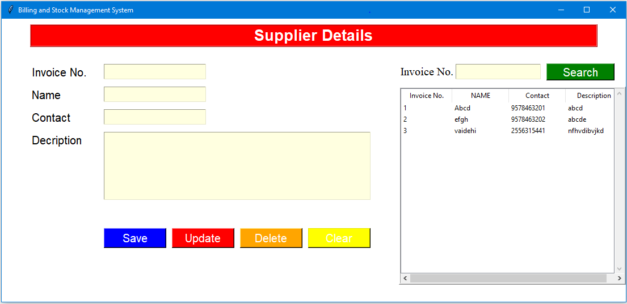
Supplier Page

Slide 16
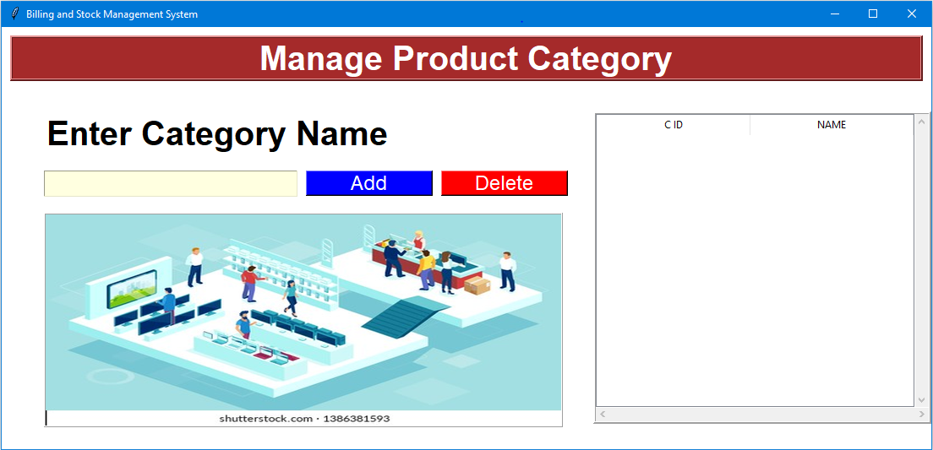
Category Page

Slide 17
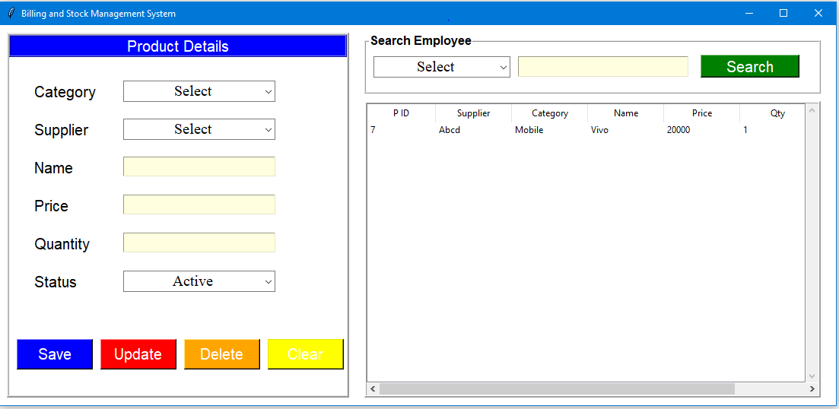
Products Page

Slide 18
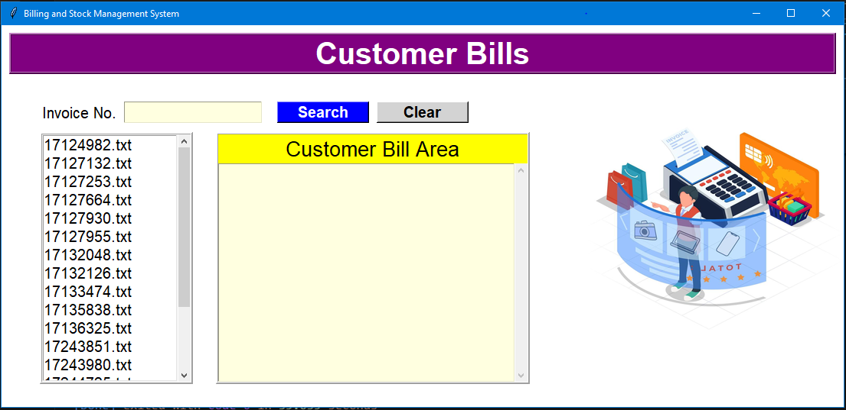
Sales Page

Slide 19
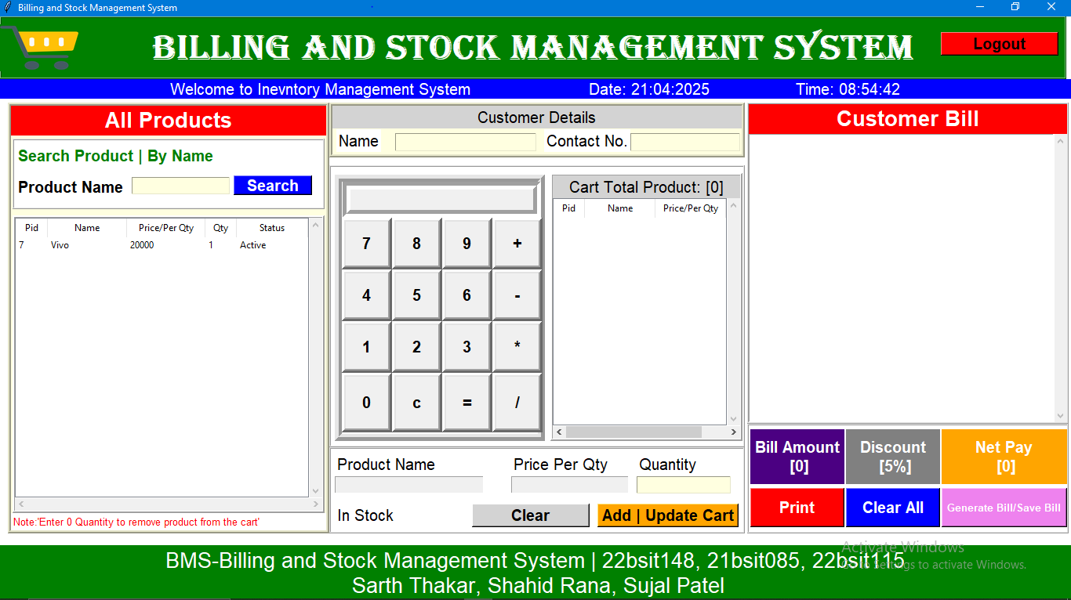
Bills Page

Slide 20
Thank you

