Slide 1

Risks mitigated or created by
password managers
Presented by :
Sarthak Siddhant Bharadwaj
Mahima Chowdary Maddineni
Guided by : Prof Yashwant K. Malaiya

Slide 2
Risks mitigated or created by password managers
Introduction
.
Password managers helps users create , save , manage and use passwords across different online platforms
All information is securely stored in a password vault and accessible via the password manager
It helps create highly random and unique passwords if the user visit’s a site for the first time.

Slide 3
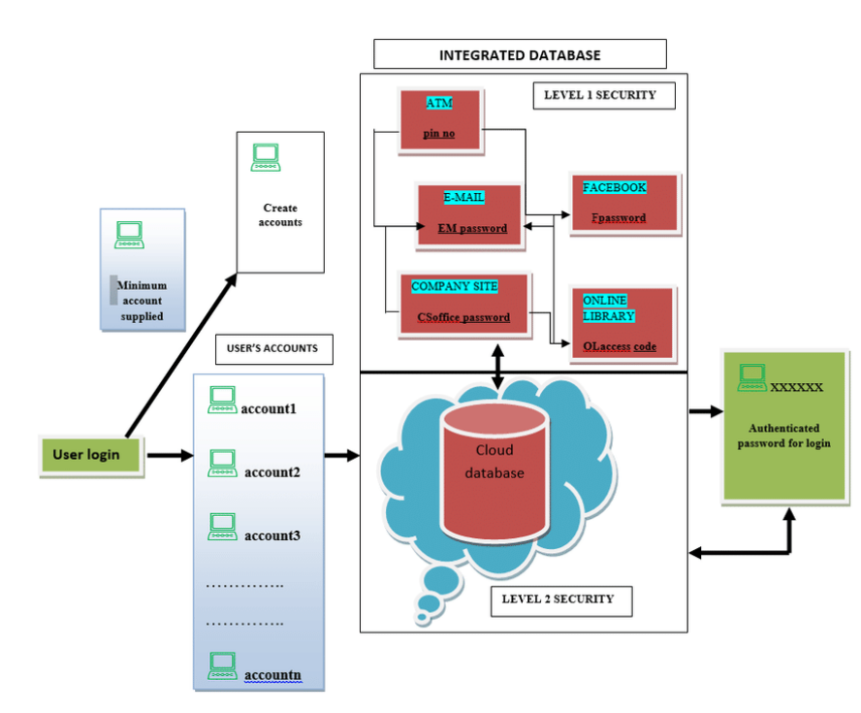
Risks mitigated or created by password managers
Architectural framework
for the common
Password Manager
Opeyemi, Ogunleye Adewale, Olumide Alese, Boniface. (2013). Factors influencing the Adoption of E-Government Services in Nigeria

Slide 4
Risks mitigated or created by password managers
Current Status
Biometric Authentication
Cross-Platform Compatibility
Password auditing
Secure sharing and Emergency access
Two-Factor Authentication (2FA)
Password Generator Enhancements

Slide 5
Risks mitigated or created by password managers
Current risks by password managers
Single Point of Failure
Synchronization and Cloud Storage
Phishing and Social Engineering
Dependency on a Single Service
Data Backup and Recovery

Slide 6

Pros -
Convinient for users
provides autofill for passwords
auto suggest strong passwords
mobility like synchronisation of password across devices such as laptop and mobiles
Risks mitigated or created by password managers
Cons -
users essentially create a single point of a failure
it may not adhere to 2 factor authentication and multi-factor authentication all the time.
Pros and Cons

Slide 7
Risks mitigated or created by password managers
Passwordless architecture.
This technology replaces passwords with Possession factors like one time passwords, authentication app codes or a hardware token ex : duo push in CSU
Passkeys technology is still far from reality Users need to open an additional email application most of the times to access online accounts which can be compromised through phising.
Zero Knowledge Architecture.
Zero-knowledge encryption security model uses encryption and data segregation to make data breaches irrelevant.
When a software platform is zero knowledge, the user’s data is encrypted and decrypted at the device level not on the company’s servers or in the cloud.
Recent Developments
Hardware Based Password Managers
There is a significant research gap between software based password managers and hardware-based password managers. No cost effectiveness is there.

Slide 8
Risks mitigated or created by password managers
Password Manager Using Honey Encryption
Cognitive CAPTCHA Password Reminder
The enhanced password manager system protects against brute-force attacks by incorporating honey encryption (HE), adding a deceptive layer to encryption.
Experiments show that combining HE with other security measures, while slightly slower, offers significantly better security than using HE alone
Zero-knowledge encryption security model uses encryption and data segregation to make data breaches irrelevant.
If the image is selected properly and strong association with a person’s visual memory has been linked to it, the chances of recalling a lengthy password he/she created should not present a problem
Recent Developments
Mono Pass
MonoPass uses the master password to generate consistent passwords across different devices. It synchronizes password metadata through a central server but avoids storing actual passwords there. Furthermore, it doesn’t require users to authenticate with the master password for synchronization

Slide 9
Bitwarden
Bitwarden is an open-source password manager offering the convenience of cloud-based synchronization alongside robust security.
Keeper.
Risks mitigated or created by password managers
It offers Keep_x0002_erChat – an exclusive feature with self-destructing messages and a media gallery for photos and videos
Security Audit – checks all our passwords, evaluates their strength, and suggests changing the weak ones
NordPass.
Offers a real-time Data Breach Scanner that scans leaked databases for your passwords and credit card details.
The OCR feature – automatically scans text information from credit cards, documents, and photos
1Password.
Products and Technologies in Industries Currently
The Watchtower – scans dark web and also checks if a website sup_x0002_ports 2FA.​
Travel Mode – hides sensitive information on your​
phone while you’re away​
KeePass
KeePass is a trusted open-source password manager known for its transparency and security. It operates by storing your passwords in a locally encrypted database file, safeguarding your data on your device.
Password Safe
Password Safe can seamlessly work with other password managers and applications that use the same format, making it a trusted choice for straightforward password management

Slide 10
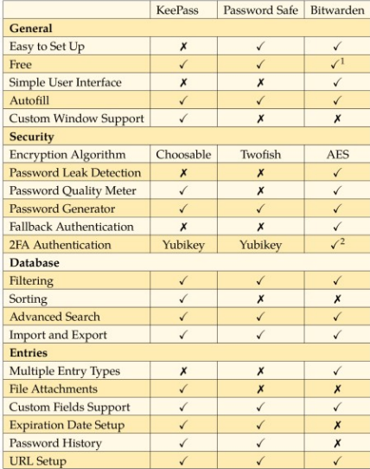
Risks mitigated or created by password managers
INFLUENTIAL ORGANIZATIONS
LastPass (LogMeIn):
It introduced secure sharing options and advanced security measures, driving industry advancements.
Open Source Community (KeePass):
KeePass’s extensible architecture and plugins influence password manager development and security practices.
Carnegie Mellon University’s CyLab:
Research labs like CyLab conduct studies on password security and encryption.
Open Web Application Security Project (OWASP)):
OWASP engages a global community of cybersecurity professionals, researchers, and enthusiasts, facilitating collaboration and the exchange of knowledge to advance password security standards.
PECUCH, Daniel. Password managers: a survey [online]. Brno, 2021 [cit. 2023-09-06]. Available from: https://is.muni.cz/th/sm620/. Bachelor thesis. Masaryk University, Faculty of Informatics. Supervisor Luka´sˇ NEMEC

Slide 11
Risks mitigated or created by password managers
Conclusion
In conclusion, password managers are essential allies in our digital security journey. They adapt to ever-evolving threats with innovations like biometrics and cognitive CAPTCHAs. While challenges exist, like phishing and cloud storage, embracing these tools enhances our online safety. Choices like KeePass, Bitwarden, or Password Safe cater to diverse needs, giving us control over our digital identities. By staying informed and proactive, we bolster our online defenses and contribute to a more secure digital world

Slide 12


