Slide 1
Online Library Management System
Review 1: Project structure, database design and UI
Java Web · Servlets · JSP · JDBC · MySQL
GUVI × Galgotias Project Board · 3rd Semester
github.com/sarthakvats440-coder/online-library-management-system
Notes:
Introduce the project: a web based library system with two roles. Review 1 covers structure, database design and connectivity, and UI.

Slide 2
Problem and objectives
1
One catalogue
Books with live available-copy counts
The problem
Small libraries track books and loans on paper or in spreadsheets. Stock counts drift, overdue books go unnoticed, and members cannot see what is available.
2
Two roles
Librarian manages, member borrows
3
Safe loans
Borrow and return are atomic in MySQL
4
Overdue tracking
A background thread flags late loans

Slide 3
Architecture: five layers
Browser
Servlets
Service
DAO
MySQL
JSP + JSTL pages, responsive CSS
→
Controllers: login, books, borrow
→
Validation and report logic
→
JDBC and SQL for each table
→
users, books, transactions
Cross-cutting: AuthFilter protects every page · OverdueScheduler runs on its own thread · DBConnection reads db.properties

Slide 4
Project structure
web-app/
├─ sql/ schema.sql, seed.sql
├─ src/main/resources/
│ └─ db.properties
├─ src/main/java/com/library/
│ ├─ model/
│ ├─ dao/
│ ├─ service/
│ ├─ servlet/
│ ├─ filter/ listener/
│ ├─ exception/
│ └─ util/
└─ src/main/webapp/
├─ *.jsp css/style.css
└─ WEB-INF/web.xml
model
User (abstract), Member, Librarian, Book, Transaction
dao
CrudDAO<T,ID>, Searchable<T>, three DAO classes
service
LibraryService: validation and reports
servlet
8 controllers, one per feature
util
DBConnection (JDBC), PasswordUtil (SHA-256)

Slide 5
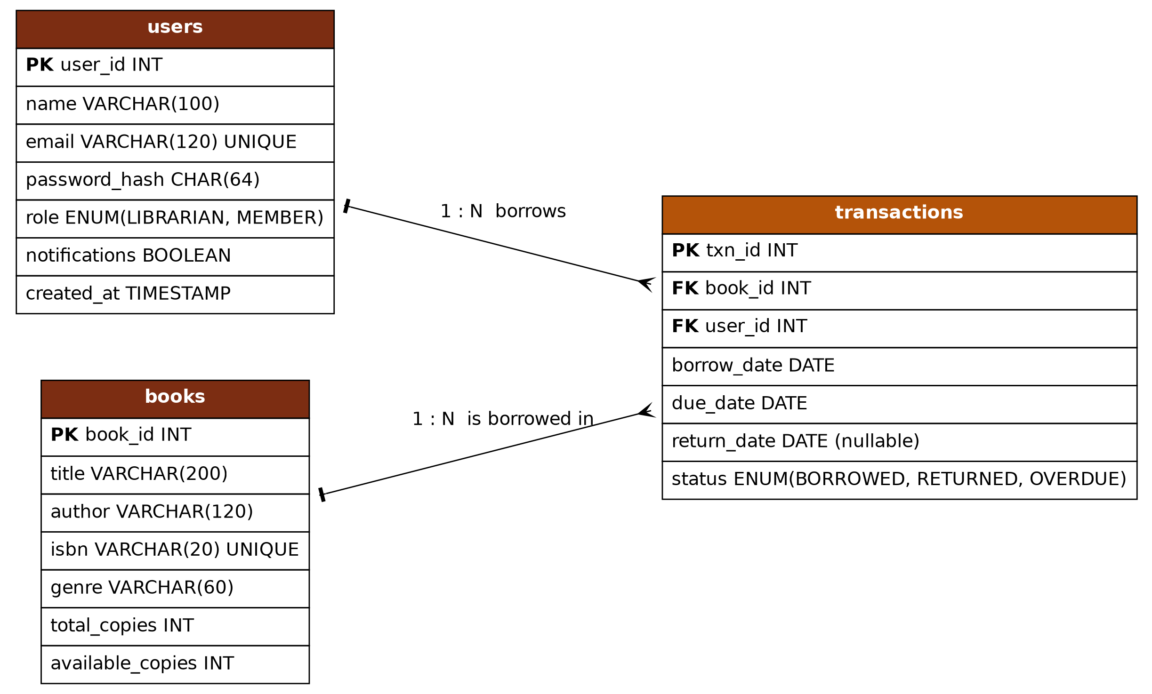
Database design: ER diagram
Relationships
One user has many transactions
One book appears in many transactions
Deleting a user or book removes its transactions (ON DELETE CASCADE)

Slide 6
Tables, keys and constraints
Table | Key columns | Rules enforced by MySQL
users | user_id (PK), email, role | email UNIQUE · role is LIBRARIAN or MEMBER · password stored as SHA-256 hash
books | book_id (PK), isbn, title | isbn UNIQUE · available_copies between 0 and total_copies
transactions | txn_id (PK), book_id (FK), user_id (FK) | status is BORROWED, RETURNED or OVERDUE · index on (status, due_date)
Full SQL: web-app/sql/schema.sql (tables) and seed.sql (demo data)

Slide 7
JDBC connectivity
Config in a file
URL, user and password live in db.properties
// DBConnection.java
Class.forName("com.mysql.cj.jdbc.Driver");
DriverManager.getConnection(url, user, pw);
// TransactionDAO.borrow()
c.setAutoCommit(false);
SELECT ... FROM books WHERE book_id=? FOR UPDATE
INSERT INTO transactions ...
UPDATE books SET available_copies = ... - 1
c.commit(); // or c.rollback() on error
PreparedStatement
Every query is parameterised, so no SQL injection
try-with-resources
Connections always close, even on errors
Atomic loans
Row lock plus commit or rollback prevents overbooking

Slide 8
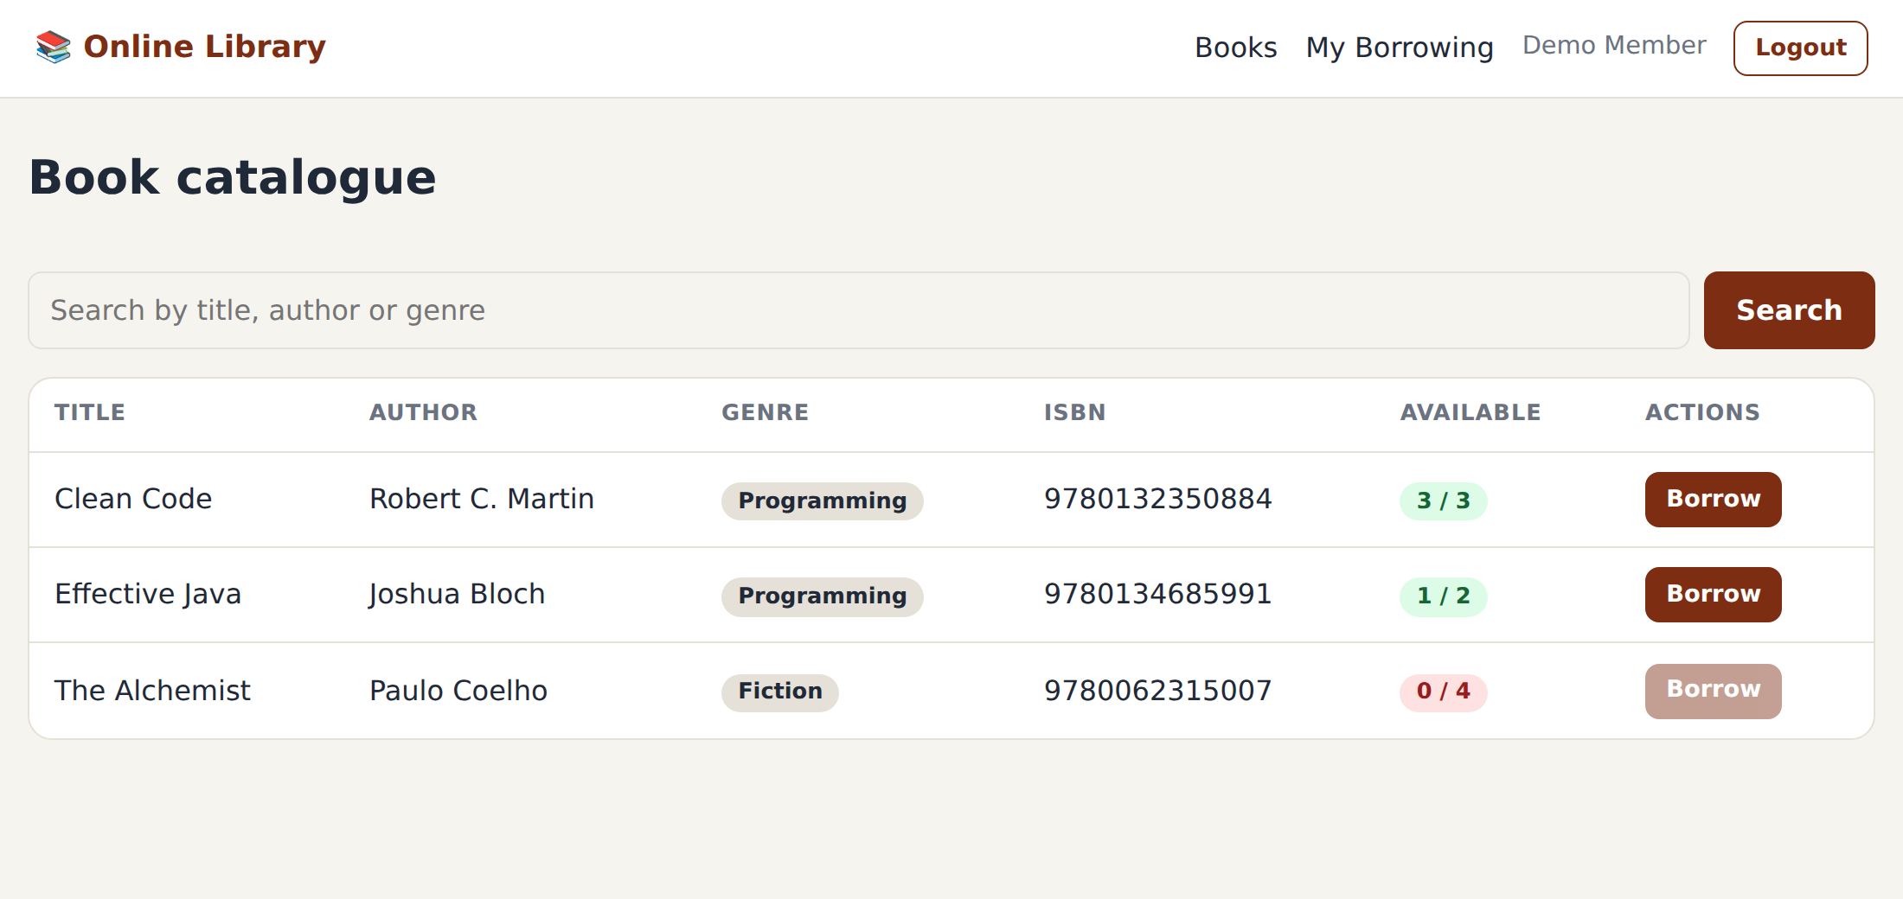
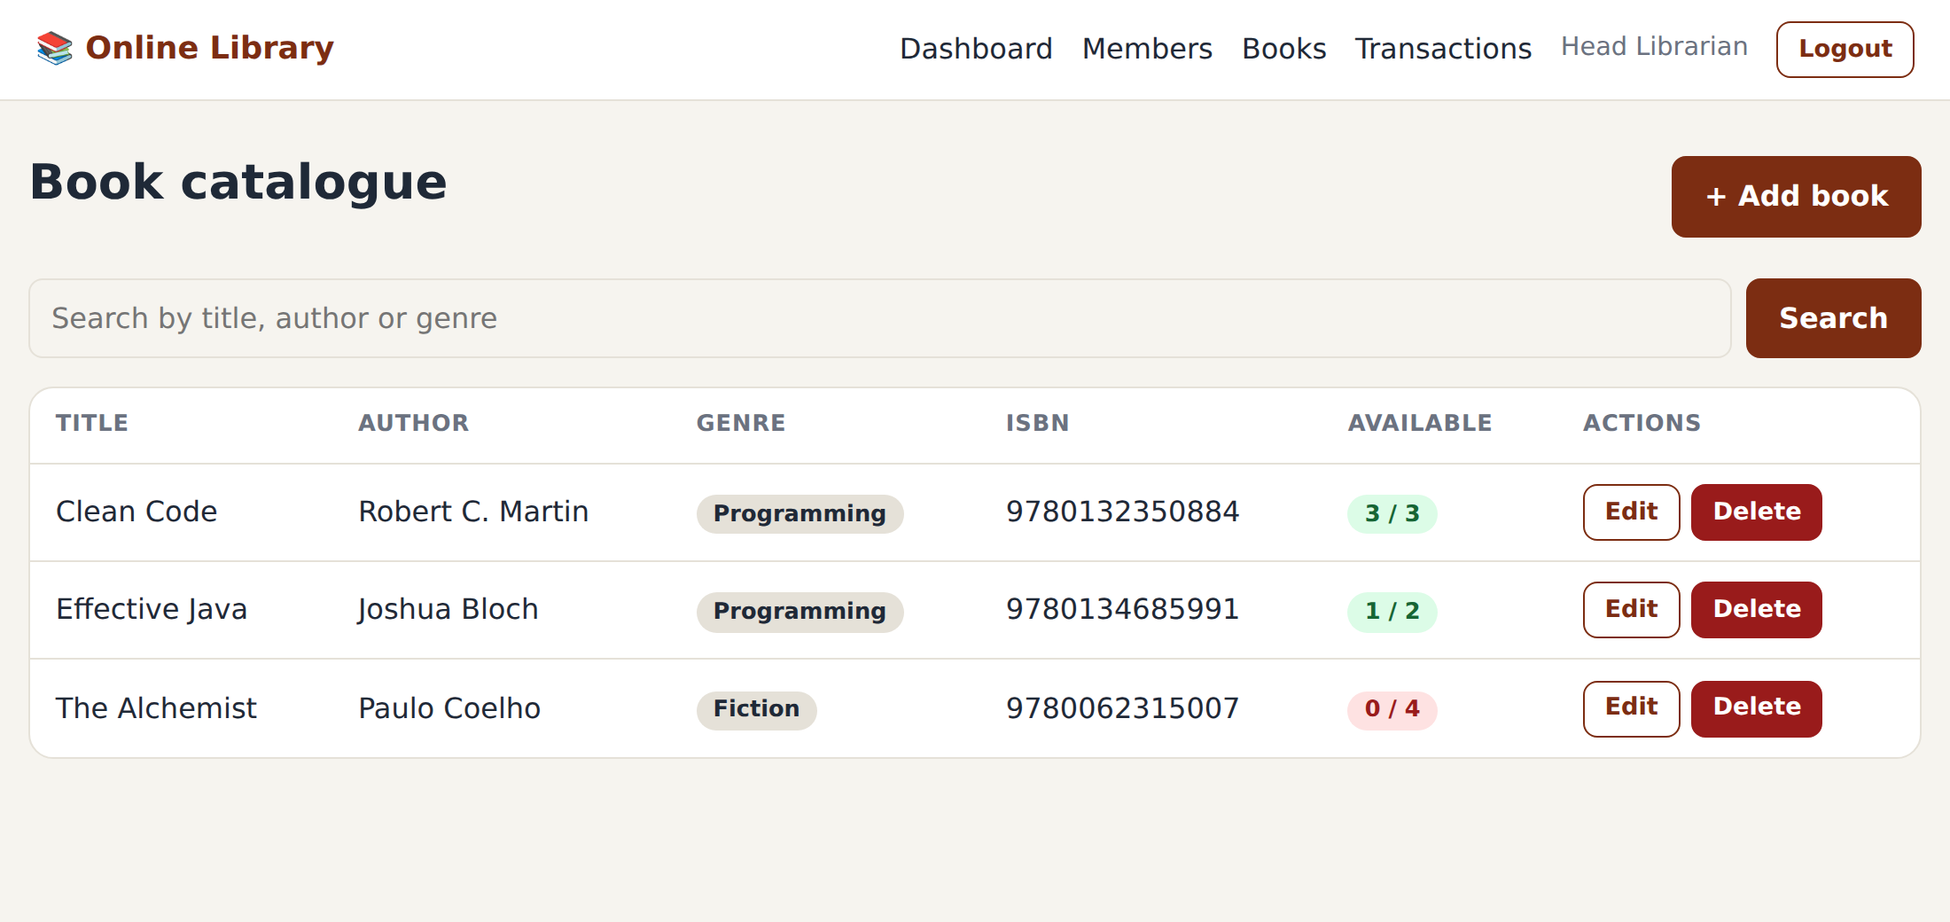
UI design: catalogue for both roles
Member view
Search, availability badge, Borrow button (disabled when stock is 0)
Librarian view
Same page, with Add, Edit and Delete instead of Borrow
Design mockups rendered from the project's own CSS

Slide 9
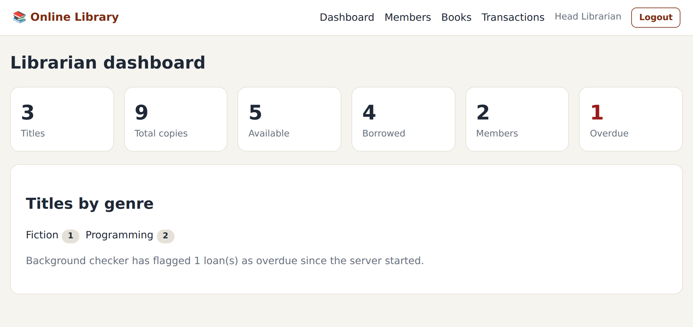
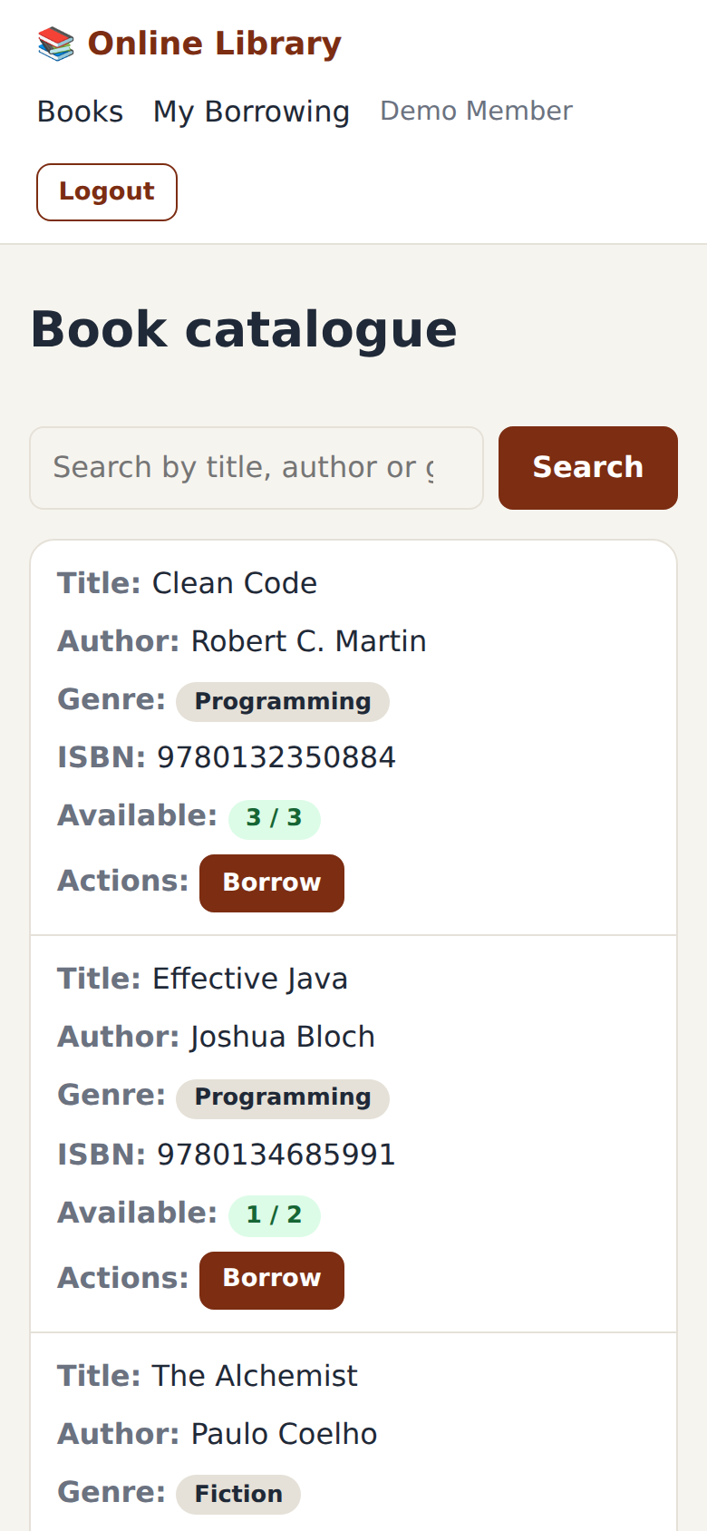
Dashboard and responsive layout
Dashboard tiles show titles, copies, available, borrowed, members and overdue loans.
Light and dark theme follow the device setting.
Below 700 px the tables turn into stacked cards.
Phone width

Slide 10
Core Java concepts and where they live
Concept | Where
Inheritance, abstraction, polymorphism | User (abstract) → Member, Librarian; getRole() and getHomePath() overridden
Interfaces and generics | CrudDAO<T,ID> and Searchable<T>, implemented by the DAOs
Exception handling | LibraryException, BookNotAvailableException, rollback on failure
Collections | List, LinkedHashMap, TreeMap and streams in LibraryService
Multithreading | OverdueScheduler: scheduled thread, AtomicInteger counter

Slide 11
Marking rubric: Java web projects
Rubric item | Marks | Evidence in the project
Problem understanding and solution design | 8 | Problem slide, two roles, layered architecture, ER diagram
Core Java concepts | 10 | OOP, generics, exceptions, collections, threads
Database integration (JDBC) | 8 | DBConnection, three DAOs, commit and rollback
Servlets and web integration | 7 | 8 servlets, filter, listener, session login, JSP views
Total: 33 marks

Slide 12
Status and next steps
Done for Review 1
Project structure and packages
MySQL schema and seed data
JDBC classes and transactions
Servlets, JSP pages, responsive CSS
Next (Review 2)
End-to-end testing on Tomcat
Fines for overdue books
Email reminders
Unit tests for DAOs

