Slide 1

2025 Marketing Performance Review
Data Analyst, Growth
Sarthak Yadav

Slide 2
Executive Summary, 2025 Marketing Performance
📊 PERFORMANCE SNAPSHOT
💡 KEY INSIGHTS
🎯 RECOMMENDATIONS
3.867%
✗
Marketing is not on track — 3.87% conversion attainment across all 5 channels and 4 markets, with Partnerships the worst at 2.0% and Paid Social the best at 5.1%
✅ SCALE UP
Conversion Attainment
Organic
10,859 actual vs 280,811 target
Highest ROAS (0.045) · Best cost-efficiency
✗
Growth is unprofitable across all markets – UK leads with 1.25% profitable users vs France with 0.25% profitable users; Paid Social drives the worst 5-week post conversion loss of -$1.86M
UK
Paid Social
Best Avg Rank (2.60) · Highest volume
Best Market
1.25% Profitable users · 0.083 UK Organic ROAS
✗
Momentum is deteriorating – median WoW ratio of 0.964 (-3.6% typical week); Spain is the weakest market (median 0.872), while France is the only improving market (median 1.014)
⚖️ MAINTAIN / OPTIMIZE
0.59%
Paid Search
Mid-tier ROAS (0.035) · Lowest CPC ($822.13)
Profitable Users
✗
Paid Social and Paid Search observe biggest attainment drops from Q1 to Q4 observing -1.2pp and -0.7pp respectively, despite being the top 2 channels by volume
55 of 9,284 users with CPA data
❌ SCALE DOWN / DEPRIORITIZE
0.964
Affiliate
✗
Two clear deprioritizations for 2026 – Partnerships ranks last in all 4 markets with the worst ROAS (0.018) and highest CPC ($2587.71); Affiliate ranks 4th in all markets with below average ROAS (0.024)
Below-avg ROAS (0.024) · Lowest Order Freq (0.176)
Median Week-over-Week Conversion Attainment
Typical week underperforms prior by 3.6%
Partnerships
Lowest ROAS (0.018) · Highest CPC ($2587.71)
Task Outputs: Query_Output

Slide 3
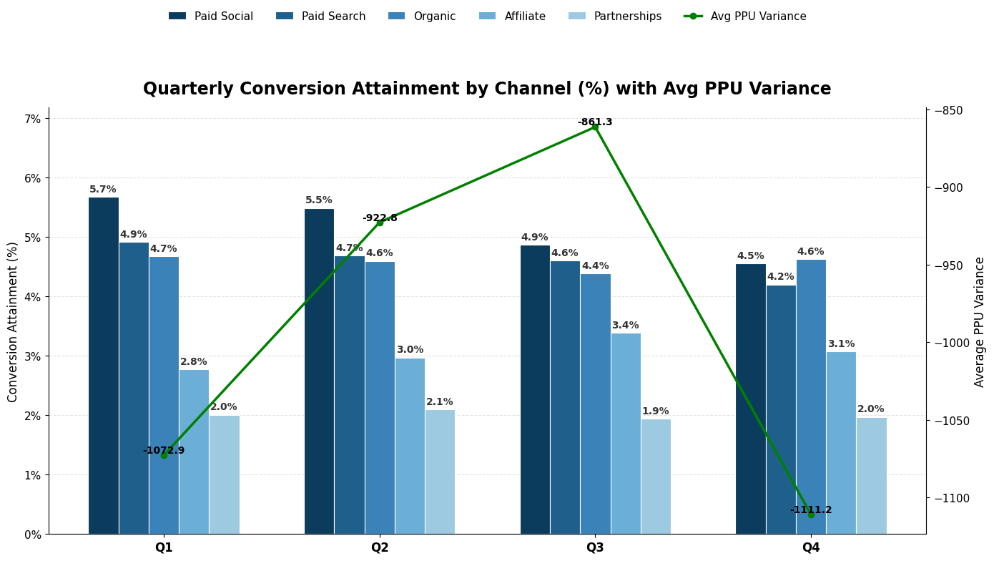
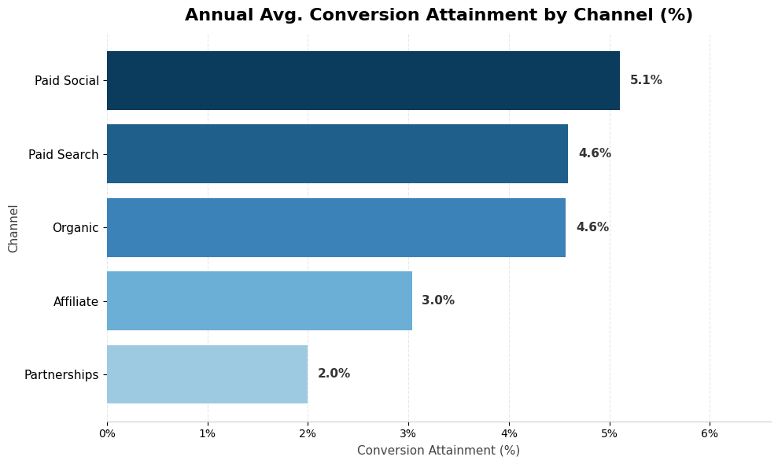
Marketing Performance is Off-Target on Conversions, On-Budget for Spend
Metric | Actual | Target | Variance | % Attainment
Conversions | 10,859 | 280,811 | −269,952 | 3.9%
Spend | $9.0M | $13.6M | −$4.6M | 66.1%
Revenue | $2.16M | N/A | N/A | N/A
% Loss | 76% | N/A | N/A | N/M
Paid Social leads every quarter (5.7– 4.5%) but shows the sharpest decline of any channel across the year (-1.2pp from Q1 to Q4).
Organic is the most stable channel — attainment holds between 4.4% and 4.7%.
Affiliate is the only channel gaining efficiency from Q1 to Q3.
Task 1: Query_Output

Slide 4
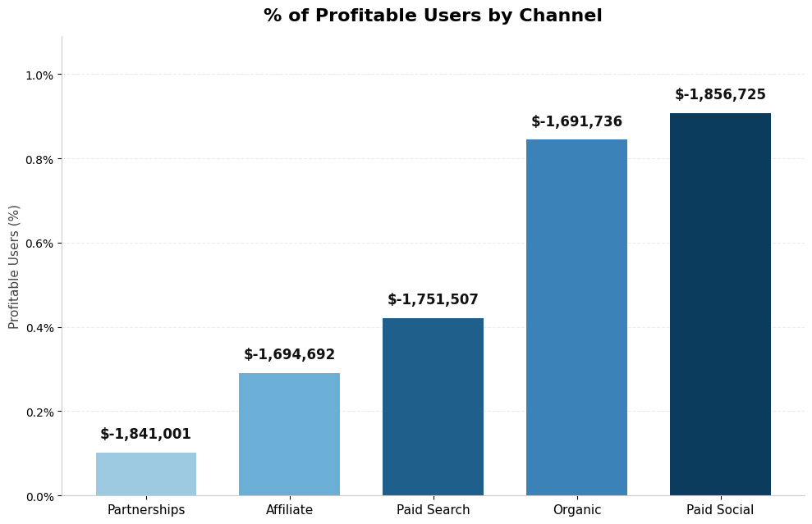
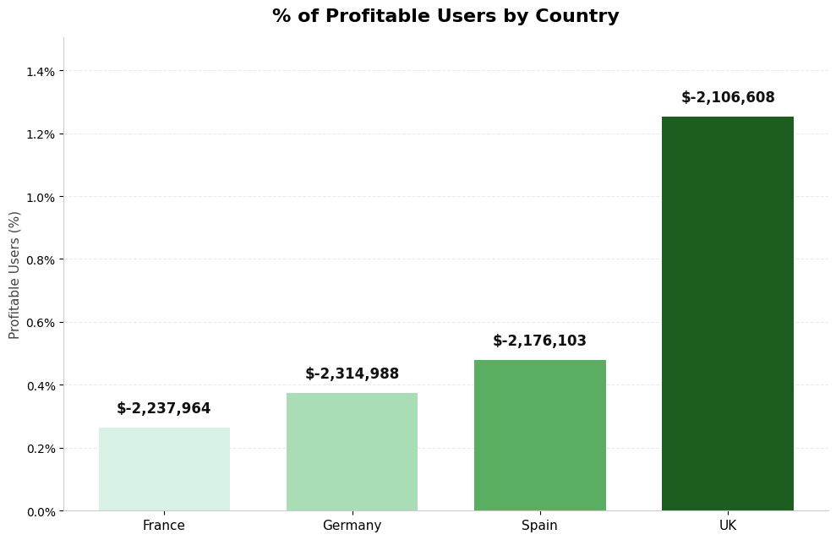
Short-Term Profitability is Structurally Negative Across All Channels
% Profitable Users (portfolio)
0.59%
55 of 9,284 users with CPA data across all channels & countries
Paid Social is the best channel in terms of profitable users ~0.9%, but it incurs the highest 5-week post conversion loss.
Partnerships is the worst channel in terms of profitable users ~0.1%, and it incurs a very high 5-week post conversion loss.
UK is the best market in terms of profitable users at 1.25%, but it incurs significant 5-week post conversion loss.
France is the worst market in terms of profitable users at 0.25% and incurring significant 5-week post conversion loss.
Task 2: Query_Output

Slide 5
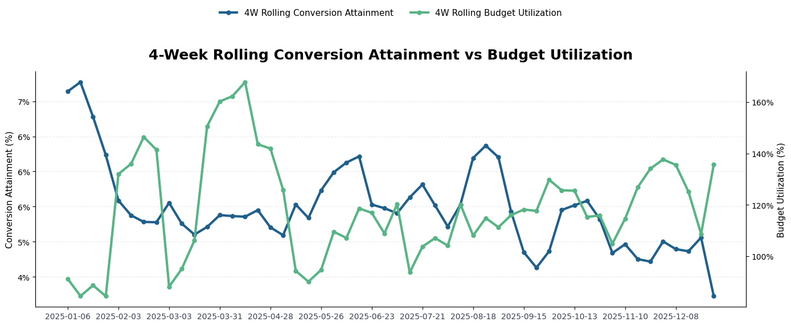
Conversion Momentum is Declining Over the Year
The budget utilization spikes are a target-setting artefact, not a real overspend event – in the most extreme cases actual spend is a normal ~$10K-$20K weekly figure deployed against targets as low as $1K-$2K inflating the ratio. The flat conversion response during these weeks confirms spend behavior did not actually change; the targets table needs to be audited and recalibrated before budget utilization can be used as a reliable planning signal.
50.8% of week-over-week moves are declining. The median ratio of week-over-week conversion attainment is 0.964 implying the typical week underperforms the prior by 3.6%. Q4 deteriorated sharply with median of 0.882. Paid Search is the only channel with a positive week-over-week trend; France is the only market improving in week-over-week trends. (Week-over-Week Output)
Task 3: Query_Output

Slide 6
2026 Budget Allocation: Overall Channel Ranking Across All Markets
Ranking framework: ROAS 33.3% + Order Frequency 33.3% + CPA 33.3% · Spend-share adjusted · Min-max normalised within market × week
Scale Up
Scale Up
Maintain
Scale Down
Deprioritize
#1
#2
#3
#4
#5
Organic
Paid Social
Paid Search
Affiliate
Partnerships
Avg ROAS
0.045
0.043
0.035
0.024
0.018
Avg Order Freq
0.188
0.182
0.177
0.176
0.194
Avg CPC
$910.44
$894.08
$822.13
$1,470.44
$2,587.71
Avg Rank
2.74
2.60
2.63
3.17
3.49
Scale Up / All Wks
47 / 212
42 / 212
42 / 212
16 / 212
14 / 212
Highest ROAS & strong order frequency. Best cost-efficiency across markets.
Strong ROAS and broad scale. Best high-volume channel across priority markets.
Mid-tier performer. Lowest CPA — targeting efficiency optimization opportunity.
Below-average ROAS and higher CPA. Limited scale with low efficiency payoff.
Consistently lowest ROAS & highest CPA. Least attractive channel for incremental budget.
Task 4: Query_Output

Slide 7
Channel Rankings Vary by Market – France Diverges from Germany, Spain & UK
Rankings within each country × week. ROAS 33.3% + Order Freq 33.3% + CPA 33.3% · Spend-share adjusted · Min-max normalised
France
Germany
Rk | Channel | ROAS | Avg CPC | Ord Freq | Avg Rank | Scale Up | Rec.
1 | Paid Search | 0.043 | $782 | 0.170 | 2.49 | 11/53 | Scale Up
2 | Paid Social | 0.025 | $940 | 0.197 | 2.57 | 9/53 | Scale Up
3 | Organic | 0.028 | $955 | 0.174 | 3.00 | 9/53 | Maintain
4 | Affiliate | 0.022 | $1,673 | 0.203 | 3.09 | 5/53 | Scale Down
5 | Partnerships | 0.014 | $2,946 | 0.201 | 3.55 | 2/53 | Scale Down
Rk | Channel | ROAS | Avg CPC | Ord Freq | Avg Rank | Scale Up | Rec.
1 | Paid Social | 0.034 | $870 | 0.164 | 2.43 | 12/53 | Scale Up
2 | Paid Search | 0.033 | $870 | 0.193 | 2.62 | 13/53 | Scale Up
3 | Organic | 0.035 | $909 | 0.175 | 2.64 | 11/53 | Scale Up
4 | Affiliate | 0.024 | $1,518 | 0.166 | 3.38 | 2/53 | Scale Down
5 | Partnerships | 0.025 | $1,871 | 0.222 | 3.55 | 6/53 | Scale Down
Spain
UK
Rk | Channel | ROAS | Avg CPC | Ord Freq | Avg Rank | Scale Up | Rec.
1 | Paid Social | 0.046 | $856 | 0.179 | 2.57 | 12/53 | Scale Up
2 | Paid Search | 0.030 | $779 | 0.162 | 2.70 | 11/53 | Scale Up
3 | Organic | 0.037 | $949 | 0.175 | 2.77 | 11/53 | Scale Up
4 | Affiliate | 0.020 | $1,240 | 0.156 | 3.21 | 4/53 | Scale Down
5 | Partnerships | 0.019 | $3,175 | 0.177 | 3.43 | 5/53 | Scale Down
Rk | Channel | ROAS | Avg CPC | Ord Freq | Avg Rank | Scale Up | Rec.
1 | Organic | 0.083 | $827 | 0.226 | 2.55 | 16/53 | Scale Up
2 | Paid Search | 0.033 | $856 | 0.182 | 2.72 | 7/53 | Scale Up
3 | Paid Social | 0.071 | $912 | 0.188 | 2.83 | 9/53 | Maintain
4 | Affiliate | 0.029 | $1,445 | 0.177 | 3.00 | 5/53 | Scale Down
5 | Partnerships | 0.016 | $2,279 | 0.176 | 3.42 | 1/53 | Scale Down
Key insight: France is the only market where Paid Search leads. UK Organic channel delivers the highest portfolio ROAS (0.083). Partnerships ranks last in all 4 markets.
Task 4: Query_Output

