Slide 1
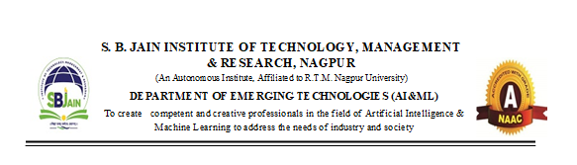
Project Review-I
College Name: S. B. Jain Institute of Technology, Management and Research, Nagpur Department Name: Emerging Technologies Project Title: Sentiment Analysis for Grievance Tracking Group Members: Mr. Sarthak Yadav (Team Leader), Ms. Jaanvi Rajput,
Mast. Adwait Joshi, Ms. Shrutika Tabhane Guide Name: Mrs. Neha Titharmare Date: 05/09/2024

Slide 2
Introduction
Overview:
Our project focuses on developing a robust system for tracking grievances using sentiment analysis across various domains such as social media, e-commerce, and customer reviews. The system will leverage BERT to analyze and categorize the sentiment of grievances to aid in prioritizing and resolving issues effectively.
Objectives:
Develop a generalized sentiment analysis model using BERT.
Design a multi-domain data processing pipeline.
Implement Aspect-Based Sentiment Analysis (ABSA).
Automate grievance severity assessment.
Establish a continuous learning framework for model adaptation.

Slide 3
Literature Review
Background Information:
Sentiment analysis has become a critical tool in understanding customer feedback and tracking grievances. Various models like RNNs and CNNs have been used historically, but transformers like BERT offer a more sophisticated approach by considering context in both directions.
Related Work:
Review of seminal papers such as "BERT: Pre-training of Deep Bidirectional Transformers for Language Understanding" and other related works that highlight the use of transformers in sentiment analysis, particularly in multi-domain contexts.

Slide 4








Methodology
Web Scraping
Database Management
Data
Preprocessing
Model
Deployment
BERT Algorithm
Sentiment
Analysis
Testing
Documentation
The system utilizes BERT for sentiment analysis, fine-tuned across multiple domains. We employ a pipeline that preprocesses input data, tags it by domain, and feeds it into the BERT model for analysis.

Slide 5
Progress so Far
Completed Tasks:
PPT created
Base Paper Found
Research Papers Collected
Literature Survey
Literature Paper
Milestones Achieved:
Decided algorithm
Found dataset websites
Studied NLP techniques
Understood NLP applications

Slide 6
Current Status
Ongoing Work:
Literature review paper
Understanding BERT algorithm
Understanding NLP techniques
Literature survey
Challenges Faced:
Decision of algorithm
Finding dataset
Decision for base paper

Slide 7
Future Work
Next Steps:
Timeline:
NLP
Machine Learning
Database Management
Bidirectional encoder
API Integration
Testing
Deployment
August:
Analyzing research papers
Decision of base paper
September:
Finalization of algorithm
Working on model
October:
Testing and deployment

Slide 8
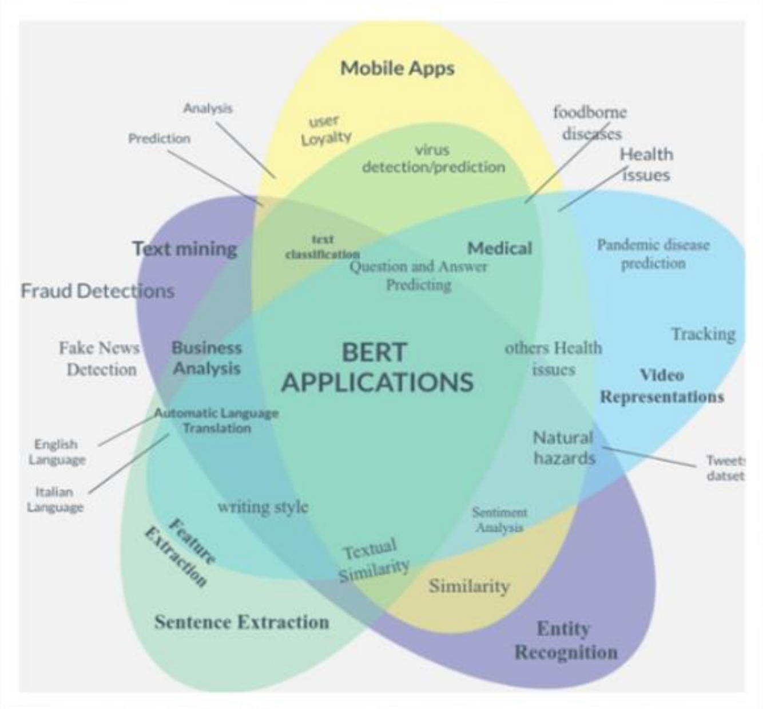
Conclusion
Summary:
The project aims to build a flexible and powerful sentiment analysis system capable of tracking and analyzing grievances from various domains. BERT's contextual understanding and our multi-domain approach ensure that the system is robust and adaptable.

Slide 9
References
Citations:
Zhan, G., Wang, M., & Zhan, M. (2020). Public Opinion Detection in an Online Lending Forum: Sentiment Analysis and Data Visualization. https://doi.org/10.1109/icccbda49378.2020.9095690
Yang, N. K., Cai, N. Y., Huang, N. D., Li, N. J., Zhou, N. Z., & Lei, N. X. (2017). An effective hybrid model for opinion mining and sentiment analysis. https://doi.org/10.1109/bigcomp.2017.7881759
Acknowledgements:
We extend our heartfelt gratitude to the Department of Emerging Technologies for providing us with the opportunity to work on this project. We are deeply thankful to our project guide, for their invaluable guidance, support, and encouragement throughout this journey. We would also like to express our sincere appreciation to our project incharge, for their constant support and coordination. Their contributions have been instrumental in the successful completion of this project.

Slide 10
Thank You!

