Slide 1

Group 14 Project Topic Seminar Presentation

Slide 2
Group Members
Mr. Sarthak Yadav (AM21022)
Ms. Jaanvi Rajput (AM21036)
Mr. Adwait Joshi (AM21057)
Ms. Shrutika Tabhane (AM21060)

Slide 3
Topic Sentiment Analysis for Grievances Tracking

Slide 4
















Technology Stack

Slide 5
Process/Methodology
Web Scraping
Database Management
Data Preprocessing
Sentiment Analysis
Documentation
Testing
Model Deployment
User Interface

Slide 6
Learning Outcomes
NLP
Machine Learning
Database Management
Web Development
API Integration
Research and Development
Project Planning
Collaboration
Communication
Critical Thinking

Slide 7

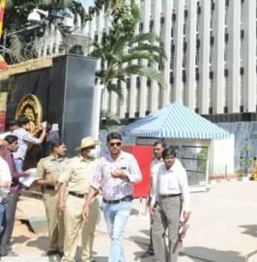

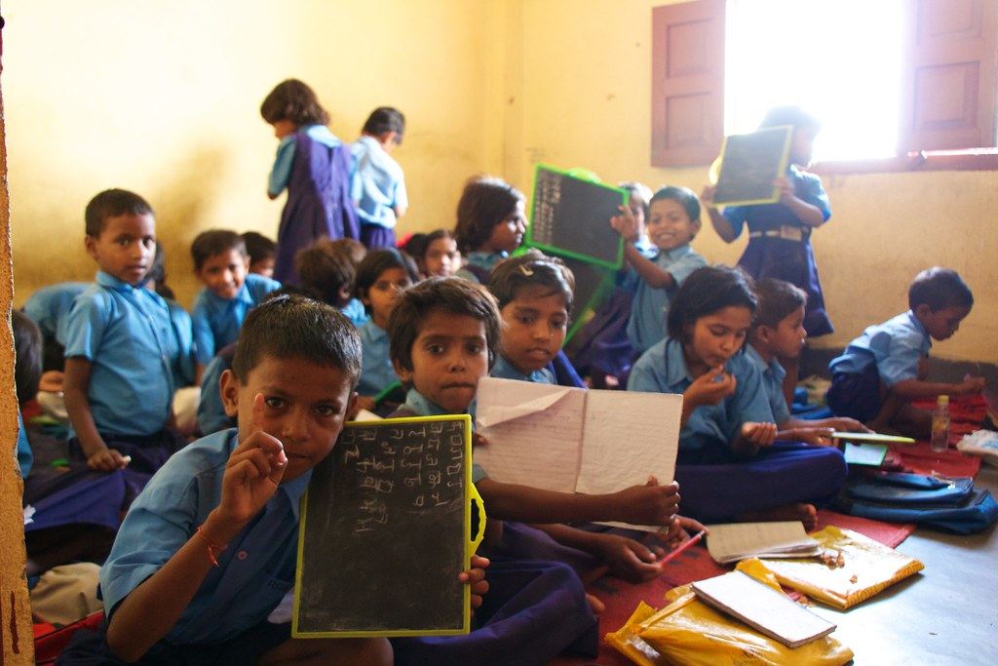
Future Applications
Customer Service and
Support
Government and Public Services
Education
Healthcare

Slide 8
Thank You!

