Slide 1

Chitkara University, Himachal Pradesh
Title: Solar Mobile Charger
SUBMITTED TO: SUBMITTED BY:
Mrs. Pooja Dhiman SARTHAK CHAWLA 1611981336
ANMOL WADHAWAN 1611981462

Slide 2
Introduction
Gone are the days when you would look up at the Sun and curse yourself for being out on a hot sunny day. Take pride very soon you will be a walking energy station with people asking you to help them charge their batteries with your clothes.
Vedic literatures in India even state the use of flying machines which were powered using the sun. Come 21st century, we have come a long way in developing solar cells which are the devices powering our future, converting sun’s energy into electricity.

Slide 3
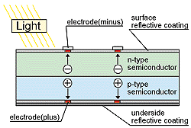
Introduction(Continued)
Solar panels are simply solar cells lined up together in series and parallel so as get sufficient voltage and are p-n junction semiconductor devices with pure silicon wafer doped with ‘n’ type phosphorous on the top and ‘p’ type boron on the base. If the PV cell is placed in the sun, photons of light strike the electrons in the p-n junction and energize them, knocking them free of their atoms. These electrons are attracted to the positive charge in the n-type silicon and repelled by the negative charge in the p-type silicon. Connecting wires across the junction will have a current in them.

Slide 4
Materials Required
Solar panel
IC7805
Lithium Ion Battery
PCB(Printed Circuit Board)
Micro USB cable
Connecting wires

Slide 5
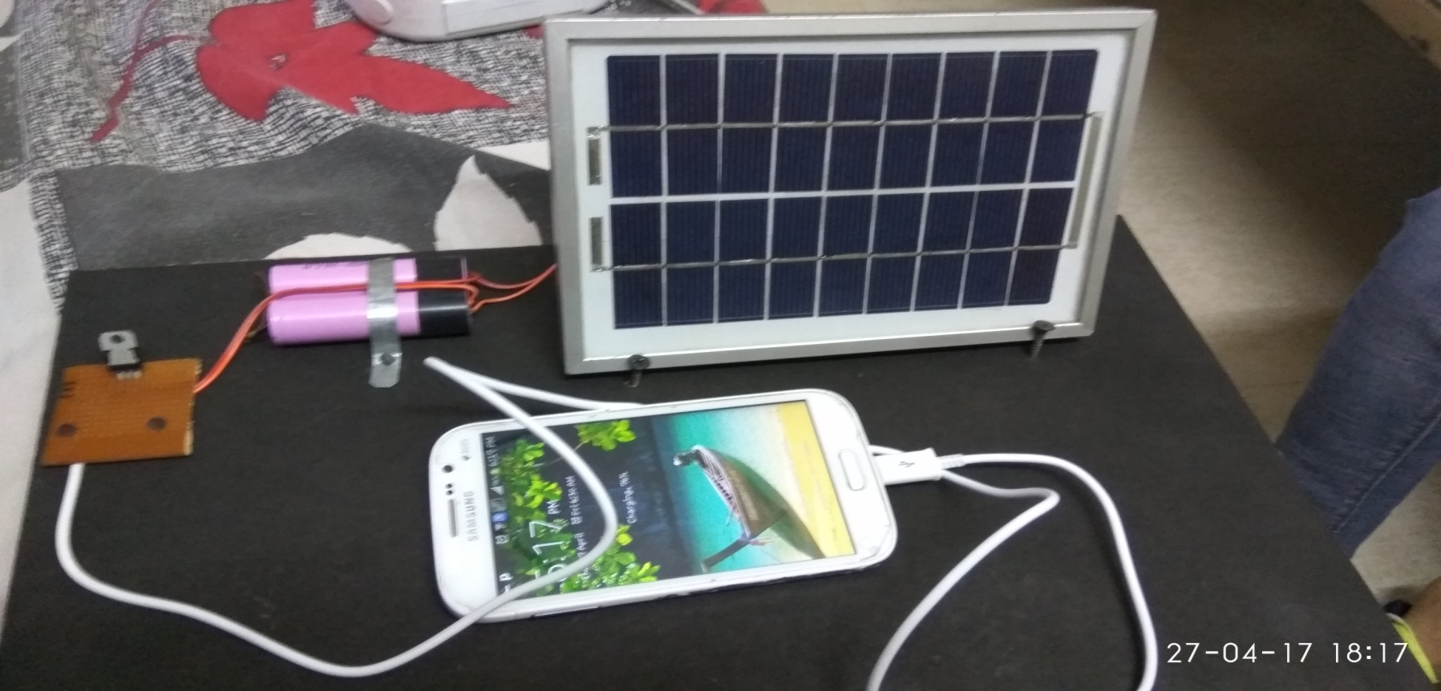
Procedure
1. Connect the circuit as shown in the figure below and then solder the components with the wires accordingly.

Slide 6
Procedure(Continued)
2. Place the whole project in direct sunlight so as the solar panel can get maximum sunlight.
3. Connect the mobile to the mini USB outlet.
4. The mobile starts charging.
5. We can make our battery in project get charged first then can use the project as a power bank and can charge the mobile later whenever required .

Slide 7
Working
The solar mobile charger is just device working on the conversion principle of voltage using Ic7805 in simple words solar panel uses photovoltaic cell or solar cells to convert solar energy in electrical energy. Output of these panels may vary from panels to panels .We can use any of these according to our need. Further we use ICs and other equipments and create a circuit to convert the input power supply coming from the solar panel into the desired power supply i.e. 2 amperes 5 volts dc . Although the adapters we use today for charging our phones today via charging cords i.e. usb wires connected to them, use input ac supply of 100-240 volts ~50-60 hertz 0.35amperes as standard for charging the modern day Smartphone. Many other companies have their own standards for input and output supplies the above one was of well known upcoming brand “MI”. At last we can say that we are basically just converting the supply we get from the solar panels into the ones we require in this case the one for the mobile charger.

Slide 8
Working(Continued)
First, solar energy is captured by photovoltaic cells present in the solar panel.
Then this electrical energy is used to charge the rechargeable lithium ion battery.
After that the voltage being further transferred is firstly converted as per the requirement i.e. 5volt.
The converted voltage is used to charge our phone via micro USB cable.

Slide 9
Applications
For low-power portable electronics, like calculators or
small fans, a photovoltaic array may be a reasonable
energy source rather than a battery.
In other situations, such as solar battery chargers,
watches, and flashlights the photovoltaic array is used to
generate electricity that is stored in batteries for later use.
By using over voltage protection circuit we can protect
our battery from over charging. Charge discharge control
circuit contain two-way Switch. It gets active when
voltage exceeds above threshold voltage level.

Slide 10
Advantages
Cost Effective: Compared to the other mobile chargers,
the solar chargers are cost effective as it absorbs power
from the sun. It does not require electric power
Versatile: It is also known to be versatile as it can be used
for all types of mobile phones
Uninterrupted Power Supply: One of the greatest
advantages of solar mobile phone charger is that it can be
used to charge mobiles even during power outages.
Emergency Purposes: Another benefit is that it hardly
requires any electrical outlet. It can therefore be used
during emergencies and outdoor purposes.
Compact Design: Solar mobile phone chargers are
compact in size and easy to carry around.

Slide 11
Limitations
Quite expensive: One of the most important drawbacks is
its price compared to the ordinary mobile phone
chargers, it is quite expensive as it utilizes solar energy
captivators.
Charging time large: Another significant drawback is the
time frame required by the chargers to charge mobile
phones. It can take six to eight hours to charge mobile
phones compared to the other.

Slide 12
Conclusion
Renewable energy is not a new concept, nevertheless at an exponential growing population, the development and improvement of them are essential to sustain world power hunger. In 2050 the population expectation on earth is about 9 billion people, where approximately 5 billion will use mobile phones. The application of renewable energy at portable devices starts to plays a significant role at global energy saving. Solar chargers are simple, portable and ready to use devices which can be used by anyone especially in remote areas.

Slide 13
Future scope
Basically the solar mobile charger is designed for charging
mobile battery. But in future, by making some
modifications we can use this charger to charge batteries
used in different portable devices like laptop, walky-talky,
i-POD, digital camera etc.

Slide 14
References
Park “Overview of Energy Harvesting Systems (for Low-Power Electronics).” Presentation at the First Los Alamos National Laboratory Engineering Institute Workshop: Energy Harvesting, 2005 .
Ferro Solutions. “VEH-360: Evaluation Power System Specifications.”
J .A. Paradiso and T. Starner. 2005. “Energy scavenging for mobile and wireless electronics.” Pervasive Computing 4(1):18–27.
EnOcean. Perpetuum International Edition4http://tinyurl.com/2lxbo5 (orwww.enocean.com/fileadmin/redaktion/pdf/perpetuum/perpetuum_ 06_en.pdf), 2007.

Slide 15
References(Continued)
C. Park and P. Chou , “Power utility maximization for multiple-supply systems by a load-matching switch”, Proc. ACM/IEEE International Symposium on Loss Power Electronics and Design, pp. 168–173, 2004.
T. Voigt, H. Ritter, and J. Schiller, “Utilizing solar power in wireless sensor networks”, Proc. IEEE Conference on Local Computer Networks, 2003.
Kansal, D. Potter, and M. Srivastava “Performance aware tasking for environmentally powered sensor networks”, Proc. ACM International Conference on Measurement and Modelling of Computer Systems, pp.223– 234, 2004.

